Slide 1
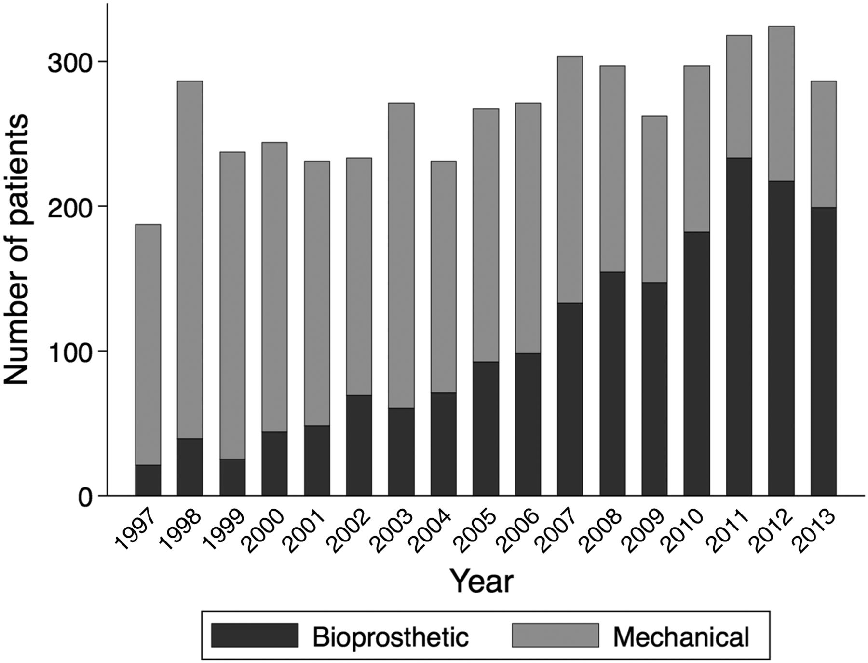
Figure 1 Number of aortic valve replacements per year. Number of patients aged 50–69 years who had undergone aortic ...
Notes:
Figure 1 Number of aortic valve replacements per year. Number of patients aged 50–69 years who had undergone aortic valve replacements with mechanical or bioprosthetic valves in Sweden between 1997 and 2013.
Unless provided in the caption above, the following copyright applies to the content of this slide: Published on behalf of the European Society of Cardiology. All rights reserved. © The Author 2015. For permissions please email: journals.permissions@oup.com.

Slide 2
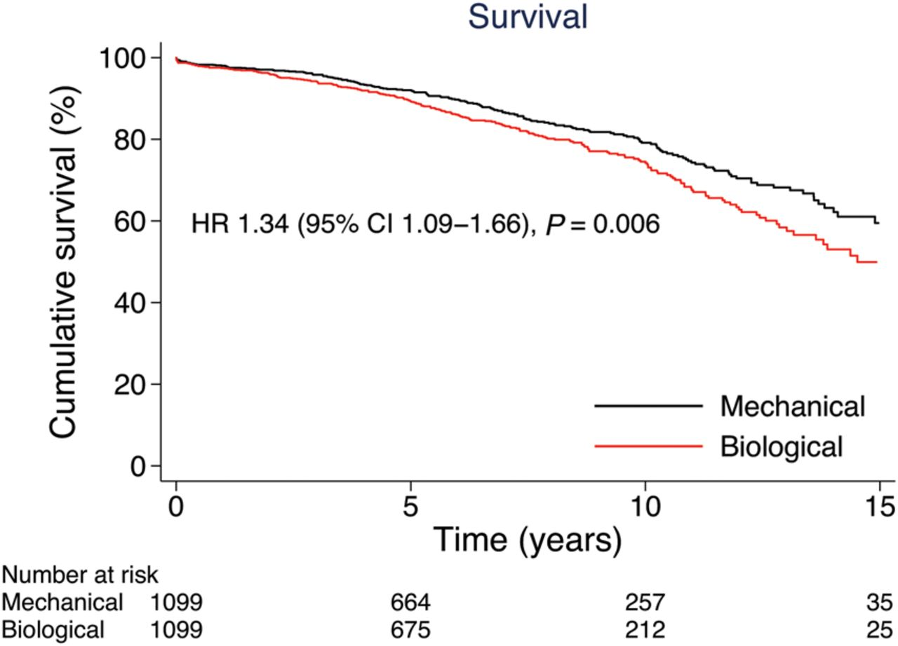
Figure 2 Survival after aortic valve replacement with mechanical valves vs. bioprostheses. Cumulative survival in ...
Notes:
Figure 2 Survival after aortic valve replacement with mechanical valves vs. bioprostheses. Cumulative survival in propensity score-matched patients aged 50–69 years who had undergone aortic valve replacements with mechanical valves vs. bioprostheses.
Unless provided in the caption above, the following copyright applies to the content of this slide: Published on behalf of the European Society of Cardiology. All rights reserved. © The Author 2015. For permissions please email: journals.permissions@oup.com.

Slide 3
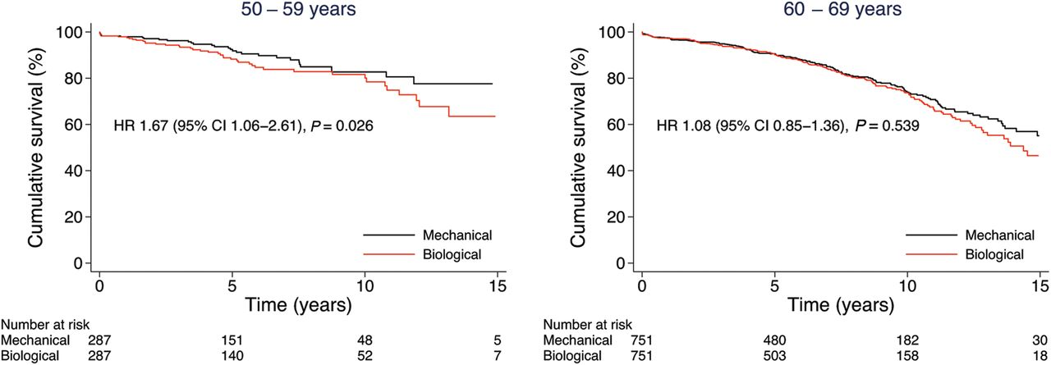
Figure 3 Survival after aortic valve replacement with mechanical valves vs. bioprostheses in age subgroups. Cumulative ...
Notes:
Figure 3 Survival after aortic valve replacement with mechanical valves vs. bioprostheses in age subgroups. Cumulative survival of propensity score-matched patients aged 50–59 years (left panel) and 60–69 years (right panel) who had undergone aortic valve replacements with mechanical valves vs. bioprostheses.
Unless provided in the caption above, the following copyright applies to the content of this slide: Published on behalf of the European Society of Cardiology. All rights reserved. © The Author 2015. For permissions please email: journals.permissions@oup.com.

Slide 4
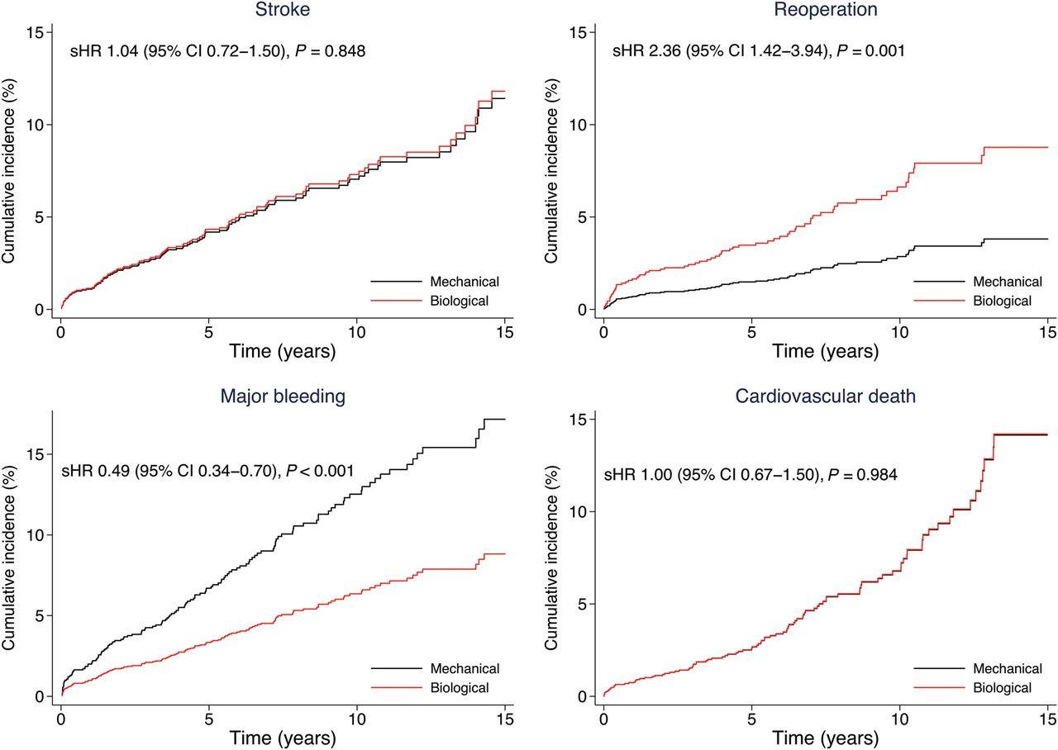
Figure 4 Risk of stroke, reoperation, major bleeding, and cardiovascular death. Cumulative incidence of stroke, aortic ...
Notes:
Figure 4 Risk of stroke, reoperation, major bleeding, and cardiovascular death. Cumulative incidence of stroke, aortic valve reoperation, major bleeding, and cardiovascular death in propensity score-matched patients aged 50–69 years who had undergone aortic valve replacements with mechanical valves vs. bioprostheses. Note: The curves for biological and mechanical valves are superimposed in the graph showing cumulative incidence for cardiovascular death.
Unless provided in the caption above, the following copyright applies to the content of this slide: Published on behalf of the European Society of Cardiology. All rights reserved. © The Author 2015. For permissions please email: journals.permissions@oup.com.

