Slide 1
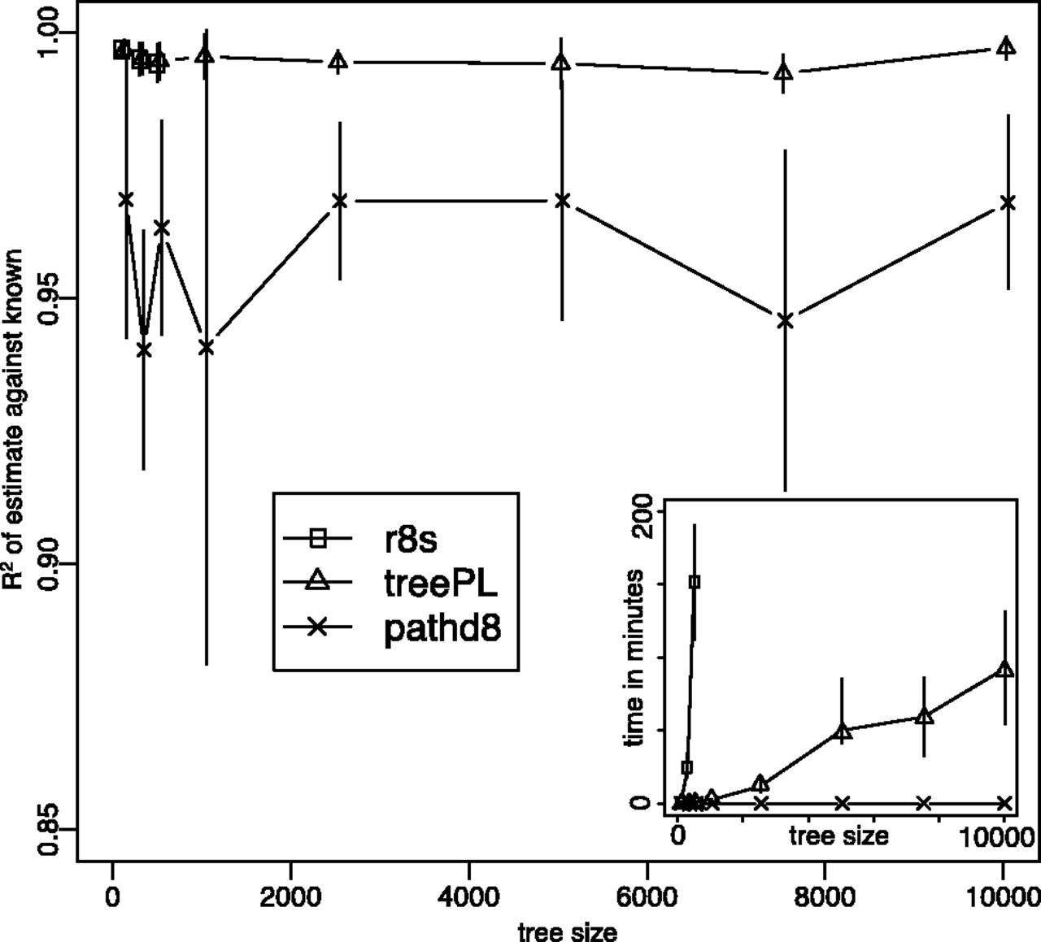
Fig. 1. The performance of r8s, treePL and PATHd8 on the simulated datasets as measured by R² of estimated ...
Notes:
Fig. 1. The performance of r8s, treePL and PATHd8 on the simulated datasets as measured by R2 of estimated node ages against known ages. The inset shows average runtimes of r8s, treePL and PATHd8 in minutes on simulated datasets. Error bars represent 95% confidence intervals
Unless provided in the caption above, the following copyright applies to the content of this slide: © The Author 2012. Published by Oxford University Press. All rights reserved. For Permissions, please e-mail: journals.permissions@oup.com

