Slide 1
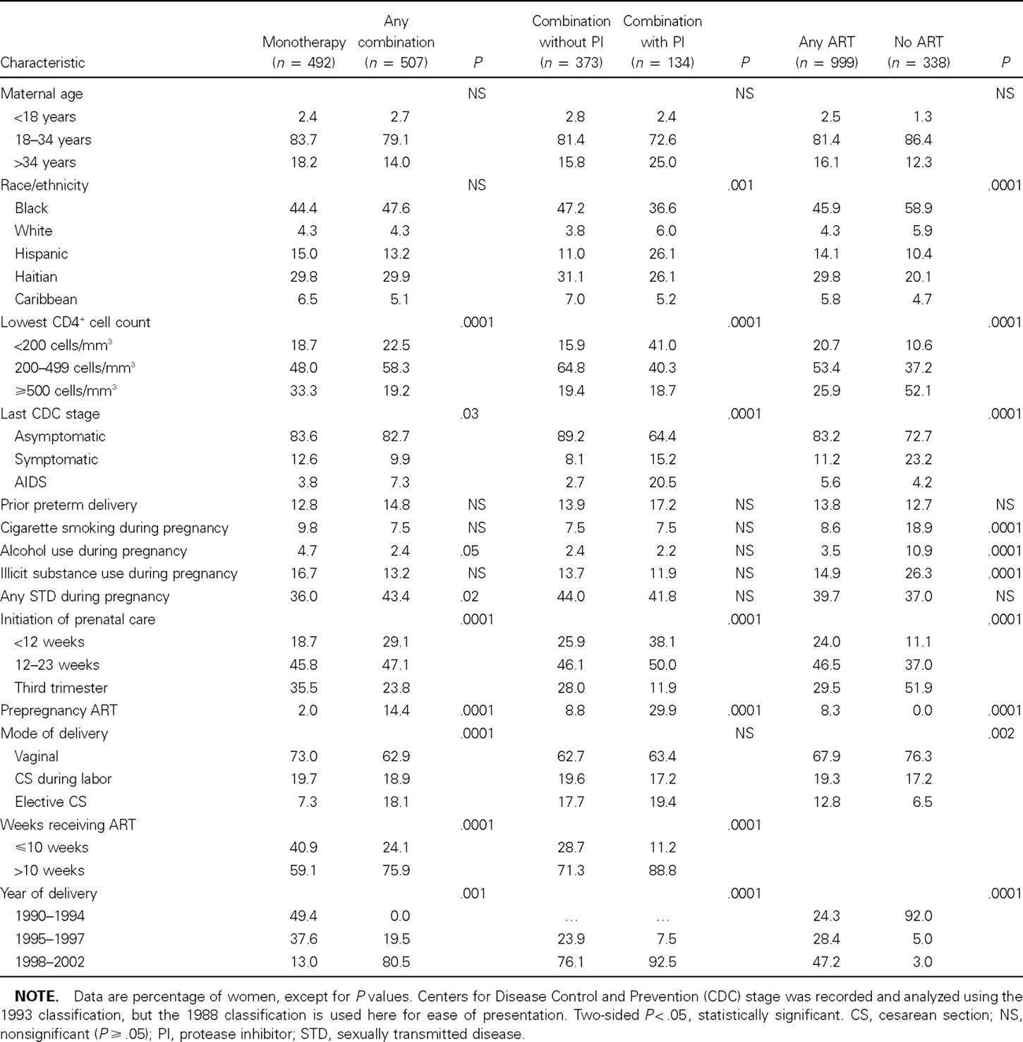
Table 1 Characteristics of the 1337 study participants according to the use and nonuse of antiretroviral therapy ...
Notes:
Table 1 Characteristics of the 1337 study participants according to the use and nonuse of antiretroviral therapy (ART) during pregnancy
Unless provided in the caption above, the following copyright applies to the content of this slide: © 2006 by the Infectious Diseases Society of America

Slide 2
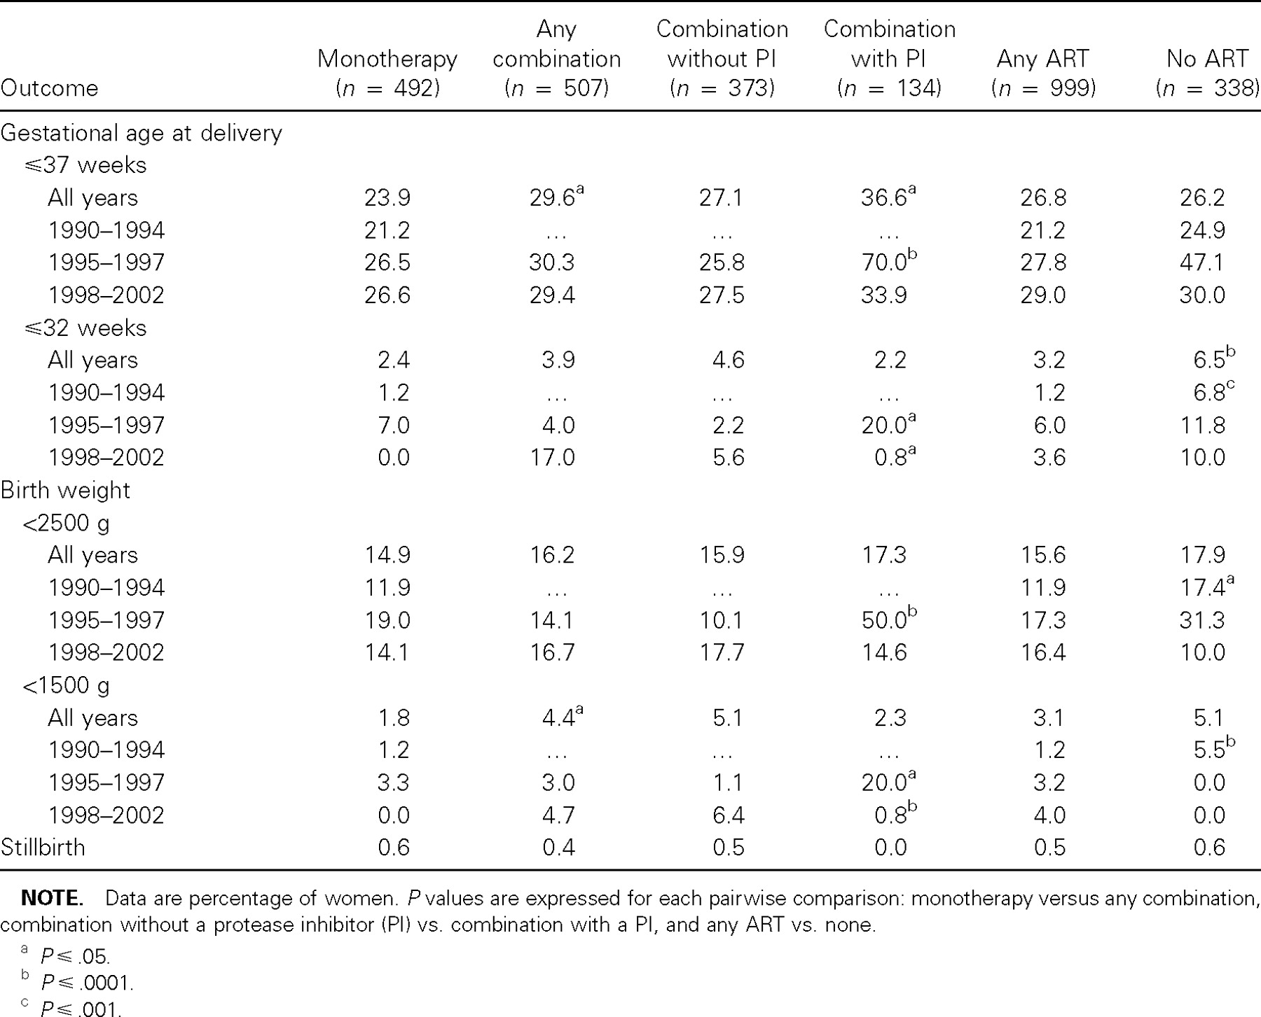
Table 2 Outcomes of pregnancy according to the use or nonuse of antiretroviral therapy (ART), stratified by era
Notes:
Table 2 Outcomes of pregnancy according to the use or nonuse of antiretroviral therapy (ART), stratified by era
Unless provided in the caption above, the following copyright applies to the content of this slide: © 2006 by the Infectious Diseases Society of America

Slide 3
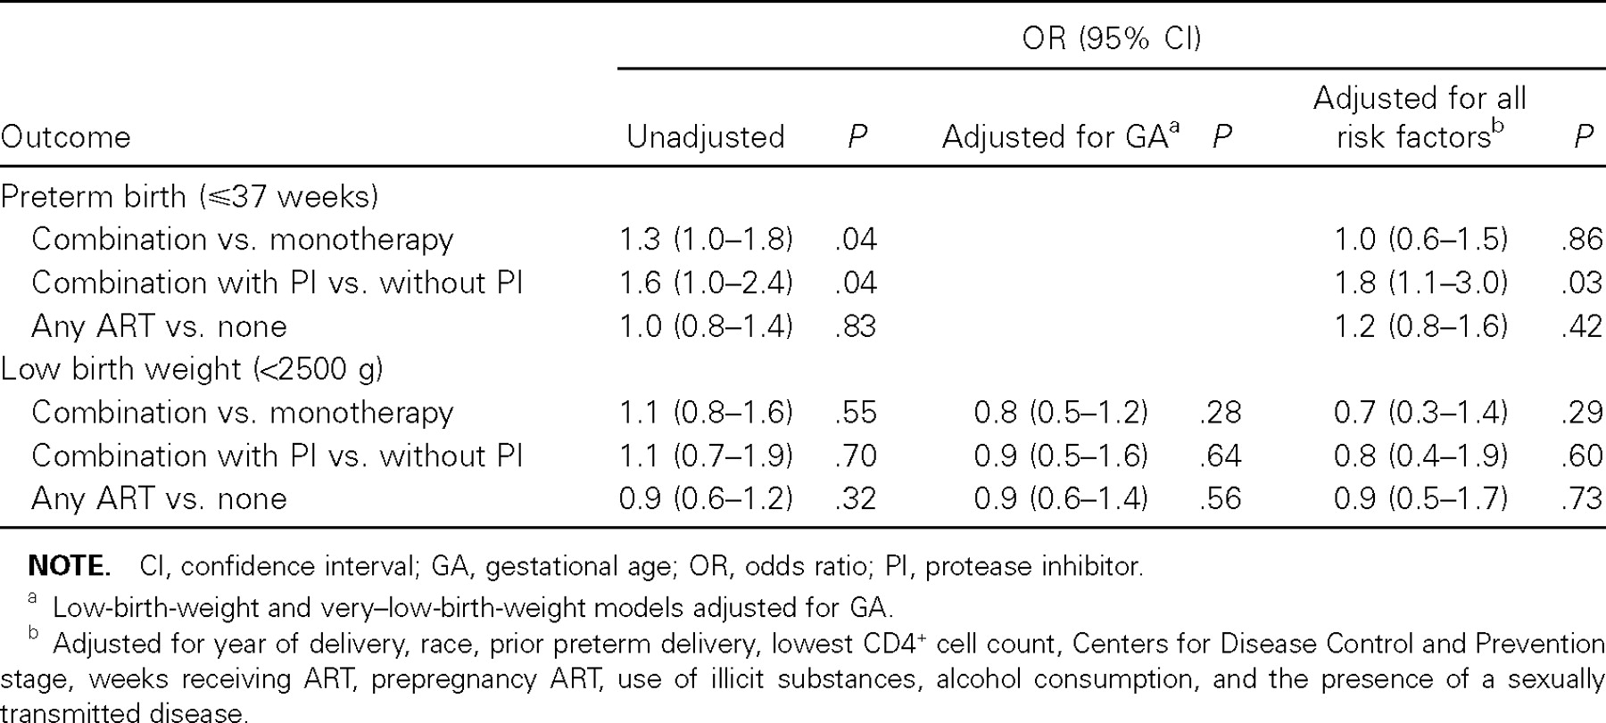
Table 3 Risks of adverse pregnancy outcomes according to the antiretroviral (ART) regimen
Notes:
Table 3 Risks of adverse pregnancy outcomes according to the antiretroviral (ART) regimen
Unless provided in the caption above, the following copyright applies to the content of this slide: © 2006 by the Infectious Diseases Society of America

