Slide 1
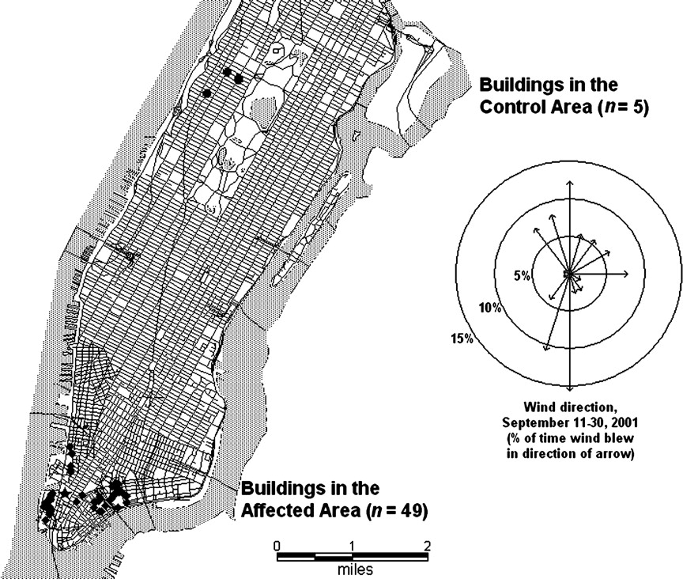
FIGURE 1. Locations of study buildings in the affected and control areas, World Trade Center Health Survey, New York ...
Notes:
FIGURE 1. Locations of study buildings in the affected and control areas, World Trade Center Health Survey, New York City, 2002. (1 mile = 1.61 km).
Unless provided in the caption above, the following copyright applies to the content of this slide: American Journal of Epidemiology Copyright © 2005 by the Johns Hopkins Bloomberg School of Public Health All rights reserved

