Slide 1
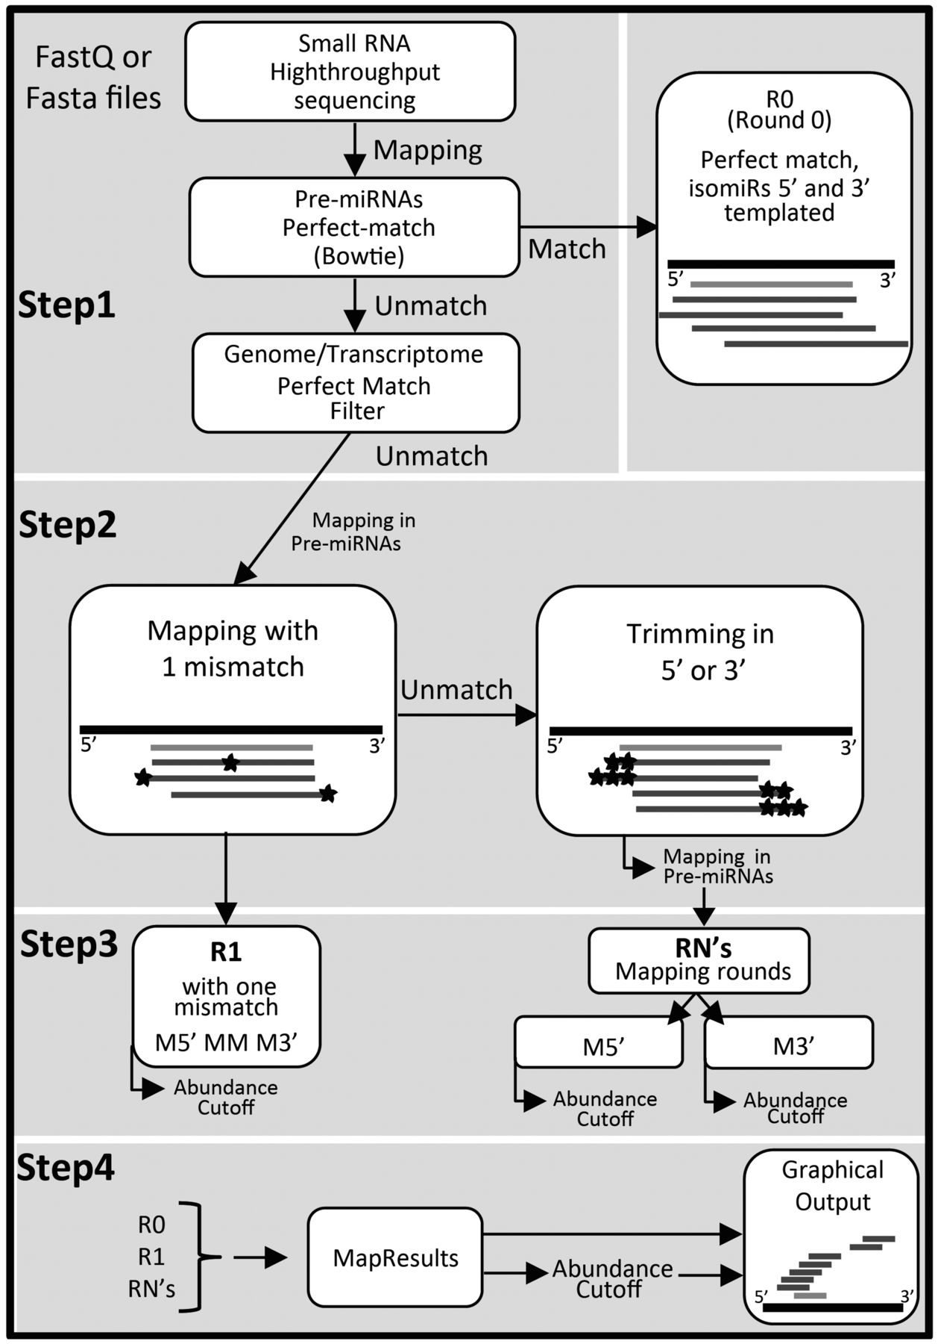
Fig. 1. Graphical representation of isomiRID workflow. (thick black line) pre-miRNA. (grey line) canonical miRNA. ...
Notes:
Fig. 1. Graphical representation of isomiRID workflow. (thick black line) pre-miRNA. (grey line) canonical miRNA. (thin black line) isomiRs. nucleotides mismatch. M5′ mismatch in 5′ end. MM mismatch in the middle of the sequence (asterisk). M3′ mismatch in the 3′ end (see text and supplementary material for detailed information)
Unless provided in the caption above, the following copyright applies to the content of this slide: © The Author 2013. Published by Oxford University Press. All rights reserved. For Permissions, please e-mail: journals.permissions@oup.com

