Slide 1
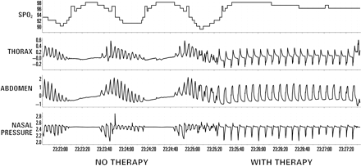
Figure 1 Elimination of respiratory instability and improvement in oxygenation during unilateral phrenic nerve ...
Notes:
Figure 1 Elimination of respiratory instability and improvement in oxygenation during unilateral phrenic nerve stimulation in a heart failure patient with central sleep apnoea.
Unless provided in the caption above, the following copyright applies to the content of this slide: Published on behalf of the European Society of Cardiology. All rights reserved. © The Author 2011. For permissions please email: journals.permissions@oup.com

