Slide 1
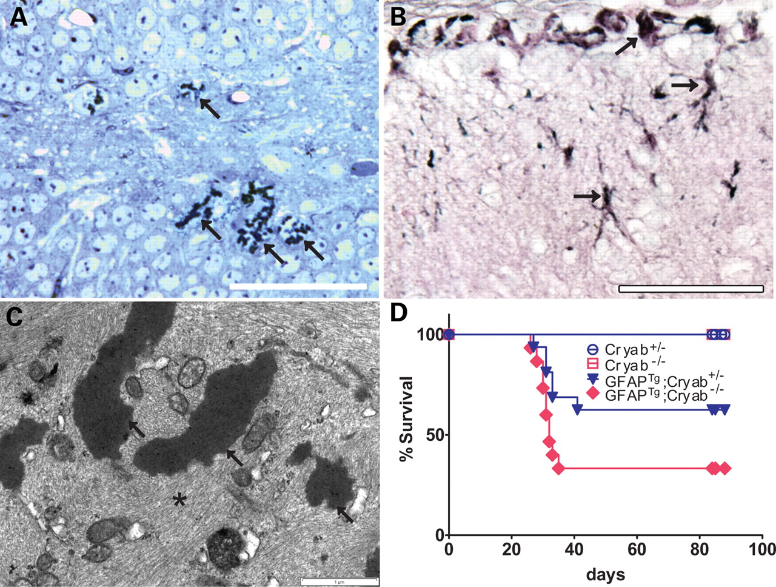
Figure 1. GFAP transgenic mice form Rosenthal fibers without Cryab, but show increased mortality. (A) Toluidine Blue ...
Notes:
Figure 1. GFAP transgenic mice form Rosenthal fibers without Cryab, but show increased mortality. (A) Toluidine Blue staining in the hippocampal dentate gyrus reveals clusters of Rosenthal fiber aggregates (arrows) in a GFAPTg;Cryab−/− mouse at 3 months of age (50 µm scale bar). (B) Immunohistochemistry demonstrates ubiquitination of Rosenthal fibers (gray/blue, indicated with arrows) near the pial surface of the superior colliculus (P25, 50 µm scale bar). (C) Ultrastructurally, electron microscopy shows dense osmiophilic structures (arrows) surrounded by swirls (asterisk) of intermediate filaments (3 months of age, 1 µm scale bar). (D) Survival proportions show a significant difference (P≤ 0.0001, log-rank Mantel–Cox test) and indicate a dose response for Cryab in GFAPTg mice, with Cryab+/− and Cryab−/− exhibiting 63 and 33% survival, respectively (Cryab+/−n = 19, Cryab−/−n = 11, GFAPTg;Cryab+/−n = 16, GFAPTg;Cryab−/−n = 15).
Unless provided in the caption above, the following copyright applies to the content of this slide: © The Author 2009. Published by Oxford University Press. All rights reserved. For Permissions, please email: journals.permissions@oxfordjournals.org

Slide 2
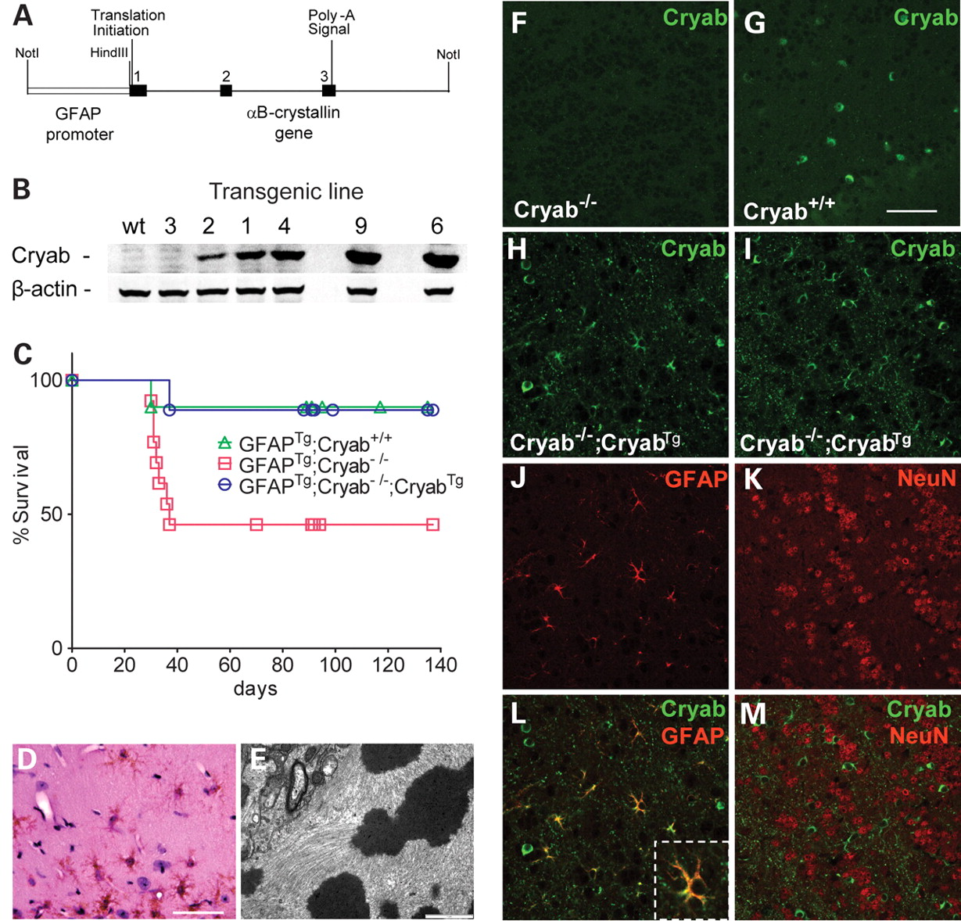
Figure 2. Rescue of lethal phenotype in GFAP^{Tg};Cryab^{−/−} mice by astrocyte-specific restoration of ...
Notes:
Figure 2. Rescue of lethal phenotype in GFAPTg;Cryab−/− mice by astrocyte-specific restoration of Cryab expression. (A) The Tg141 transgene, consisting of the human GFAP promoter ligated to the hamster Cryab gene, was constructed to over-express Cryab in astrocytes. (B) Several founder lines were generated (Tg141 1–4, 6, 9) with varying levels of Cryab expression, as shown by western analysis. (C) Survival proportions show lethality in 54% of GFAPTg;Cryab−/− mice (n = 13) compared with ∼10% of GFAPTg;Cryab−/−;CryabTg (n = 9) and GFAPTg;Cryab+/+ (n = 10) littermates (P = 0.0281, log-rank Mantel–Cox test). (D) Rosenthal fibers under light microscopy are eosinophilic (red) and appear to outline astrocytic processes in the GFAPTg;Cryab−/−;CryabTg mice (50 µm scale bar). (E) Fibers in GFAPTg;Cryab−/−;CryabTg mice have the same ultrastructural qualities as those in GFAPTg mice (1 µm scale bar). (F,G) Immunofluorescence shows the absence of Cryab in null mice (F) compared with wild-type (G, 50 µm scale bar) with confocal microscopy using equivalent gain. (H,J,L) Expression of the CryabTg (green) in Cryab−/− animals is astrocyte-specific (GFAP, red). (L) The inset shows an enlarged view of an astrocyte from the same field expressing Cryab (yellow). (I,K,M) No Cryab (green) staining is apparent in neurons (NeuN, red). (F–M) Olfactory bulb (granular layer) shown at same magnification.
Unless provided in the caption above, the following copyright applies to the content of this slide: © The Author 2009. Published by Oxford University Press. All rights reserved. For Permissions, please email: journals.permissions@oxfordjournals.org

Slide 3
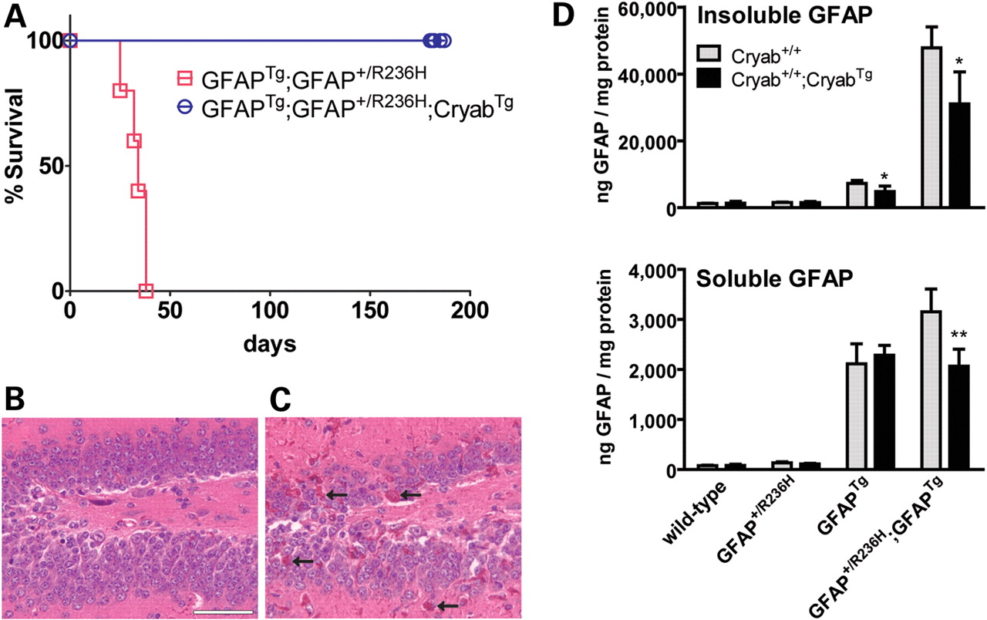
Figure 3. Increased Cryab expression rescues lethal seizures and reduces GFAP levels and Rosenthal fibers in ...
Notes:
Figure 3. Increased Cryab expression rescues lethal seizures and reduces GFAP levels and Rosenthal fibers in GFAPTg;GFAP+/R236H mice. (A) Hundred percent of GFAPTg;GFAP+/R236H mice die at an early age [∼30 days (12); for littermates shown (n = 5), median age of death = 34] compared with 100% survival in GFAPTg;GFAP+/R236H mice expressing CryabTg (n = 8; P = 0.0002, log-rank Mantel–Cox test). (B,C) Fewer Rosenthal fibers (red) appear in the hippocampus of GFAPTg;GFAP+/R236H;CryabTg (B, 50 µm scale bar) compared with GFAPTg;GFAP+/R236H mice (C, arrows show representative Rosenthal fibers). (D) GFAP levels in the different transgenic and mutant mice comparing those with or without the CryabTg (P26) show that elevated Cryab decreases insoluble GFAP in hippocampi from GFAPTg mice (*P = 0.0409) and decreases both the soluble (**P = 0.0088) and insoluble (*P = 0.0259) pool of GFAP in GFAPTg;GFAP+/R236H animals. CryabTg does not significantly affect GFAP expression or solubility in wild-type or GFAP+/R236H mice.
Unless provided in the caption above, the following copyright applies to the content of this slide: © The Author 2009. Published by Oxford University Press. All rights reserved. For Permissions, please email: journals.permissions@oxfordjournals.org

Slide 4
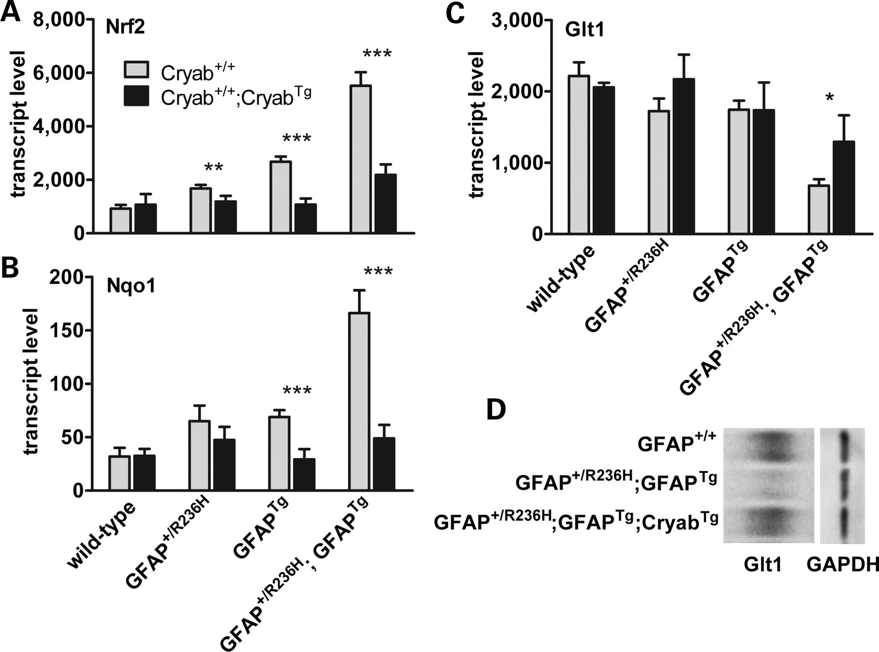
Figure 4. Cryab^{Tg} decreases the stress response and restores Glt1 expression in ...
Notes:
Figure 4. CryabTg decreases the stress response and restores Glt1 expression in GFAPTg;GFAP+/R236H hippocampus. (A,B) Quantitative PCR shows reduced expression of stress genes Nrf2 (A, **P = 0.0079, ***P < 0.0001) and Nqo1 (B, ***P = 0.0005 for GFAPTg; ***P < 0.0001 for GFAPTg;GFAP+/R236H) with increased expression of Cryab and (C) increased expression of the glutamate transporter Glt1 (*P = 0.0182). Unpaired t-tests (two-tailed) were used to generate P-values for comparisons. Error bars represent standard deviation. (D) Western analysis of Glt1 protein in hippocampi from GFAPTg;GFAP+/R236H and GFAPTg;GFAP+/R236H;CryabTg mice shows the same pattern as Glt1 transcription with CryabTg restoring expression close to that of wild-type mice. GAPDH expression is shown for control.
Unless provided in the caption above, the following copyright applies to the content of this slide: © The Author 2009. Published by Oxford University Press. All rights reserved. For Permissions, please email: journals.permissions@oxfordjournals.org

Slide 5
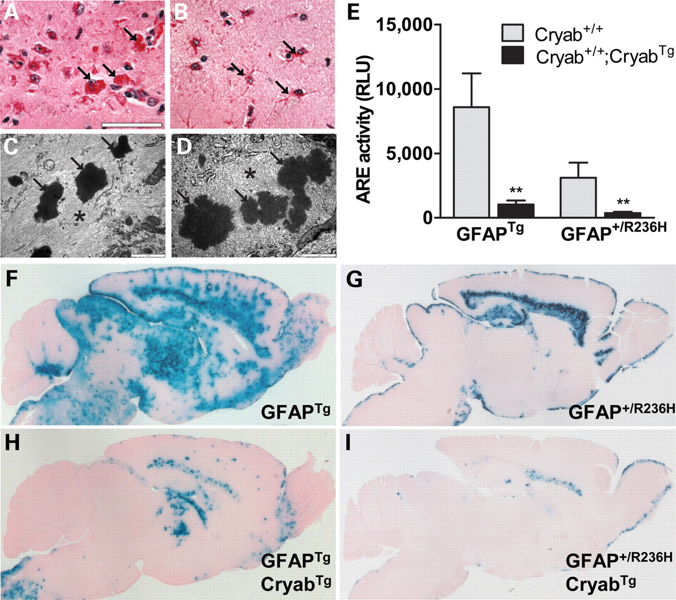
Figure 5. Increased expression of Cryab in transgenic mice alters Rosenthal fiber distribution and decreases CNS stress ...
Notes:
Figure 5. Increased expression of Cryab in transgenic mice alters Rosenthal fiber distribution and decreases CNS stress response. (A,B) Rosenthal fiber morphology and cellular distribution in the hippocampus differ between GFAPTg and GFAPTg;CryabTg mice at 6 weeks, with eosinophilic fibers (arrows) appearing condensed and globular in the GFAPTg mice (A; 50 µm scale bar) and punctate or granular and aligned with astrocytic processes in GFAPTg;CryabTg astrocytes (B). (C,D) Ultrastructural analysis shows Rosenthal fibers as the same dense osmiophilic structures (arrows) among swirls of intermediate filaments (asterisks) regardless of appearance under light microscopy (C, GFAPTg; D, GFAPTg;CryabTg; 1 µm scale bar). (E–I) Elevation of Cryab leads to a decreased stress response in both GFAPTg and GFAP+/R236H mice. (E) Quantification of alkaline phosphatase reporter activity in whole brain indicates a marked decrease in the ARE response for both GFAPTg (**P = 0.0012) and GFAP+/R236H (**P = 0.0037) mice when positive for CryabTg (unpaired t-test, two tailed). RLU, relative luminescence unit; error bars represent standard deviation. (F, G) Histochemistry for ARE-hPAP reporter activity (blue reaction product) indicates a stress response in several regions of the brain for GFAPTg (F) and GFAP+/R236H (G) mice. This response is greatly diminished in GFAPTg;CryabTg (H) and GFAP+/R236H;CryabTg mice (I) and absent altogether in some regions (6 weeks of age shown).
Unless provided in the caption above, the following copyright applies to the content of this slide: © The Author 2009. Published by Oxford University Press. All rights reserved. For Permissions, please email: journals.permissions@oxfordjournals.org

