Slide 1
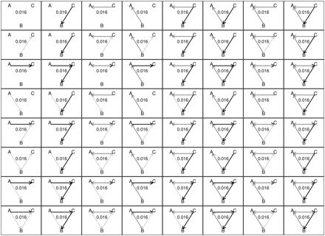
Fig. 1 The uniform distribution over a three-node directed network. The darker the edge, the higher the value of a ...
Notes:
Fig. 1 The uniform distribution over a three-node directed network. The darker the edge, the higher the value of a hypothetical edge-wise covariate with three possible values. The number in each cell gives the probability of observing that configuration.
Unless provided in the caption above, the following copyright applies to the content of this slide: © The Author 2010. Published by Oxford University Press on behalf of the Society for Political Methodology. All rights reserved. For Permissions, please email: journals.permissions@oup.com

Slide 2
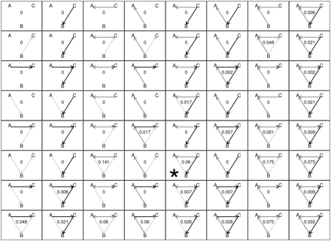
Fig. 2 The ERG distribution over a three-node directed network. The parameters were estimated by MLE on the starred ...
Notes:
Fig. 2 The ERG distribution over a three-node directed network. The parameters were estimated by MLE on the starred network. The darker the edge, the higher the value of a hypothetical edge-wise covariate with three possible values. The number in each cell gives the probability of observing that configuration.
Unless provided in the caption above, the following copyright applies to the content of this slide: © The Author 2010. Published by Oxford University Press on behalf of the Society for Political Methodology. All rights reserved. For Permissions, please email: journals.permissions@oup.com

Slide 3
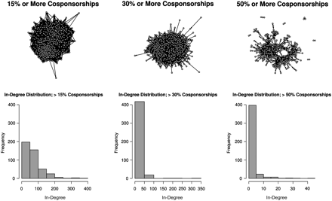
Fig. 3 This figure has six cells each showing the 108th House cosponsorship network at the same time t. The network ...
Notes:
Fig. 3 This figure has six cells each showing the 108th House cosponsorship network at the same time t. The network is thinned by drawing a link from a legislator that cosponsors at least X% of the legislation sponsored by the receiver. The degree of thinning increases as increases from left to right (15%, 30%, and 50%, respectively). The top row depicts the network and the bottom row shows histograms of the in-degree of legislators (i.e., the in-degree distribution).
Unless provided in the caption above, the following copyright applies to the content of this slide: © The Author 2010. Published by Oxford University Press on behalf of the Society for Political Methodology. All rights reserved. For Permissions, please email: journals.permissions@oup.com

Slide 4
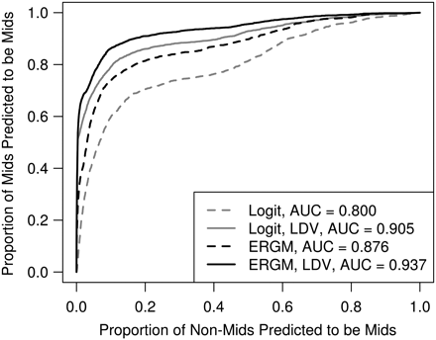
Fig. 4 ROC curves demonstrating the in-sample predictive performance of the models for MIDs. The area under the ROC ...
Notes:
Fig. 4 ROC curves demonstrating the in-sample predictive performance of the models for MIDs. The area under the ROC curve (AUC) listed in the legend is a common nonparametric measure of predictive fit. The closer the AUC is to one, the closer the model is to perfect classification. LDV indicates that a lagged dependent variable was included in the model specification.
Unless provided in the caption above, the following copyright applies to the content of this slide: © The Author 2010. Published by Oxford University Press on behalf of the Society for Political Methodology. All rights reserved. For Permissions, please email: journals.permissions@oup.com

