Slide 1
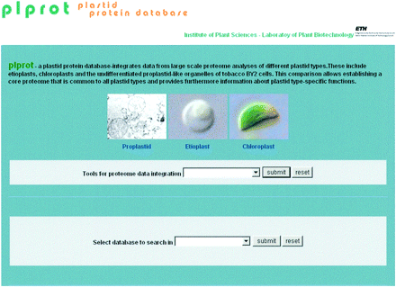
Fig. 1 Screenshot of the plprot database interface. plprot consists of two modules with selection menus (grey ...
Notes:
Fig. 1 Screenshot of the plprot database interface. plprot consists of two modules with selection menus (grey panels). Module one (upper grey panel) features a menu to select plastid type-specific information and tools for proteome data analysis. The plastid type-specific information is also accessible via clickable microscopy pictures of the different plastid types. Module two (lower grey panel) features a menu to select the searchable plastid proteome databases.
Unless provided in the caption above, the following copyright applies to the content of this slide:

Slide 2
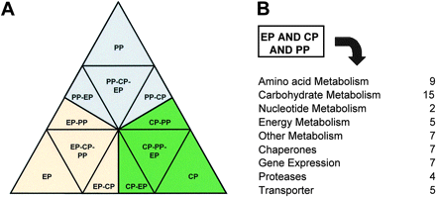
Fig. 2 Plastid type comparisons. (A) Homology-based search strategy to identify proteins that are plastid ...
Notes:
Fig. 2 Plastid type comparisons. (A) Homology-based search strategy to identify proteins that are plastid type specific or common to two or all three plastid types. Since the direction of the BLAST search determines how many homologues can be found, we have BLAST searched the data from each vertex of the triangle (i.e. each plastid type). Proteins displayed at the interface of two plastid types are those that are specific to these two plastid types and are not found in the third plastid type. EP, etioplast; CP, chloroplast, PP, proplastid. (B) Examples of proteins in functional categories that are shared between all three plastid types (using EP as the basis for the BLAST search). Most of the proteins in the ‘core proteome’ of plastids have specific functions in carbohydrate and amino acid metabolism.
Unless provided in the caption above, the following copyright applies to the content of this slide:

