Slide 1
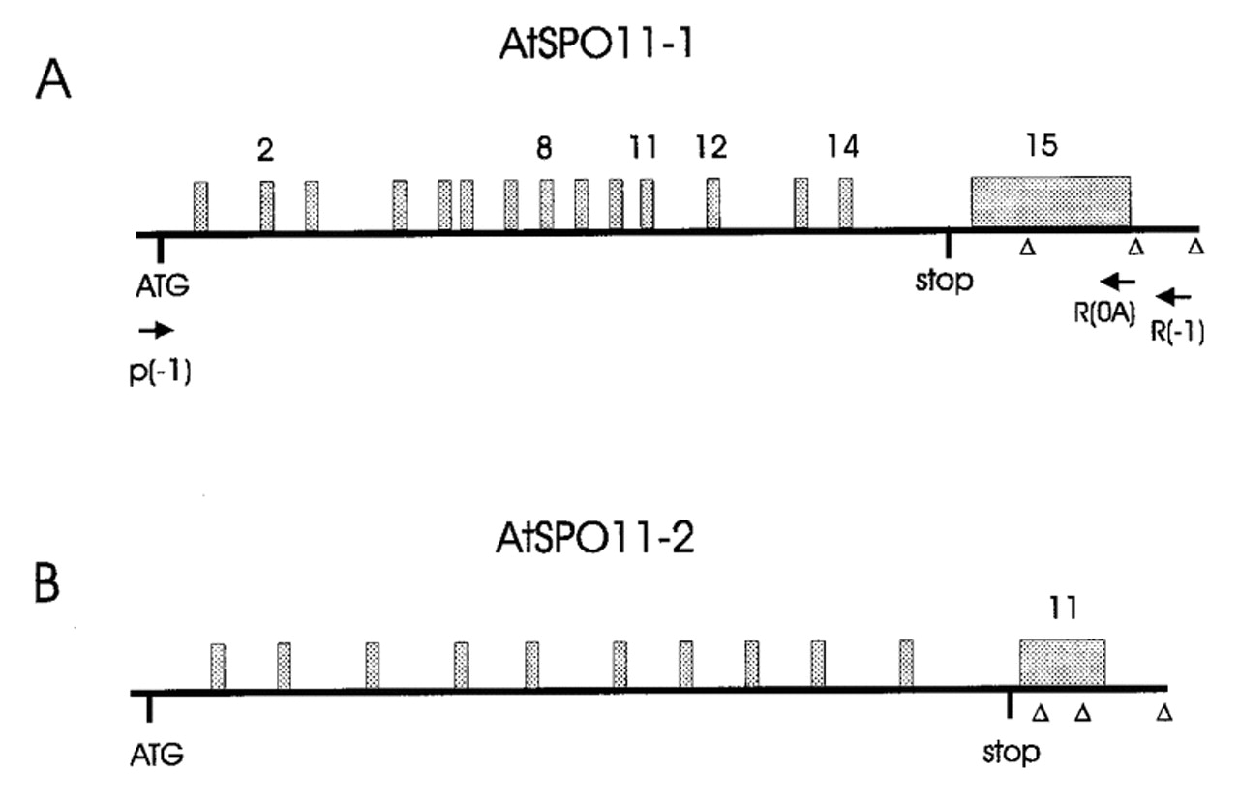
Figure 1. Schematic structure of both A.thaliana SPO11 homologous genes: Introns are shown as grey boxes ...
Notes:
Figure 1. Schematic structure of both A.thaliana SPO11 homologous genes: Introns are shown as grey boxes above the sequence. Verified polyadenylation sites are represented by open triangles. (A) Primers used for RT–PCR analysis of AtSPO11-1 are shown as arrows below the schematic sequence.
Unless provided in the caption above, the following copyright applies to the content of this slide:

Slide 2
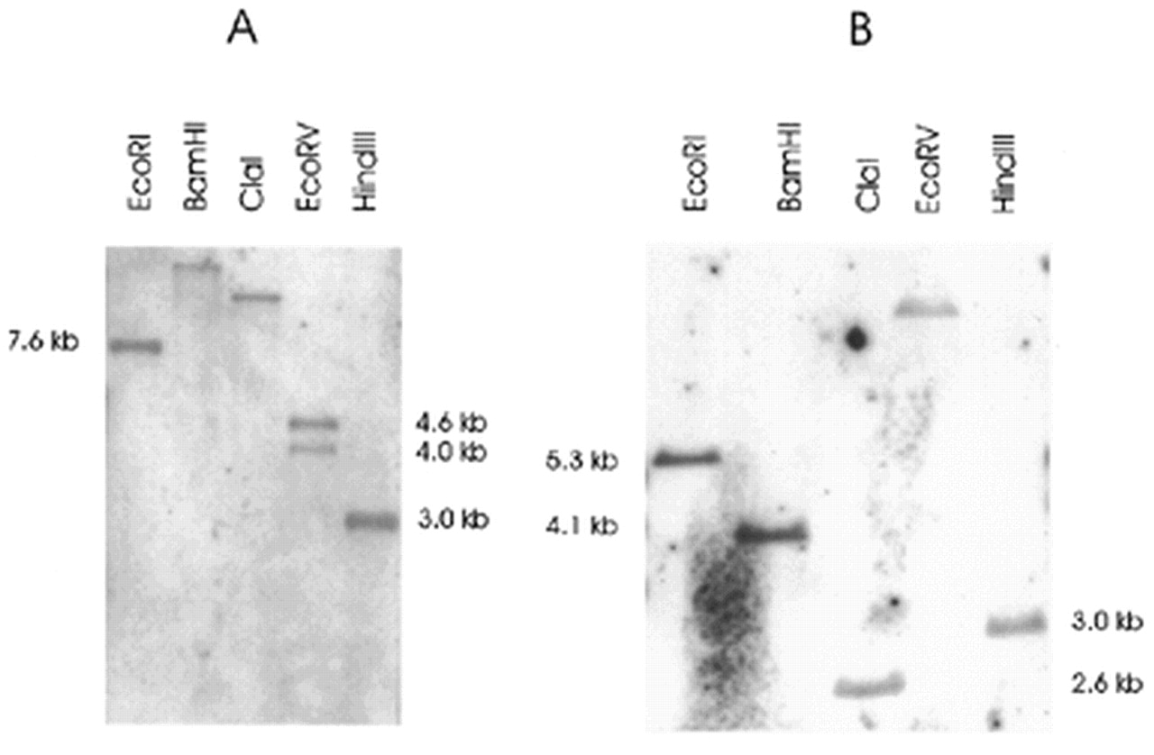
Figure 2. Southern analysis of A.thaliana SPO11-1 (A) and SPO11-2 (B). The indicated fragment sizes are ...
Notes:
Figure 2. Southern analysis of A.thaliana SPO11-1 (A) and SPO11-2 (B). The indicated fragment sizes are calculated from the sequence information of the genomic BAC clones AP000375 for AtSPO11-1 and AC077640 for AtSPO11-2. Both genes show a banding pattern, which is in accordance with a single copy status in the Arabidopsis genome.
Unless provided in the caption above, the following copyright applies to the content of this slide:

Slide 3
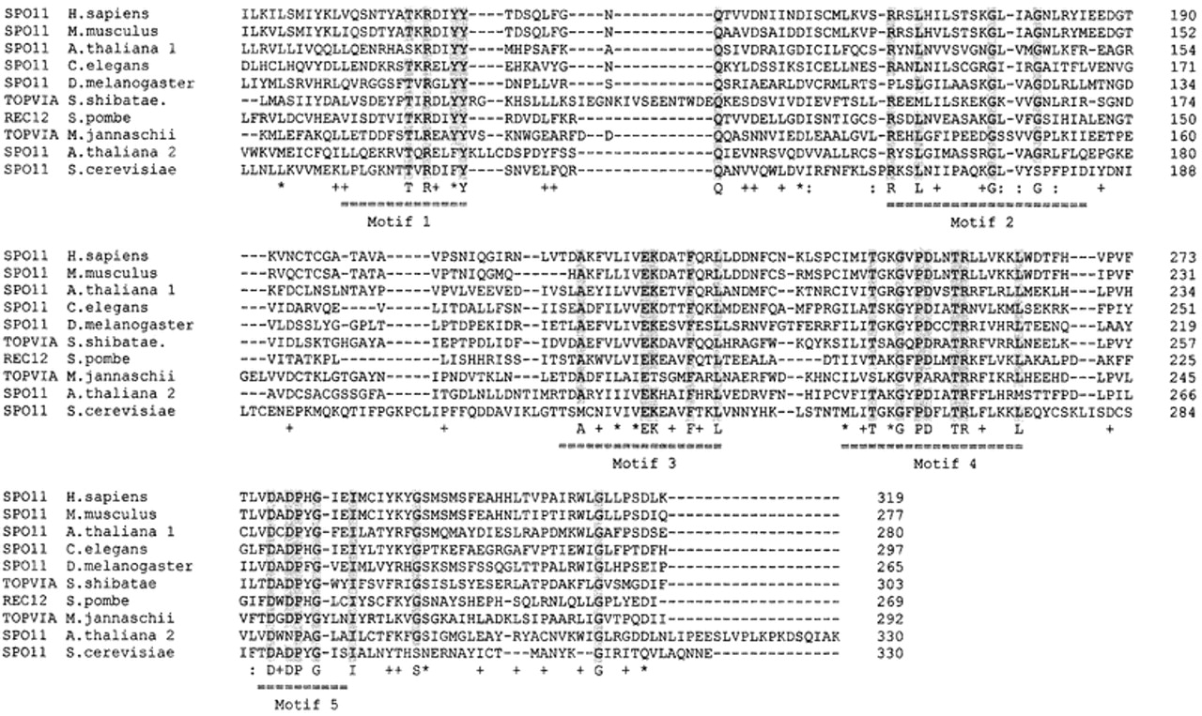
Figure 3. Multiple alignment of the DNA gyrase motif I–V from topoisomerase VIA, Spo11 and Rec12. The ...
Notes:
Figure 3. Multiple alignment of the DNA gyrase motif I–V from topoisomerase VIA, Spo11 and Rec12. The multiple alignment was done with CLUSTALW (v.1.7; http://www.ibc.wustl.edu ). Gaps are represented by dashes, amino acids conserved in more than 5 of the 10 sequences are marked by plus sign (6), colon (7) and asterisk (8). Amino acids that are conserved in all of 9 out of 10 positions are shaded in grey and represented by letters. The conserved DNA gyrase motifs I–V are underlined with dashed double lines. The respective amino acid position of each sequence is given on the right.
Unless provided in the caption above, the following copyright applies to the content of this slide:

Slide 4
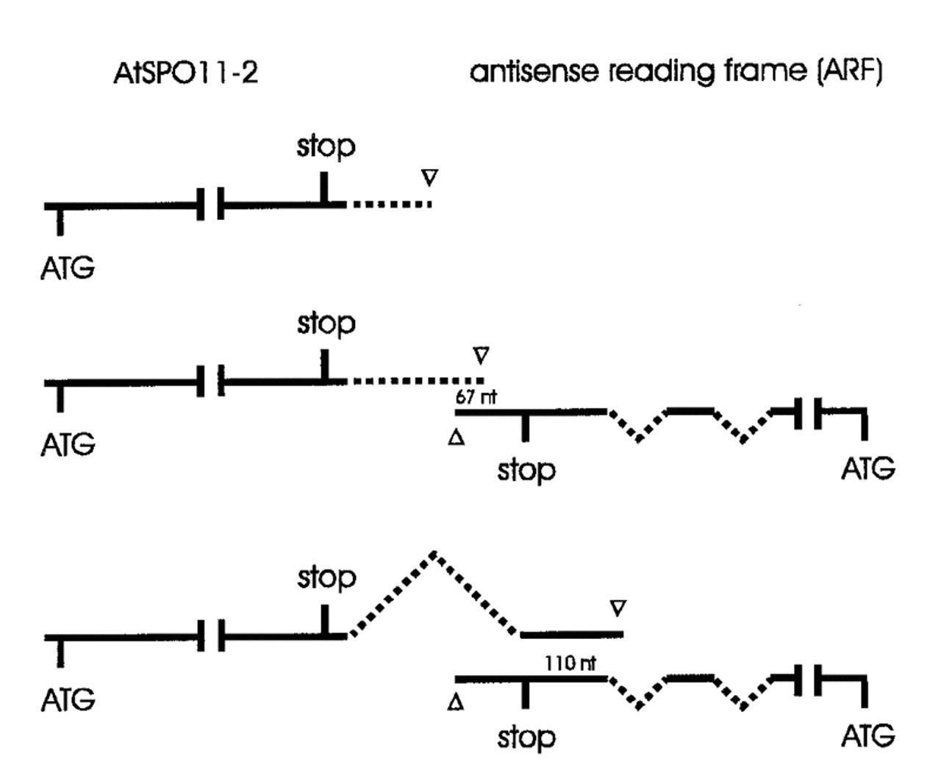
Figure 4. Possible interactions between AtSPO11-2 mRNA and the mRNA of an unknown gene in antisense ...
Notes:
Figure 4. Possible interactions between AtSPO11-2 mRNA and the mRNA of an unknown gene in antisense orientation (ARF) next to it. Unspliced introns are shown as dashed lines, spliced introns as curved dashed lines. The polyadenylation sites of both genes are represented by open triangles. Both genes overlap in an antisense manner if polyadenylation sites two and three of AtSPO11-2 are used.
Unless provided in the caption above, the following copyright applies to the content of this slide:

Slide 5
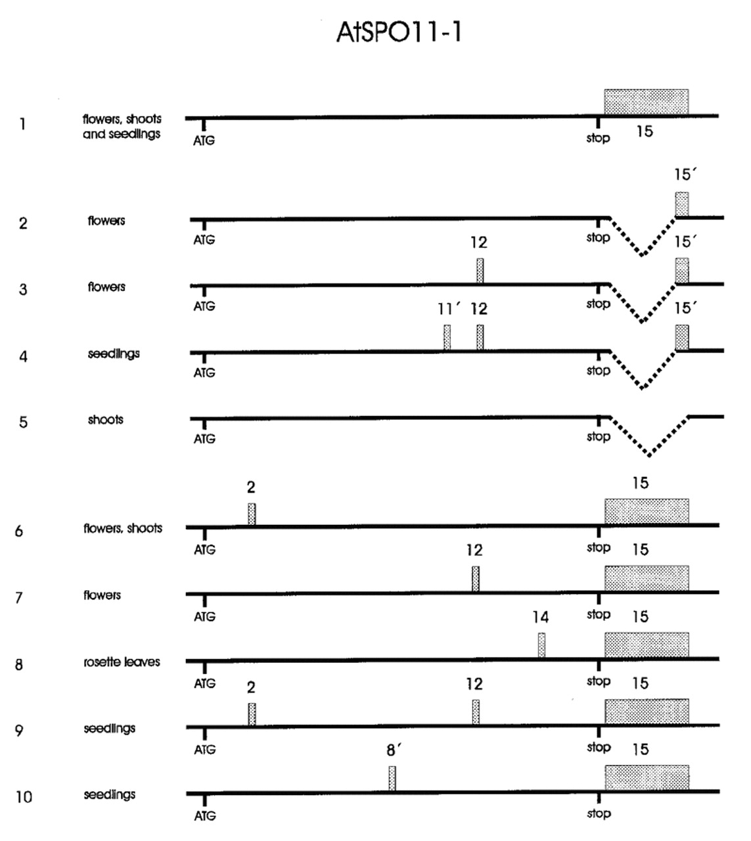
Figure 5. Analysis of alternative splicing products of AtSPO11-1 by RT–PCR and sequencing. All splice ...
Notes:
Figure 5. Analysis of alternative splicing products of AtSPO11-1 by RT–PCR and sequencing. All splice products with resting introns would result in truncated proteins due to premature stop codons. Introns are represented by grey boxes and numbered in the same order as in the full gene (Fig. 1). The partially spliced out intron 15 is represented by a curved dashed line. Partially remaining introns are numbered 8′, 11′ and 15′. The organs from which the cDNAs derived are shown on the left. In number five the intron 15 is slightly longer then in all other lanes because an alternative splice junction was found.
Unless provided in the caption above, the following copyright applies to the content of this slide:

Slide 6
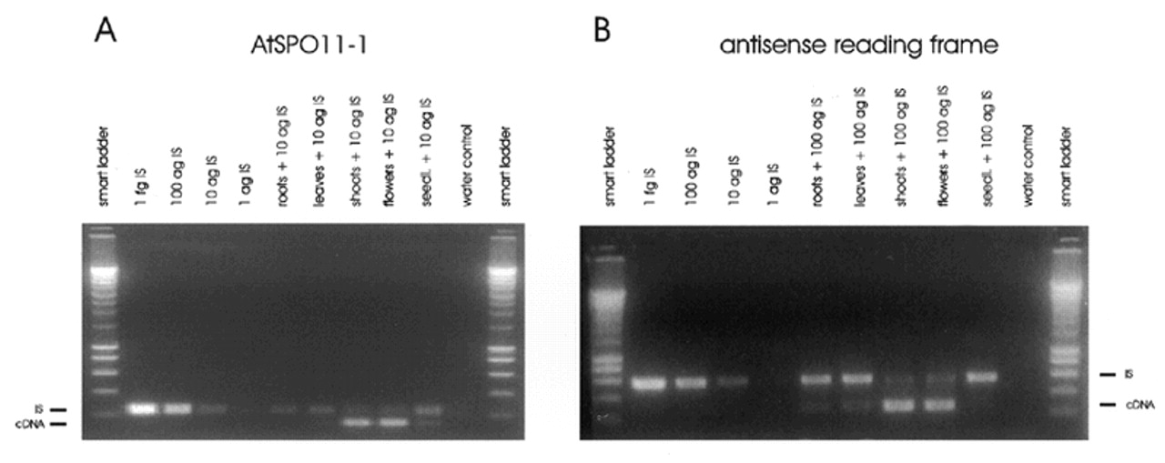
Figure 6. Semiquantitative RT–PCR of AtSPO11-1 (A) and the ARF gene (B). The origin of the respective samples ...
Notes:
Figure 6. Semiquantitative RT–PCR of AtSPO11-1 (A) and the ARF gene (B). The origin of the respective samples and the amounts of the internal standard (IS) used are given on top of the lanes. (A) Ten microlitres of root cDNA and 1 µl of all other cDNAs were used for RT–PCR together with 10 ag of IS. (B) A 1:10 dilution of root cDNA and 1:100 dilutions of all other cDNAs were used together with 100 ag of IS. (A and B) The lower band in each part represents the cDNA and the upper band the internal standard. The first five bands of the smart ladder are, from bottom to top, 200, 400, 600 and 800 bp and 1 kb.
Unless provided in the caption above, the following copyright applies to the content of this slide:

