Slide 1
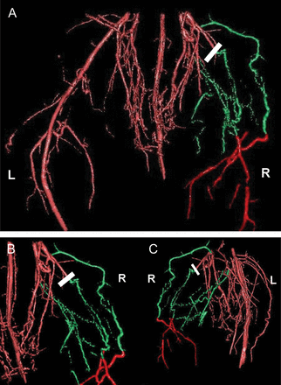
Figure 1 Representative MR angiogram of the mouse hindlimb 3 weeks after the induction of ischaemia. MRAs are shown ...
Notes:
Figure 1 Representative MR angiogram of the mouse hindlimb 3 weeks after the induction of ischaemia. MRAs are shown from different projection views: (A) frontal view; (B) zoom; (C) 45° left lateral from the back. Ligation of left femoral artery is indicated by white bars. Newly developed collateral arteries are coloured green and are identified easily by their tortuous morphology. The distal and proximal original vascular bed is coloured red. For clarification, right (R) and left (L) sides of the animal are indicated in the figure.
Unless provided in the caption above, the following copyright applies to the content of this slide: Published on behalf of the European Society of Cardiology. All rights reserved. © The Author 2012. For permissions please email: journals.permissions@oup.com.

Slide 2
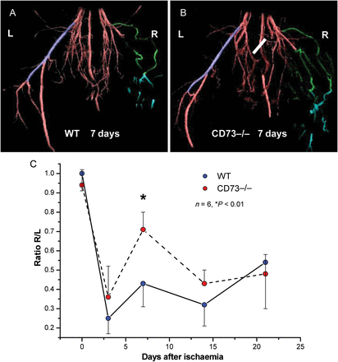
Figure 2 MRAs show faster collateral vessel formation in CD73−/− mice. (A) and (B) Representative MRAs of WT and ...
Notes:
Figure 2 MRAs show faster collateral vessel formation in CD73−/− mice. (A) and (B) Representative MRAs of WT and CD73−/− mice. A defined segment of the contralateral intact artery is used as reference volume (blue) for calculating left-to-right ratios, to account for interindividual differences in vessel size. (C) The time course of blood flow recovery over 3 weeks. Recovery was faster in CD73−/− mice, and significance was reached at day 7 (P < 0.01; n = 6).
Unless provided in the caption above, the following copyright applies to the content of this slide: Published on behalf of the European Society of Cardiology. All rights reserved. © The Author 2012. For permissions please email: journals.permissions@oup.com.

Slide 3
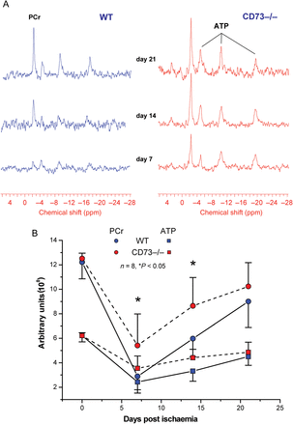
Figure 3 ³¹P MR spectra of hindlimb in WT and CD73−/− over a period of 3 weeks after the ligation of left ...
Notes:
Figure 3 31P MR spectra of hindlimb in WT and CD73−/− over a period of 3 weeks after the ligation of left femoral artery. (A) Representative spectra showing attenuated decrease and faster recovery of ATP and PCr in muscle of CD73−/− mice. (B) Mean values of tissue content of ATP and PCr measured at days 7, 14, and 21 (P < 0.05; n = 8).
Unless provided in the caption above, the following copyright applies to the content of this slide: Published on behalf of the European Society of Cardiology. All rights reserved. © The Author 2012. For permissions please email: journals.permissions@oup.com.

Slide 4
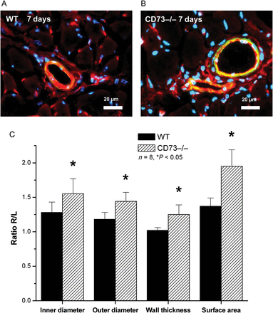
Figure 4 Histological analysis of collateral artery geometry in muscle sections of the ischaemic hindlimb at day 7. ...
Notes:
Figure 4 Histological analysis of collateral artery geometry in muscle sections of the ischaemic hindlimb at day 7. (A) and (B) Collateral arteries are identified by BS-1 lectin (red) and smc-actin staining (yellow-green). Nuclei stained blue. (C) Determined inner and outer diameters as well as the calculated wall thickness and surface area are significantly larger in CD73−/− when compared with WT mice (P < 0.05; n = 8).
Unless provided in the caption above, the following copyright applies to the content of this slide: Published on behalf of the European Society of Cardiology. All rights reserved. © The Author 2012. For permissions please email: journals.permissions@oup.com.

Slide 5
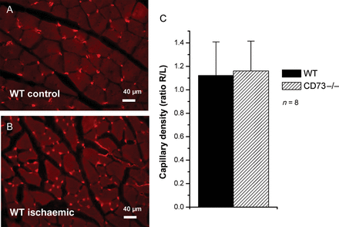
Figure 5 Assessment of capillary density in the ischaemic calf muscle after 7 days. (A) and (B) Capillaries stained by ...
Notes:
Figure 5 Assessment of capillary density in the ischaemic calf muscle after 7 days. (A) and (B) Capillaries stained by BS-1 lectin (red). (C) No significant differences in capillary density between mutant and control mice.
Unless provided in the caption above, the following copyright applies to the content of this slide: Published on behalf of the European Society of Cardiology. All rights reserved. © The Author 2012. For permissions please email: journals.permissions@oup.com.

Slide 6
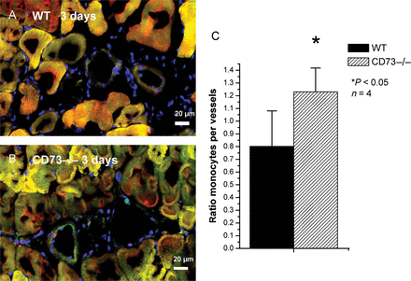
Figure 6 Enhanced monocyte invasion in CD73−/−mice 3 days after the induction of ischaemia. (A) and (B) Histology of ...
Notes:
Figure 6 Enhanced monocyte invasion in CD73−/−mice 3 days after the induction of ischaemia. (A) and (B) Histology of collateral vessels showing an increased infiltration of CD11b-positive cells (red) into the vascular wall of CD73−/− when compared with WT mice. Endothelial cells (red), smooth muscle cells (yellow-green). (C) The number of monocytes was referenced to the number of vessel segments per section for statistical analysis (P < 0.05; n = 4).
Unless provided in the caption above, the following copyright applies to the content of this slide: Published on behalf of the European Society of Cardiology. All rights reserved. © The Author 2012. For permissions please email: journals.permissions@oup.com.

