Slide 1
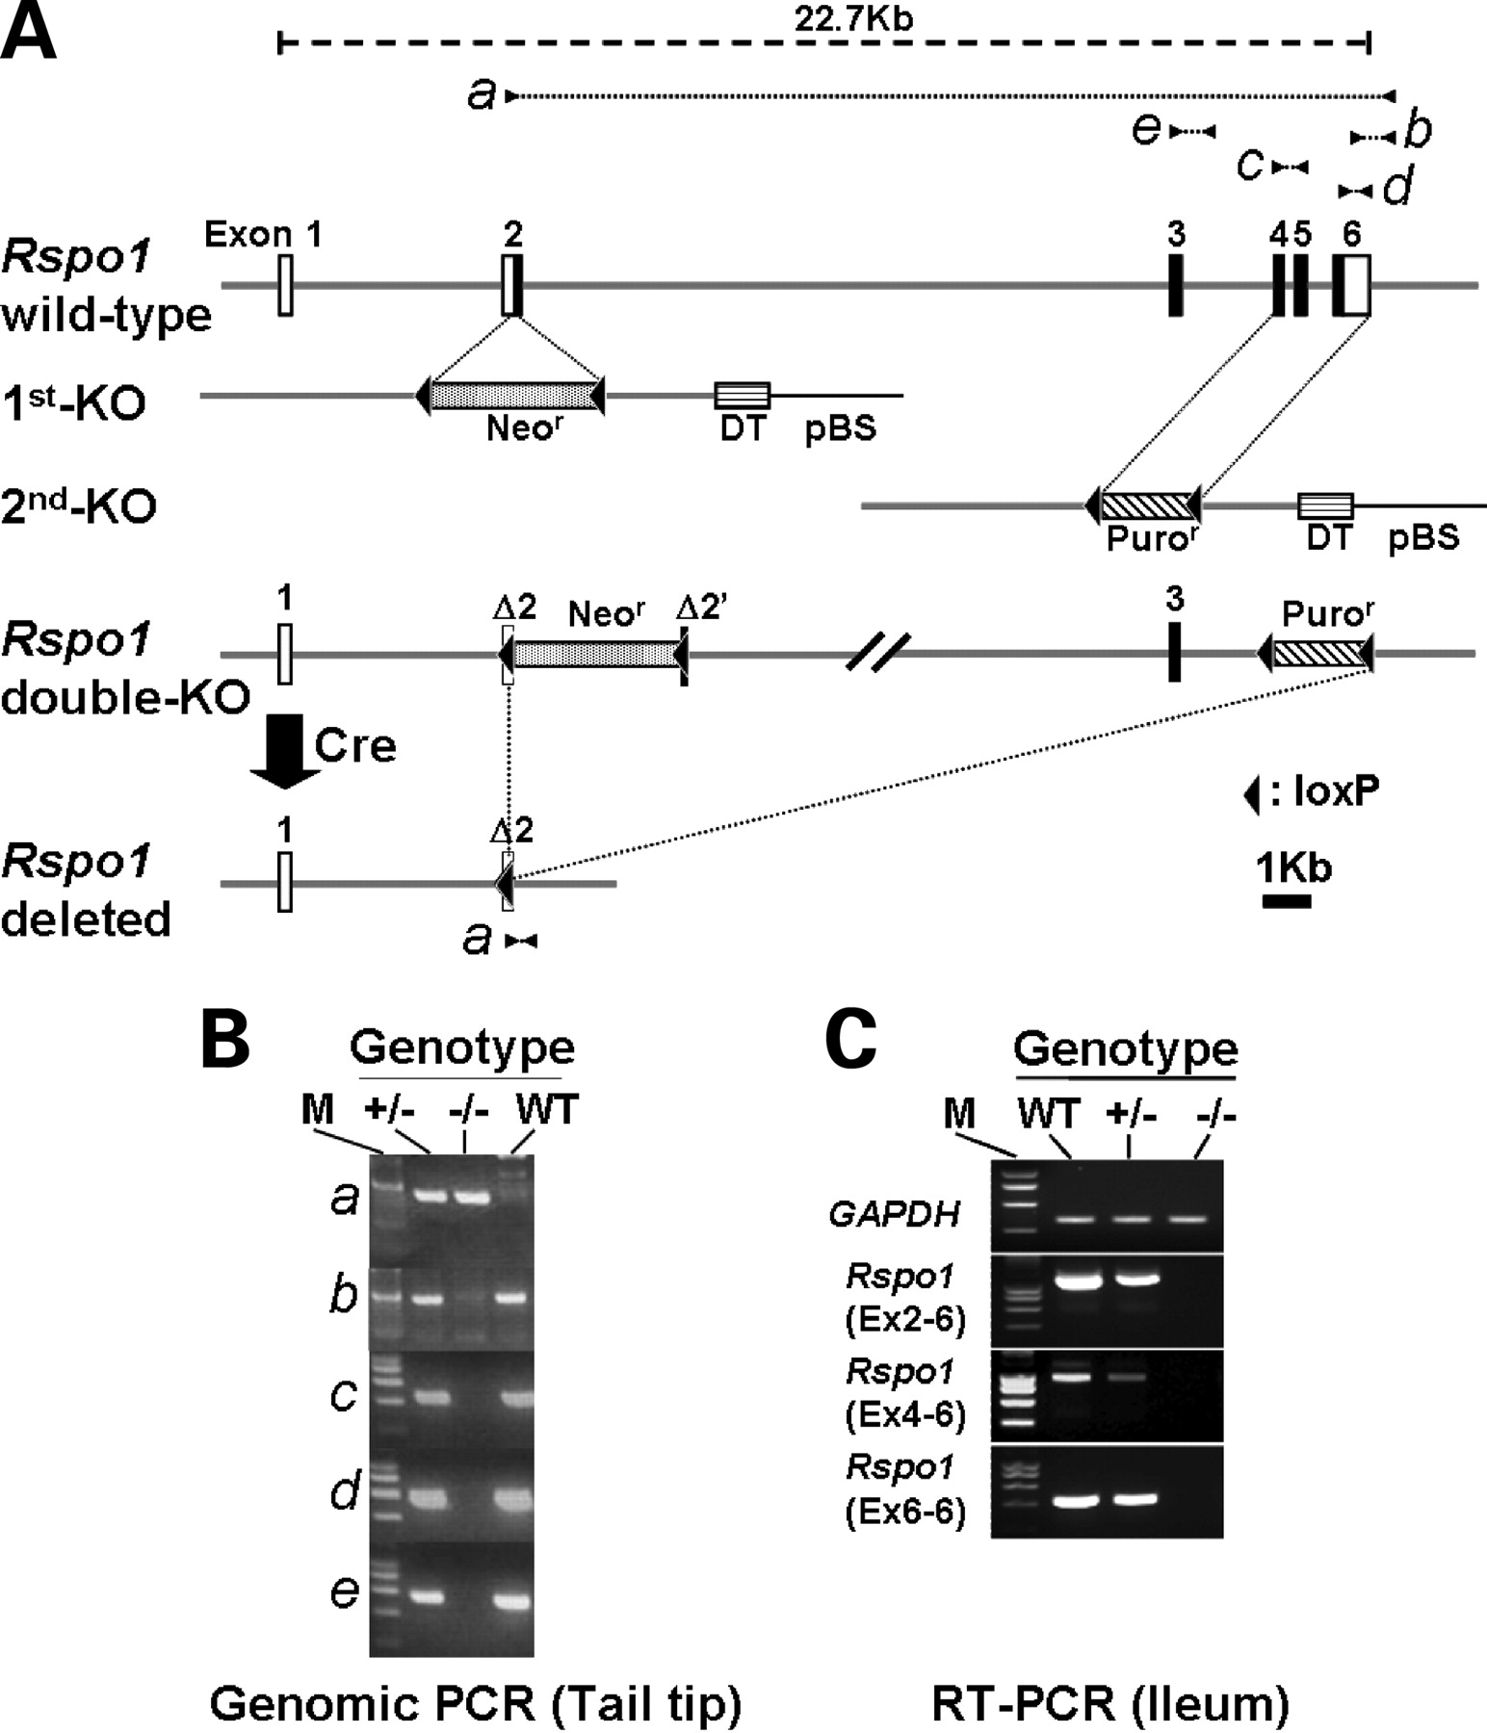
Figure 1. Generation of Rspo1-null mutant mice. (A) Schematic diagram of the wild-type and modified Rspo1 loci and ...
Notes:
Figure 1. Generation of Rspo1-null mutant mice. (A) Schematic diagram of the wild-type and modified Rspo1 loci and targeting constructs. Numbered boxes (1–6) denote exons. Black boxes mark the open reading frame, with the first in-frame ATG codon located in exon 2. The 1st-KO vector contains 4.8 kb of the 5′ and 2.3 kb of the 3′ Rspo1 genomic sequence. A loxP-flanked STNeo (Neor) selection marker replaced 50 bp of the exon 2 sequence containing the initiator ATG of the Rspo1 gene. A counter-selection cassette encoding the A subunit of diphtheria toxin (DT) was inserted at the site between the 3′ arm and pBluescript (pBS). The 2nd-KO vector contains 5.0 kb of the 5′ and 2.0 kb of the 3′ Rspo1 genomic sequence. A loxP-flanked PGKPuro (Puror) selection marker replaced the 2.0 kb genomic sequence encompassing exons 4–6 of the Rspo1 gene, and the subunit of diphtheria toxin (DT) was inserted as a counter-selection marker. The correct recombination in the 1st and 2nd targeting events was verified by Southern blot analysis using 5′ and 3′ external probes (see Materials and Methods, data not shown). In the final step of genetic modification, targeted clones carrying double-KO allele were subjected to transfection with the Cre expression vector to delete the 17.8 kb region containing all the protein-coding sequence for the Rspo1 gene. Successful recombination with Cre in ES cells resulting in ES clones carrying the Rspo1-deleted allele was confirmed by Southern blot (data not shown) and PCR analysis (see Materials and Methods). (B) PCR-based genotyping of Rspo1 mutant mice. Positions of the five primer pairs (a-e, see Materials and Methods) used in genomic DNA analysis are shown in (A). Primer pair a produced a 377 bp PCR product from the Rspo1-deleted allele, and an 18.0 kb PCR product from the wild-type allele that was difficult to detect because of its large size. The other four primer pairs, b, c, d and e, were designed to amplify the wild-type Rspo1 sequence spanning the region of exon 3-intron 3 (e), exon 4-intron 4-exon 5 (c) and exon 6 (b, d). In a homozygote for Rspo1 deletion (−/−), the 377 bp product was detected with primer pair a, but none was detected with the other four primer pairs (b–e) by PCR analyses of tail-tip DNA. A Rspo1 heterozygote (+/−) was positive for all the five primer pairs, and a wild-type (WT) was positive for four primer pairs (b–e), but not for a. We routinely use a, b and e primer pairs for genotyping. M, DNA size marker. (C) The absence of Rspo1 transcripts in the ileum of Rspo1−/− mice. Total RNA samples prepared from the ileum of 8-week-old Rspo1−/− (−/−), Rspo1+/− (+/−) and wild-type (WT) mice were subjected to semi-quantitative RT-PCR analyses using three primer pairs for amplifying exons 2–6 (Ex2-6), exons 4–6 (Ex4-6) and exon 6 (Ex6-6) regions of Rspo1 transcripts. Murine glyceraldehyde dehydrogenase (GAPDH) was used as a control. The sizes of resulting PCR products in all experiments were consistent with the expected sizes predicted from reported cDNA sequences. M, DNA size marker.
Unless provided in the caption above, the following copyright applies to the content of this slide: © The Author 2008. Published by Oxford University Press. All rights reserved. For Permissions, please email: journals.permissions@oxfordjournals.org

Slide 2
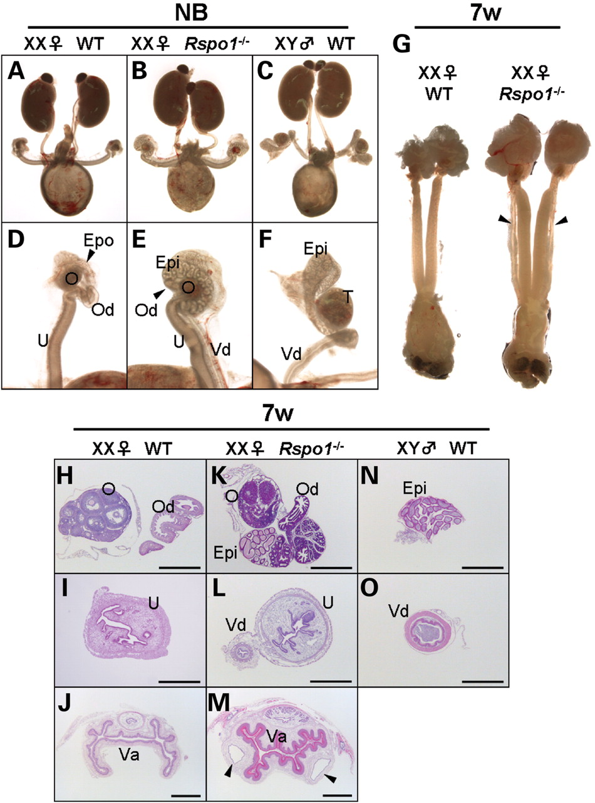
Figure 2. Pseudohermaphroditism in the reproductive tract of newborn and adult Rspo1^{−/−} females. (A–F) Gross ...
Notes:
Figure 2. Pseudohermaphroditism in the reproductive tract of newborn and adult Rspo1−/− females. (A–F) Gross morphology of the urogenital system of newborn (NB) mice. Rspo1−/− females possess an extra ductal structure (E, Epi) resembling the male epididymis (F, Epi) beside the oviduct (E, Od, indicated with an arrowhead). Furthermore, a vas deferens-like ductal structure (E, Vd; see male Vd in F) and an apparently normal uterine horn (E, U) parallel each other. (G) Gross morphology of internal reproductive organs of 7-week-old (7W) wild-type and Rspo1−/− XX females, indicating the persistence of extra Wolffian duct-derived, vas deferens-like structures (indicated with arrowheads) alongside the apparently normal female reproductive tracts. (H–O) Hematoxylin and eosin (H&E) stained sections from the reproductive tracts of 7-week-old wild-type male (XY) and female (XX), and Rspo1−/− female (XX) mice. Ovaries and oviducts of wild-type (H) and Rspo1−/− (K) mice. Ureri of wild-type (I) and Rspo1−/− (L) mice. The vagina of wild-type (J) and Rspo1−/− (M) mice. Note the presence of extra ductal structure(s) (K, Epi; L, Vd; M, arrowheads) resembling male sex ducts (N, epididymis; O, vas deferens) in Rspo1−/− female mice. Routine H&E staining was performed for the histological examination of 6 µm paraffin-embedded sections by light microscopy. Epo, epoöphoron (a remnant of the Wolffian duct); O, ovary; Od, oviduct; U, uterus; Epi, epididymis in males or epididymis-like ductal structure in females; Vd, vas deferens in males or vas deferens-like ductal structure in females; T, testis; Va, vagina. Scale bar: 1 mm.
Unless provided in the caption above, the following copyright applies to the content of this slide: © The Author 2008. Published by Oxford University Press. All rights reserved. For Permissions, please email: journals.permissions@oxfordjournals.org

Slide 3
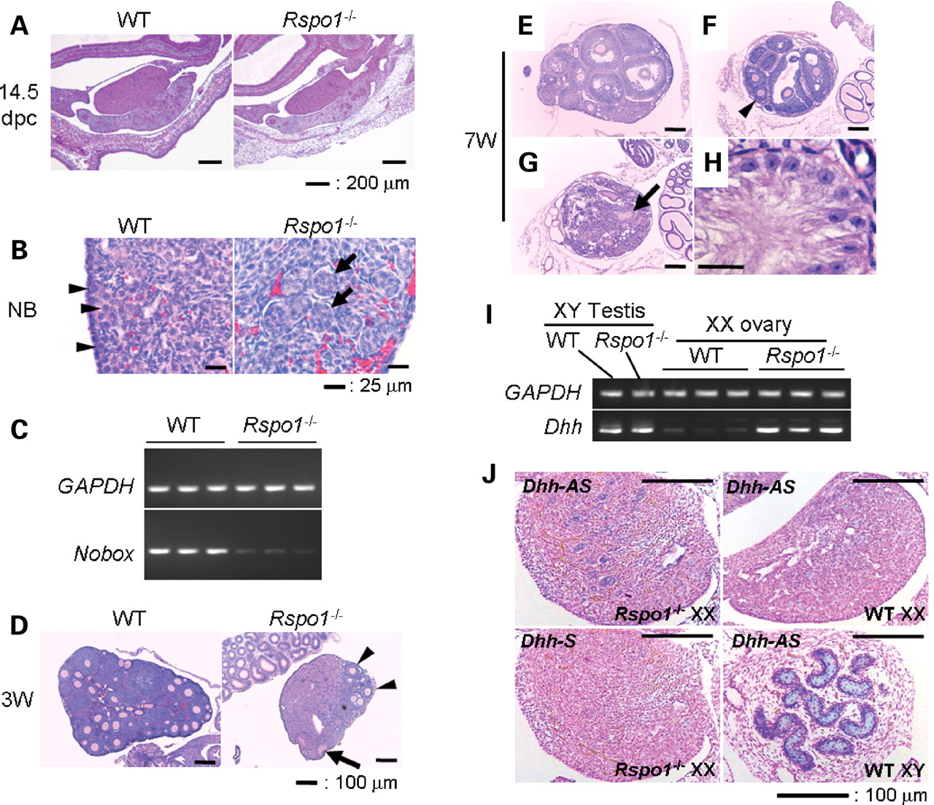
Figure 3. Masculinization of Rspo1^{−/−} XX gonads. (A) Representative 14.5 dpc wild-type (WT) and ...
Notes:
Figure 3. Masculinization of Rspo1−/− XX gonads. (A) Representative 14.5 dpc wild-type (WT) and Rspo1−/− ovary sections stained with H&E. (B) High-powered magnification of representative newborn wild-type (WT) and Rspo1−/− ovary sections shows reduced numbers of cortical oocytes (indicated with arrowheads) and an emergence of sex cord-like structures (indicated with arrows) in Rspo1−/− ovaries. (C) Reduced expression of Nobox, an oocyte-specific gene in Rspo1−/− XX ovaries. Total RNA samples prepared from newborn Rspo1−/− (n = 3) and wild-type (WT, n = 3) XX ovaries were subjected to semi-quantitative RT-PCR analysis using primer pairs to detect transcripts for Nobox (newborn ovary homeobox gene). Murine glyceraldehyde dehydrogenase (GAPDH) was used as a control. The sizes of resulting PCR products were consistent with the expected sizes predicted from reported cDNA sequences. When compared with wild-type ovaries, transcripts for Nobox, which is preferentially expressed in primordial and growing oocytes (38), were diminished in the Rspo1−/− ovaries. (D) Representative 3-week-old (3W), prepubertal wild-type (WT) and Rspo1−/− ovary sections. In Rspo1−/− sections, healthy, maturing follicles were present (indicated with arrowheads), whereas sex cords similar to seminiferous tubules can also be seen (indicated with an arrow). (E–G) Representative 7-week-old (7W), pubertal wild-type (WT, E) and Rspo1−/− (F and G) ovary sections. Healthy, maturing follicles were present in some Rspo1−/− sections (F, indicated with an arrowhead), whereas no growing follicles were observed in other sections (G). Note that sections (F) and (G) were prepared from the same Rspo1−/− ovary sample. Sex cords similar to seminiferous tubules can be seen in the Rspo1−/− ovaries (G, indicated with an arrow). Scale bar: 100 µm. (H) High-powered magnification of a seminiferous tubule-like sex cord seen in G (indicated with an arrow), which contains the cells resembling Sertoli cells of the testis, characterized by tripartite nucleoli and veil-like cytoplasmic extensions. Scale bar: 25 µm. (I, J) Ectopic expression of testis-specific Dhh transcripts in Rspo1−/− XX ovaries. The total RNA samples prepared from newborn Rspo1−/− (n = 3) and wild-type (WT, n = 3) XX ovaries, and the newborn Rspo1−/− (−/−, n = 1) and wild-type (WT, n = 1) XY testes were subjected to semi-quantitative RT-PCR analysis (I) using primer pairs to detect transcripts for a Sertoli cell differentiation marker gene, Dhh. Murine glyceraldehyde dehydrogenase (GAPDH) was used as a control. The sizes of resulting PCR products in all experiments were consistent with the expected sizes predicted from reported cDNA sequences. When compared with wild-type controls, Dhh expression was elevated in the Rspo1−/− ovaries. RNA in situ hybridization (J) to newborn gonads show that the Dhh is expressed in wild-type (WT) testes (XY) and Rspo1−/− ovaries (XX), but are undetectable in wild-type ovaries (XX). Note that the Dhh positivity was frequently associated with the sex cord-like tubular structure. Hybridization using the sense probe did not result in any detectable signals in this experiment. AS, anti-sense probe; S, sense probe.
Unless provided in the caption above, the following copyright applies to the content of this slide: © The Author 2008. Published by Oxford University Press. All rights reserved. For Permissions, please email: journals.permissions@oxfordjournals.org

Slide 4
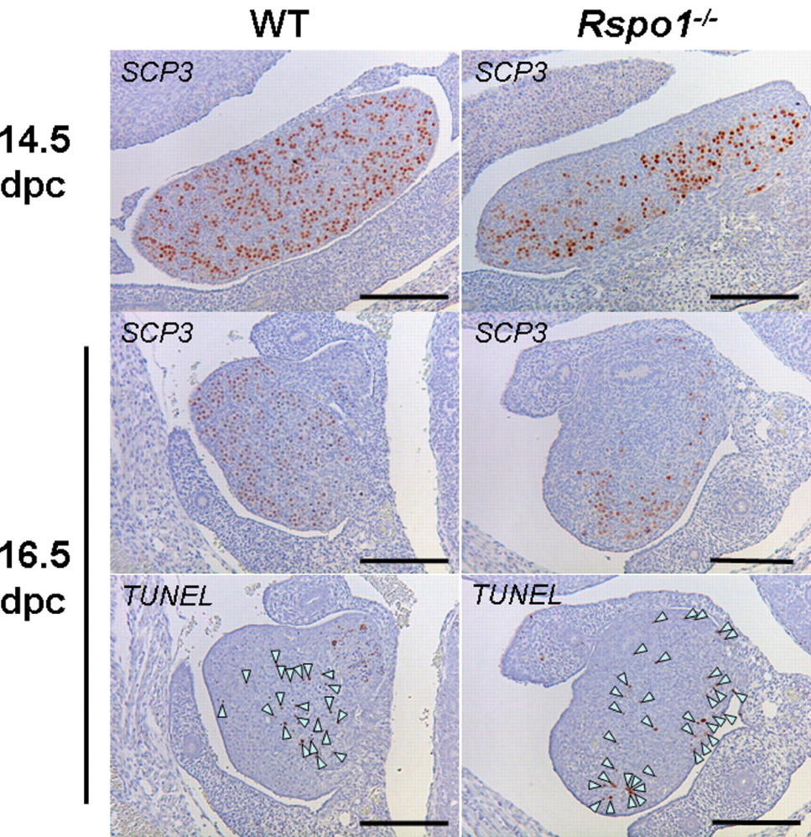
Figure 4. Immunostaining for meiotic germ cell marker, SCP3 and staining for apoptosis by TUNEL assay. A substantial ...
Notes:
Figure 4. Immunostaining for meiotic germ cell marker, SCP3 and staining for apoptosis by TUNEL assay. A substantial number of SCP3-positive oocytes can be detected throughout the wild-type (WT) ovary at 14.5 dpc. On the other hand, in the Rspo1−/− ovary at 14.5 dpc, the distribution of oocytes is apparently restricted to a region other than the coelomic domain of the ovary. At both 14.5 and 16.5 dpc, the numbers of SCP3-positive oocytes are diminished in the Rspo1−/− ovaries as compared with the wild-type (WT) ovaries. Cells positive for TUNEL staining at 16.5 dpc are indicated with arrow heads. Apoptotic cells are observed mainly within the medullary region in the wild-type (WT) ovary, whereas they appeared throughout the Rspo1−/− ovary.
Unless provided in the caption above, the following copyright applies to the content of this slide: © The Author 2008. Published by Oxford University Press. All rights reserved. For Permissions, please email: journals.permissions@oxfordjournals.org

Slide 5
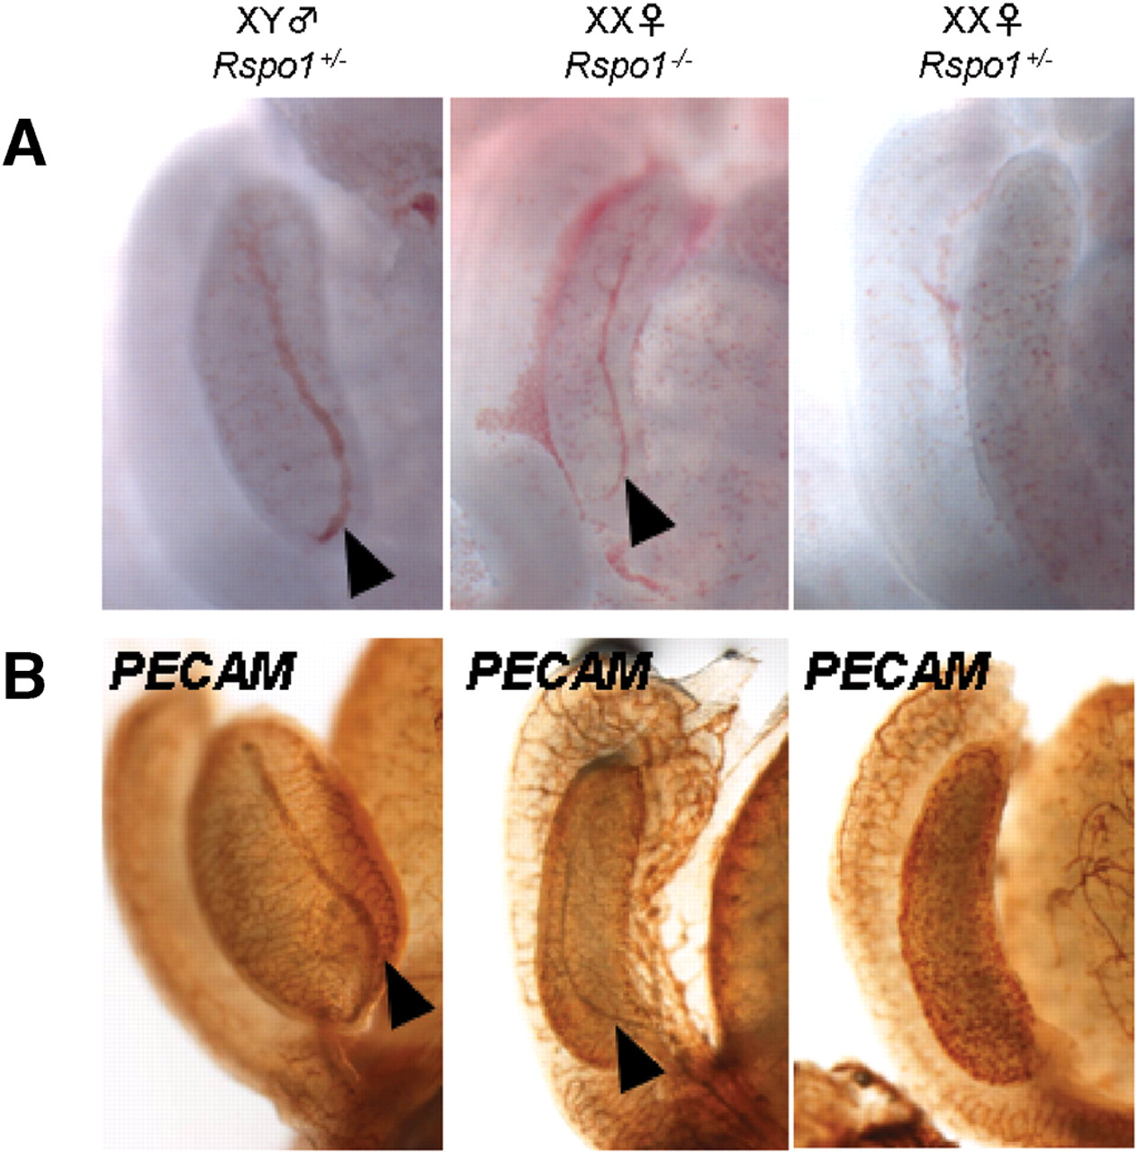
Figure 5. Ectopic formation of the male-specific coelomic blood vessel in Rspo1^{−/−} XX gonads. (A,B) Light ...
Notes:
Figure 5. Ectopic formation of the male-specific coelomic blood vessel in Rspo1−/− XX gonads. (A,B) Light microscope images (A) and PECAM stained images (B) of 13.5 dpc gonads. A clear artery (indicated with arrowheads) is seen on the coelomic surface of Rspo1+/− XY and Rspo1−/− XX gonads, but not on the Rspo1+/− XX gonad.
Unless provided in the caption above, the following copyright applies to the content of this slide: © The Author 2008. Published by Oxford University Press. All rights reserved. For Permissions, please email: journals.permissions@oxfordjournals.org

Slide 6
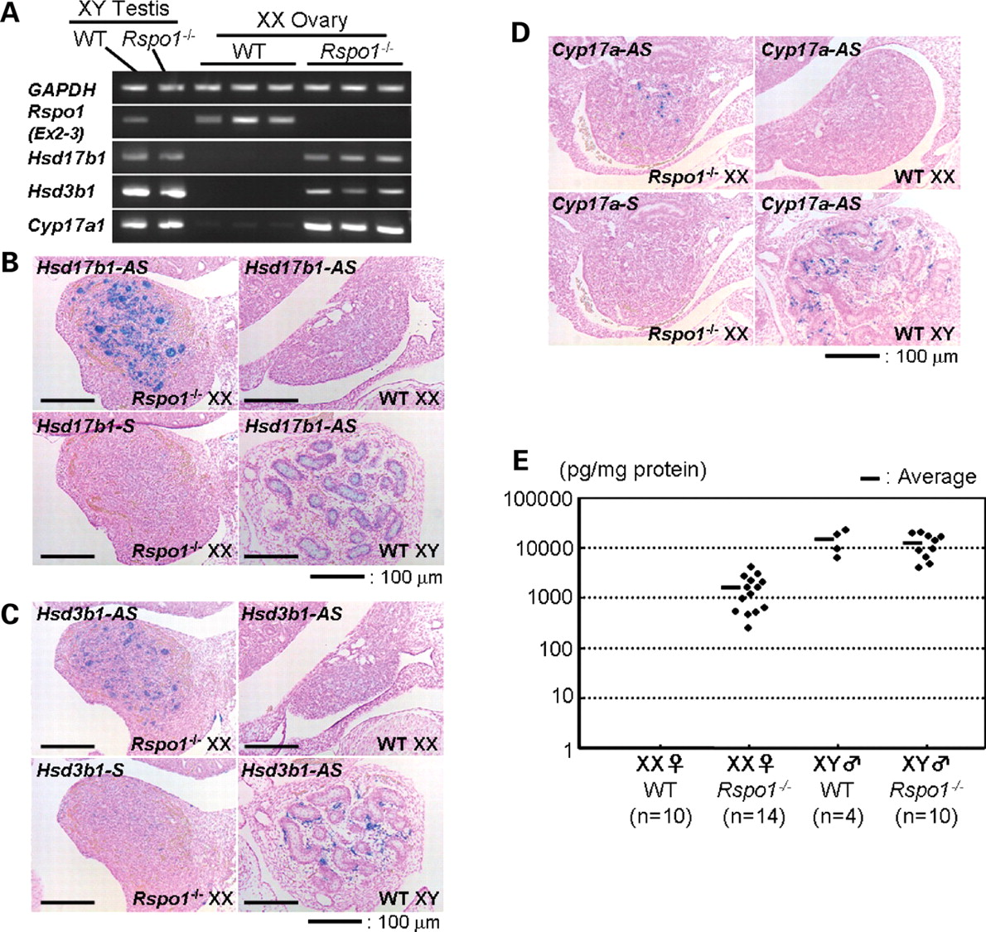
Figure 6. Ectopic expression of genes for steroidogenic enzymes and the production of testosterone in newborn ...
Notes:
Figure 6. Ectopic expression of genes for steroidogenic enzymes and the production of testosterone in newborn Rspo1−/− XX ovaries. (A) The total RNA samples prepared from newborn Rspo1−/− (n = 3) and wild-type (WT, n = 3) XX ovaries, and newborn Rspo1−/− (n = 1) and wild-type (n = 1) XY testes were subjected to semi-quantitative RT-PCR analysis using primer pairs to detect transcripts for three steroidogenic enzyme genes (Hsd17b1, Hsd3b1 and Cyp17a1). Murine glyceraldehyde dehydrogenase (GAPDH) was used as a control. The sizes of resulting PCR products in all experiments were consistent with expected sizes predicted from reported cDNA sequences. The absence of Rspo1 transcripts in Rspo1−/− mice was confirmed using a primer pair to amplify the 503 bp sequence spanning the exon 2–3 region. When compared with wild-type controls, all three testis-specific transcripts were elevated in the Rspo1−/− ovaries. It should also be noted that these testis-specific transcripts were not affected in Rspo1−/− testis. (B–D) RNA in situ hybridization to newborn gonads shows that genes for steroidogenic enzymes (Hsd17b1, B; Hsd3b1, C; Cyp17a, D) are expressed in wild-type (WT) testes (XY), but are undetectable in wild-type ovaries (XX). All these three testis-specific genes are ectopically expressed in Rspo1−/− ovaries (XX). As shown for each gene, hybridization using the sense probe did not result in any detectable signals in any of the experiments. AS, anti-sense probe; S, sense probe. (E) Testosterone was detected in the newborn gonads of wild-type and Rspo1−/− males and in Rspo1−/− females, but not in wild-type females. All the results from wild-type females were below the detection limit and were recorded as zero.
Unless provided in the caption above, the following copyright applies to the content of this slide: © The Author 2008. Published by Oxford University Press. All rights reserved. For Permissions, please email: journals.permissions@oxfordjournals.org

Slide 7
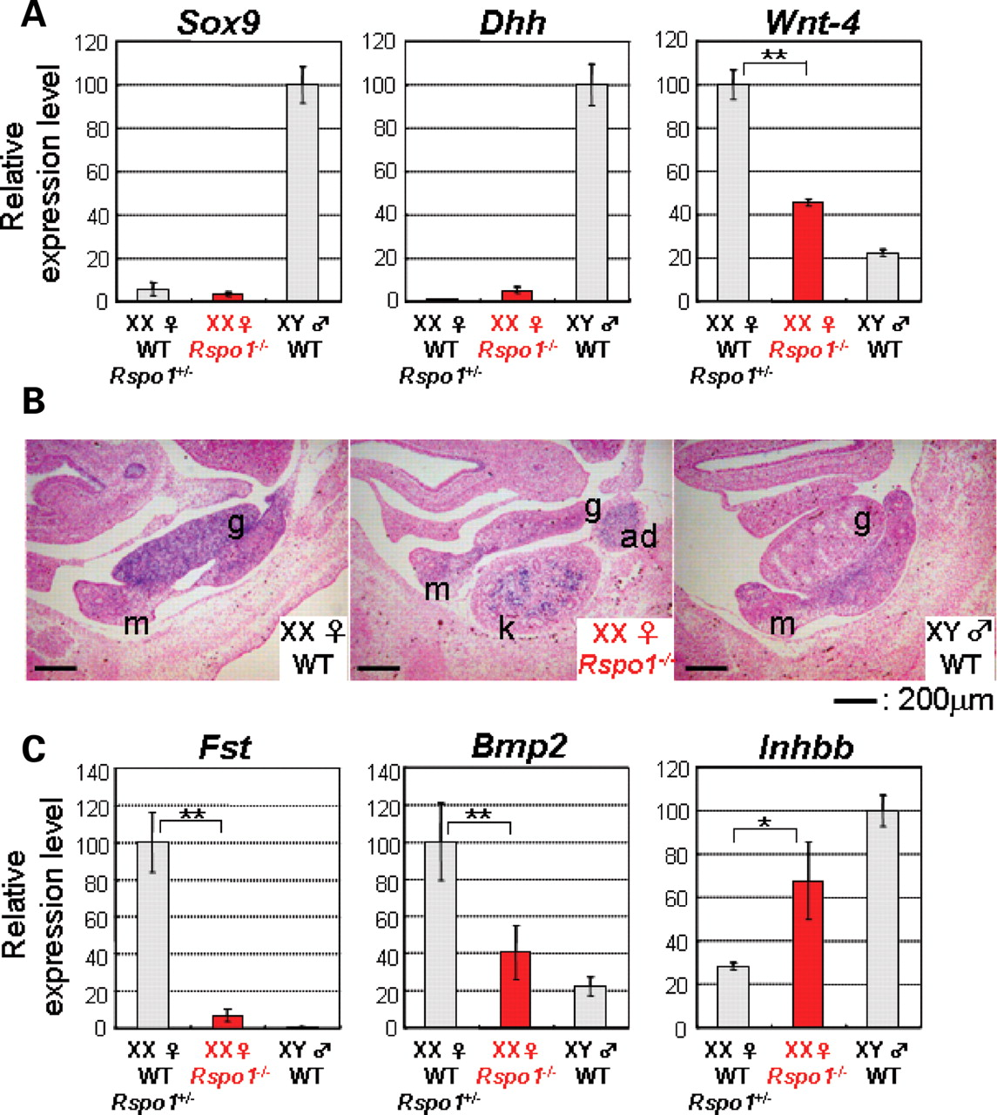
Figure 7. Deregulation of Wnt-4 and its downstream genes in 13.5 dpc Rspo1^{−/−} XX gonads. (A) TaqMan ...
Notes:
Figure 7. Deregulation of Wnt-4 and its downstream genes in 13.5 dpc Rspo1−/− XX gonads. (A) TaqMan real-time PCR analyses of Sox9, Dhh, and Wnt-4 mRNA levels in 13.5 dpc wild-type/Rspo1+/− (n = 3/2), Rspo1−/− XX (n = 6) and wild-type XY (n = 3) gonads. The expression level of the tested genes was normalized to GAPDH. In each analysis, the averaged expression level in wild-type XY (for Sox9 and Dhh) or wild-type/Rspo1−/+ XX (for Wnt-4) gonads was arbitrarily defined as unit 100. The mean value for five real-time PCR experiments was calculated for each sample, and the data are presented as mean ± SD. (B) RNA in situ hybridization to 13.5 dpc gonads show that an ovary marker, Wnt-4 is expressed in the wild-type XX gonad, but undetectable in the wild-type XY gonad. The Rspo1−/− XX gonad shows only a weak Wnt-4 signal compared with the wild-type XX gonad. It should be noted that the developing kidney (23) and adrenal grand (31) normally express Wnt-4, and the Rspo1−/− kidney (k) and adrenal grand (ad) still express Wnt-4, suggesting that Rspo1 may not be involved in the regulation of Wnt-4 expression in these tissues. g, gonad; m, mesonephros. (C) TaqMan real-time PCR analyses of Fst, Bmp2 and Inhbb mRNA levels in 13.5 dpc wild-type/Rspo1+/− (n = 3/2), Rspo1−/− XX (n = 6) and wild-type XY (n = 3) gonads. The expression level of the tested genes was normalized to GAPDH. In each analysis, the averaged expression level in wild-type/Rspo1+/− gonads was arbitrarily defined as unit 100. The mean value for five real-time PCR experiments was calculated for each sample and the data are presented as mean ± SD. P < 0.0001 (double asterisk); P < 0.001 (single asterisk).
Unless provided in the caption above, the following copyright applies to the content of this slide: © The Author 2008. Published by Oxford University Press. All rights reserved. For Permissions, please email: journals.permissions@oxfordjournals.org

