Slide 1
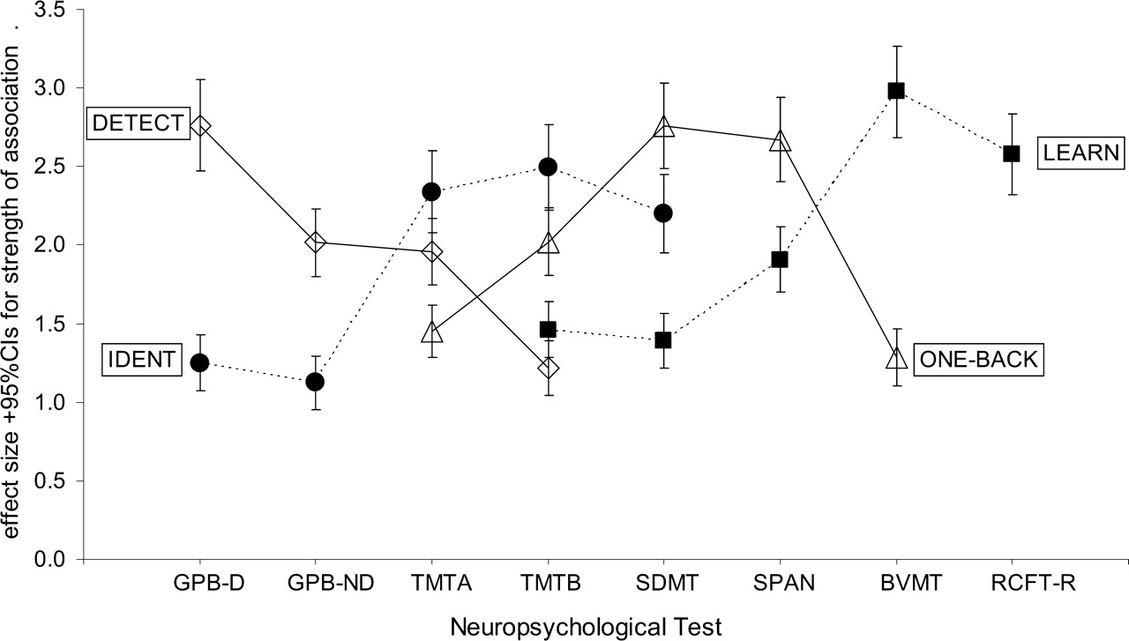
Fig. 1. Effect sizes and their 95% confidence intervals (95% CIs) for significant correlations between CogState tasks ...
Notes:
Fig. 1. Effect sizes and their 95% confidence intervals (95% CIs) for significant correlations between CogState tasks and the comparator neuropsychological tests. Where 95% CIs do not overlap effect sizes are significantly different. Open diamonds joined by a solid line indicate effect sizes for Detect task; filled circles joined by a dotted line indicate effect sizes for Ident task; Open triangles joined by a solid line indicate effect sizes for One-Back task; Filled squares joined by a dotted line indicate effect sizes for Learn task.
Unless provided in the caption above, the following copyright applies to the content of this slide: © The Author 2009. Published by Oxford University Press on behalf of the National Academy of Neuropsychology. All rights reserved. For permissions, please e-mail: journals.permissions@oxfordjournals.org.

Slide 2
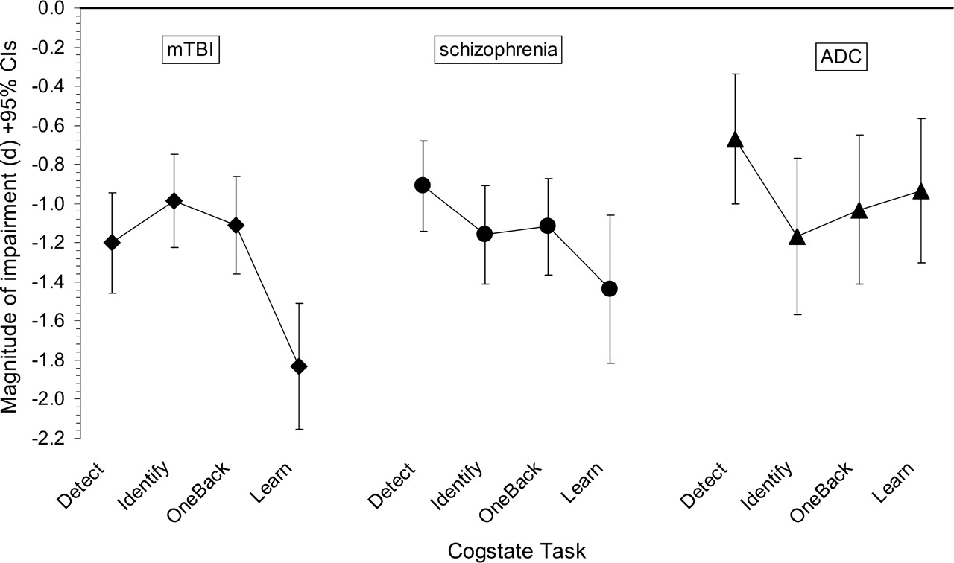
Fig. 2. Effect sizes and their 95% confidence intervals for the magnitude of cognitive impairment on the CogState ...
Notes:
Fig. 2. Effect sizes and their 95% confidence intervals for the magnitude of cognitive impairment on the CogState outcome measures for mild traumatic brain injury (mTBI), schizophrenia (schiz), and the AIDS dementia complex (ADC). GPB = grooved pegboard; -D = dominant hand; -ND = non-dominant hand; TMT-A/B = Trail Making Test parts A and B; SDMT = Symbol Digit Modalities Test; Span = WMS III spatial span task; BVMT = Brief Visual Memory Test; RCFT-R = Rey Complex Figure Test-Delayed Recall.
Unless provided in the caption above, the following copyright applies to the content of this slide: © The Author 2009. Published by Oxford University Press on behalf of the National Academy of Neuropsychology. All rights reserved. For permissions, please e-mail: journals.permissions@oxfordjournals.org.

