Slide 1
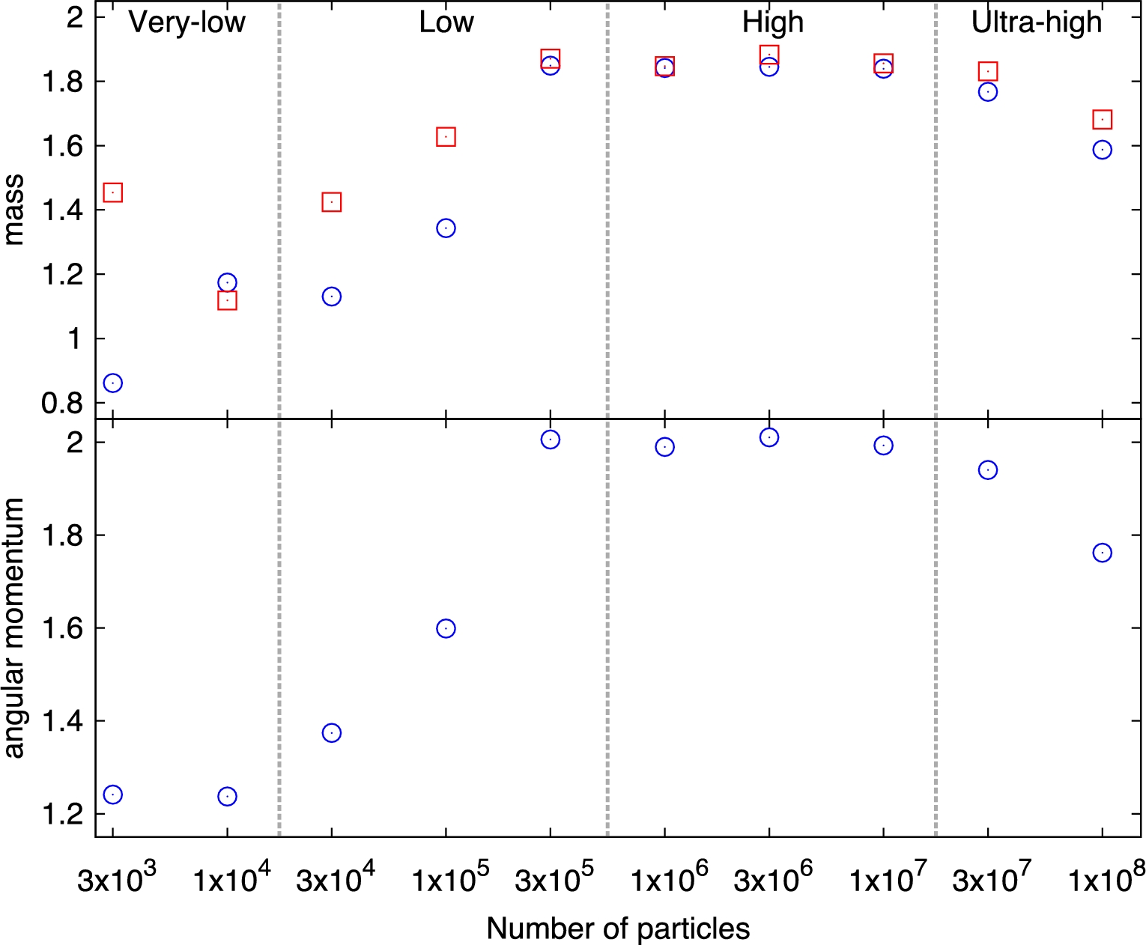
Fig. 1. Disc properties vs. number of particles. The upper panel shows the disc mass (blue circles) and predicted ...
Notes:
Fig. 1. Disc properties vs. number of particles. The upper panel shows the disc mass (blue circles) and predicted moon mass (red squares) normalised by the current lunar mass, while the lower panel shows $L_\mathrm{disc} / \sqrt{G M_\oplus R_\mathrm{Roche}}$. (Color online)
Unless provided in the caption above, the following copyright applies to the content of this slide: © The Author 2017. Published by Oxford University Press on behalf of the Astronomical Society of Japan. All rights reserved. For Permissions, please email: journals.permissions@oup.com

Slide 2
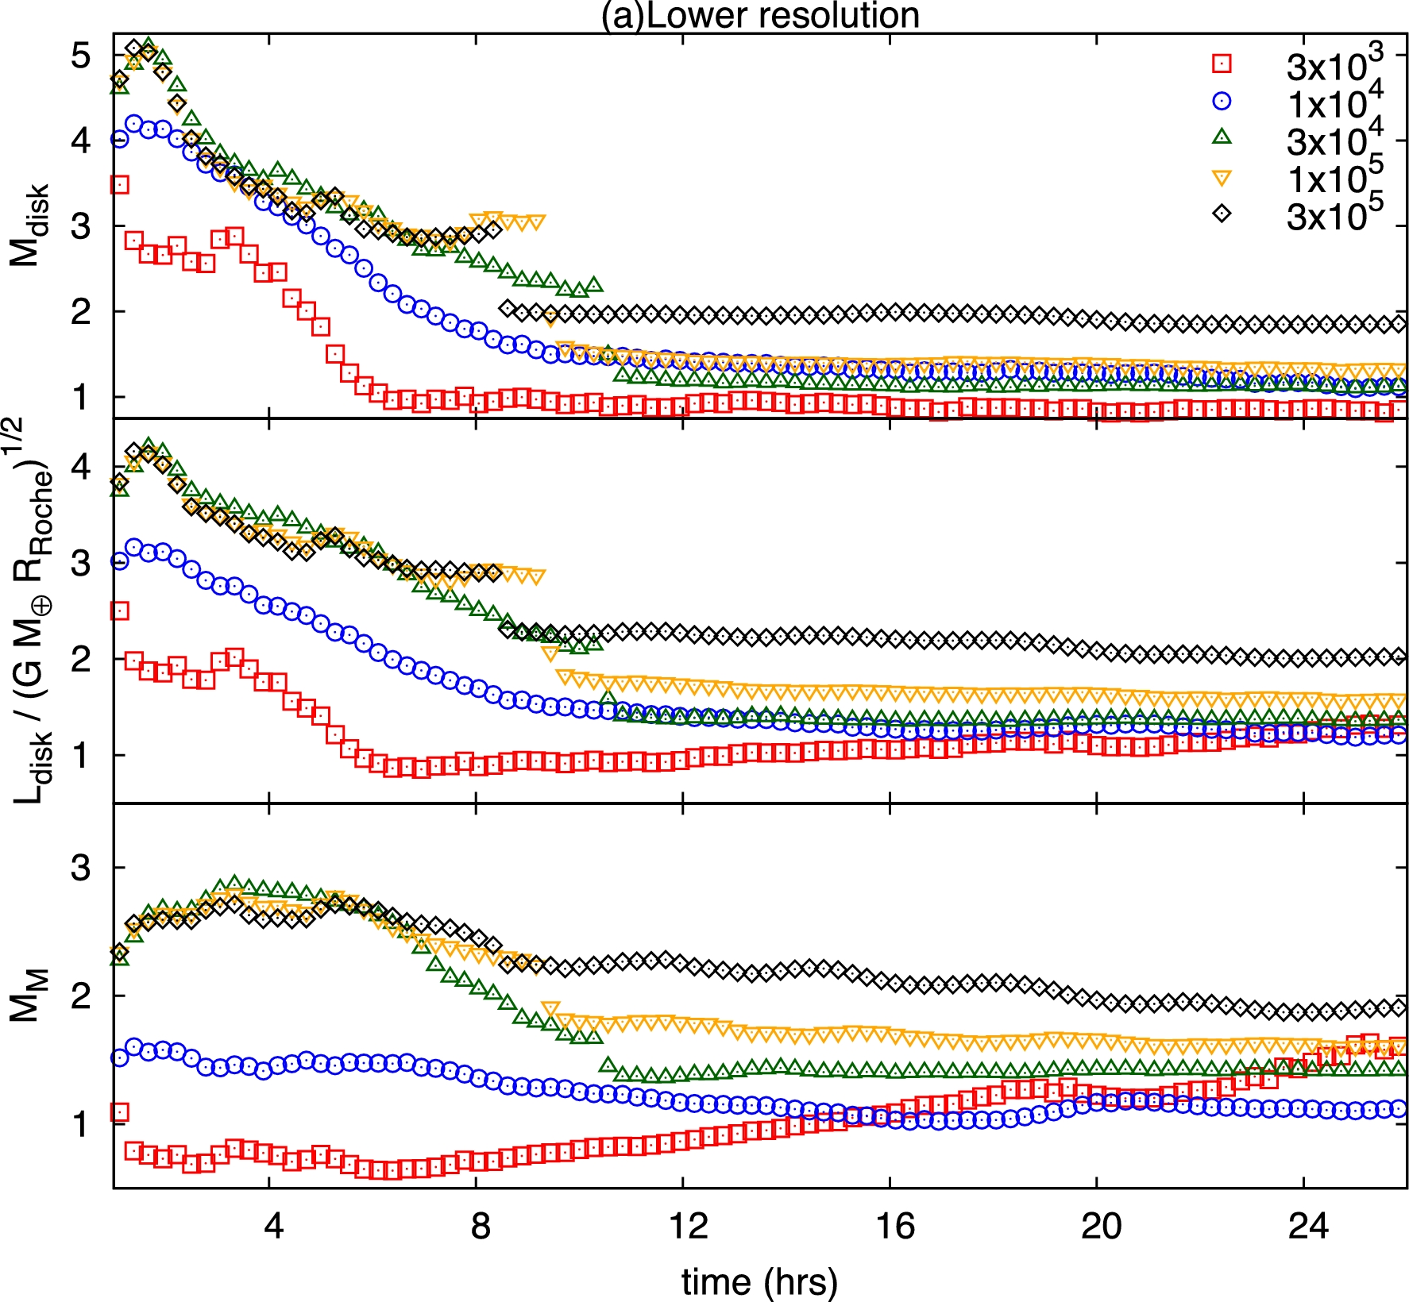
Fig. 2. Time evolutions of M_{disc}, $L_\mathrm{disc} / \sqrt{G M_\oplus R_\mathrm{Roche}}$, and ...
Notes:
Fig. 2. Time evolutions of Mdisc, $L_\mathrm{disc} / \sqrt{G M_\oplus R_\mathrm{Roche}}$, and MM normalised by the current Lunar mass. The meaning of symbols are indicated in the top panel. The number of particles in this part of the figure is 3 × 103 to 3 × 105. (Color online)
Unless provided in the caption above, the following copyright applies to the content of this slide: © The Author 2017. Published by Oxford University Press on behalf of the Astronomical Society of Japan. All rights reserved. For Permissions, please email: journals.permissions@oup.com

Slide 3
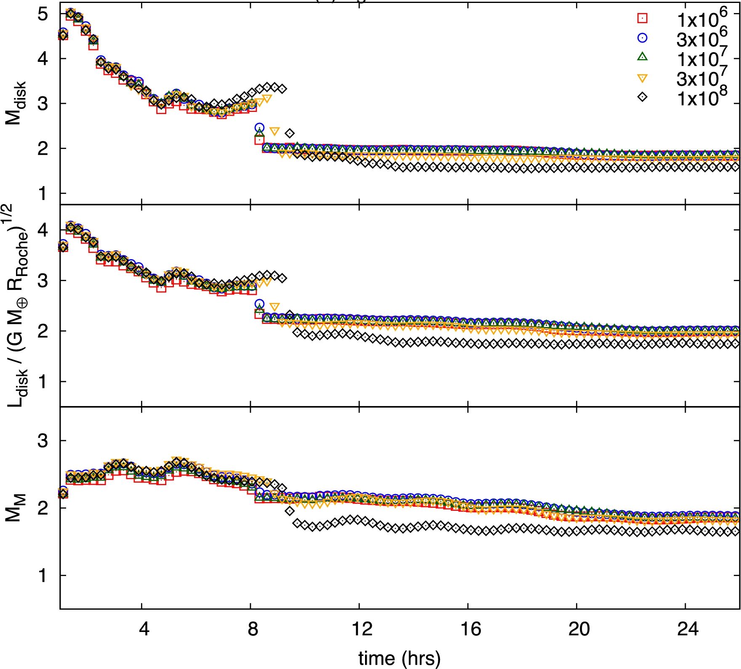
Fig. 2 (Continued) Same as first part of figure 2, but for N = 1 × 10⁶ to N = 1 × 10⁸. (Color ...
Notes:
Fig. 2 (Continued) Same as first part of figure 2, but for N = 1 × 106 to N = 1 × 108. (Color online)
Unless provided in the caption above, the following copyright applies to the content of this slide: © The Author 2017. Published by Oxford University Press on behalf of the Astronomical Society of Japan. All rights reserved. For Permissions, please email: journals.permissions@oup.com

Slide 4
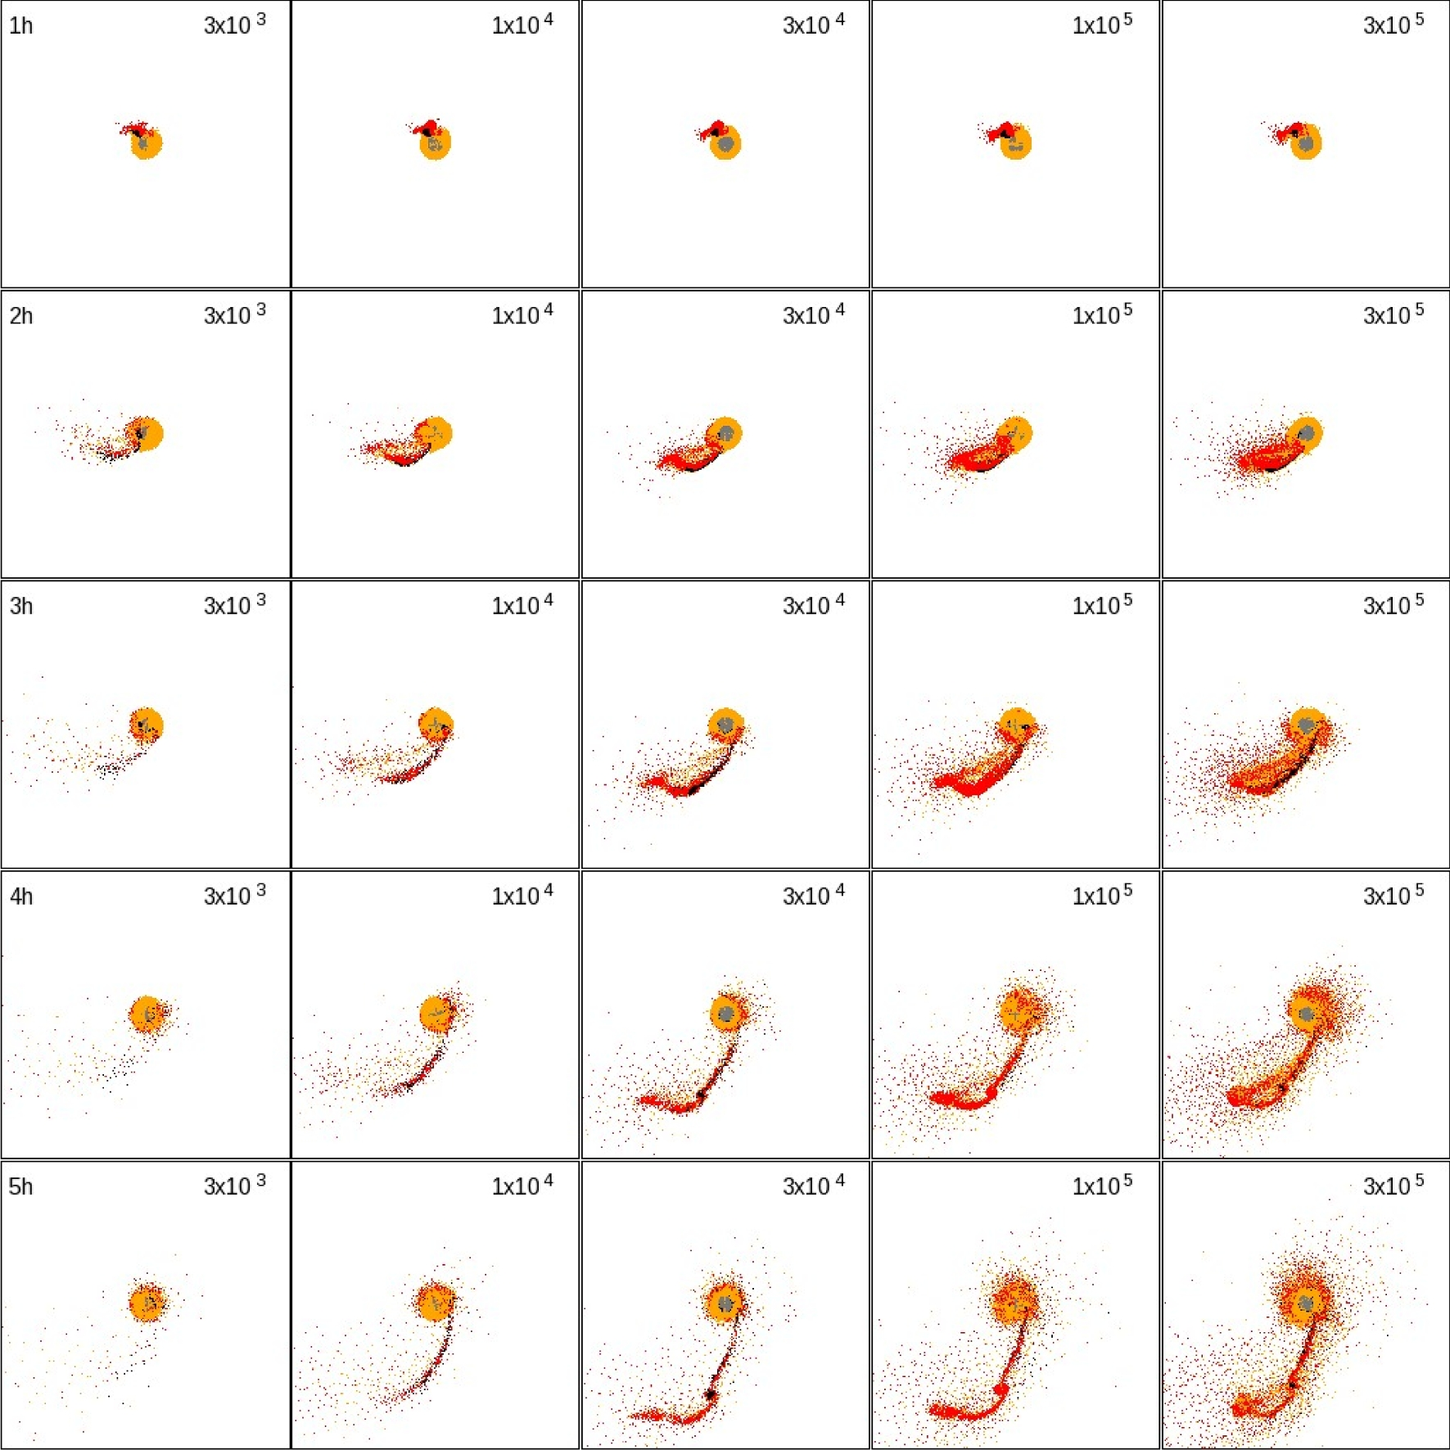
Fig. 3. Snapshots from runs of GI. The snapshot time and number of particles are given in the top left- and ...
Notes:
Fig. 3. Snapshots from runs of GI. The snapshot time and number of particles are given in the top left- and right-hand corners, respectively. Each particle indicates mantle particles of the proto-Earth (orange) and the impactor (red) and core particles of the proto-Earth (grey) and the impactor (black). An animation of this figure is available at 〈https://vimeo.com/194156367〉. (Color online)
Unless provided in the caption above, the following copyright applies to the content of this slide: © The Author 2017. Published by Oxford University Press on behalf of the Astronomical Society of Japan. All rights reserved. For Permissions, please email: journals.permissions@oup.com

Slide 5
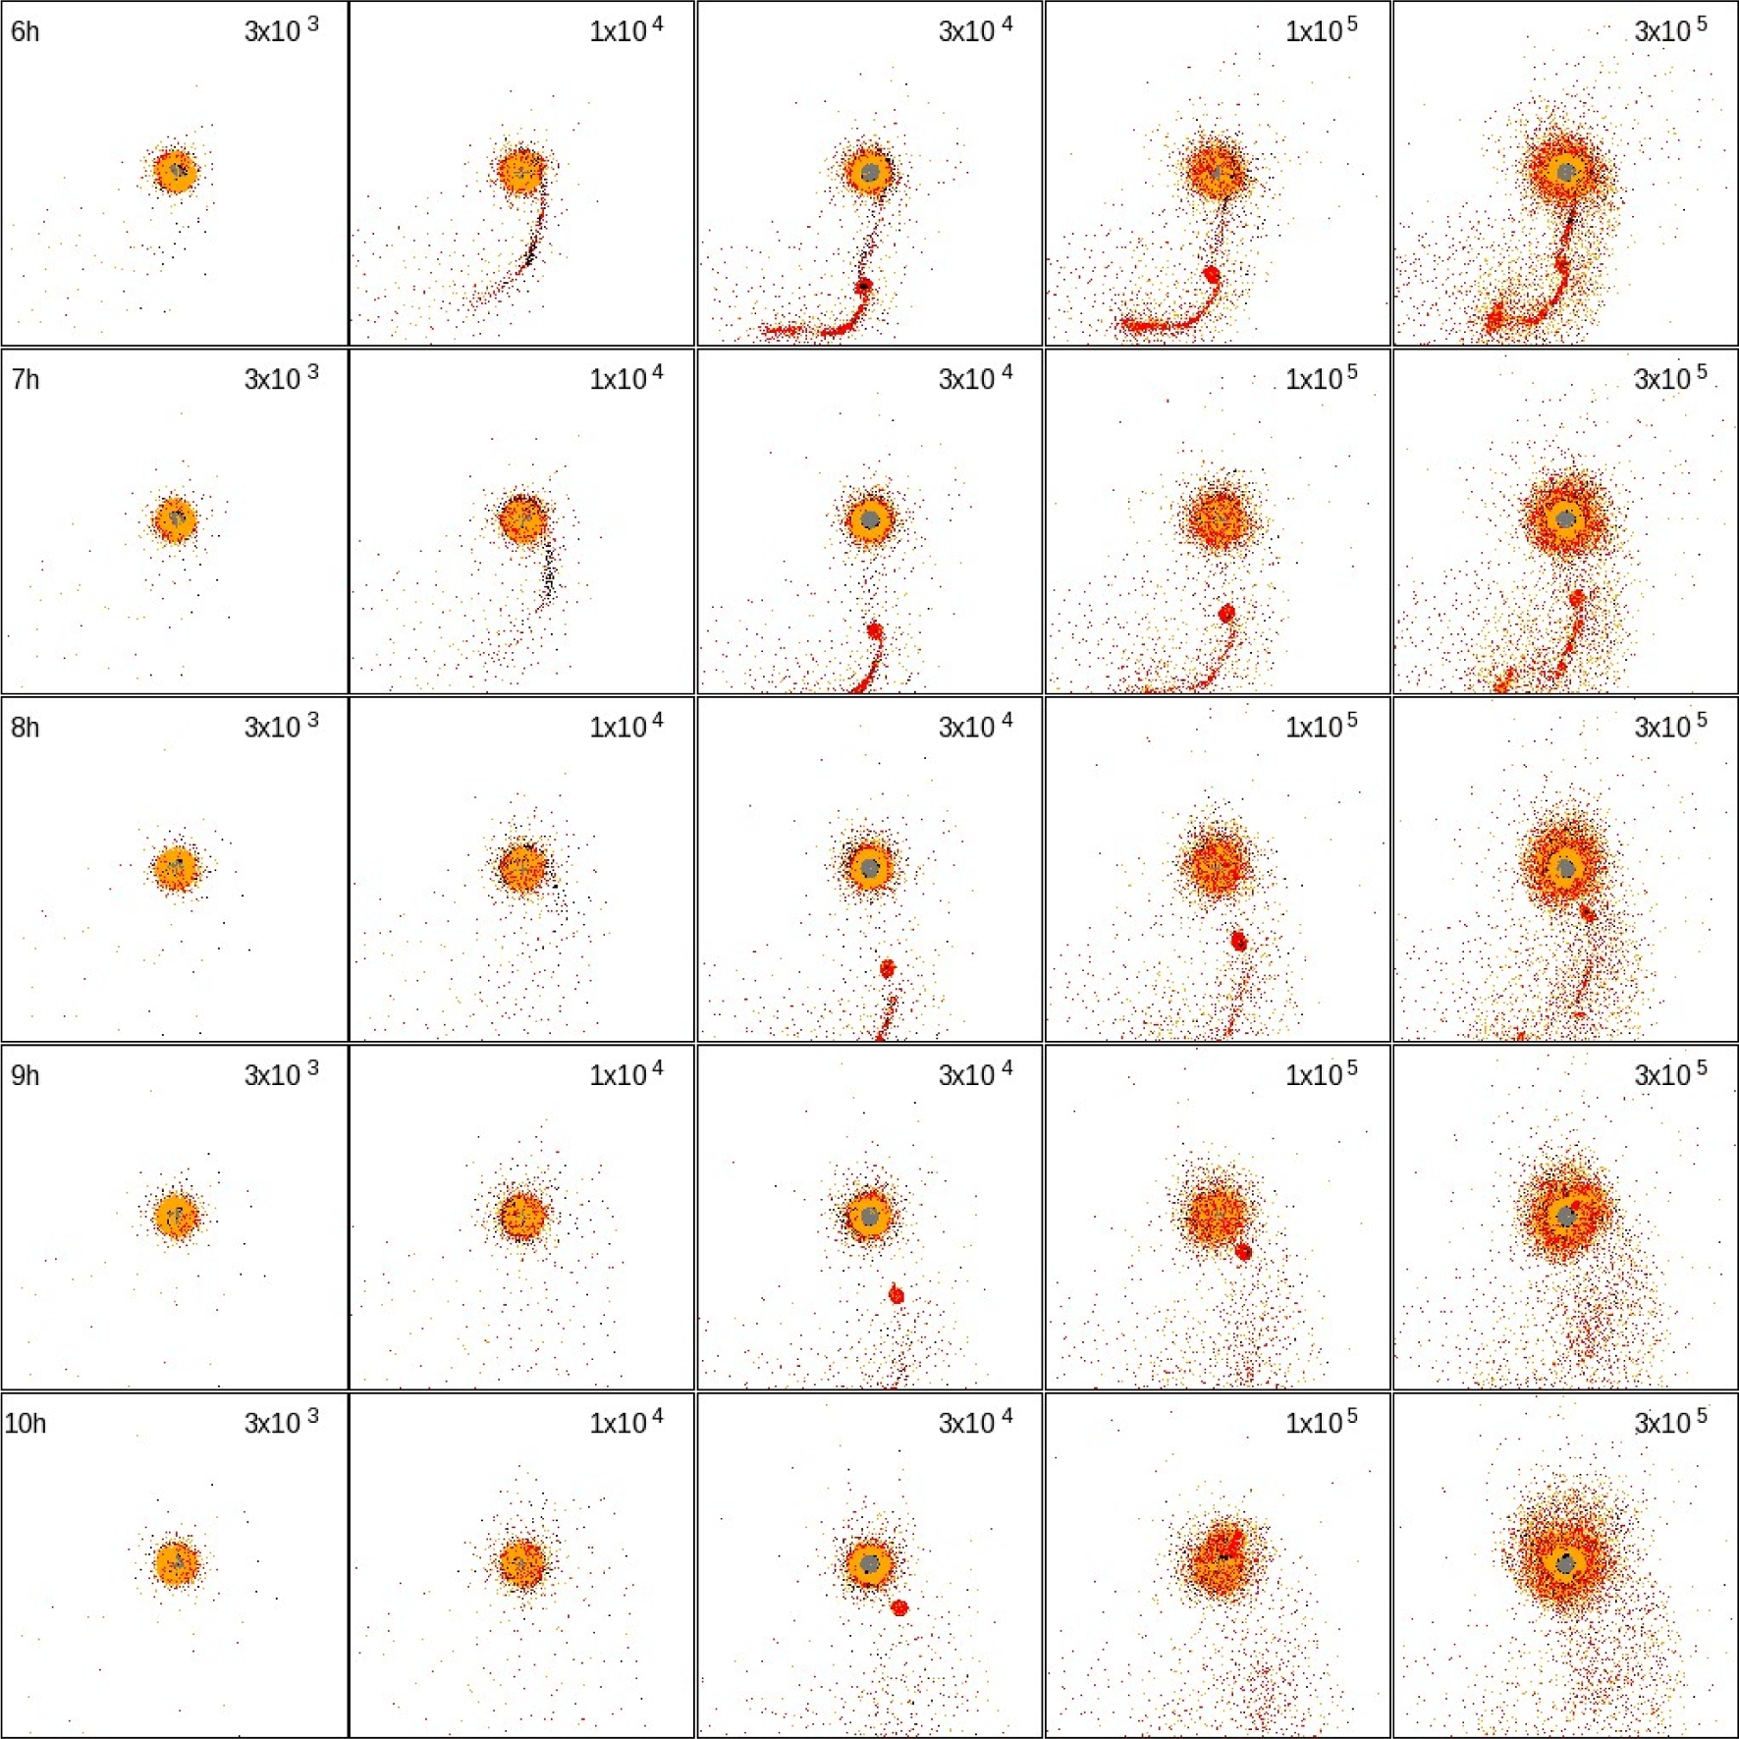
Fig. 3 (Continued) (Color online)
Notes:
Fig. 3 (Continued) (Color online)
Unless provided in the caption above, the following copyright applies to the content of this slide: © The Author 2017. Published by Oxford University Press on behalf of the Astronomical Society of Japan. All rights reserved. For Permissions, please email: journals.permissions@oup.com

Slide 6
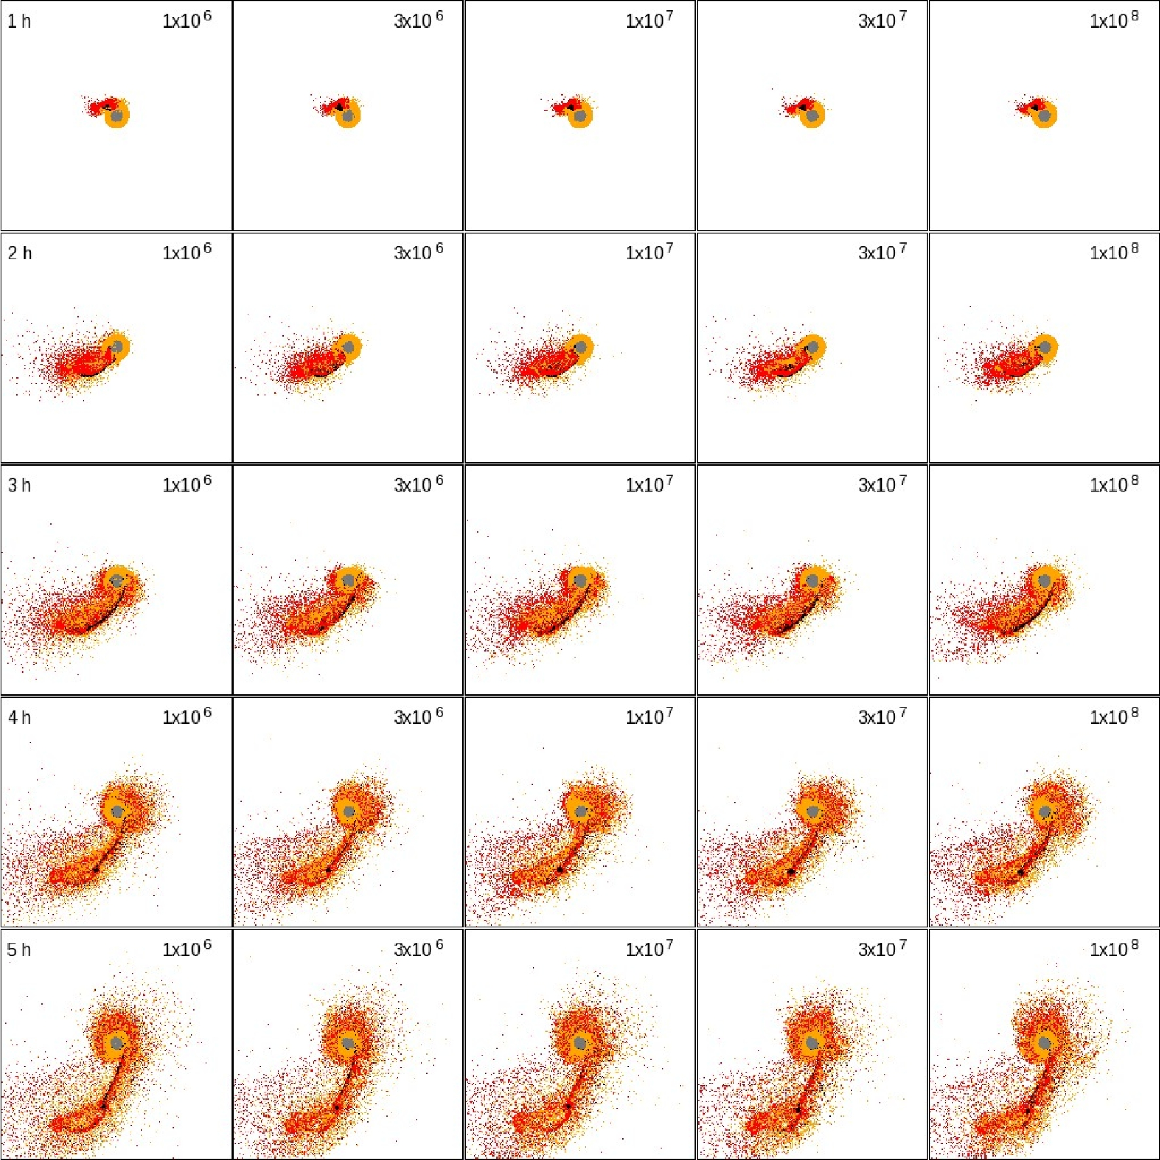
Fig. 4. Same as figure 3, but reduces the number of plotted particles is reduced to 10⁶. Only the results ...
Notes:
Fig. 4. Same as figure 3, but reduces the number of plotted particles is reduced to 106. Only the results of higher-resolution runs are shown. (Color online)
Unless provided in the caption above, the following copyright applies to the content of this slide: © The Author 2017. Published by Oxford University Press on behalf of the Astronomical Society of Japan. All rights reserved. For Permissions, please email: journals.permissions@oup.com

Slide 7
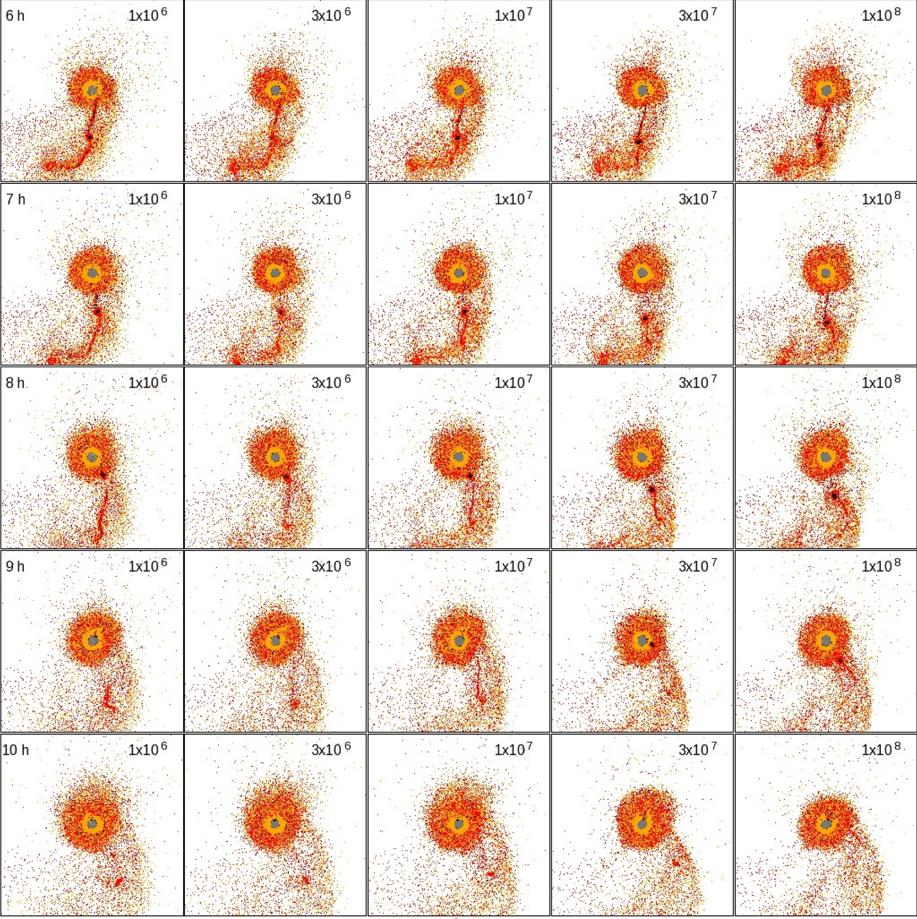
Fig. 4 (Continued) (Color online)
Notes:
Fig. 4 (Continued) (Color online)
Unless provided in the caption above, the following copyright applies to the content of this slide: © The Author 2017. Published by Oxford University Press on behalf of the Astronomical Society of Japan. All rights reserved. For Permissions, please email: journals.permissions@oup.com

Slide 8
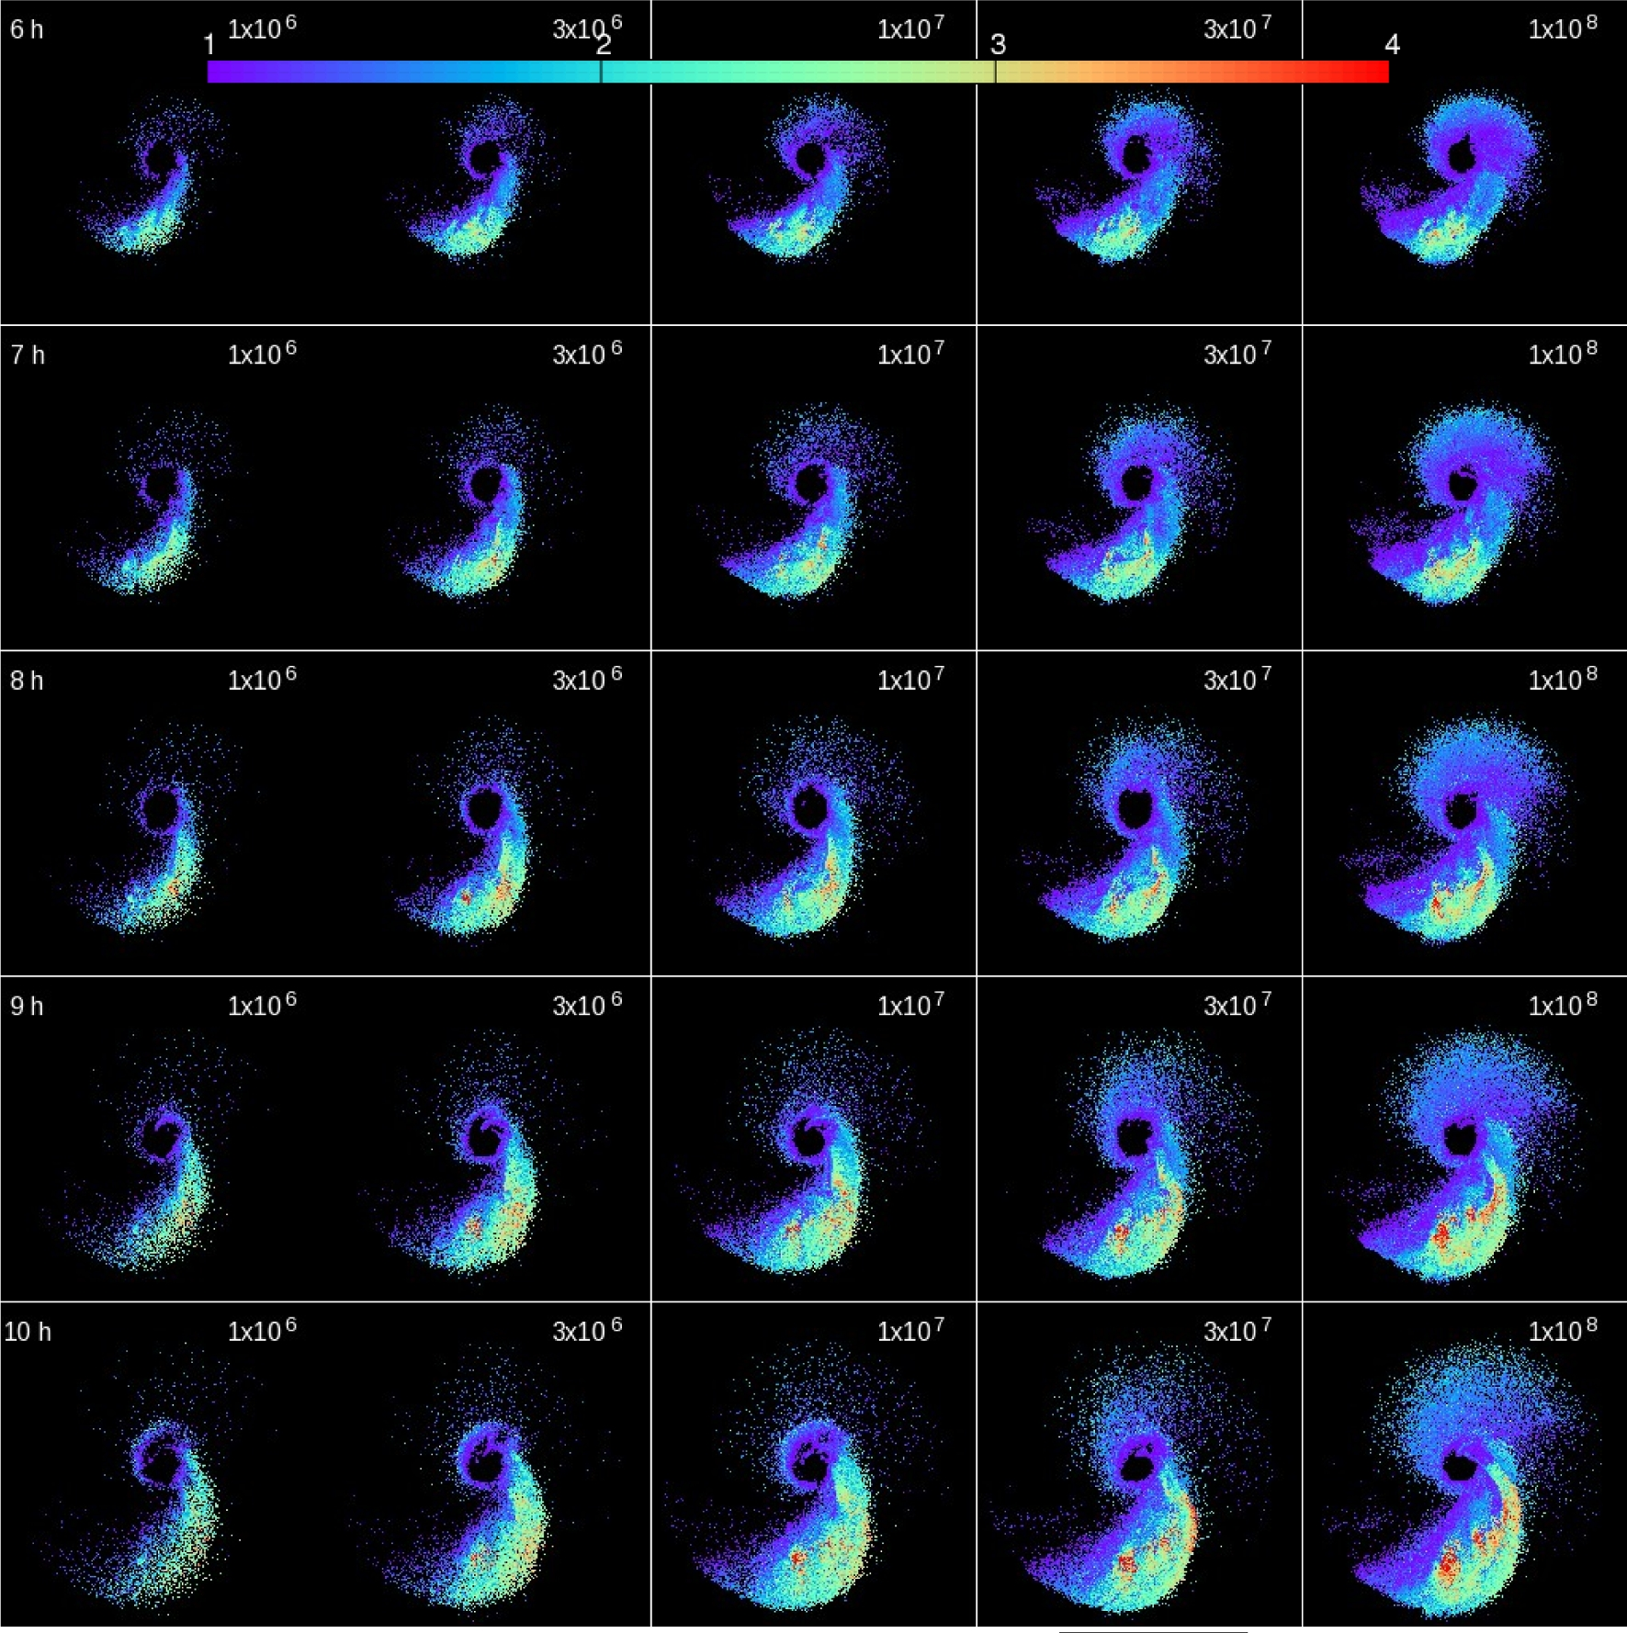
Fig. 5. Same as figure 3, but shows the distributions of specific angular momentum ($L_\mathrm{disc} / \sqrt{G ...
Notes:
Fig. 5. Same as figure 3, but shows the distributions of specific angular momentum ($L_\mathrm{disc} / \sqrt{G M_\oplus R_\mathrm{Roche}}$). Only the particles within [−10, 10] × [−10, 10] are shown. (Color online)
Unless provided in the caption above, the following copyright applies to the content of this slide: © The Author 2017. Published by Oxford University Press on behalf of the Astronomical Society of Japan. All rights reserved. For Permissions, please email: journals.permissions@oup.com

Slide 9
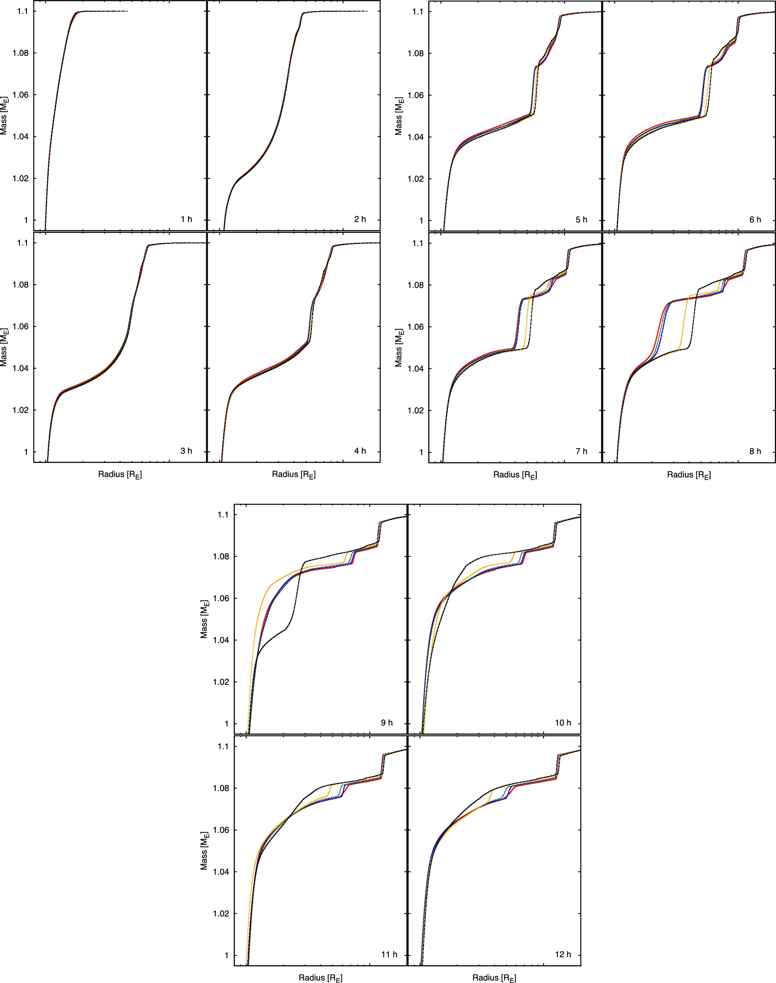
Fig. 6. Radius vs. the cumulative mass from t = 1 to 10 hr with an interval of 1 hr. The horizontal axis is shown in ...
Notes:
Fig. 6. Radius vs. the cumulative mass from t = 1 to 10 hr with an interval of 1 hr. The horizontal axis is shown in log scale. The colours for each curve are the same to those of figure 2. (Color online)
Unless provided in the caption above, the following copyright applies to the content of this slide: © The Author 2017. Published by Oxford University Press on behalf of the Astronomical Society of Japan. All rights reserved. For Permissions, please email: journals.permissions@oup.com

