Slide 1
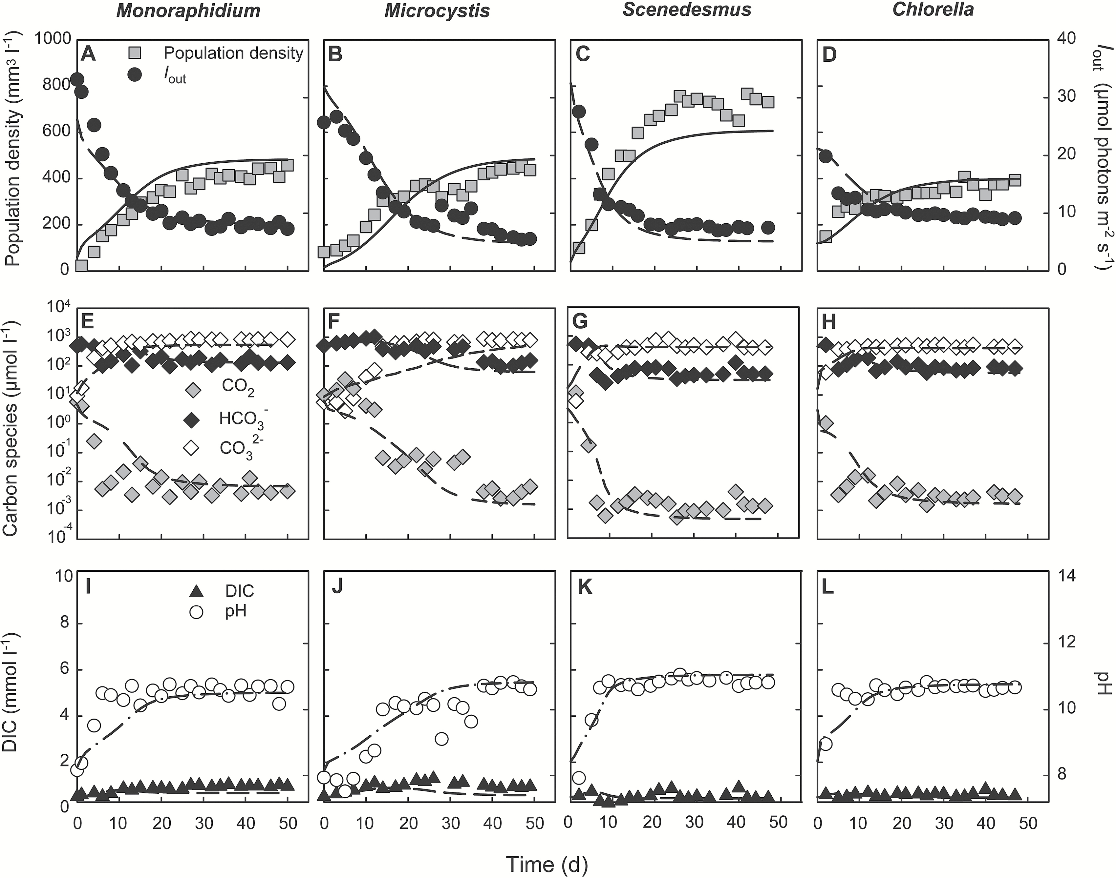
Fig. 1. Monoculture experiments at low pCO₂ (100 ppm). (A–D) Population density (expressed as biovolume) ...
Notes:
Fig. 1. Monoculture experiments at low pCO2 (100 ppm). (A–D) Population density (expressed as biovolume) and light intensity Iout penetrating through the chemostat. (E–H) CO2(aq), bicarbonate and carbonate concentrations. (I–L) Dissolved inorganic carbon (DIC) and pH. Different panels represent different species: (A, E, I) Monoraphidium; (B, F, J) Microcystis; (C, G, K) Scenedesmus; (D, H, L) Chlorella. Symbols indicate experimental data, and lines indicate model fits. Parameter values of the model are provided in Table 1 and Table 2.
Unless provided in the caption above, the following copyright applies to the content of this slide: © The Author 2017. Published by Oxford University Press on behalf of the Society for Experimental Biology.This is an Open Access article distributed under the terms of the Creative Commons Attribution License (http://creativecommons.org/licenses/by/4.0/), which permits unrestricted reuse, distribution, and reproduction in any medium, provided the original work is properly cited.

Slide 2
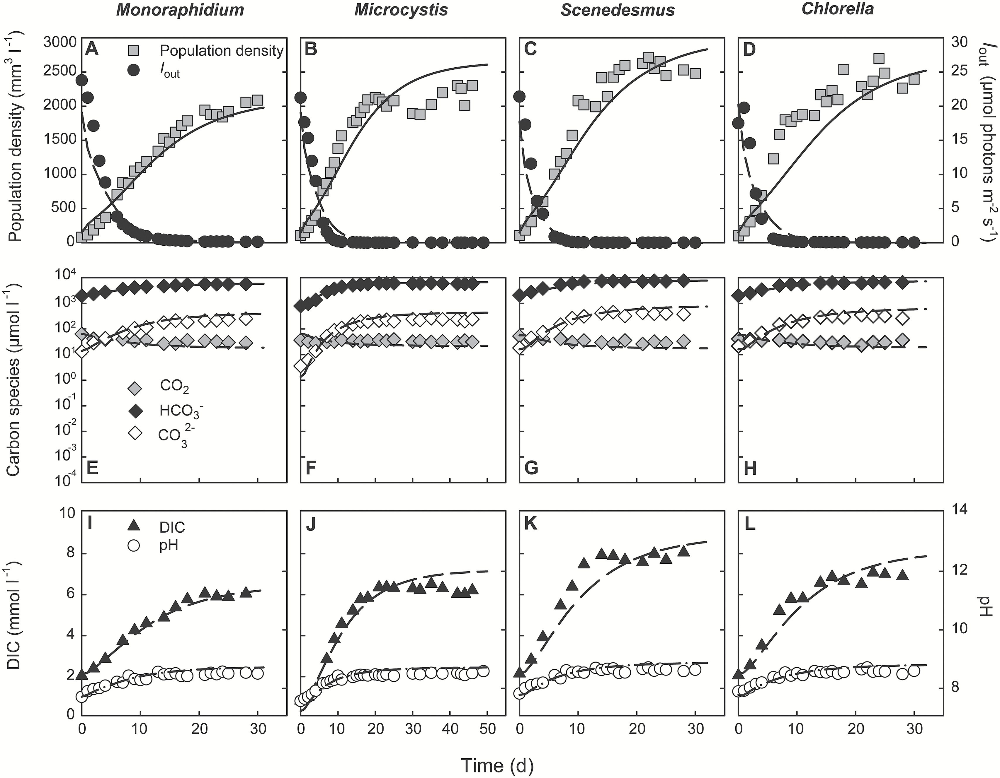
Fig. 2. Monoculture experiments at high pCO₂ (2000 ppm). (A–D) Population density (expressed as biovolume) ...
Notes:
Fig. 2. Monoculture experiments at high pCO2 (2000 ppm). (A–D) Population density (expressed as biovolume) and light intensity Iout penetrating through the chemostat. (E–H) CO2(aq), bicarbonate and carbonate concentrations. (I–L) Dissolved inorganic carbon (DIC) and pH. Different panels represent different species: (A, E, I) Monoraphidium; (B, F, J) Microcystis; (C, G, K) Scenedesmus; (D, H, L) Chlorella. Symbols indicate experimental data, and lines indicate model fits. Parameter values of the model are provided in Table 1 and Table 2.
Unless provided in the caption above, the following copyright applies to the content of this slide: © The Author 2017. Published by Oxford University Press on behalf of the Society for Experimental Biology.This is an Open Access article distributed under the terms of the Creative Commons Attribution License (http://creativecommons.org/licenses/by/4.0/), which permits unrestricted reuse, distribution, and reproduction in any medium, provided the original work is properly cited.

Slide 3
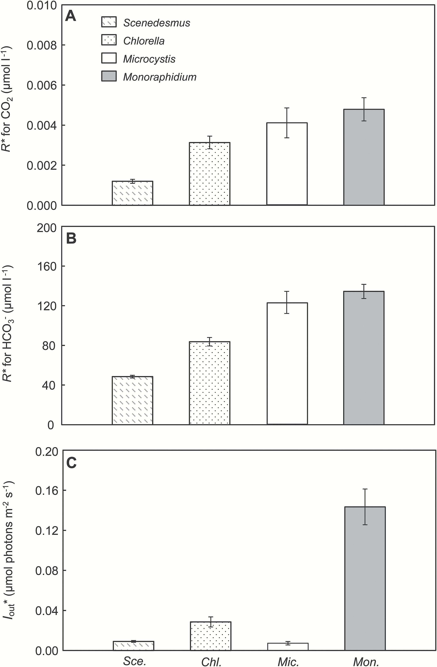
Fig. 3. R* values of the species. (A, B) R* values for CO₂(aq) (A) and bicarbonate (B) of the species, ...
Notes:
Fig. 3. R* values of the species. (A, B) R* values for CO2(aq) (A) and bicarbonate (B) of the species, indicative of their competitive abilities for inorganic carbon. R* values were estimated from the CO2 and bicarbonate concentrations measured in the steady-state monocultures at low pCO2. (C) Critical light intensities (I*out) of the species, indicative of their competitive abilities for light. Critical light intensities were estimated from the light intensities penetrating through the steady-state monocultures at high pCO2. All estimates are based on the mean±SD of the last five data points of each monoculture experiment. Sce, Scenedesmus; Chl, Chlorella; Mic, Microcystis; Mon, Monoraphidium.
Unless provided in the caption above, the following copyright applies to the content of this slide: © The Author 2017. Published by Oxford University Press on behalf of the Society for Experimental Biology.This is an Open Access article distributed under the terms of the Creative Commons Attribution License (http://creativecommons.org/licenses/by/4.0/), which permits unrestricted reuse, distribution, and reproduction in any medium, provided the original work is properly cited.

Slide 4
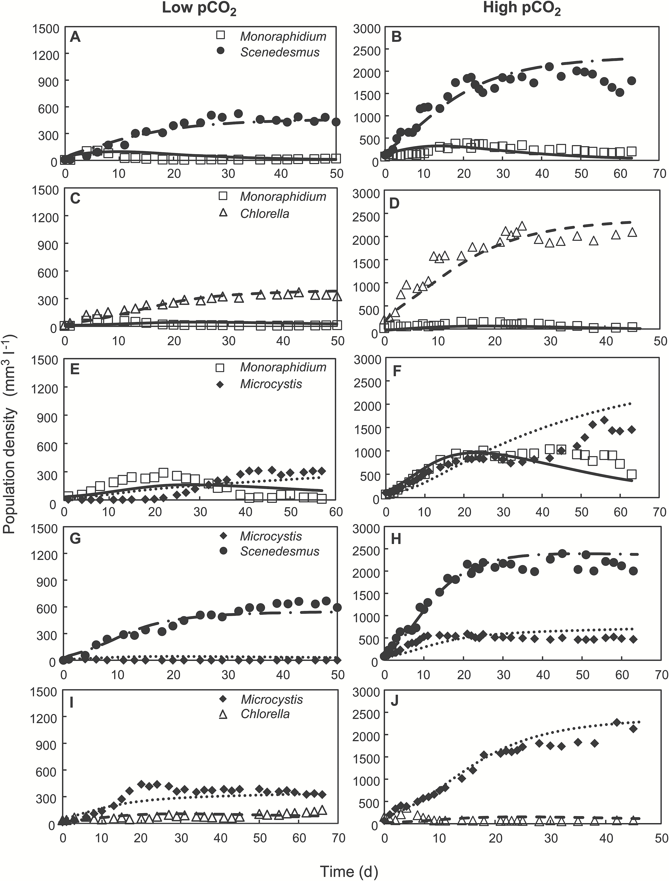
Fig. 4. Competition experiments. The competition experiments were performed at low pCO₂ (100 ppm; left ...
Notes:
Fig. 4. Competition experiments. The competition experiments were performed at low pCO2 (100 ppm; left panels) and high pCO2 (2000 ppm; right panels). (A, B) Competition between Monoraphidium and Scenedesmus. (C, D) Competition between Monoraphidium and Chlorella. (E, F) Competition between Monoraphidium and Microcystis. (G, H) Competition between Microcystis and Scenedesmus. (I, J) Competition between Microcystis and Chlorella. Dynamic changes in light conditions, carbon speciation and pH during the competition experiments are presented in Supplementary Figs S1 and S2. Symbols indicate experimental data, and lines indicate model predictions. Parameter values of the model are provided in Tables 1 and 2.
Unless provided in the caption above, the following copyright applies to the content of this slide: © The Author 2017. Published by Oxford University Press on behalf of the Society for Experimental Biology.This is an Open Access article distributed under the terms of the Creative Commons Attribution License (http://creativecommons.org/licenses/by/4.0/), which permits unrestricted reuse, distribution, and reproduction in any medium, provided the original work is properly cited.

