Slide 1
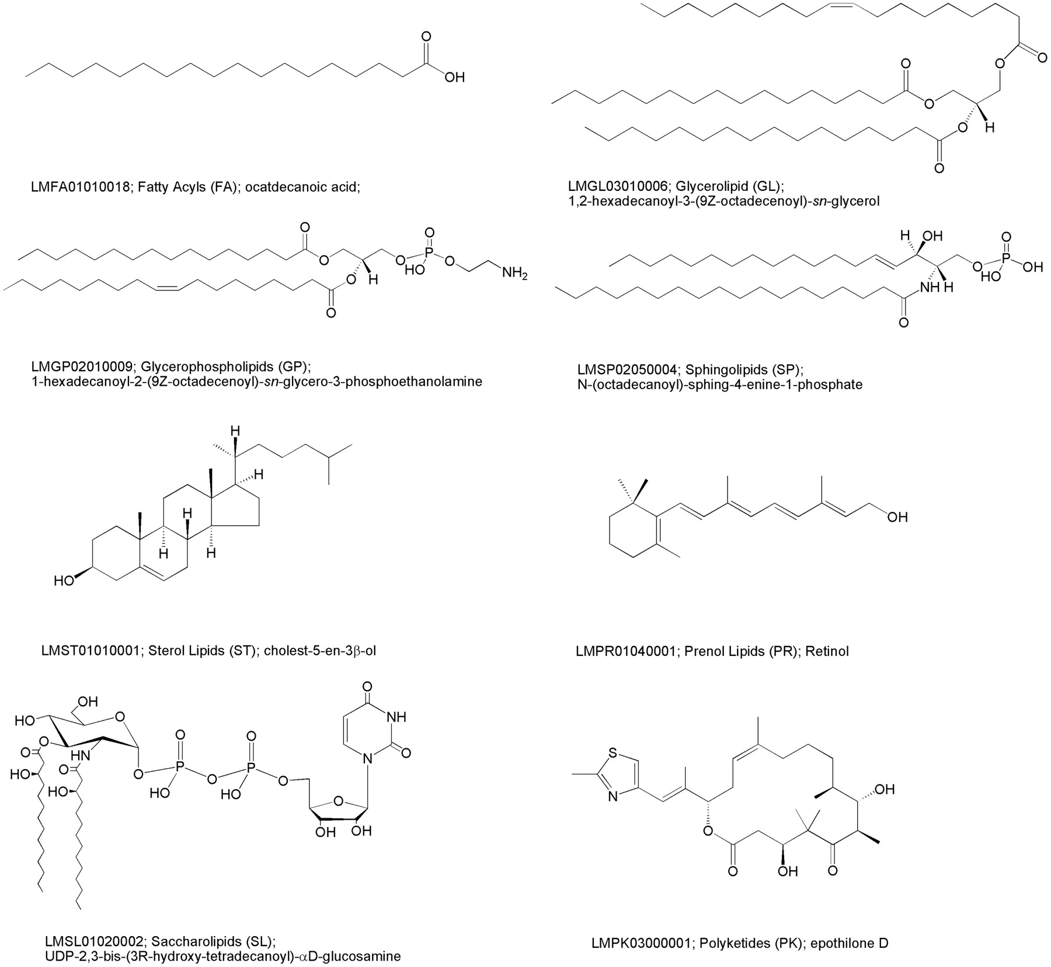
Figure 1 Representative structures for each lipid category along with LM ID, category name, category abbreviation and ...
Notes:
Figure 1 Representative structures for each lipid category along with LM ID, category name, category abbreviation and systematic name.
Unless provided in the caption above, the following copyright applies to the content of this slide: © 2006 The Author(s)This is an Open Access article distributed under the terms of the Creative Commons Attribution Non-Commercial License (http://creativecommons.org/licenses/by-nc/2.0/uk/) which permits unrestricted non-commercial use, distribution, and reproduction in any medium, provided the original work is properly cited.

Slide 2
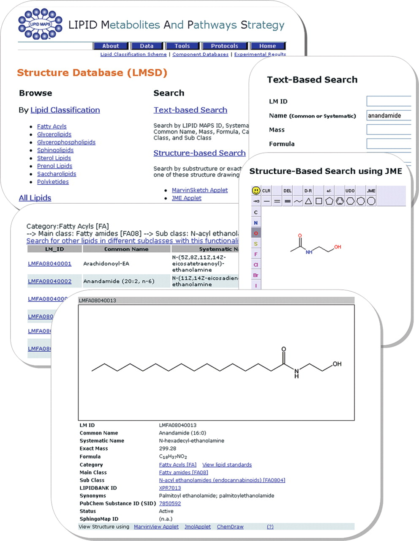
Figure 2 A montage of LMSD screen shots showing different ways to retrieve information for anandamide.
Notes:
Figure 2 A montage of LMSD screen shots showing different ways to retrieve information for anandamide.
Unless provided in the caption above, the following copyright applies to the content of this slide: © 2006 The Author(s)This is an Open Access article distributed under the terms of the Creative Commons Attribution Non-Commercial License (http://creativecommons.org/licenses/by-nc/2.0/uk/) which permits unrestricted non-commercial use, distribution, and reproduction in any medium, provided the original work is properly cited.

