Slide 1
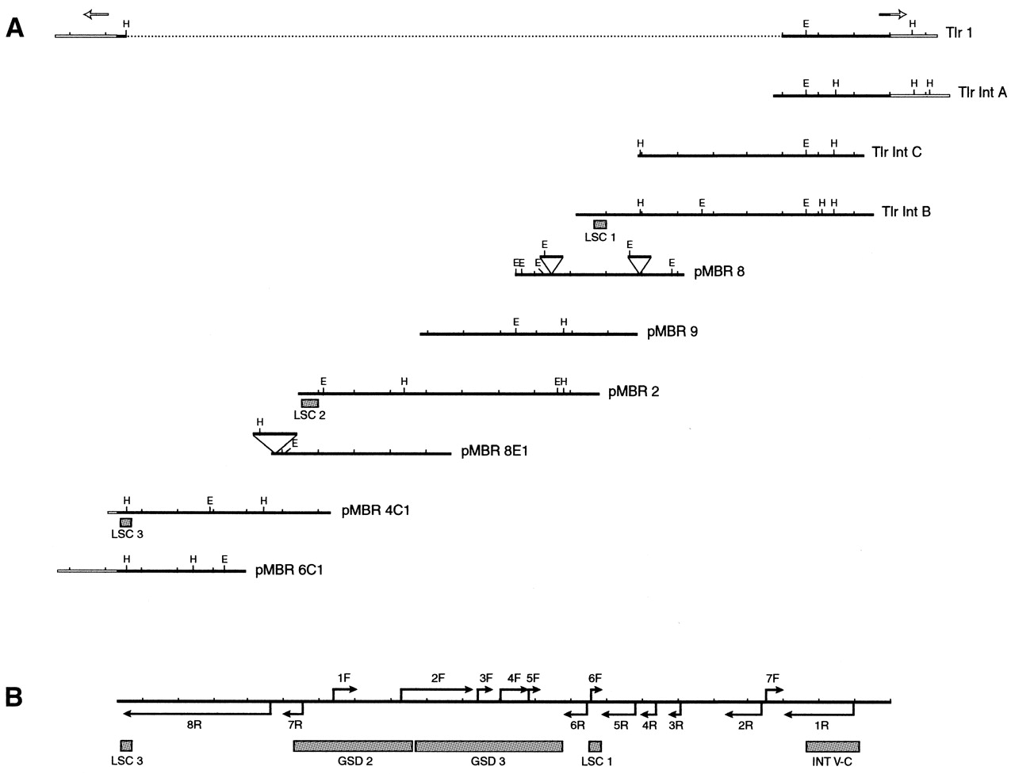
Figure 1. (A) Alignment of Tlr clones obtained from consecutive micronuclear library screens. Solid bars ...
Notes:
Figure 1. (A) Alignment of Tlr clones obtained from consecutive micronuclear library screens. Solid bars indicate sequence within the Tlr internal conserved region. Open bars indicate non-conserved sequence outside the Tlr internal region. Arrows over the Tlr1 element depict the position of its terminal inverted repeat. The dotted line represents uncharacterized Tlr1 sequence. Shaded boxes indicate the locations of probes used in library screens. Apparent insertion elements are depicted as large triangles. The distance between hash marks represents ∼1 kb. HindIII (H) and EcoRV (E) sites are indicated. Clones Tlr1 and Tlr Int A–C were isolated and partially characterized by Gershan and Karrer (32). (B) Composite diagram of the assembled Tlr internal conserved region. Arrows indicate locations and orientations of major ORFs. Shaded boxes represent positions of probes used in Southern blot analyses.
Unless provided in the caption above, the following copyright applies to the content of this slide:

Slide 2
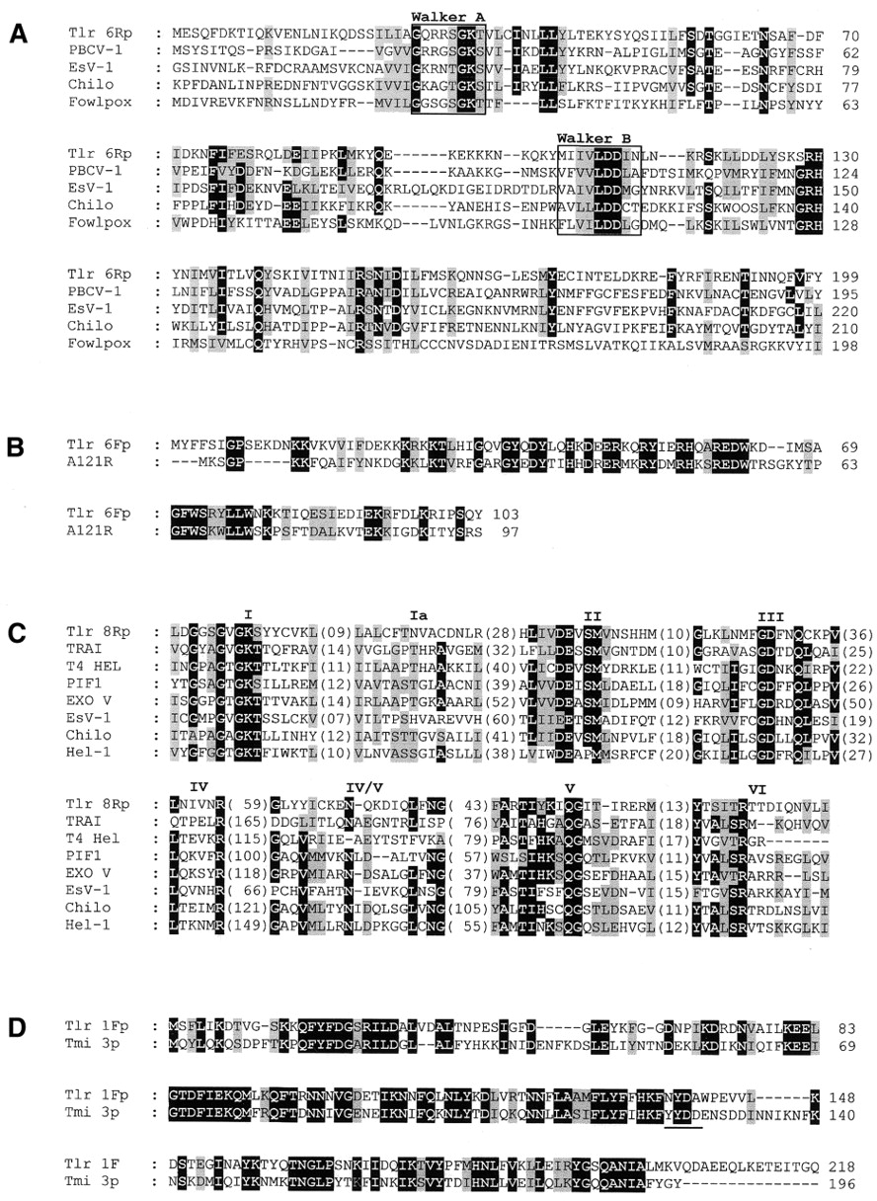
Figure 2. Conceptual amino acid sequences of proteins encoded by selected Tlr ORFs aligned with similar ...
Notes:
Figure 2. Conceptual amino acid sequences of proteins encoded by selected Tlr ORFs aligned with similar proteins from the GenBank peptide database. Amino acids that are identical in >60% of aligned sequences are shaded in black. Similar amino acids are shaded in gray. (A) Alignment of the first 199 amino acids of the Tlr 6Rp consensus sequence with ATPase-like putative proteins from diverse viruses. Walker A and B motifs are boxed. Definitions and accession numbers of compared amino acid sequences are: PBCV-1 A392Rp, NP_048749; EsV-1-26 putative protein, NP_077511; Chilo iridescent virus protein 075L, NP_149538; fowlpox virus FPV197 virion assembly protein, NP_039160. (B) Amino acid sequence of Tlr 6Fp aligned with the putative protein of unknown function encoded by the PBCV-1 A121R gene, accession no. NP_048469. (C) Conserved helicase domains of Tlr 8Rp from pMBR 4C1 and a set of DNA helicases and putative DNA helicases aligned as described by Kapitonov and Jurka (43). Helicase domain designations are indicated above amino acid sequence blocks. Distances between motifs are indicated in parentheses. Definitions and accession numbers of compared amino acid sequences are: TRAI DNA helicase I from the F plasmid of E.coli, P14565; enterobacteria dsDNA phage T4 DNA helicase (T4 Hel), P32270; PIF1 DNA helicase from Saccharomyces cerevisiae, P07271; α-subunit of exonuclease V from E.coli (EXO V), P04993; EsV-1-29 putative helicase, NP_077514; Chilo iridescent virus 030L putative helicase, AAD48149; Hel-1 putative helicase from Helitron1 of Arabidopsis thaliana (43). (D) The first 218 amino acids of the Tlr 1Fp consensus sequence aligned with Tmi 3p, accession no. CAA42575. The YXDD motif from Tmi 3p is underlined.
Unless provided in the caption above, the following copyright applies to the content of this slide:

Slide 3
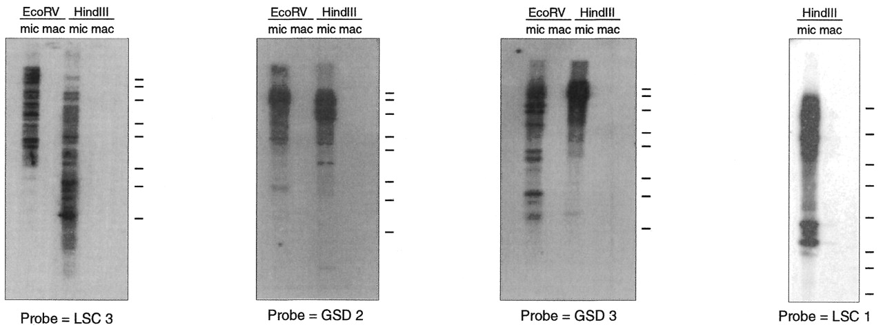
Figure 3. Southern blots of micronuclear (mic) and macronuclear (mac) DNA digested with EcoRV or HindIII and ...
Notes:
Figure 3. Southern blots of micronuclear (mic) and macronuclear (mac) DNA digested with EcoRV or HindIII and probed with fragments from within the Tlr internal conserved region (Fig. 1B). Bars to the right of each blot indicate mobilities of the 10, 8.0, 6.0, 4.0, 3.0, 2.0, 1.5 and 1.0 kb DNA fragments of the HiLo marker (Minnesota Molecular, Bloomington, MN), run as molecular weight standards.
Unless provided in the caption above, the following copyright applies to the content of this slide:

Slide 4
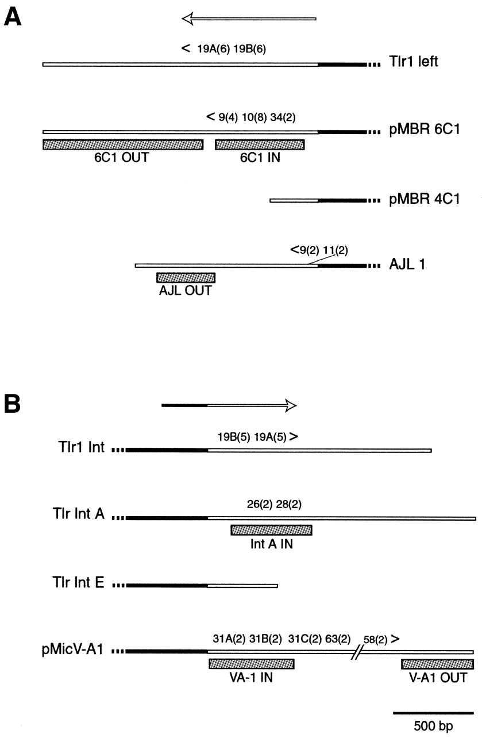
Figure 4. Left (A) and right (B) terminal regions of Tlr elements. Solid bars indicate sequence within the ...
Notes:
Figure 4. Left (A) and right (B) terminal regions of Tlr elements. Solid bars indicate sequence within the Tlr internal conserved region. Open bars indicate sequence outside the Tlr internal conserved region. Broken bars indicate continuation of cloned sequence beyond the diagram. Overhead arrows depict the positions of the Tlr1 terminal inverted repeat. Approximate locations of sub-terminal direct repeats are indicated above clones. Numbers outside parentheses indicate repeat unit length. Where an individual clone contains different repeats of the same length, letters are used to differentiate sequences. Numbers inside parentheses indicate the number of iterations. Greater than and less than symbols indicate location and orientation of conserved terminal 47mers. The break in pMicV-A1 indicates ∼1 kb of cloned sequence not diagrammed. Shaded boxes indicate positions of probes used in Southern blot analyses. Clone Tlr Int E was isolated and partially characterized by Gershan and Karrer (32).
Unless provided in the caption above, the following copyright applies to the content of this slide:

Slide 5
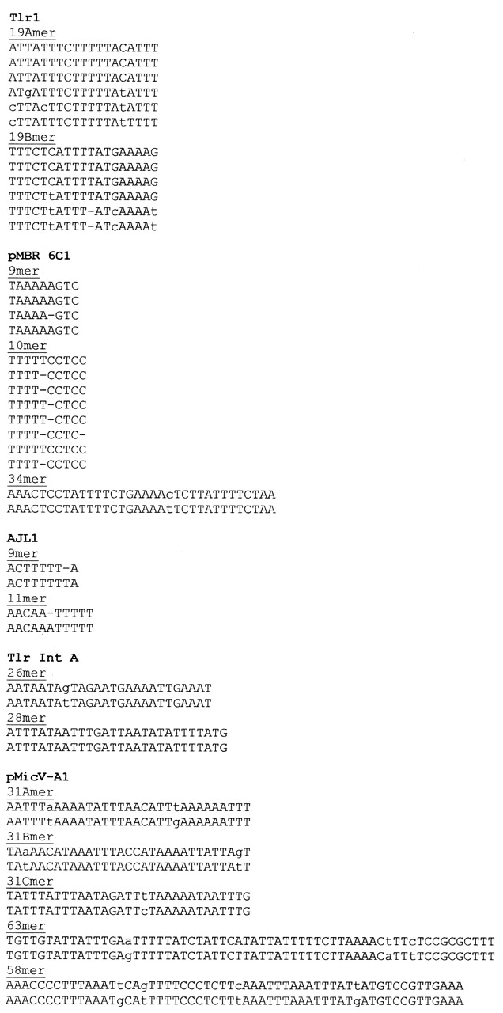
Figure 5. Nucleotide sequence of direct repeats located within cloned DNA outside the Tlr internal conserved ...
Notes:
Figure 5. Nucleotide sequence of direct repeats located within cloned DNA outside the Tlr internal conserved region. Nucleotides that do not match the consensus are shown in lower case.
Unless provided in the caption above, the following copyright applies to the content of this slide:

Slide 6
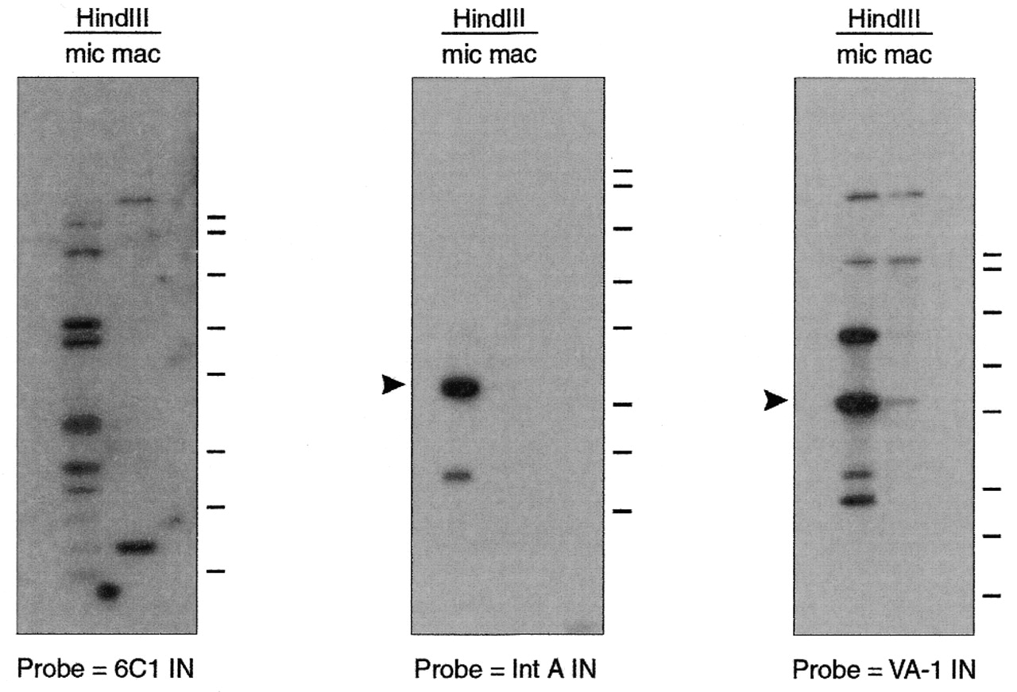
Figure 6. Southern blots of micronuclear (mic) and macronuclear (mac) DNA digested with HindIII and probed ...
Notes:
Figure 6. Southern blots of micronuclear (mic) and macronuclear (mac) DNA digested with HindIII and probed with fragments from direct repeat regions of cloned Tlr elements (Fig. 4A and B). Arrowheads indicate sizes of expected HindIII fragments based on restriction maps of cloned sequences. The ∼3.1 kb minor band in macronuclear DNA that co-migrates with an intensely hybridizing fragment in the micronuclear DNA on the blot probed with VA-1 IN is likely a result of contamination of macronuclear DNA preparations with micronuclear DNA. Bars to the right of each blot indicate mobilities of the 10, 8.0, 6.0, 4.0, 3.0, 2.0, 1.5 and 1.0 kb DNA fragments of the HiLo marker.
Unless provided in the caption above, the following copyright applies to the content of this slide:

Slide 7
Figure 7. Nucleotide sequences of conserved terminal 47mers from cloned Tlr elements. R or L in parentheses ...
Notes:
Figure 7. Nucleotide sequences of conserved terminal 47mers from cloned Tlr elements. R or L in parentheses indicates whether a sequence is associated with the right or left end of its respective element. All right-end sequences are inverted to facilitate alignment with left-end sequences. Nucleotides represented by lower case letters indicate deviation from consensus.
Unless provided in the caption above, the following copyright applies to the content of this slide:

Slide 8
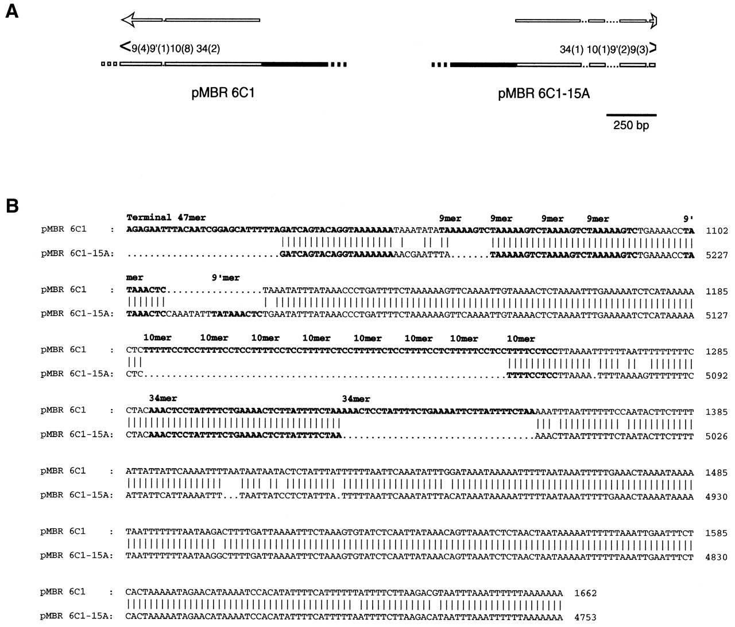
Figure 8. (A) Diagram of the sub-terminal regions of left-end clone pMBR 6C1 and right-end clone pMBR ...
Notes:
Figure 8. (A) Diagram of the sub-terminal regions of left-end clone pMBR 6C1 and right-end clone pMBR 6C1-15A. Solid bars indicate sequence within the Tlr internal conserved region. Open bars indicate sequence outside the Tlr internal conserved region. Overhead arrows depict the positions of the proposed 6C1 terminal inverted repeats. Dotted lines represent gap regions. Broken bars indicate continuation of cloned sequence beyond the diagram. Approximate locations of sub-terminal direct repeats are indicated above the clones. Numbers outside parentheses indicate repeat unit lengths and numbers inside parentheses indicate iterations. Greater than and less than symbols indicate location and orientation of conserved terminal 47mers. The cloned sequence of pMBR 6C1-15A ends within its terminal 47mer, indicated by a truncated arrowhead. (B) Gapped nucleotide alignment of the proposed terminal inverted repeat regions from pMBR 6C1 and pMBR 6C1-15A. pMBR 6C1-15A sequence is inverted to facilitate alignment. Terminal 47mer and 9mer, 10mer and 34mer are indicated in bold.
Unless provided in the caption above, the following copyright applies to the content of this slide:

Slide 9
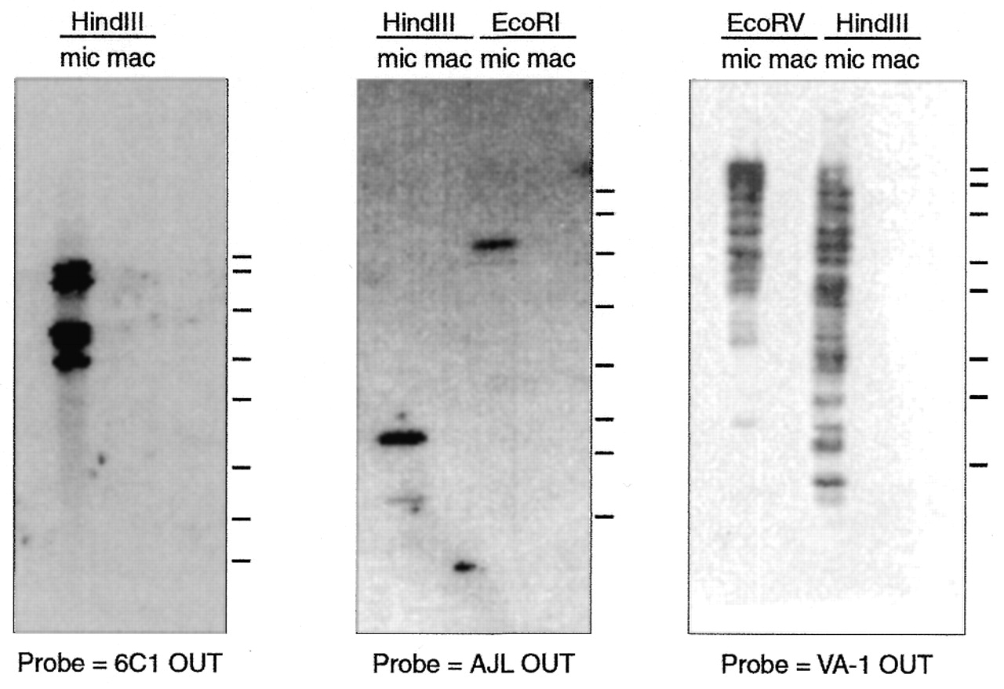
Figure 9. Southern blots of micronuclear (mic) and macronuclear (mac) DNA digested with HindIII, EcoRI or ...
Notes:
Figure 9. Southern blots of micronuclear (mic) and macronuclear (mac) DNA digested with HindIII, EcoRI or EcoRV and probed with DNA fragments from flanking regions of cloned Tlr elements (Fig. 4A and B). Bars to the right of each blot indicate the mobilities of the 10, 8.0, 6.0, 4.0, 3.0, 2.0, 1.5 and 1.0 kb DNA fragments of the HiLo marker.
Unless provided in the caption above, the following copyright applies to the content of this slide:

