Slide 1
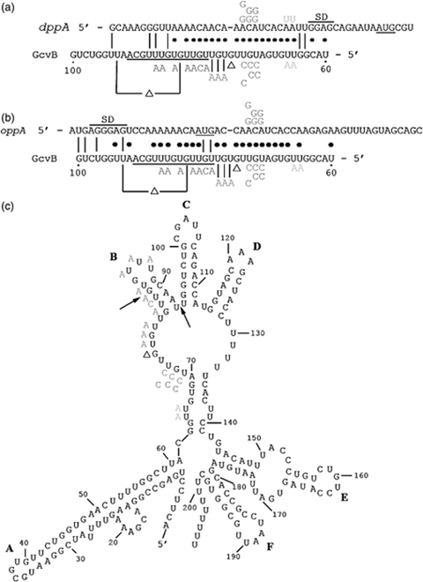
1 Comparison of GcvB between +60 and +100 nt with the dppA (a) and oppA (b) mRNAs. The AUG translation ...
Notes:
1 Comparison of GcvB between +60 and +100 nt with the dppA (a) and oppA (b) mRNAs. The AUG translation initiation sites for dppA and oppA mRNAs are underlined and potential Shine–Dalgarno sequences are overlined and labeled SD (Igarashi et al., 1997; Sharma et al., 2007). A 13-base region of GcvB from +79 to +91 nt (Con) conserved in GcvB homologs from the genera Escherichia, Salmonella, Yersinia, Haemophilus, Vibrio, Pasteurella, Shigella, Klebsiella, and Photorhabdus is underlined (see Fig. 3). Regions of complementarity are indicated with dots between the sequences. GU base pairs are indicated by a line. Changes made to GcvB are indicated below the sequence. A 1 and an 11 bp deletion are indicated with Δs. A 7 bp substitution in the Con region is shown in brown. The –AAA– mutation made to GcvB, GcvB+76AAA, is shown in pink, the –CCC– mutation, GcvB+71CCC, is shown in red, the –CC– mutation, GcvB+71CC, is shown in blue, the –C– mutation, GcvB+73C, is shown in purple, and the –AA– mutation, GcvB+65AA, is shown in green. Mutations made in dppA-lacZ and oppA-phoA that restore complementarity to the GcvB mutations are shown above the sequences and are color coded to correspond with the mutations made in GcvB. The –A– nucleotide of the translation initiation codon in dppA and oppA mRNAs is designated +1. Mutations upstream of the translation initiation sites are defined using negative numbers and mutations downstream are defined with positive numbers. (c) Proposed secondary structure of Escherichia coli GcvB using m-fold (Zuker, 2003). The nucleotides changed in GcvB are shown to the left of the WT GcvB secondary structure in the respective colors designated in (a) and (b). The single nucleotide deletion is designated by Δ. The bases between the arrows designate the nucleotides deleted by the 11 bp deletion. Conserved predicted stem-loop structures among E. coli, Shigella dysenteriae, Salmonella typhimurium, Yersinia pestis, Haemophilus influenzae, and Vibrio cholerae are designated by letters A–F.
Unless provided in the caption above, the following copyright applies to the content of this slide: © 2008 Federation of European Microbiological Societies. Published by Blackwell Publishing Ltd. All rights reserved

Slide 2
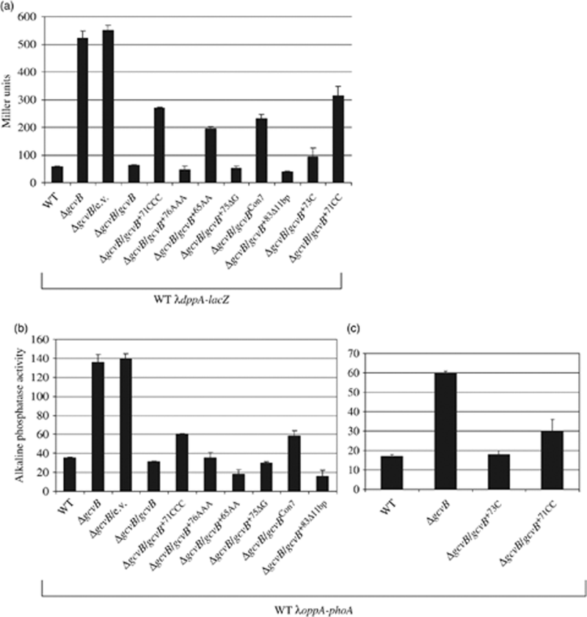
2 β-Galactosidase (a) or alkaline phosphatase (b and c) levels of λdppA-lacZ or λoppA-phoA from WT, ΔgcvB, or ...
Notes:
2 β-Galactosidase (a) or alkaline phosphatase (b and c) levels of λdppA-lacZ or λoppA-phoA from WT, ΔgcvB, or the ΔgcvB strain transformed with the single copy empty vector (e.v.) or a single copy plasmid carrying either the WT gcvB or a mutated gcvB allele. The respective gcvB allele in the ΔgcvB background strain is designated below the bar graph after the slash mark. The lysogens and transformants were grown in LB or LB+ampicillin to an OD600 nmc. 0.5 and assayed for either β-galactosidase activity (Miller, 1972) (a) or alkaline phosphatase activity (Brickman & Beckwith, 1975) (b and c). Results are the averages of two or more assays, with each assay performed in triplicate.
Unless provided in the caption above, the following copyright applies to the content of this slide: © 2008 Federation of European Microbiological Societies. Published by Blackwell Publishing Ltd. All rights reserved

Slide 3
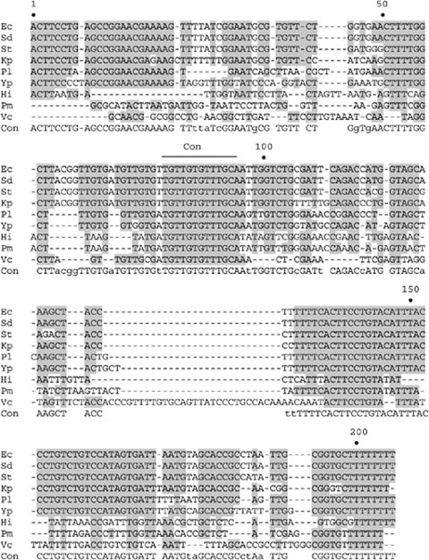
3 Comparison of the Escherichia coli gcvB sequence with homologs from other organisms. Regions of high ...
Notes:
3 Comparison of the Escherichia coli gcvB sequence with homologs from other organisms. Regions of high consensus are boxed in gray. The consensus is shown below the sequence with high consensus bases in capital letters. One 13 bp region conserved in these homologs is overlined and designated Con. Numbering is based on the E. coli sequence. The region of complementarity between GcvB and the target mRNAs dppA and oppA occurs between +60 and +100 nt in GcvB. Ec, E. coli; Sd, Shigella dysenteriae; St, Salmonella typhimurium; Kp, Klebsiella pneumoniae; Pl, Photorhabdus luminescens; Yp, Yersinia pestis; Hi, Haemophilus influenzae; Pm, Pasteurella multocida; Vc, Vibrio cholerae; Con, conserved sequence.
Unless provided in the caption above, the following copyright applies to the content of this slide: © 2008 Federation of European Microbiological Societies. Published by Blackwell Publishing Ltd. All rights reserved

Slide 4
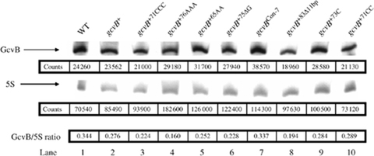
4 Northern blot analysis of GcvB expressed from plasmids carrying either a WT or a mutant gcvB allele. Total ...
Notes:
4 Northern blot analysis of GcvB expressed from plasmids carrying either a WT or a mutant gcvB allele. Total cell RNA was isolated from each strain, run on an 8 M urea–8% polyacrylamide gel, and probed with either a digoxigenin-labeled GcvB or a 5S-specific DNA probe. Total RNA extracts are as follows: lane 1, WT (GS162); lane 2, gcvB+ (GS1144 pGS594); lane 3, gcvB+71CCC (GS1144 pGS596); lane 4, gcvB+76AAA (GS1144 pGS602); lane 5, gcvB+65AA (GS1144 pGS605); lane 6, gcvB+75ΔG (GS1144 pGS597); lane 7, gcvBCon–7 (GS1144 pGS595); lane 8, gcvB+83Δ11 bp (GS1144 pGS603); lane 9, gcvB+73C (GS1144 pGS618); lane 10, gcvB+71CC (GS1144 pGS619). RNA was quantified using image gauge 3.12 software, and the counts determined for each sample are shown below each lane. The bottom row shows the ratio of GcvB RNA compared with the 5S RNA gene for each sample. The ratio observed for lane 1 (WT GcvB expressed in WT cells) was considered to be the WT amount of GcvB expressed in LB.
Unless provided in the caption above, the following copyright applies to the content of this slide: © 2008 Federation of European Microbiological Societies. Published by Blackwell Publishing Ltd. All rights reserved

Slide 5
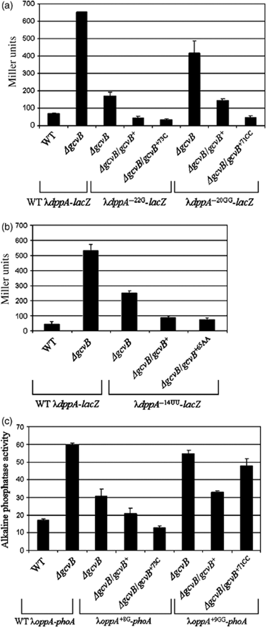
5 β-Galactosidase levels of WT λdppA-lacZ, λdppA^{−22G}-lacZ, or λdppA^{−20GG}-lacZ (a) or ...
Notes:
5 β-Galactosidase levels of WT λdppA-lacZ, λdppA−22G-lacZ, or λdppA−20GG-lacZ (a) or alkaline phosphatase activity of WT λoppA-phoA, λoppA+8G-phoA, or λoppA+9GG-phoA (c) from either WT, ΔgcvB, or the ΔgcvB strain transformed with WT gcvB or the mutant gcvB+73C or gcvB+71CC alleles. β-Galactosidase levels of either λdppA-lacZ or λdppA−14UU-lacZ (b) from WT, ΔgcvB, or the ΔgcvB strain transformed either WT gcvB or the mutant gcvB+65AA allele. The fusion assayed in each strain is designated below the bar graph. The lysogens and transformants were grown in LB or LB+ampicillin to an OD600 nmc. 0.5 and assayed for either β-galactosidase activity (Miller, 1972) (a and b) or alkaline phosphatase activity (Brickman & Beckwith, 1975) (c). Results are the average of two or more assays with each assay performed in triplicate.
Unless provided in the caption above, the following copyright applies to the content of this slide: © 2008 Federation of European Microbiological Societies. Published by Blackwell Publishing Ltd. All rights reserved

