Slide 1
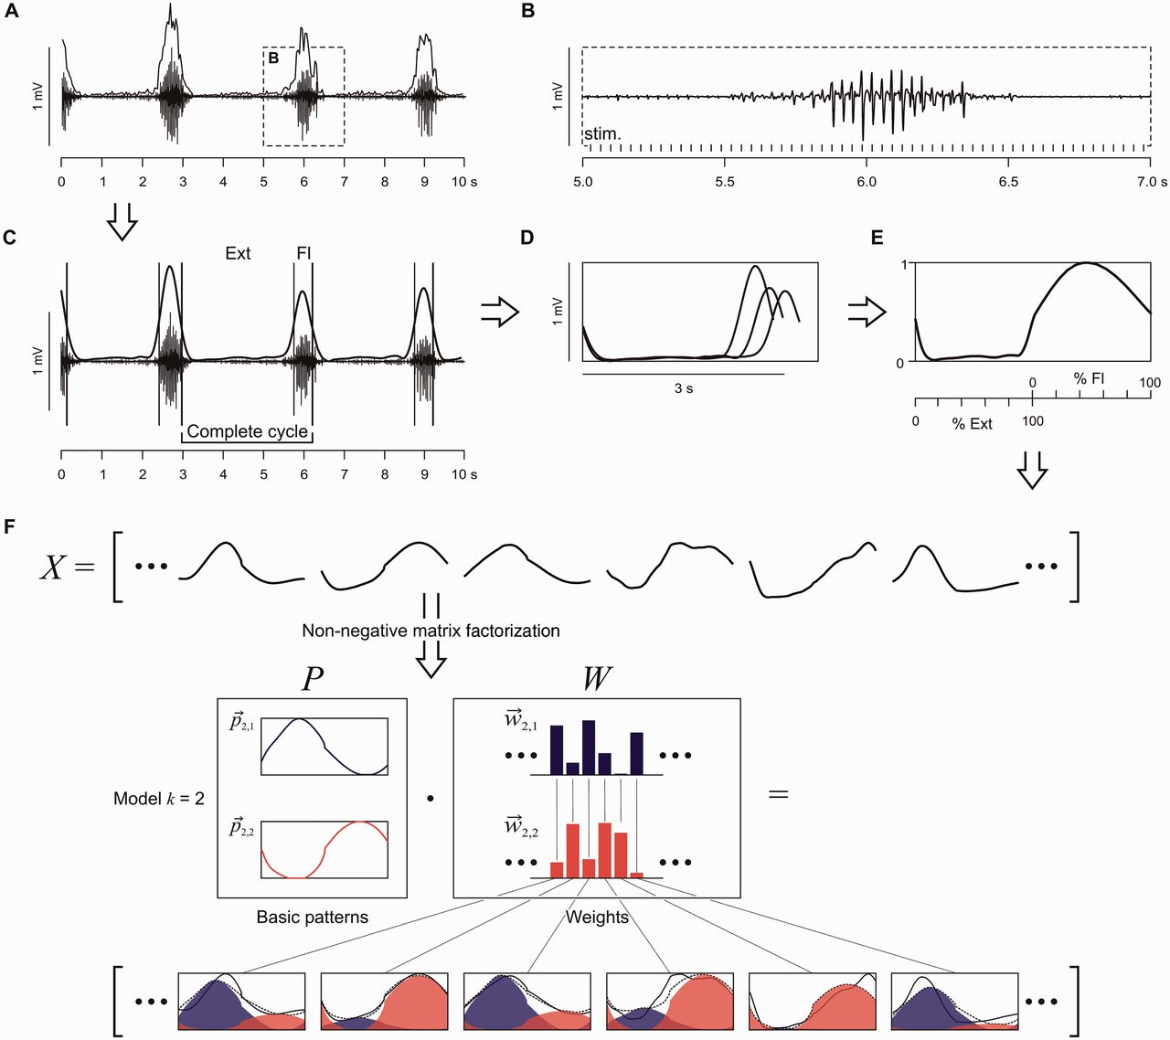
Figure 1 Non-negative matrix factorization (NMF): data preparation and interpretation of the basic patterns and ...
Notes:
Figure 1 Non-negative matrix factorization (NMF): data preparation and interpretation of the basic patterns and weights. Construction of EMG profiles that served as input data for the NMF, shown for tibialis anterior (A–E). (A) Envelopes of the selected rhythmic EMG segments were calculated from peak-to-peak amplitudes of series of responses. (B) Section of same EMG trace with enlarged time-scale shows that bursts are comprised of modulating reflex-compound muscle action potentials time-related to the stimulus pulses (stim.). (C) Low-pass filtered envelopes of the same tibialis anterior bursts were used to define the cycles and their separation into extension- (Ext) and flexion-like (Fl) phases. (D) Filtered envelopes of all complete cycles within the 10-s sample. These subdivisions were extrapolated to 100 data points for the Ext and Fl phase each, amplitude normalized, and averaged to construct the EMG profile (E). Calculated for all muscles and samples, these EMG profiles (X) served as the input to the NMF (F). The NMF identifies a preselected number of k basic patterns (P) and their weights (W), the latter specifying the contribution of each basic pattern to a given EMG profile. The various EMG profiles (black solid lines) can be approximated (dotted lines) by the weighted sum of the small number of basic patterns, which represent common underlying temporal components. p→k,j are individual basic patterns, and w→k,j their weights, consecutively numbered by index j.
Unless provided in the caption above, the following copyright applies to the content of this slide: © The Author (2015). Published by Oxford University Press on behalf of the Guarantors of Brain. All rights reserved. For Permissions, please email: journals.permissions@oup.com

Slide 2
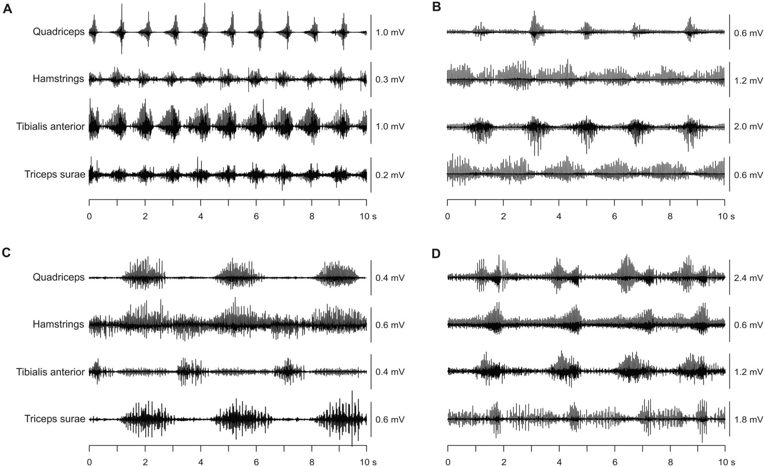
Figure 2 Example 10-s segments of rhythmic EMG activity evoked by epidural spinal cord stimulation in quadriceps, ...
Notes:
Figure 2 Example 10-s segments of rhythmic EMG activity evoked by epidural spinal cord stimulation in quadriceps, hamstrings, tibialis anterior, and triceps surae. (A) Subject 2, right side, electrode pairing and polarity of 0+ and 1−, 7 V, 30.1 Hz; (B) Subject 3, left side, electrodes 0+ and 3−, 10 V, 22.5 Hz; (C) Subject 4, left side, electrodes 0+ and 3−, 6 V, 31.5 Hz; (D) Subject 2, right side, electrodes 1+ and 3−, 10 V, 27.7 Hz.
Unless provided in the caption above, the following copyright applies to the content of this slide: © The Author (2015). Published by Oxford University Press on behalf of the Guarantors of Brain. All rights reserved. For Permissions, please email: journals.permissions@oup.com

Slide 3
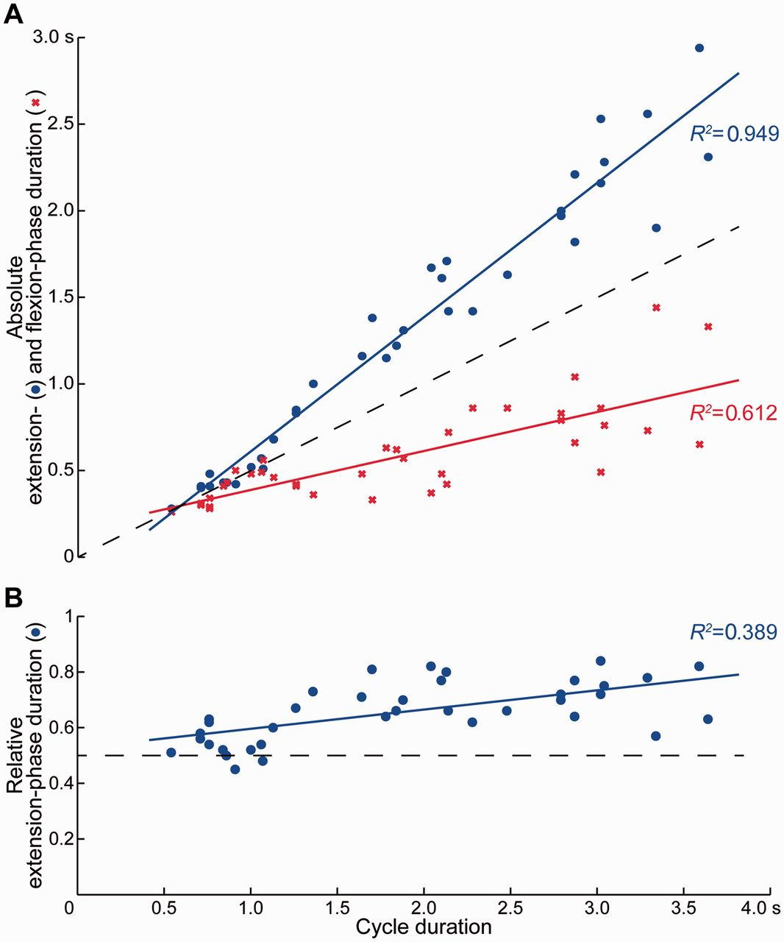
Figure 3 Relation between cycle duration and (A) absolute extension- and flexion-phase duration as well as (B) ...
Notes:
Figure 3 Relation between cycle duration and (A) absolute extension- and flexion-phase duration as well as (B) relative extension-phase duration of spinal cord stimulation-induced rhythmic activity. Solid lines are regression lines fitted to the observed data. Dashed lines indicate changes of cycle duration with equal extension- and flexion-phase durations.
Unless provided in the caption above, the following copyright applies to the content of this slide: © The Author (2015). Published by Oxford University Press on behalf of the Guarantors of Brain. All rights reserved. For Permissions, please email: journals.permissions@oup.com

Slide 4
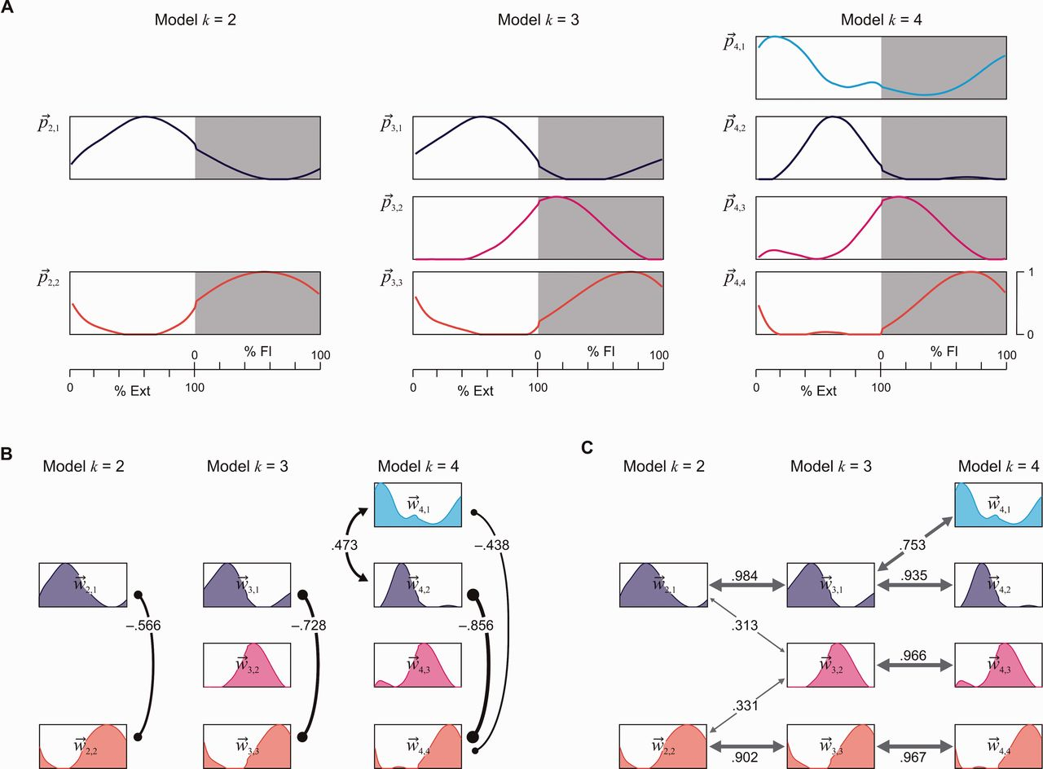
Figure 4 Basic activation patterns p→k,j and relations between their weights w→k,j identified by non-negative matrix ...
Notes:
Figure 4 Basic activation patterns p→k,j and relations between their weights w→k,j identified by non-negative matrix factorization from the pooled EMG-profile data across all subjects, muscles and samples of rhythmic EMG patterns. (A) Amplitude-normalized basic activation patterns shown for the models with k = 2, 3, and 4, ordered according to the relative timing of their peaks. (B) Negative (lines ending with small filled circles) and positive (lines ending with arrowheads) correlations between the weights of different basic activation patterns within each model indicate the tendency of reciprocal or simultaneous loading of two patterns. (C) Positive correlations in-between models, informing on preservation or splitting of basic activation patterns with increasing number of k. In B and C, only (Bonferroni corrected) correlations with P < 0.05 are illustrated. Index j in p→k,j and w→k,j enumerates the basic activation patterns based on their peak-timing; Ext = extension and Fl = flexion phase.
Unless provided in the caption above, the following copyright applies to the content of this slide: © The Author (2015). Published by Oxford University Press on behalf of the Guarantors of Brain. All rights reserved. For Permissions, please email: journals.permissions@oup.com

Slide 5
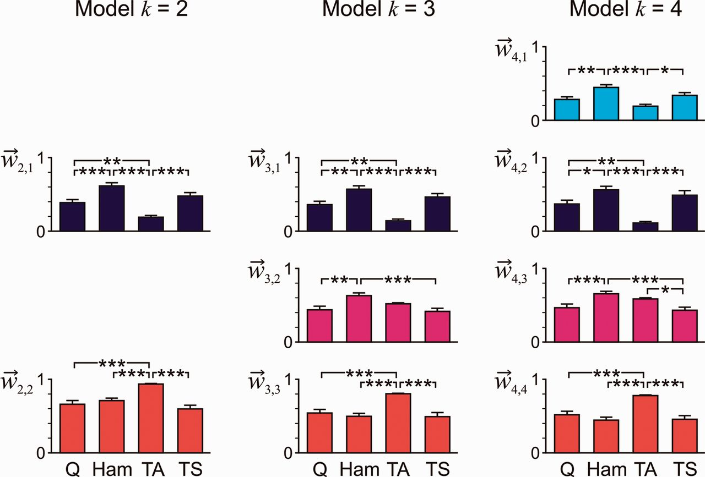
Figure 5 Correlations between weights w→k,j of a given basic activation pattern across muscles and all selected EMG ...
Notes:
Figure 5 Correlations between weights w→k,j of a given basic activation pattern across muscles and all selected EMG samples. Relations are given for the models with k = 2, 3, and 4 basic activation patterns for quadriceps (Q), hamstrings (Ham), tibialis anterior (TA), and triceps surae (TS). Bars indicate group mean and standard error, normalized to the individual maximum weight of the respective basic activation pattern and model. Index j in w→k,j enumerates the basic activation patterns based on their peak-timing. All group tests P < 0.001, asterisks indicate significant post hoc tests: *P < 0.05, **P < 0.01, ***P < 0.001.
Unless provided in the caption above, the following copyright applies to the content of this slide: © The Author (2015). Published by Oxford University Press on behalf of the Guarantors of Brain. All rights reserved. For Permissions, please email: journals.permissions@oup.com

