Slide 1
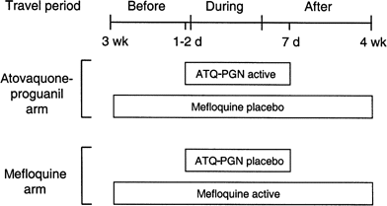
Figure 1 Study drug dosing regimens. ATQ, atovaquone; d, day; PGN, proguanil; wk, week.
Notes:
Figure 1 Study drug dosing regimens. ATQ, atovaquone; d, day; PGN, proguanil; wk, week.
Unless provided in the caption above, the following copyright applies to the content of this slide: © 2001 by the Infectious Diseases Society of America

Slide 2
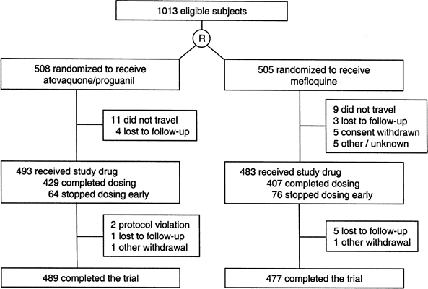
Figure 2 Flow diagram of subject accountability during the trial. R, randomized.
Notes:
Figure 2 Flow diagram of subject accountability during the trial. R, randomized.
Unless provided in the caption above, the following copyright applies to the content of this slide: © 2001 by the Infectious Diseases Society of America

Slide 3
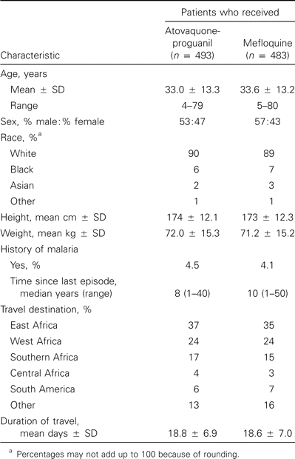
Table 1 Baseline characteristics of the study groups in a comparison of atovaquone-proguanil with melfoquine for ...
Notes:
Table 1 Baseline characteristics of the study groups in a comparison of atovaquone-proguanil with melfoquine for malaria prophylaxis.
Unless provided in the caption above, the following copyright applies to the content of this slide: © 2001 by the Infectious Diseases Society of America

Slide 4
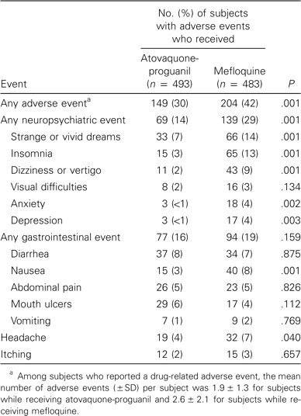
Table 2 Treatment-emergent adverse events attributed to the study drug.
Notes:
Table 2 Treatment-emergent adverse events attributed to the study drug.
Unless provided in the caption above, the following copyright applies to the content of this slide: © 2001 by the Infectious Diseases Society of America

Slide 5
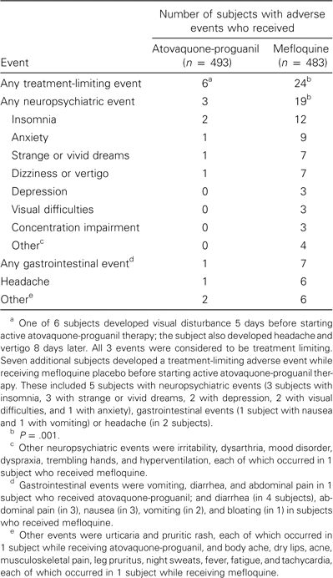
Table 3 Treatment-limiting adverse events attributed to the study drug.
Notes:
Table 3 Treatment-limiting adverse events attributed to the study drug.
Unless provided in the caption above, the following copyright applies to the content of this slide: © 2001 by the Infectious Diseases Society of America

Slide 6
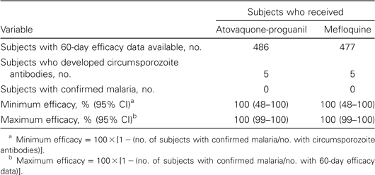
Table 4 Estimates of minimum and maximum efficacy for malaria prophylaxis.
Notes:
Table 4 Estimates of minimum and maximum efficacy for malaria prophylaxis.
Unless provided in the caption above, the following copyright applies to the content of this slide: © 2001 by the Infectious Diseases Society of America

