Slide 1
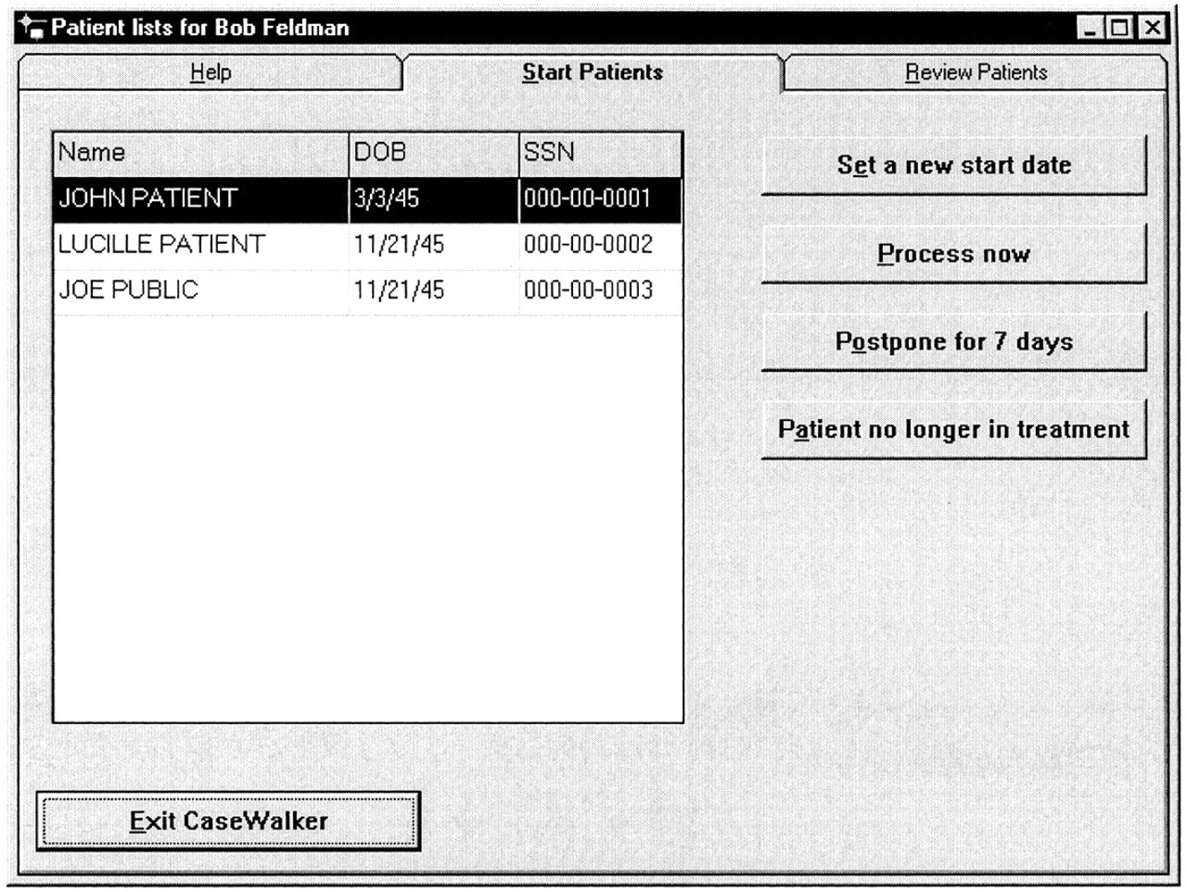
Figure 1 Reminder for patients requiring initial screening and assessment.
Notes:
Figure 1 Reminder for patients requiring initial screening and assessment.
Unless provided in the caption above, the following copyright applies to the content of this slide: American Medical Informatics Association

Slide 2
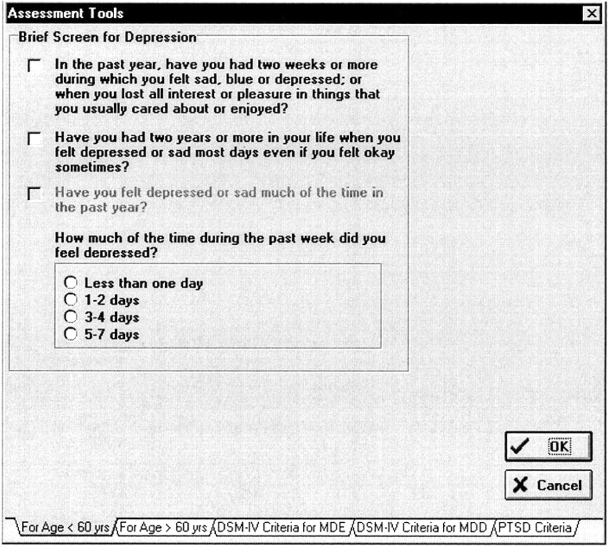
Figure 2 Checklist for initial screening for mood disorder.
Notes:
Figure 2 Checklist for initial screening for mood disorder.
Unless provided in the caption above, the following copyright applies to the content of this slide: American Medical Informatics Association

Slide 3
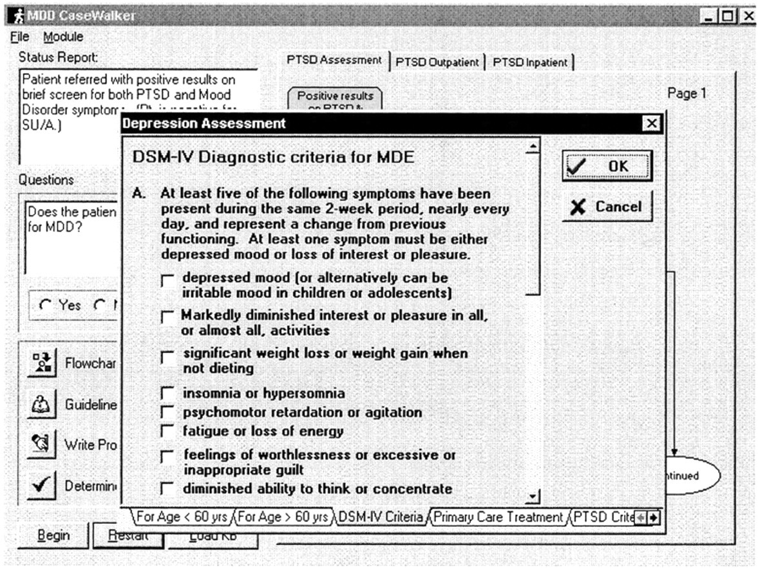
Figure 3 First section of the checklist of DSM-IV criteria for major depressive disorder.
Notes:
Figure 3 First section of the checklist of DSM-IV criteria for major depressive disorder.
Unless provided in the caption above, the following copyright applies to the content of this slide: American Medical Informatics Association

Slide 4
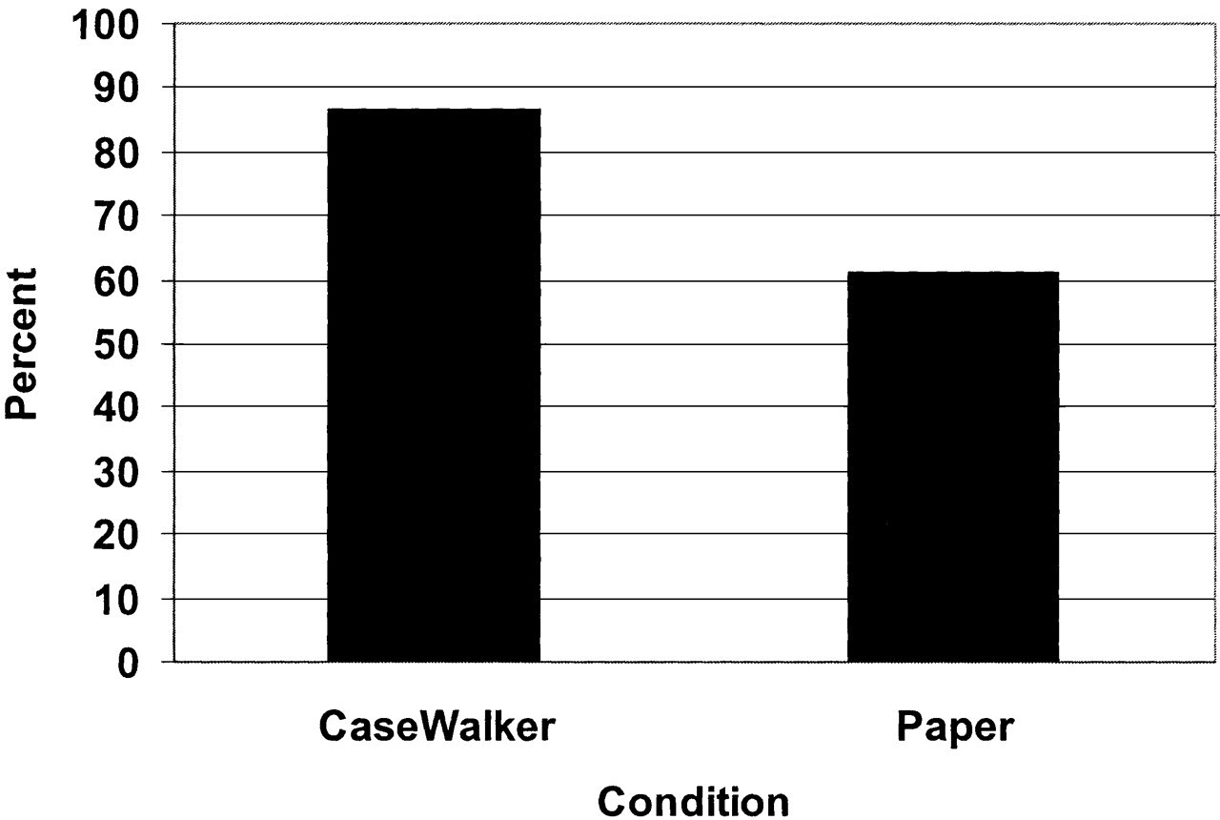
Figure 4 Percentage of cases screened for mood disorder in the CaseWalker and paper conditions.
Notes:
Figure 4 Percentage of cases screened for mood disorder in the CaseWalker and paper conditions.
Unless provided in the caption above, the following copyright applies to the content of this slide: American Medical Informatics Association

Slide 5
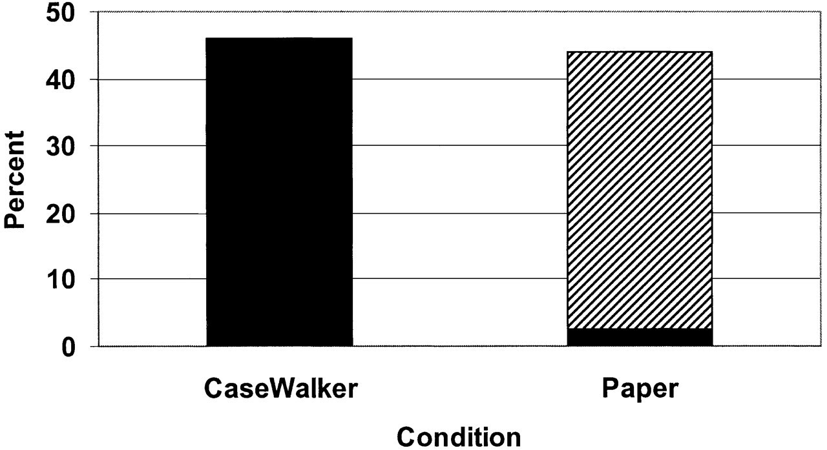
Figure 5 Percentage of cases in which major depressive disorder criteria were documented in the CaseWalker and paper ...
Notes:
Figure 5 Percentage of cases in which major depressive disorder criteria were documented in the CaseWalker and paper conditions. Black indicates complete documentation; hatching, incomplete documentation.
Unless provided in the caption above, the following copyright applies to the content of this slide: American Medical Informatics Association

