Slide 1
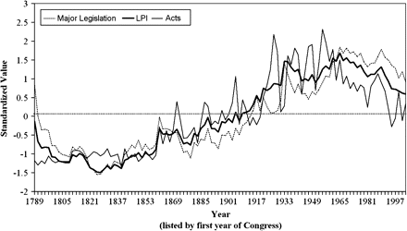
Fig. 1 LPI, MLI, and All Public Acts, 1789–2004.
Notes:
Fig. 1 LPI, MLI, and All Public Acts, 1789–2004.
Unless provided in the caption above, the following copyright applies to the content of this slide: © The Author 2008. Published by Oxford University Press on behalf of the Society for Political Methodology. All rights reserved. For Permissions, please email: journals.permissions@oxfordjournals.org

Slide 2
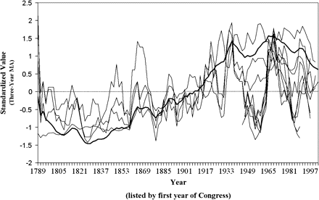
Fig. 2 Constituent indicators and the LPI (dark line is the LPI).
Notes:
Fig. 2 Constituent indicators and the LPI (dark line is the LPI).
Unless provided in the caption above, the following copyright applies to the content of this slide: © The Author 2008. Published by Oxford University Press on behalf of the Society for Political Methodology. All rights reserved. For Permissions, please email: journals.permissions@oxfordjournals.org

Slide 3
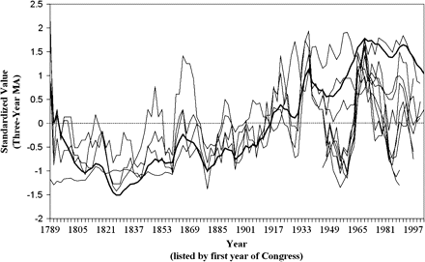
Fig. 3 Constituent indicators and the MLI (dark line is the MLI).
Notes:
Fig. 3 Constituent indicators and the MLI (dark line is the MLI).
Unless provided in the caption above, the following copyright applies to the content of this slide: © The Author 2008. Published by Oxford University Press on behalf of the Society for Political Methodology. All rights reserved. For Permissions, please email: journals.permissions@oxfordjournals.org

Slide 4
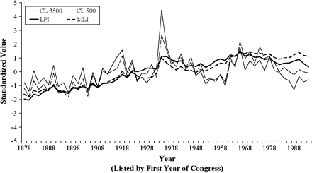
Fig. 4 Comparison of LPI and CL aggregations at 500 and 3500 thresholds.
Notes:
Fig. 4 Comparison of LPI and CL aggregations at 500 and 3500 thresholds.
Unless provided in the caption above, the following copyright applies to the content of this slide: © The Author 2008. Published by Oxford University Press on behalf of the Society for Political Methodology. All rights reserved. For Permissions, please email: journals.permissions@oxfordjournals.org

