Slide 1
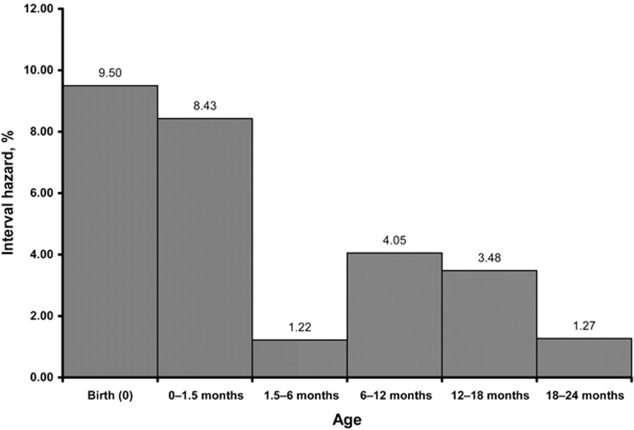
Figure 1. Interval hazard of infant HIV infection. Estimates are based on Kaplan-Meier survival analyses.
Notes:
Figure 1. Interval hazard of infant HIV infection. Estimates are based on Kaplan-Meier survival analyses.
Unless provided in the caption above, the following copyright applies to the content of this slide: © 2007 by the Infectious Diseases Society of America

Slide 2
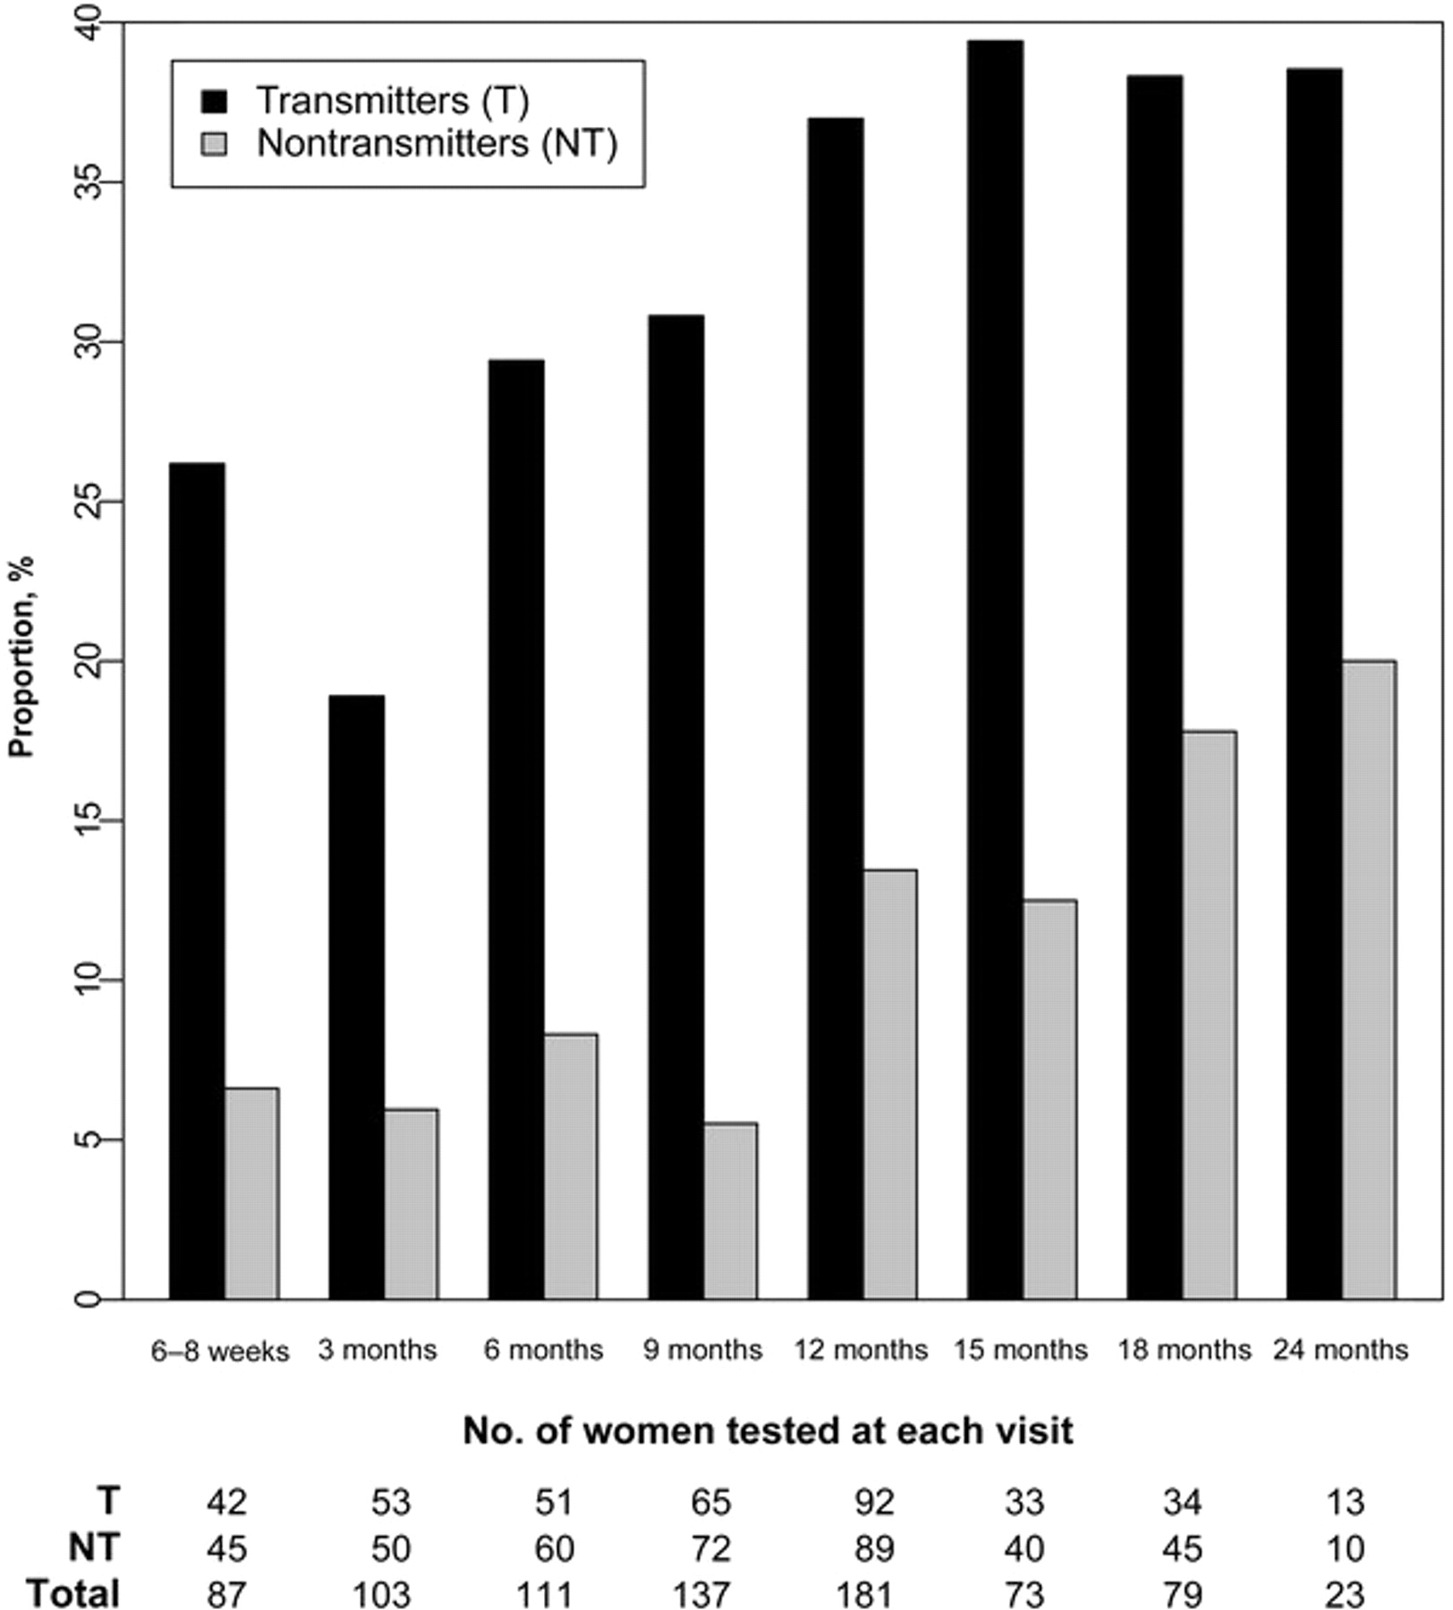
Figure 2. Proportion of women with detectable breast milk viral load
Notes:
Figure 2. Proportion of women with detectable breast milk viral load
Unless provided in the caption above, the following copyright applies to the content of this slide: © 2007 by the Infectious Diseases Society of America

