Slide 1
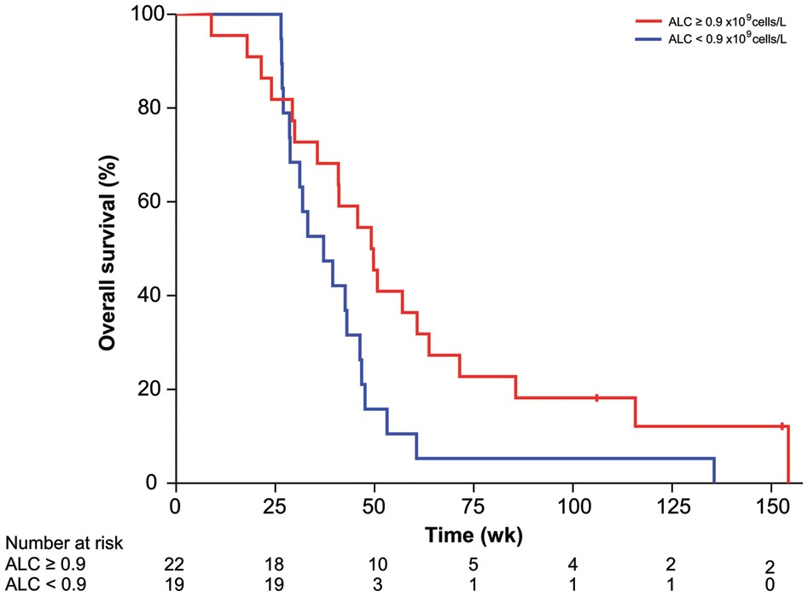
Fig. 2. Kaplan–Meier estimates of OS in 41 patients receiving the HSPPC-96 vaccine for recurrent GBM stratified by ...
Notes:
Fig. 2. Kaplan–Meier estimates of OS in 41 patients receiving the HSPPC-96 vaccine for recurrent GBM stratified by ALC relative to median expression. Vertical lines indicate the timepoints at which patients were censored.
Unless provided in the caption above, the following copyright applies to the content of this slide: © The Author(s) 2013. Published by Oxford University Press on behalf of the Society for Neuro-Oncology. All rights reserved. For permissions, please e-mail: journals.permissions@oup.com.

Slide 2
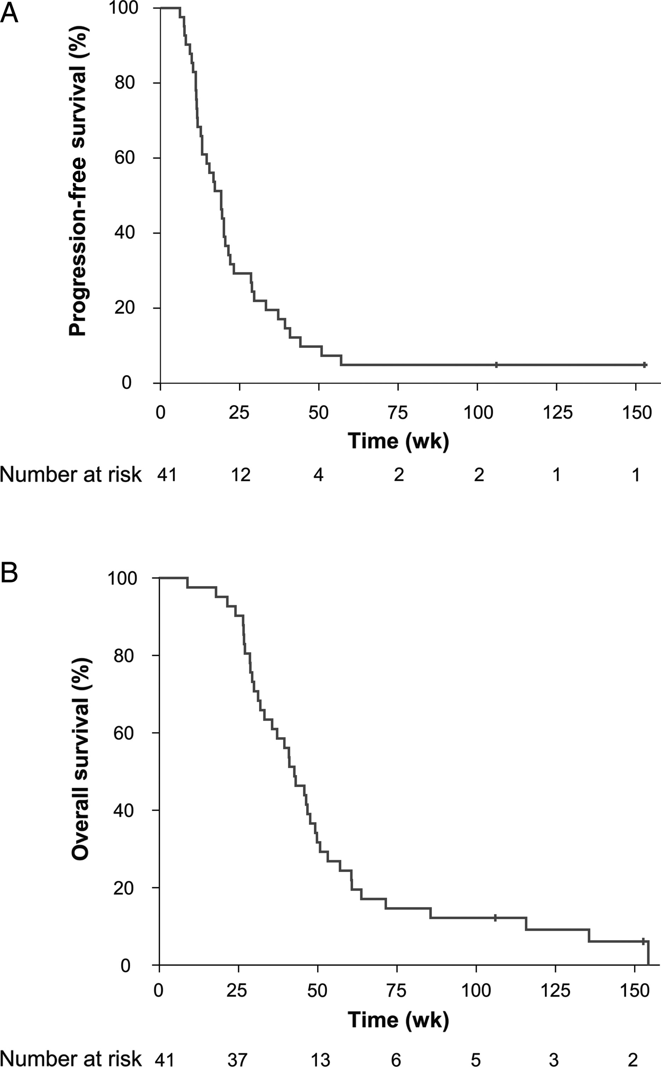
Fig. 1. (A) Kaplan–Meier estimates of PFS in 41 patients receiving the HSPPC-96 vaccine for recurrent GBM. Vertical ...
Notes:
Fig. 1. (A) Kaplan–Meier estimates of PFS in 41 patients receiving the HSPPC-96 vaccine for recurrent GBM. Vertical lines indicate the timepoints at which patients were censored. (B) Kaplan–Meier estimates of OS in 41 patients receiving the HSPPC-96 vaccine for recurrent GBM. Vertical lines indicate the timepoints at which patients were censored.
Unless provided in the caption above, the following copyright applies to the content of this slide: © The Author(s) 2013. Published by Oxford University Press on behalf of the Society for Neuro-Oncology. All rights reserved. For permissions, please e-mail: journals.permissions@oup.com.

