Slide 1
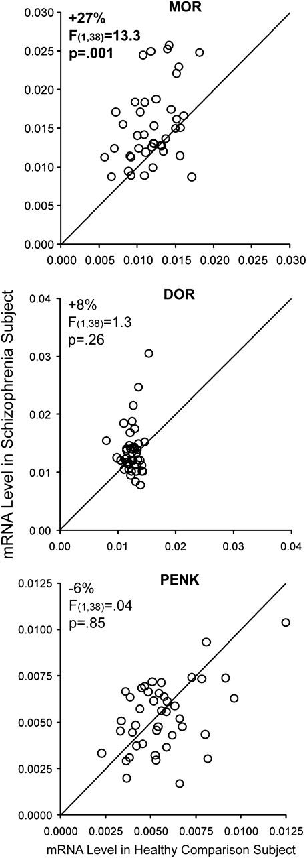
Figure 1. mRNA expression levels of opioid markers in schizophrenia. mRNA expression levels for schizophrenia subjects ...
Notes:
Figure 1. mRNA expression levels of opioid markers in schizophrenia. mRNA expression levels for schizophrenia subjects relative to matched healthy comparison subjects in a pair are indicated by open circles. Data points to the left of the unity line indicate higher levels of mRNA expression in the schizophrenia subject relative to the healthy comparison subject and vice versa. Statistically significant differences (α = 0.016) in mRNA expression levels in schizophrenia subjects were found for MOR but not DOR or proenkephalin (PENK).
Unless provided in the caption above, the following copyright applies to the content of this slide: © The Author 2011. Published by Oxford University Press. All rights reserved. For permissions, please e-mail: journals.permissions@oup.com

Slide 2
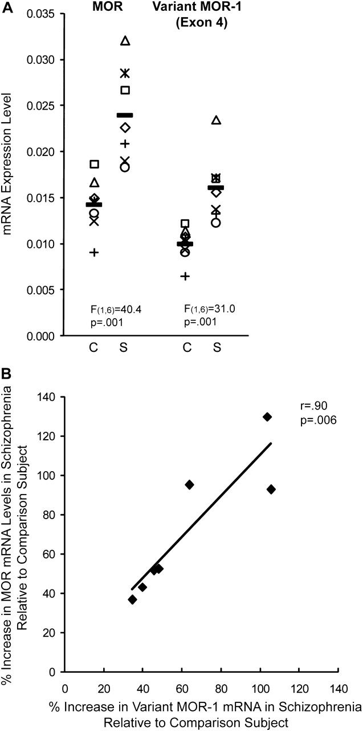
Figure 2. Expression levels of exon 4-containing MOR mRNA in schizophrenia subjects. mRNA expression levels were ...
Notes:
Figure 2. Expression levels of exon 4-containing MOR mRNA in schizophrenia subjects. mRNA expression levels were determined in 7 schizophrenia subjects relative to comparison subjects using primer sets targeting the transmembrane region common to MOR mRNA splice variants (MOR primer set 1; Supplementary Table S2) and exon 4 of MOR mRNA (Supplementary Table S2), which appears to selectively target the MOR-1 splice variant in human PFC. (A) An ANCOVA with mRNA level as the dependent variable, diagnostic group as the main effect, and subject pair as a blocking factor revealed significant elevations in exon 4-containing MOR mRNA levels in schizophrenia subjects. Data points that share a symbol indicate subjects in the same pair. Horizontal black lines indicate the mean mRNA expression level for the diagnostic group. (B) Differences in MOR mRNA expression levels and splice variant MOR-1 mRNA expression levels between schizophrenia and matched healthy comparison subjects were highly correlated.
Unless provided in the caption above, the following copyright applies to the content of this slide: © The Author 2011. Published by Oxford University Press. All rights reserved. For permissions, please e-mail: journals.permissions@oup.com

Slide 3
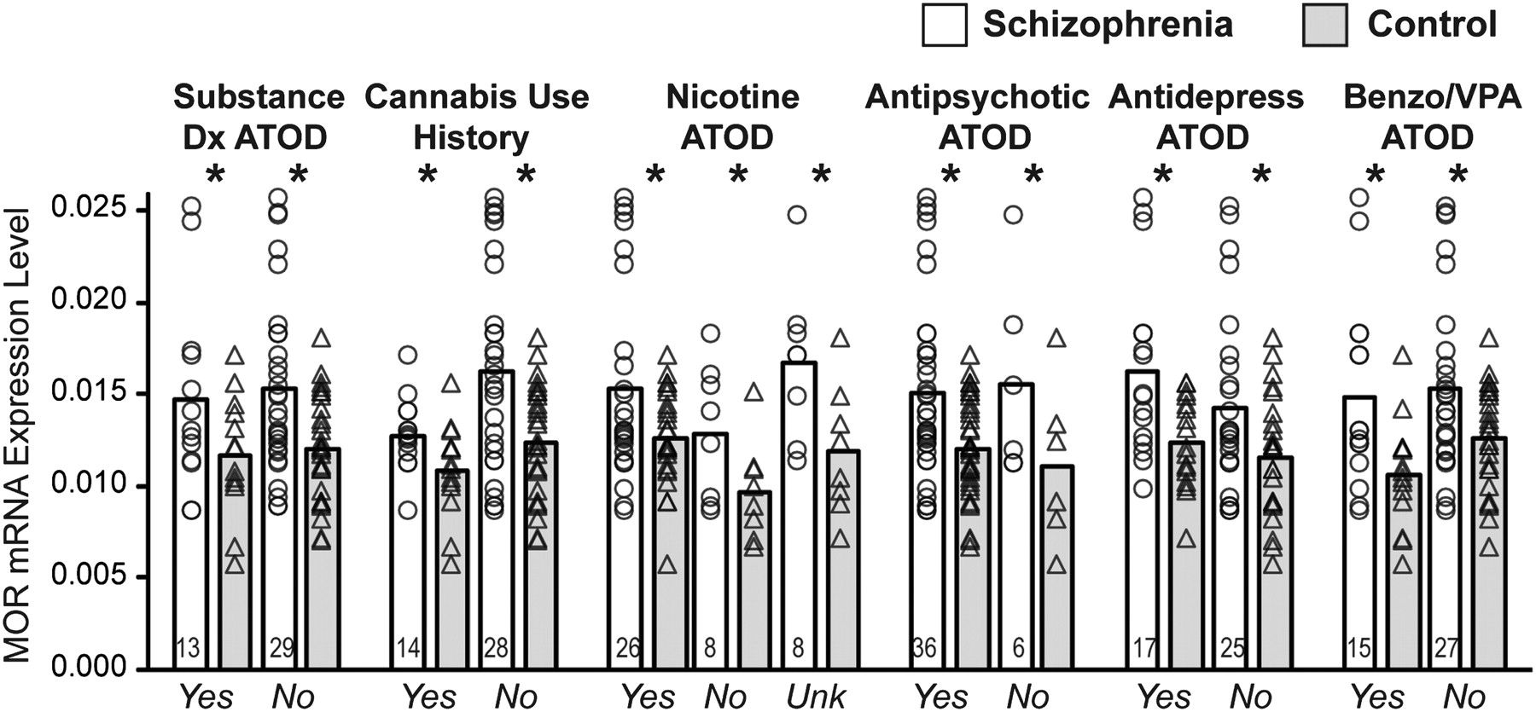
Figure 3. Effects of substance abuse and psychotropic medications on MOR mRNA expression levels in schizophrenia. ...
Notes:
Figure 3. Effects of substance abuse and psychotropic medications on MOR mRNA expression levels in schizophrenia. Schizophrenia subjects and matched comparison subjects were divided in subsets of subjects based on the presence in the schizophrenia subject of substance abuse or dependence ATOD; history of cannabis use; nicotine use ATOD; and antipsychotic, antidepressant, or benzodiazepine and valproic acid medications ATOD. MOR mRNA levels for schizophrenia subjects within each of these subgroups were then compared with MOR mRNA levels in their matched comparison subjects. Open columns and gray columns denote the average MOR mRNA expression level in the schizophrenia and corresponding comparison subjects, respectively. Open circles and open triangles denote MOR mRNA expression levels in individual schizophrenia and healthy comparison subjects, respectively. Number of subjects in each subgroup are provided in the open column. * denotes P < 0.05. Abbreviations: Dx, diagnosis; ATOD, at time of death; Benzo, benzodiazepine; VPA, valproic acid.
Unless provided in the caption above, the following copyright applies to the content of this slide: © The Author 2011. Published by Oxford University Press. All rights reserved. For permissions, please e-mail: journals.permissions@oup.com

Slide 4
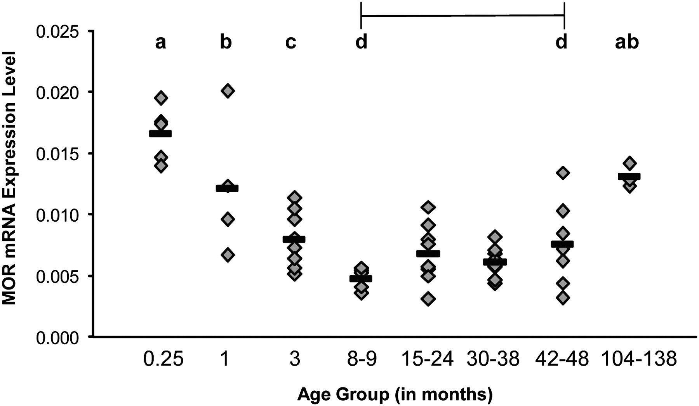
Figure 4. MOR mRNA expression levels across postnatal development in the PFC of female monkeys. MOR mRNA expression ...
Notes:
Figure 4. MOR mRNA expression levels across postnatal development in the PFC of female monkeys. MOR mRNA expression levels in PFC area 10 from 49 individual monkeys are plotted in age-defined groups. Mean values are shown as horizontal black bars. Statistical analysis revealed a significant (F7,41 = 12.0, P < 0.001) effect of age group on MOR mRNA expression levels. Age groups not sharing the same letters (a–d) are significantly different (P < 0.05) in MOR mRNA expression levels. Note the prominent decline in MOR mRNA expression levels from 1 week to 8–9 months (−71%), following by a period of relatively stable MOR mRNA expression levels across adolescence (8–48 months) and subsequent age-related increase in MOR mRNA expression levels (+72%) from late adolescence (42–48 months) to middle adulthood (104–138 months).
Unless provided in the caption above, the following copyright applies to the content of this slide: © The Author 2011. Published by Oxford University Press. All rights reserved. For permissions, please e-mail: journals.permissions@oup.com

Slide 5
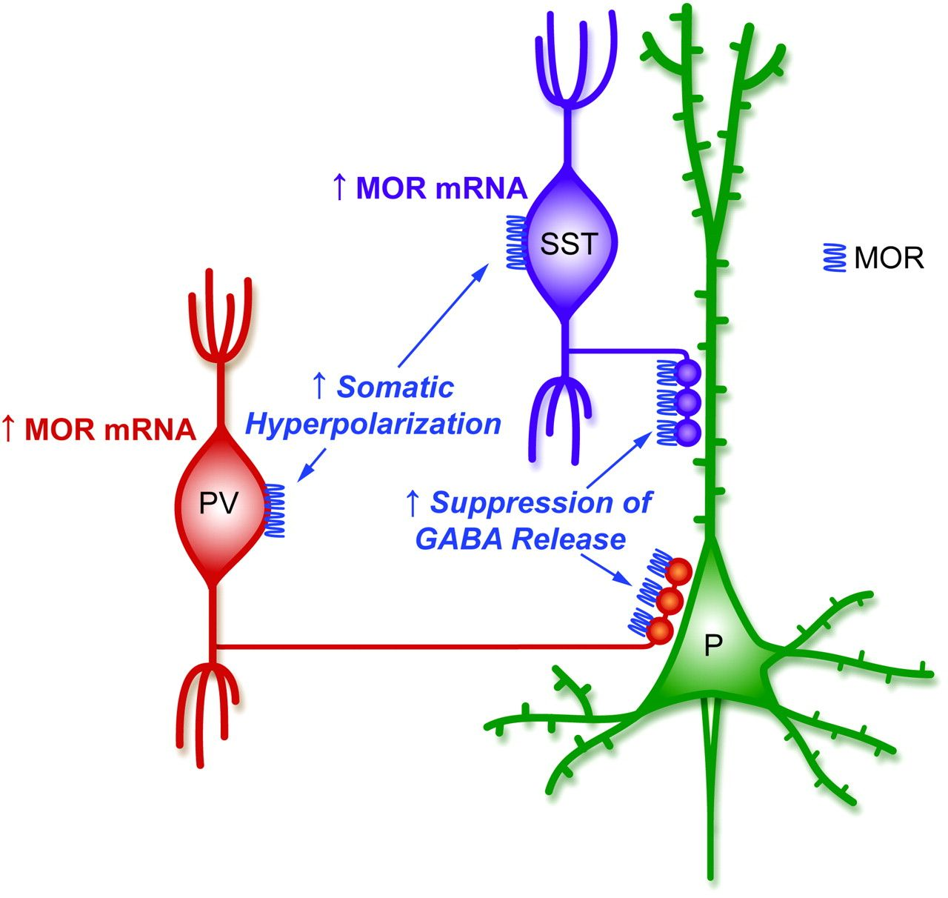
Figure 5. Schematic of alterations in MOR in schizophrenia and the potential downstream impact on GABA ...
Notes:
Figure 5. Schematic of alterations in MOR in schizophrenia and the potential downstream impact on GABA neurotransmission. Studies in rat brain have found that MOR are primarily found in the axon terminals and somatodendritic region of virtually all parvalbumin (PV)- and most somatostatin (SST)-containing neurons but not in pyramidal neurons (P) or glial cells (Drake and Milner 1999, 2002; Stumm et al. 2004). MOR activation suppresses GABA release from axon terminals and hyperpolarizes the cell body that reduces responsiveness to excitatory input (Lupica 1995; Glickfeld et al. 2008). In schizophrenia, higher MOR mRNA levels, if accompanied by a corresponding increase in protein levels, may both suppress GABA release from PV and SST axon terminals and hyperpolarize their cell bodies, reducing their ability to fire in response to excitatory inputs.
Unless provided in the caption above, the following copyright applies to the content of this slide: © The Author 2011. Published by Oxford University Press. All rights reserved. For permissions, please e-mail: journals.permissions@oup.com

