Slide 1
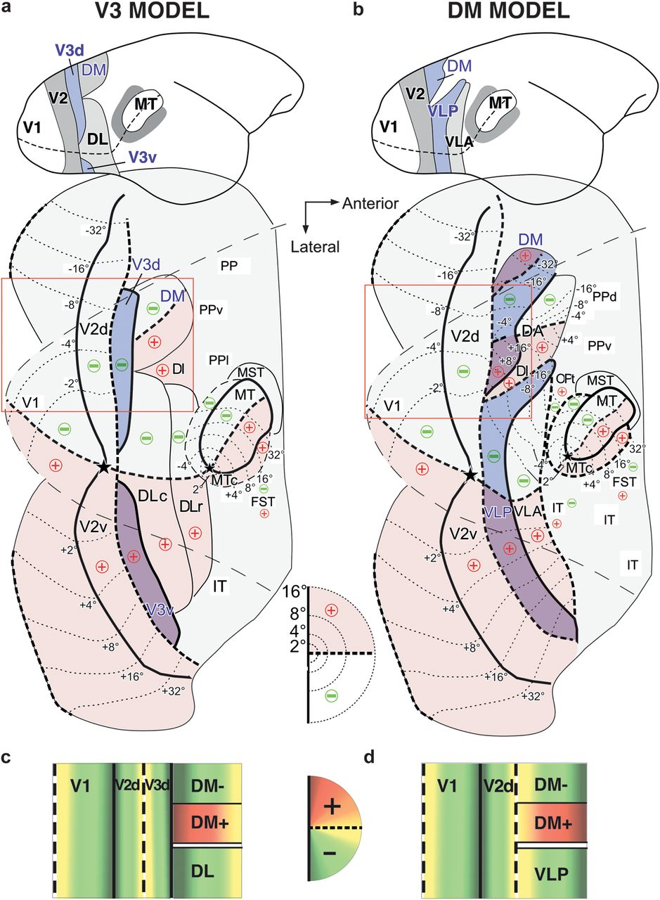
Figure 1. Two partitioning models proposed for marmoset visual cortex. The “V3” model is depicted in (a,c), the “DM” ...
Notes:
Figure 1. Two partitioning models proposed for marmoset visual cortex. The “V3” model is depicted in (a,c), the “DM” model in (b,d). (a,b) Top: Sketch of the lateral view of the marmoset brain, showing the partitioning of visual cortex between V2 and MT according to each model. Bottom: Partitioning of visual cortex, according to each model, shown onto an outline of unfolded and flattened marmoset visual cortex. The outer thin dashed outline is the outline of the dorsolateral surface of visual cortex prior to unfolding, while the outer thin solid outline is the outline of unfolded medial and ventral cortex. Middle inset: Diagram of the central 16° of the right visual hemifield; here and elsewhere in the figure, the thick dashed lines/contours represent the HM, the thick solid lines/contours the VM, the stars the fovea, the thin dotted contours the iso-eccentricity lines (numbers indicate eccentricity), and the “+” and “−” signs indicate the upper and lower visual field, respectively, with upper field regions additionally shaded in pink. + and − are indicated only for areas for which retinotopic maps have been determined by previous electrophysiological studies (adapted from: Rosa and Schmid 1995; Rosa et al. 2005). Thinner solid lines demarcating areal borders indicate uncertainty of meridian representations. The region inside the red box is schematically diagrammed in (c,d). (a) In the V3 model, V3d, representing the lower visual quadrant, is interposed between V2d and area DM. V3v, instead, representing the upper visual quadrant, abuts V2v anteriorly. Cortex between foveal V2 and MT includes posterior and anterior subdivisions of area DL/V4 (Sereno and Allman 1990; Kaas 1997). This scheme is similar to that proposed for macaque (Gattass et al. 1988; Lyon and Kaas 2002a). A modified version of this scheme in macaque, based on described connectional and functional asymmetries between V3d and V3v, views these as 2 different areas, V3 and VP, representing contralateral lower and upper visual quadrants, respectively (Burkhalter et al. 1986). (b) In the DM model, area DM, representing both upper and lower visual quadrants, directly abuts V2d anteriorly and medially. Lateral to DM+, a second visual area, VLP, also representing the entire visual hemifield, borders V2d anterolaterally and V2v anteriorly. VLP, thus, encompasses the upper field representation of V3v and parts of the lower field representation of V3d and posterior DL of the competing model. (c,d) Schematic block diagrams of cortex inside the red box in (a) and (b), respectively, showing, in color code, the representation of polar angles in each cortical area, with orange and green indicating upper and lower visual quadrants, respectively, yellow the HM and dark red and dark green the VM. In (c), the lower quadrant representation of V3d abuts and mirrors that of V2d, with the HM represented at the V2d/V3d border and the VM at the V3d/DM border. In (d), the upper quadrant representation of DM abuts V2d, with the HM represented at the V2d/DM border and the VM at the anterior DM border. In (d), the lower quadrant representation of VLP also abuts and mirrors the lower quadrant representation of V2d. Note that in both models, there exists an upper field representation (DM+) in cortex anterior to V2d, but its posterior border represents a different meridian in the 2 different models. The location of DM+ constrains the location of V3 to be posterior to it, therefore making V2d in the Lyon and Kaas (2001) model narrower than V2d in the Rosa et al. (2005) model.
Unless provided in the caption above, the following copyright applies to the content of this slide: © The Author 2012. Published by Oxford University Press. All rights reserved. For permissions, please e-mail: journals.permissions@oup.com

Slide 2
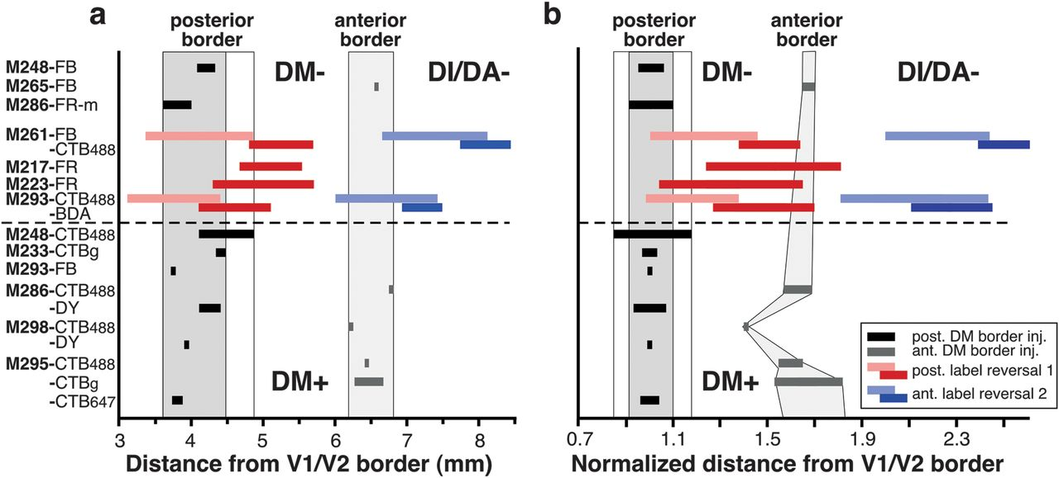
Figure 12. Quantitative analysis of the location of label reversals relative to the DM+ borders. (a) Distance of the DM ...
Notes:
Figure 12. Quantitative analysis of the location of label reversals relative to the DM+ borders. (a) Distance of the DM posterior (black horizontal bars) and anterior (gray horizontal bars) borders from the V1/V2 border. Each black or gray horizontal bar represents a separate injection case (case numbers are indicated on the y-axis and apply to both a and b), and its width indicates the width of the label-defined transition zone at the area borders (see Materials and Methods). Different injections are arranged in order of mediolateral location (i.e., approximate eccentricity), with more medial locations represented at the top of the graph. Shaded gray vertical columns indicate the range of distances across the population of injection sites for the posterior (dark gray column) and anterior (light gray column) DM border, respectively. Colored horizontal bars indicate distances from the V1/V2 border of label reversal 1 (pink–red bars) and reversal 2 (blue bars) produced by rows of injections across the width of V2 (reversals 1 and 2 in Figs 8a,b and 10b) or produced by injection confined to the V1/V2 border (cases M217 FR and M223 FR in Table 1). Pink and light blue bars indicate the most posterior patch in each reversal (i.e., that resulting from the injection site at the V2d anterior border—HM representation), while red and dark blue bars indicate the most anterior patch in each reversal (i.e., that resulting from the injections site at the V1/V2 border—VM representation). Dashed horizontal line in (a) and (b) separates DM+ from DM−. (b) The distances from the V1/V2 border of DM borders and label reversals were normalized to the width of V2d at the same mediolateral level of the respective injection site or label patch. Other conventions are as in (a). Note that in (b), the anterior DM border forms a curve reminiscent of the shape of DM.
Unless provided in the caption above, the following copyright applies to the content of this slide: © The Author 2012. Published by Oxford University Press. All rights reserved. For permissions, please e-mail: journals.permissions@oup.com

Slide 3
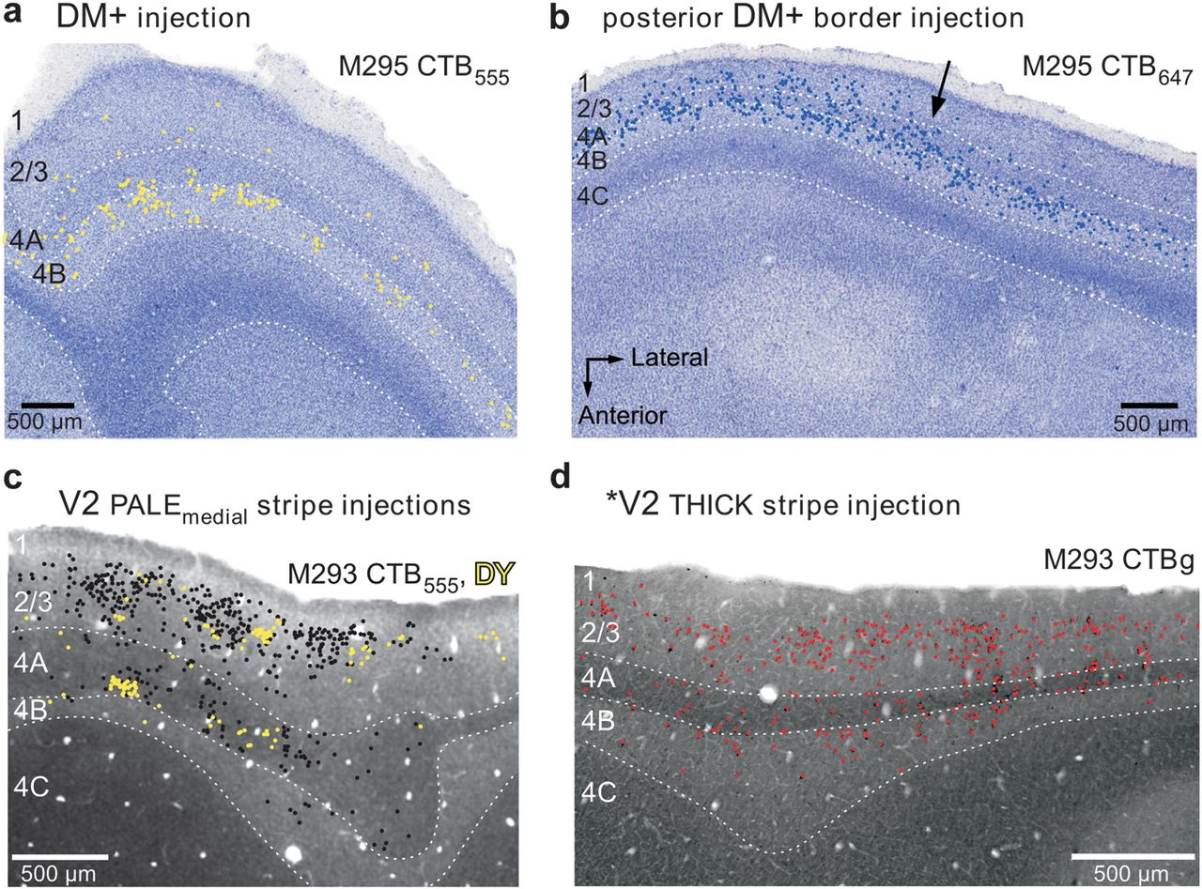
Figure 4. Laminar pattern of retrograde label in V1 produced by tracer injections in different cortical areas. (a) Case ...
Notes:
Figure 4. Laminar pattern of retrograde label in V1 produced by tracer injections in different cortical areas. (a) Case M295 CTB-555. Injection in DM+. Plots of retrogradely labeled cells (yellow dots) in V1 are shown superimposed on a Nissl stain of the same section. The injection site for this case is shown in yellow in Figure 3b. Label is predominantly in layer 4B. Here and in (b–d), dotted lines indicate laminar boundaries, and numbers to the left label the respective V1 layers. (b) Case M295 CTB-647. Injection straddling the posterior DM+ border (blue injection in Fig. 3b). Plots of labeled cells (blue dots) are superimposed onto a Nissl stain of the same section. Note that to the left of the arrow label is heavy in layers 2/3, 4A, and 4B, while to the right of the arrow label is heaviest in layer 4B only. This label pattern suggests that the V1 projection to the DM side of the injection site extended farther in visual field than the projection to the V2d/V3d side of the injection; this is consistent with the larger receptive field size and magnification factor of DM (Rosa et al. 1997, 2005). Anatomical coordinates in (b) apply to (a–d). (c,d) Case M293, V2 injections. Plots of retrograde label (colored dots) in V1 from 2 adjacent tissue sections are shown superimposed to images of CO-stained sections. In (c), the black and yellow cells resulted from a CTB-555 and a DY injection, respectively, located side-by-side in the same pale-medial CO stripe of V2 (injection sites for this case are shown in black and yellow, respectively, in Figs 7b and 8a,b,d,f). Both injections produced label in layers 2/3 and 4A and virtually no label in layer 4B. The CO-stained section in (c) is immediately adjacent to the one in which the cells were plotted. In (d), the red cells resulted from an injection of CTBg located in a thick CO stripe of V2 (red injection site shown in Figs 7b and 8b,c). Cell label was plotted from the same CO section shown in (d), as this section was double stained for CO and CTBg. Label was predominant in layers 2/3, but significant label was also in layers 4A and 4B, consistent with the injection being located in a thick CO stripe of V2. The CO stripe location for these 3 V2 injection sites and quantification of resulting labeled cells in the different V1 laminae are shown in Supplementary Figure 4 and Table 4 in Federer, Ichida et al. (2009).
Unless provided in the caption above, the following copyright applies to the content of this slide: © The Author 2012. Published by Oxford University Press. All rights reserved. For permissions, please e-mail: journals.permissions@oup.com

Slide 4
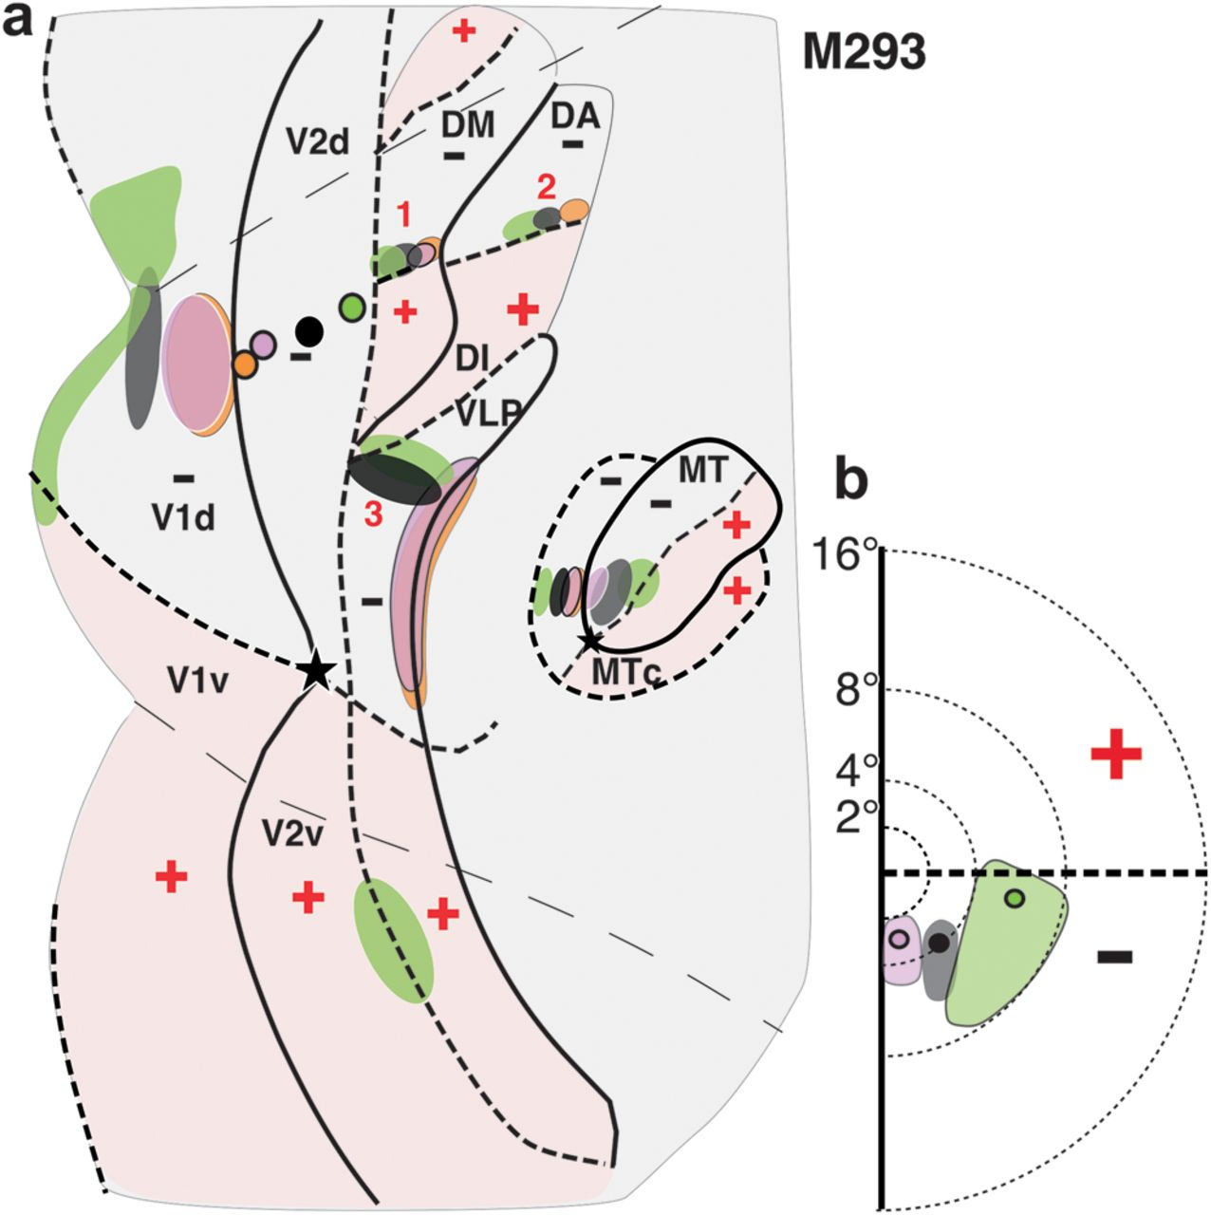
Figure 9. Summary of areal location of tracer injections and transported label for case M293. (a) Same as in Figure 7c, ...
Notes:
Figure 9. Summary of areal location of tracer injections and transported label for case M293. (a) Same as in Figure 7c, left, but here, the borders of areas just anterior to V2d are indicated, together with outlines of label within them resulting from the tracer injections. Borders and outlines of label are also shown for areas DI/DA, MT, and MTc. (b) Same as Figure 7c, right.
Unless provided in the caption above, the following copyright applies to the content of this slide: © The Author 2012. Published by Oxford University Press. All rights reserved. For permissions, please e-mail: journals.permissions@oup.com

Slide 5
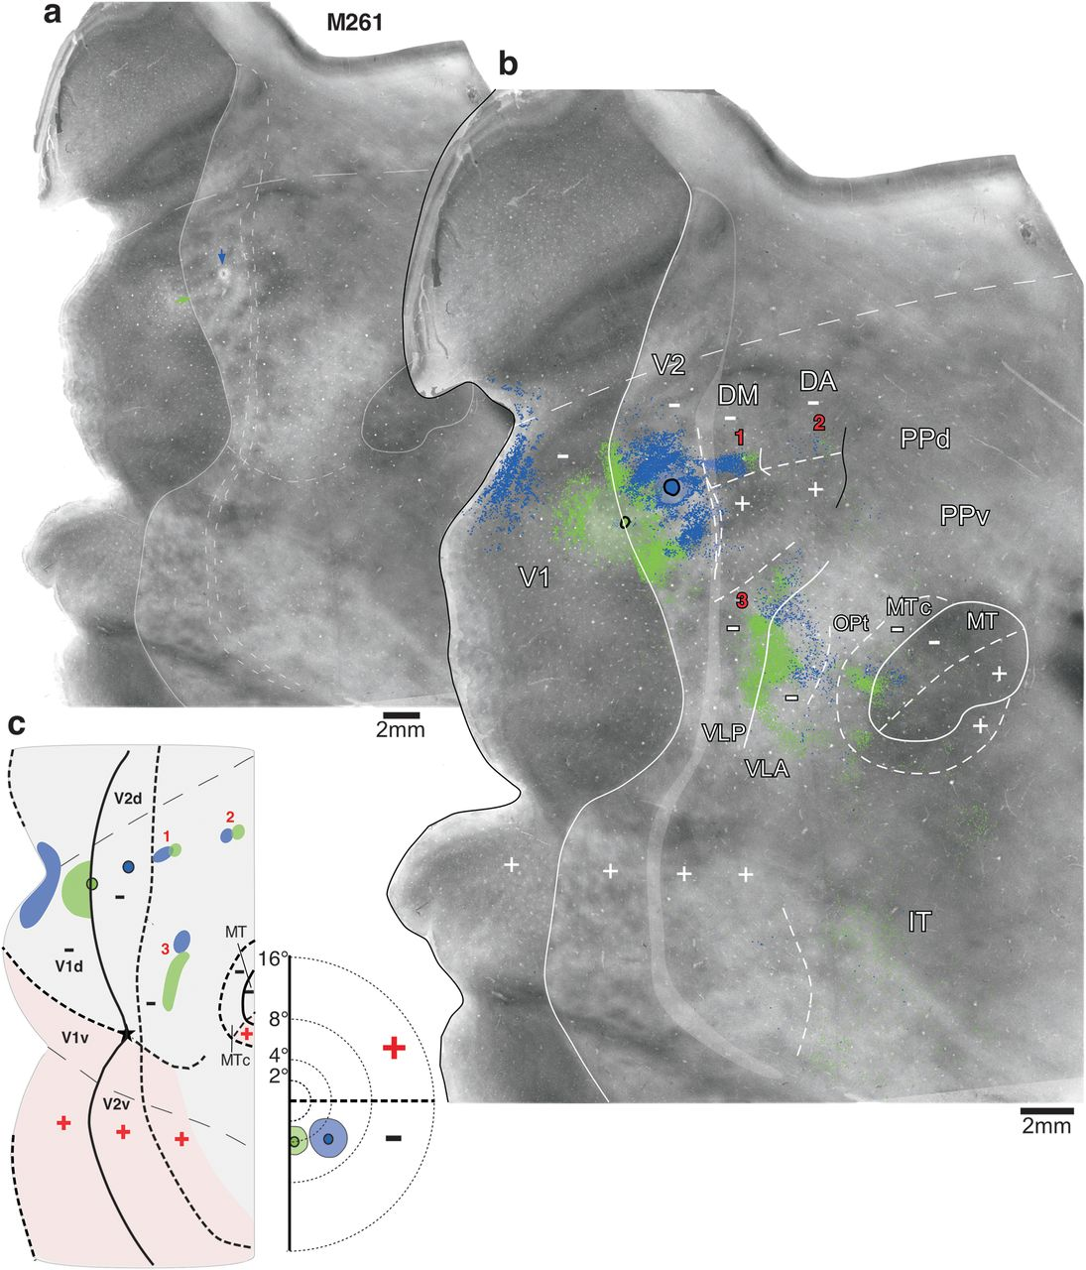
Figure 10. Row of tracer injections across the width of V2d. Case M261. (a) Image merge of 3 CO-stained sections with ...
Notes:
Figure 10. Row of tracer injections across the width of V2d. Case M261. (a) Image merge of 3 CO-stained sections with light delineation of the V2 and MT borders. The pale CO spot (blue arrow) is the location of the FB injection site; the green arrow points at the location of the CTB-488 injection site. (b) The same image as in (a), enlarged, with overlaid composite injection sites and the mapped cell label (CTB-488, green and FB, blue). Three different tracer injection sites were made in this case, but only label resulting from the most posterior and anterior injections is shown in the figure. (c) Left: Diagram of injection sites in V2d, and transported label in V1d and dorsal cortex anterior to V2d illustrating the 3 label reversals (numbered 1–3 here and in panel b) observed for this case. Right: Approximate visual field location of the tracer injections and their respective V1 label. Other conventions are as in Figure 3.
Unless provided in the caption above, the following copyright applies to the content of this slide: © The Author 2012. Published by Oxford University Press. All rights reserved. For permissions, please e-mail: journals.permissions@oup.com

Slide 6
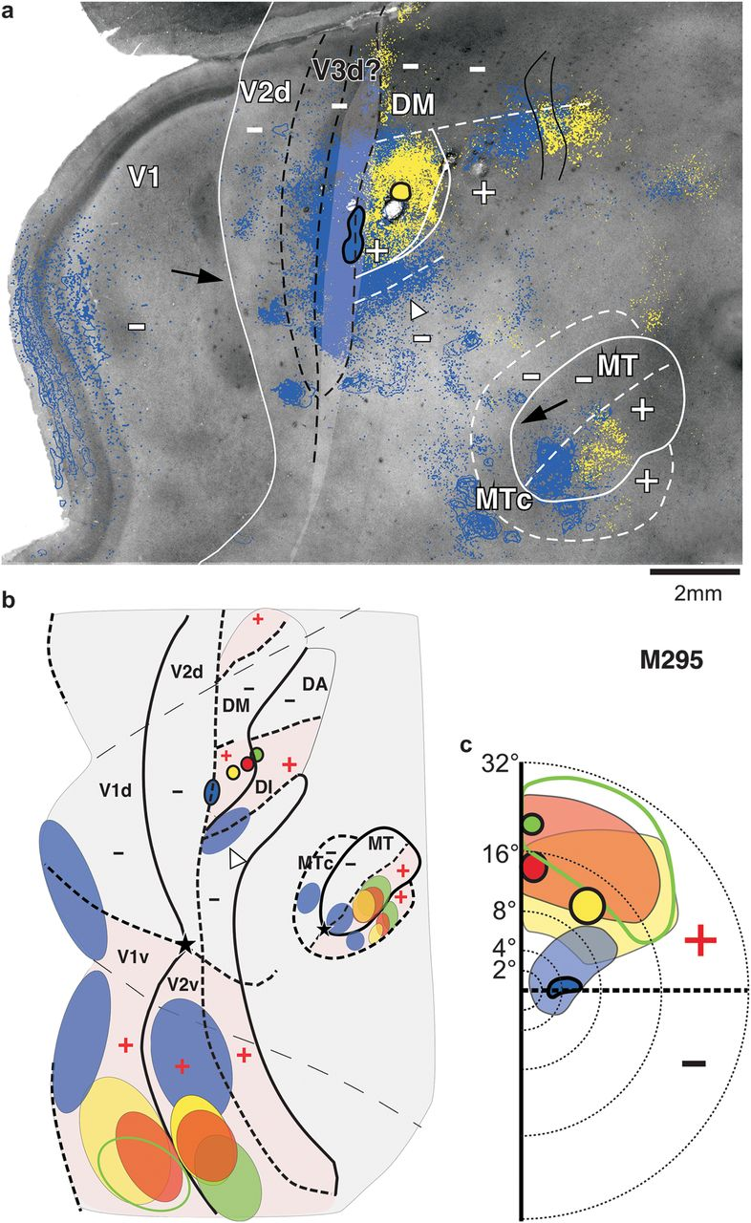
Figure 5. Area V3d cannot exist between DM+ and V2d. (a) Case M295. Attempt to “fit” V3d between V2d and DM+. The ...
Notes:
Figure 5. Area V3d cannot exist between DM+ and V2d. (a) Case M295. Attempt to “fit” V3d between V2d and DM+. The hypothetical borders of putative V3d are drawn in black. Black arrows point at the site of the VM representation in V1d and dorsal MT, where transported label is expected to result from a CTB-647 injection site (blue) straddling the VM representation at the V3d/DM+ border. Clearly, there is no CTB-647 label in these regions. Here and in (c), the open arrowhead points at the CTB-647 label at the HM representation of lower field VLP. Other conventions are as in Figure 3b. (b) Same as in Figure 3c, left, but here, the borders of areas just anterior to V2d are indicated, together with schematic outlines of label within them resulting from the tracer injections. Borders and outlines of label are also shown for areas MT and MTc. (c) Same as Figure 3c, right.
Unless provided in the caption above, the following copyright applies to the content of this slide: © The Author 2012. Published by Oxford University Press. All rights reserved. For permissions, please e-mail: journals.permissions@oup.com

Slide 7
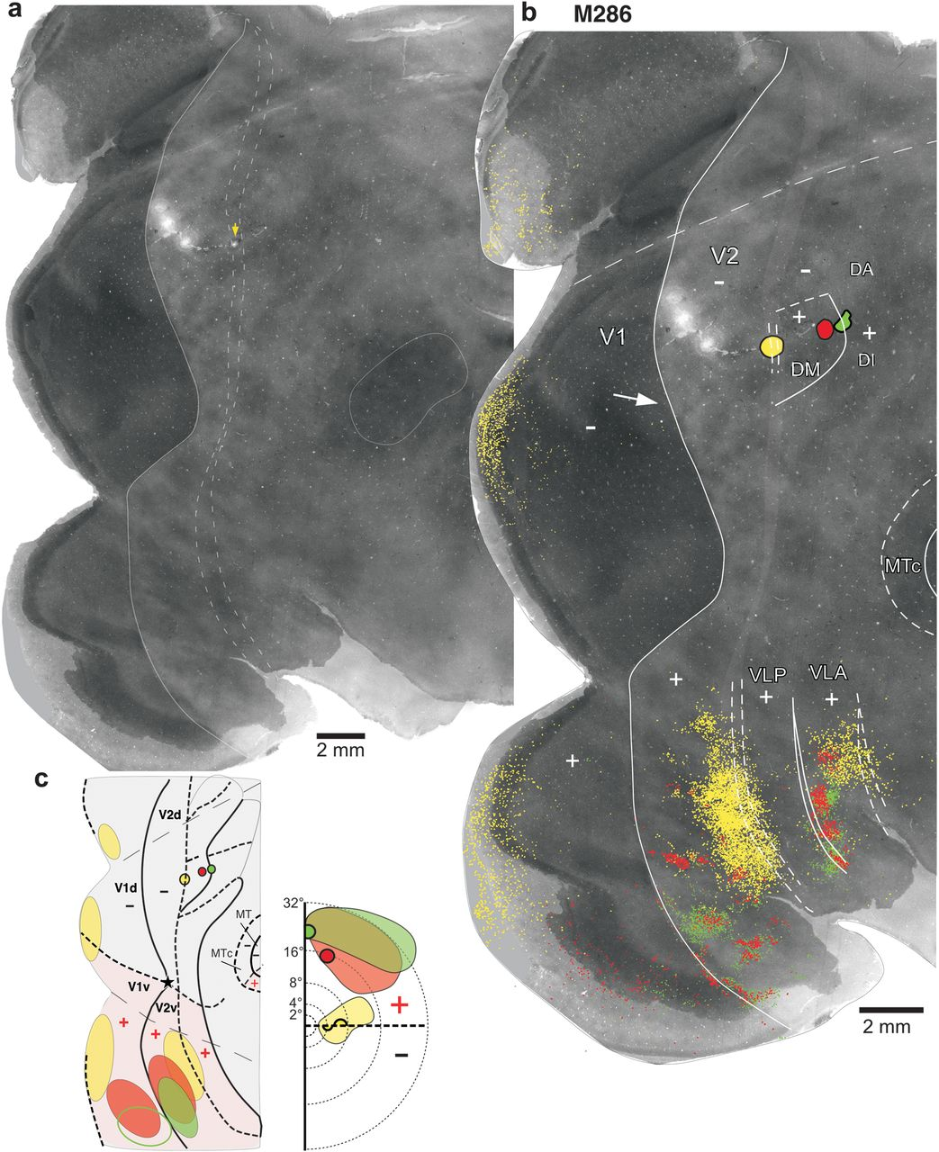
Figure 6. Row of 3 different tracer injections in cortex anterior to V2d. Case M286. (a) Image merge of 2 CO-stained ...
Notes:
Figure 6. Row of 3 different tracer injections in cortex anterior to V2d. Case M286. (a) Image merge of 2 CO-stained sections with light delineation of the V2 and MT borders. (b) Same CO image as in (a), enlarged, with overlaid composite injection sites (DY, yellow; CTBg, red, and CTB-488, green) and the mapped cell label in V1d, V1v, and ventral extrastriate cortex resulting from them. DY label in V2d (largely intraareal label) is not mapped because the presence of 3 large injections of FB obscured it and caused tissue damage (visible as lesions in V2d). There was no V2d label resulting from the 2 other injections. Label in dorsal cortex anterior to V2d was not mapped. Arrow indicates absence of transported label at/near the VM representation in V1, where it would be expected to result from an injection site located at the VM representation at the putative V3d/DM+ border. Other conventions are as in Figure 3b. (c) Left: Schematic diagram of unfolded and flattened V1 and part of extrastriate cortex showing, for this case, the location of the injection sites (outlined in black) and the outlines of the densest transported label (filled ovals) in V1 and V2 (intra-areal label is omitted). Unfilled green oval in V1v indicates sparse label. Right: visual field map of the approximate location of the injection sites (outlined in black) and resulting V1 label (shaded colored regions). All other conventions are as in Figure 3c.
Unless provided in the caption above, the following copyright applies to the content of this slide: © The Author 2012. Published by Oxford University Press. All rights reserved. For permissions, please e-mail: journals.permissions@oup.com

Slide 8
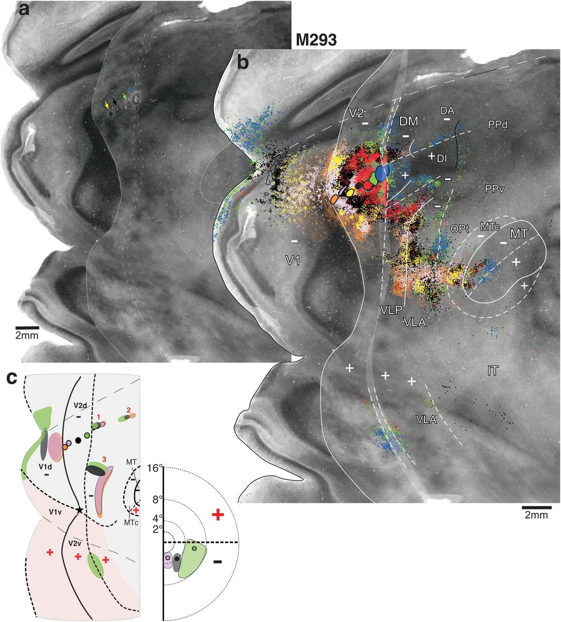
Figure 7. Row of 7 different tracer injections across the width of V2d: low magnification. Case M293. (a) Image merge ...
Notes:
Figure 7. Row of 7 different tracer injections across the width of V2d: low magnification. Case M293. (a) Image merge of 3 CO-stained sections with light delineation of the V2 and MT borders. Arrows point at the location of the DY (yellow), CTB-555 (black), CTB-488 (green), and FB (blue) injection sites, visible as small lesions or discolorations of CO staining. (b) Same image as in (a), enlarged, with overlaid composite injection sites and mapped cell label (BDA, orange; CTB-647, pink; DY, yellow; CTB-555, black; CTBg, red; CTB-488, green; and FB, blue). The BDA injection site produced almost exclusively anterograde label; labeled fibers were drawn in extrastriate cortex but not fully in V1, where the location of BDA label is instead indicated as a shaded orange area. (c) Left: Diagram of injection sites in V2d and transported label in V1d, V1v, V2v, and dorsal cortex anterior to V2d illustrating the 3 label reversals (numbered 1–3) observed for this case. For clarity of illustration, only the orange, pink, black, and green injections and their resulting label are shown. Note that orange and pink labels largely overlap, except in reversal 2, which showed no transport from the pink injection. Right: Approximate visual field location of the pink, black, and green injections and their respective V1 label; the visual field map of the BDA (orange) label in V1 largely overlaps that of the pink label and thus is not shown. Other conventions are as in Figure 3.
Unless provided in the caption above, the following copyright applies to the content of this slide: © The Author 2012. Published by Oxford University Press. All rights reserved. For permissions, please e-mail: journals.permissions@oup.com

Slide 9
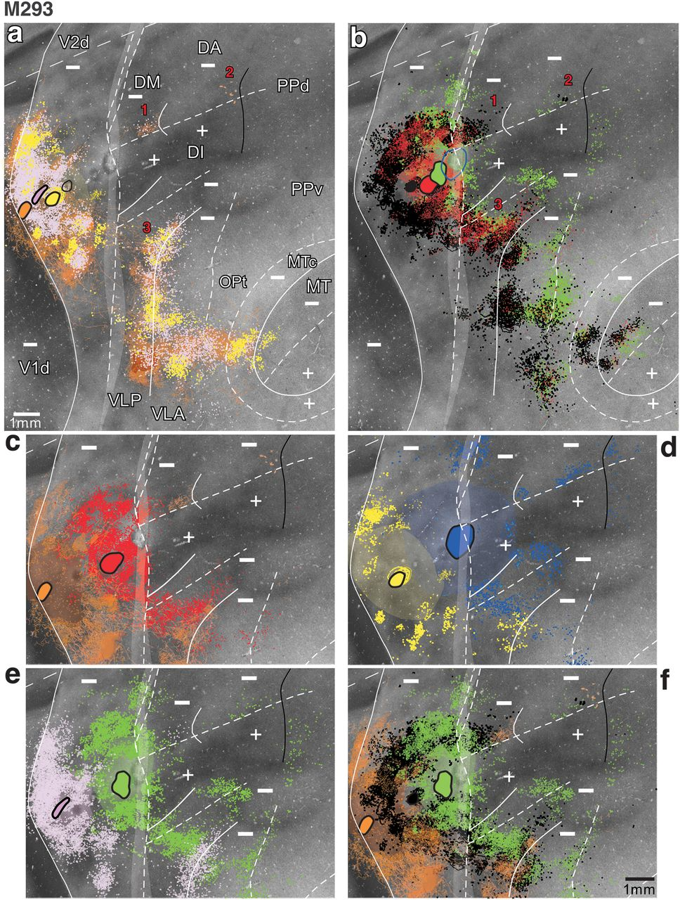
Figure 8. Row of injections across the width of V2d: high magnification. Case M293. (a,b) Enlarged images of injection ...
Notes:
Figure 8. Row of injections across the width of V2d: high magnification. Case M293. (a,b) Enlarged images of injection sites and resulting label in dorsal cortex from Figure 7. In (a), only label resulting from the 3 posterior injections is shown, while in (b), only label resulting from the 3 anterior injections is shown. The FB (blue) injection is not shown in (b) because it straddled the anterior border of V2d, thus involving 2 areas. Black and blue outlines in (a) and (b), respectively, outline the CTB-555 and FB injection sites, respectively. Numbers 1–3 indicate the 3 label reversals. (c–f) Portions of the images in (a,b) are further enlarged to better illustrate the 3 label reversals in cortex anterior to V2d. Only 2 or 3 injection sites and their resulting label are shown in each panel for clarity of illustration.
Unless provided in the caption above, the following copyright applies to the content of this slide: © The Author 2012. Published by Oxford University Press. All rights reserved. For permissions, please e-mail: journals.permissions@oup.com

Slide 10
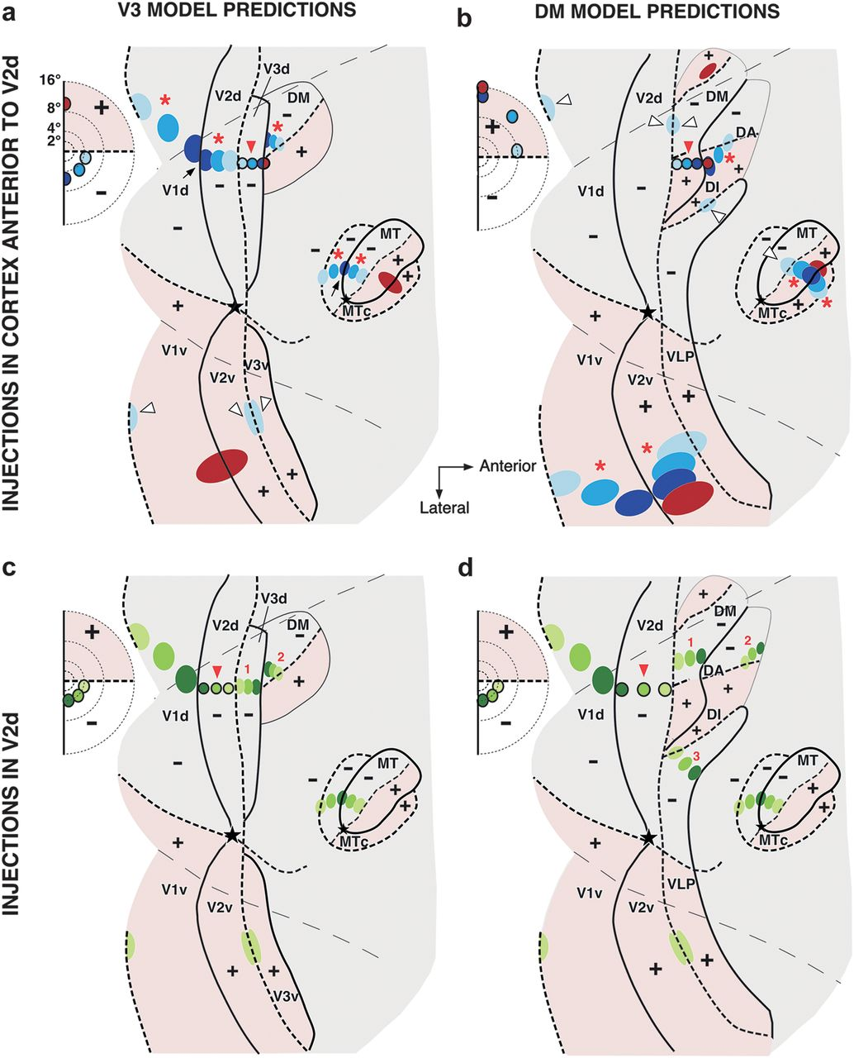
Figure 2. Topography of interareal connectivity predicted by the V3 and DM models. Predictions of the V3 (a,c) and DM ...
Notes:
Figure 2. Topography of interareal connectivity predicted by the V3 and DM models. Predictions of the V3 (a,c) and DM (b,d) models are illustrated onto outlines of unfolded and flattened marmoset visual cortex. Conventions are as in Figure 1. (a) Hypothetical row of multiple tracer injections (red arrowhead) starting in V3d near the V2d/V3d border and ending at the V3d/DM+ border. Injection sites (outlined circles) and respective resulting label (ovals) are shown in blue for injections involving the lower visual field representation of V3d and in red for the portion of the injection involving the upper visual field representation of DM. Here and in (b–d), the inset on the left indicates the eccentricities of the hypothetical tracer injection sites. The regions representing the upper visual field are shaded in pink. Only the red half of the injection involving DM+ is expected to produce significant label in upper visual field regions, nearer VM representations (red ovals). The V3d injection near the HM representation (lightest blue) is expected to produce some label in upper visual field regions confined to HM representations (open arrowheads). All other injections are expected to produce label in cortex representing the lower visual field (red asterisks). (b) A hypothetical row of injections (red arrowhead) starting in DM+, near the V2d/DM+ border and ending just anterior to the DM+ border, in the upper visual field representation of area DI/DA. Injection sites and resulting transported label are shown in blue for injections involving DM+, and in red for the injection involving DI/DA. All injections are in upper visual field cortex and therefore are expected to produce significant label in topographically corresponding cortical regions representing the upper visual field (red asterisks). The injection nearest the HM representation of the DM+ posterior border (lightest blue) may produce label in lower visual field regions but confined to HM representations (lightest blue ovals in dorsal cortex marked by open arrowheads). (c,d) Hypothetical row of tracer injections (outlined green circles marked by red arrowhead) involving the full width of V2d and expected location of resulting label (green ovals) according to each model, respectively (see Results). Numbers 1–3 indicate the label reversals resulting from the injection sequence. For simplicity, in (a–d), some areas and respective transported label are omitted.
Unless provided in the caption above, the following copyright applies to the content of this slide: © The Author 2012. Published by Oxford University Press. All rights reserved. For permissions, please e-mail: journals.permissions@oup.com

Slide 11
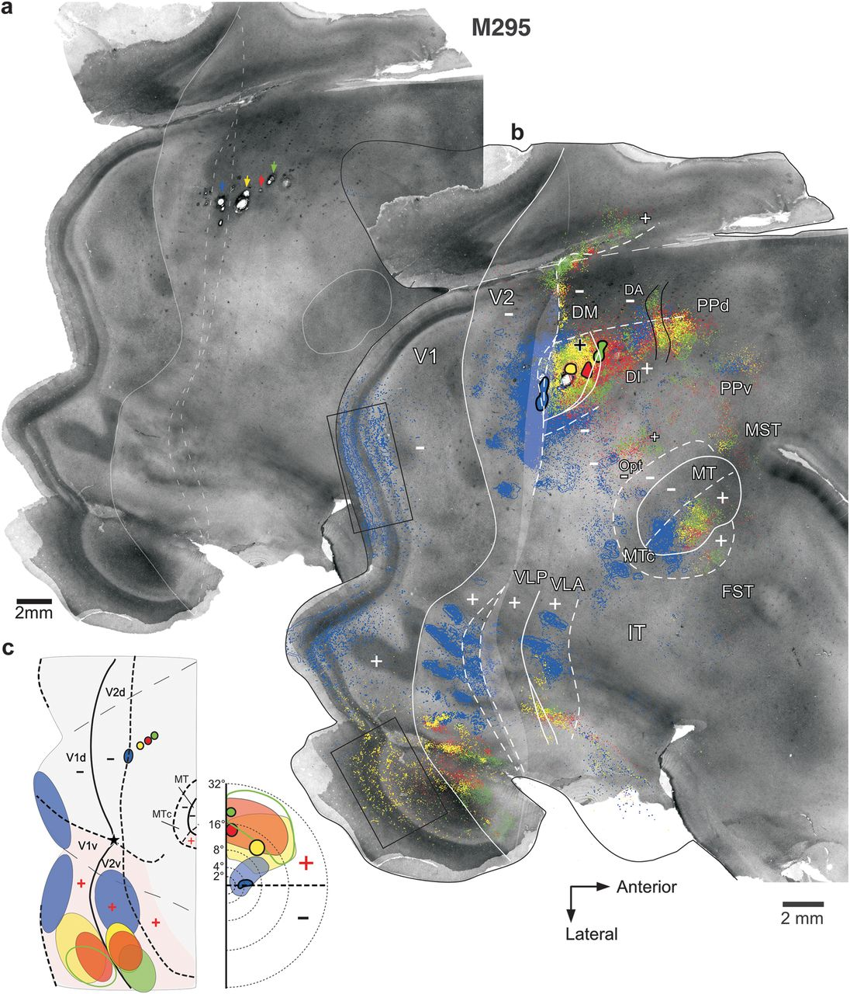
Figure 3. Row of 4 different tracer injections in cortex anterior to V2d. Case M295. (a) CO image resulting from the ...
Notes:
Figure 3. Row of 4 different tracer injections in cortex anterior to V2d. Case M295. (a) CO image resulting from the merging of 3 CO-stained sections. To avoid obscuring the CO-staining pattern, only the posterior V2 and MT borders (solid contours) and the posterior and anterior boundaries of the CO-defined transition zone (dashed contours) at the V2 anterior border are delineated. The CO-defined transition zone is indicated as a shaded gray area in (b). Colored arrows point at the location of the 4 injection sites, which are visible on the CO image as small lesions. Additional lesions are from additional tracer injections, which failed to transport. (b) The same image as in (a) is shown enlarged, with overlaid composite injection sites (encircled in black) and the mapped cell label resulting from each injection (CTB-647, blue; CTB-555, yellow; CTBg, red; and CTB-488, green). These tracers sometimes also labeled anterogradely axon fibers; their location is outlined in the figure and is shown overlaid to the retrograde label as the 2 showed the same topographic distribution. Solid and dashed white contours: areal borders representing the VM and HM, respectively. Black contours demarcate areal borders based on the topography of transported label but for which the meridian representation is unknown. Thin dashed contour outlines the dorsal surface of visual cortex prior to unfolding. “+” and “−” signs indicate cortical regions representing the upper and lower visual field, respectively. In cases in which a single border could not be unequivocally identified based on the topography of label, we delineated the outer extremes of the uncertainty border region. Black boxes in V1v and V1d indicate the location of label shown enlarged in Figure 4a,b, respectively. Scale bars here and in all remaining figures are corrected for tissue shrinkage. (c) Left: Schematic diagram of a standard unfolded and flattened visual cortex showing the location of the injection sites (outlined in black) and the outlines of the densest transported label (filled ovals) in V1 and V2 (the dense intraareal label in V2d resulted from the blue injection is omitted). Only the V1, V2, MT, and MTc borders are marked. Unfilled green oval in V1v indicates sparse label. Right: visual field map of the approximate location of the injection sites (outlined in black) and resulting V1 label (shaded colored regions). All other conventions are as in Figure 1. Same conventions are used in all remaining figures.
Unless provided in the caption above, the following copyright applies to the content of this slide: © The Author 2012. Published by Oxford University Press. All rights reserved. For permissions, please e-mail: journals.permissions@oup.com

Slide 12
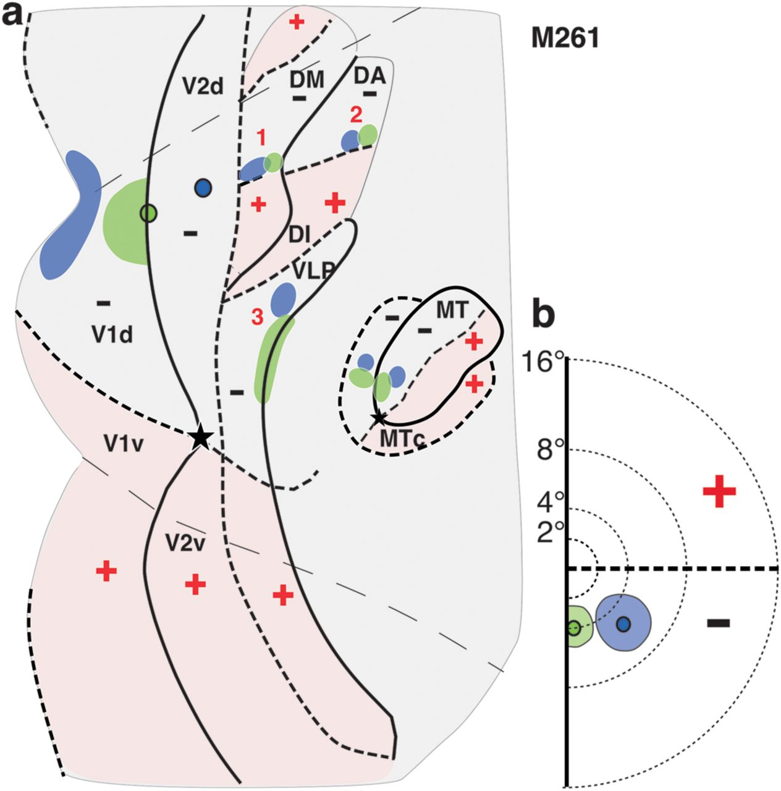
Figure 11. Summary of areal location of tracer injections and transported label for case M261. (a) Same as in Figure ...
Notes:
Figure 11. Summary of areal location of tracer injections and transported label for case M261. (a) Same as in Figure 10c, left, but here, the borders of areas just anterior to V2d are indicated, together with outlines of label within them resulting from the tracer injections. Borders and outlines of label are also shown for areas DI/DA, MT, and MTc. (b) Same as Figure 10c, right.
Unless provided in the caption above, the following copyright applies to the content of this slide: © The Author 2012. Published by Oxford University Press. All rights reserved. For permissions, please e-mail: journals.permissions@oup.com

