Slide 1
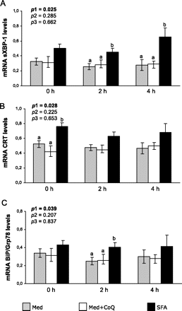
Figure 3. Fasting and postprandial levels of sXBP-1 mRNA (A), CRT mRNA (B), and BiP/Grp78 mRNA (C) in peripheral ...
Notes:
Figure 3. Fasting and postprandial levels of sXBP-1 mRNA (A), CRT mRNA (B), and BiP/Grp78 mRNA (C) in peripheral mononuclear cells according to the type of fat consumed. Data were analyzed using analysis of variance for repeated measures. All values represent the mean ± SEs. Bars with different superscript letters depict statistically significantly differences (p < .05). p1: diet effect, p2: time effect, and p3: Diet × Time interaction.
Unless provided in the caption above, the following copyright applies to the content of this slide: © The Author 2011. Published by Oxford University Press on behalf of The Gerontological Society of America. All rights reserved. For permissions, please e-mail: journals.permissions@oup.com.

Slide 2
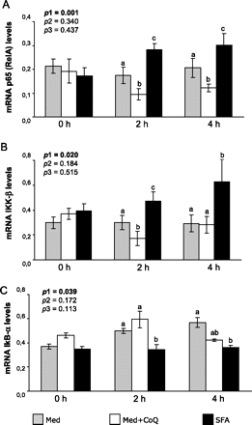
Figure 1. Fasting and postprandial levels of p65 (RelA) mRNA (A), IKK-β mRNA (B), and IkB-α mRNA (C) in peripheral ...
Notes:
Figure 1. Fasting and postprandial levels of p65 (RelA) mRNA (A), IKK-β mRNA (B), and IkB-α mRNA (C) in peripheral mononuclear cells according to the type of fat consumed. Data were analyzed using analysis of variance for repeated measures. All values represent the mean ± SEs. Bars with different superscript letters depict statistically significantly differences (p < .05). p1: diet effect, p2: time effect, and p3: Diet × Time interaction.
Unless provided in the caption above, the following copyright applies to the content of this slide: © The Author 2011. Published by Oxford University Press on behalf of The Gerontological Society of America. All rights reserved. For permissions, please e-mail: journals.permissions@oup.com.

Slide 3
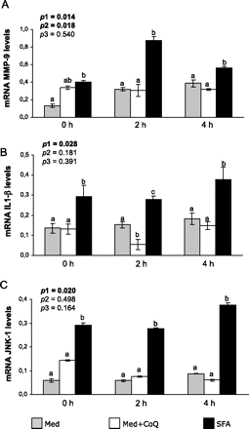
Figure 2. Fasting and postprandial levels of MMP-9 mRNA (A), IL1-β mRNA (B), and JNK-1 mRNA (C) in peripheral ...
Notes:
Figure 2. Fasting and postprandial levels of MMP-9 mRNA (A), IL1-β mRNA (B), and JNK-1 mRNA (C) in peripheral mononuclear cells according to the type of fat consumed. Data were analyzed using analysis of variance for repeated measures. All values represent the mean ± SEs. Bars with different superscript letters depict statistically significantly differences (p < .05). p1: diet effect, p2: time effect, and p3: Diet × Time interaction.
Unless provided in the caption above, the following copyright applies to the content of this slide: © The Author 2011. Published by Oxford University Press on behalf of The Gerontological Society of America. All rights reserved. For permissions, please e-mail: journals.permissions@oup.com.

