Slide 1
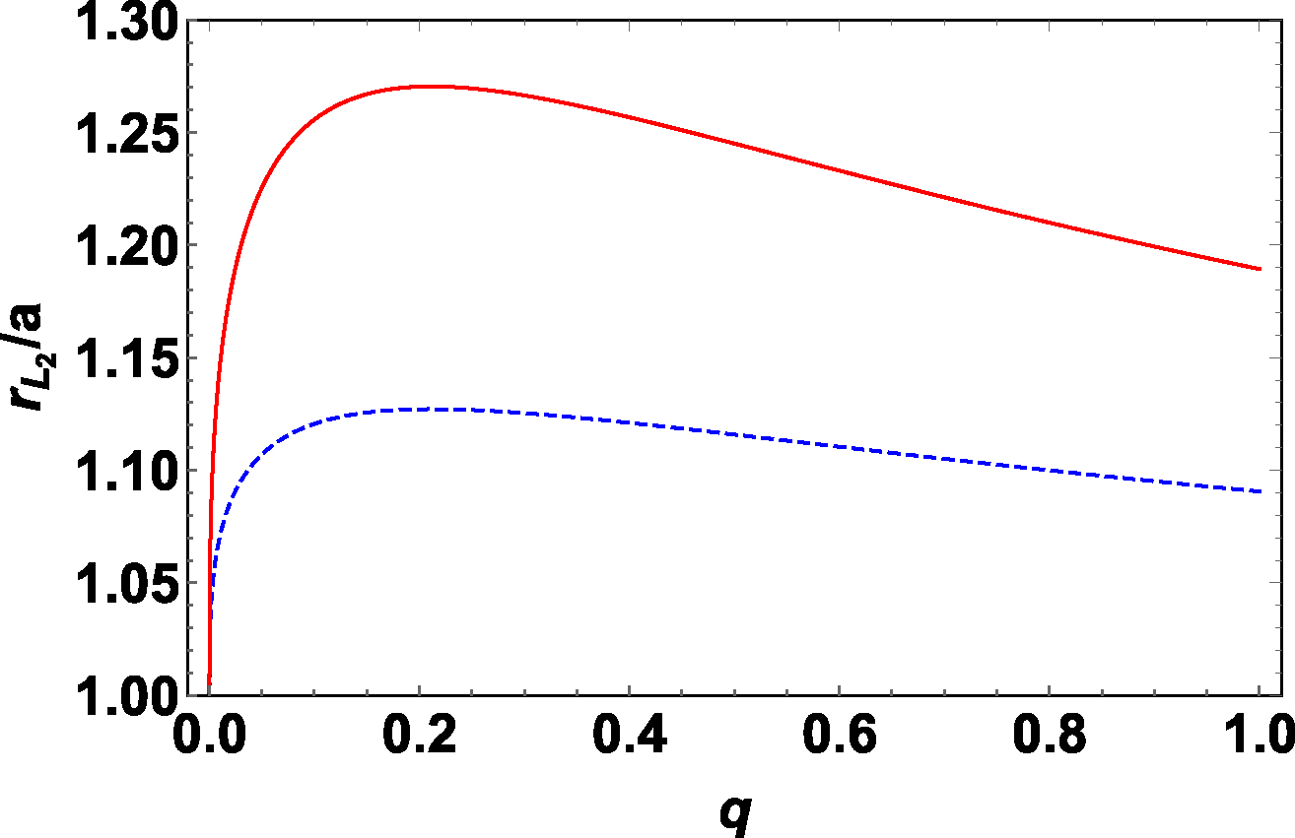
Figure 1. Distance to the L₂ point from the binary system’s barycentre $r_{L_2}$ in units of the relative ...
Notes:
Figure 1. Distance to the L2 point from the binary system’s barycentre $r_{L_2}$ in units of the relative orbital separation a for mass ratio 0 ≤ q ≤ 1 (the solid upper curve, equation 5). The dashed curve shows the value $\sqrt{r_{L_2}/a}$ determining the angular momentum loss through L2.
Unless provided in the caption above, the following copyright applies to the content of this slide: © 2018 The Author(s) Published by Oxford University Press on behalf of the Royal Astronomical SocietyThis article is published and distributed under the terms of the Oxford University Press, Standard Journals Publication Model (https://academic.oup.com/journals/pages/about_us/legal/notices)

Slide 2
Figure 2. Constraints on the mass ratio of SS433 for different values of parameters x = 1.0, 1.1, and α = 0.086 ...
Notes:
Figure 2. Constraints on the mass ratio of SS433 for different values of parameters x = 1.0, 1.1, and α = 0.086 (left-hand panel) and 0.86 (right-hand panel) corresponding to the mass-loss rate $\dot{M}_\mathrm{v}=10^{-4}$ and $10^{-5} \, \mathrm{M}_\odot$ yr−1, respectively.
Unless provided in the caption above, the following copyright applies to the content of this slide: © 2018 The Author(s) Published by Oxford University Press on behalf of the Royal Astronomical SocietyThis article is published and distributed under the terms of the Oxford University Press, Standard Journals Publication Model (https://academic.oup.com/journals/pages/about_us/legal/notices)

