Slide 1
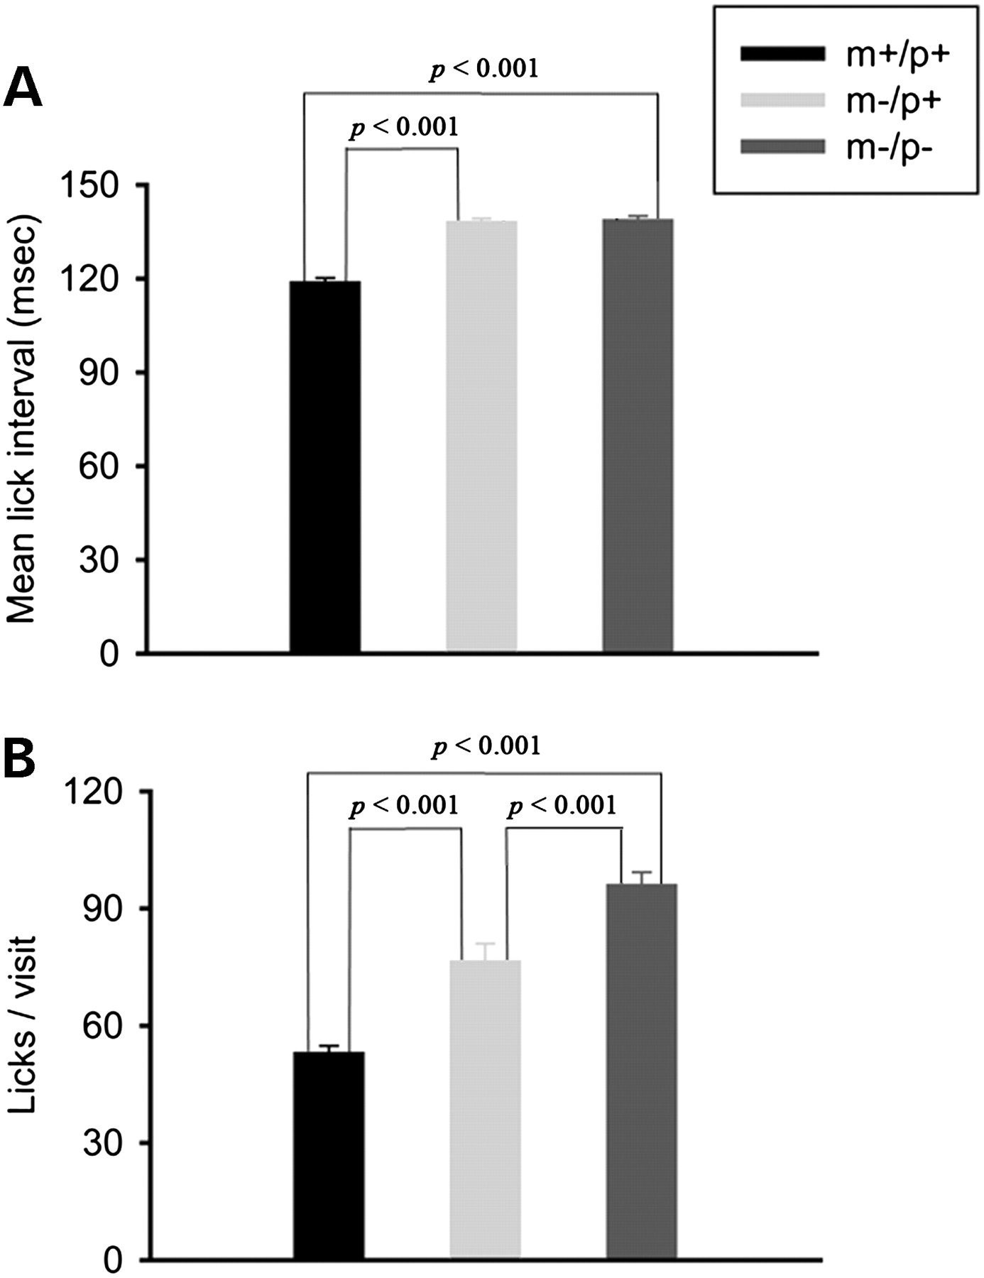
Figure 1. Quantitative analysis of fluid consumption and licking behavior in wild-type and Ube3a deficient mice. (A) ...
Notes:
Figure 1. Quantitative analysis of fluid consumption and licking behavior in wild-type and Ube3a deficient mice. (A) The mean inter-lick intervals were significantly longer in both groups of Ube3a deficient mice (dark grey bar, m−/p−, light grey bar, m−/p+) compared to wild-type (black bar, m+/p+). (B) All three groups also differed significantly in the number of licks generated per visit to the water spout. Both groups of Ube3a deficient mice generated significantly more licks than wild-type mice and knock-out mice licked significantly more often than maternal heterozygotes. Error bars are standard error of the mean (SEM). Statistical significance was determined with the Mann–Whitney U test. Number of animals tested: m+/p+: N = 9, m−/p+: N = 10, m−/p−: N = 10.
Unless provided in the caption above, the following copyright applies to the content of this slide: © The Author 2008. Published by Oxford University Press. All rights reserved. For Permissions, please email: journals.permissions@oxfordjournals.org

Slide 2
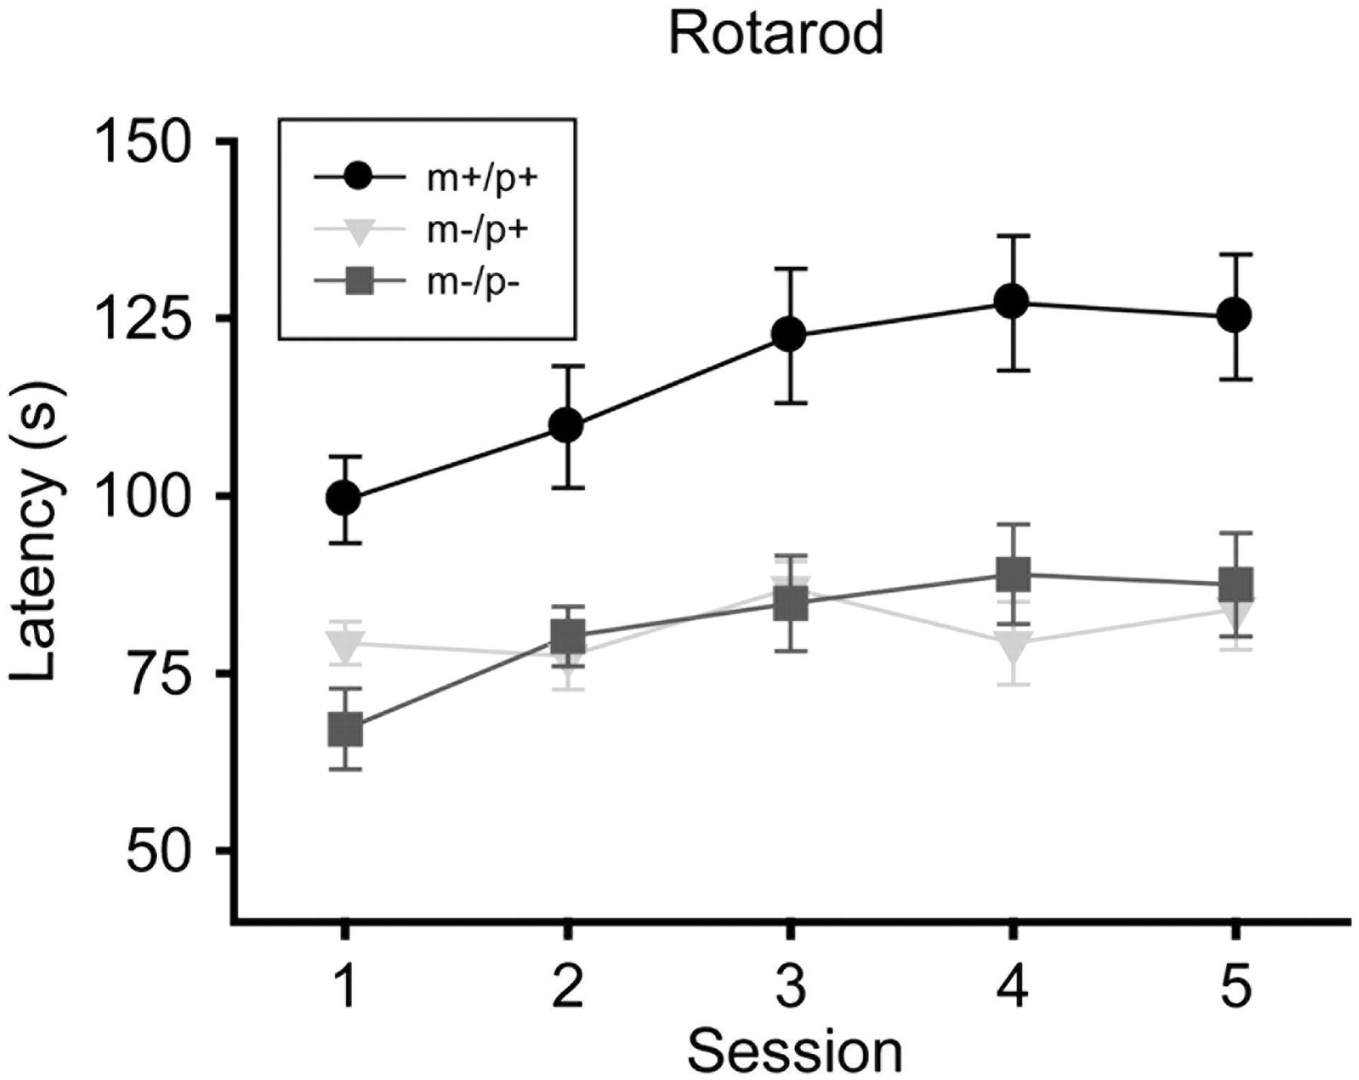
Figure 2. Rotarod analysis of motor functioning in wild-type and Ube3a deficient mice. Eight mice from all three ...
Notes:
Figure 2. Rotarod analysis of motor functioning in wild-type and Ube3a deficient mice. Eight mice from all three genotypes were tested on an accelerating rotarod with the same destination speed for five consecutive days. The latencies from rotation onset until the mice fell off the rod were measured. Wild-type mice (black circles) managed to stay significantly longer on the accelerating rotarod than Ube3am−/p+ (light grey inverted triangles) and Ube3am−/p− (grey squares) mice. Differences between Ube3am−/p+ versus wild-type littermates (P < 0.05) and between Ube3am−/p− versus wild-type littermates (P < 0.05) were significant for all data points in a one-way ANOVA test. Each data point represents the average across right mice. Error bars are SEM.
Unless provided in the caption above, the following copyright applies to the content of this slide: © The Author 2008. Published by Oxford University Press. All rights reserved. For Permissions, please email: journals.permissions@oxfordjournals.org

Slide 3
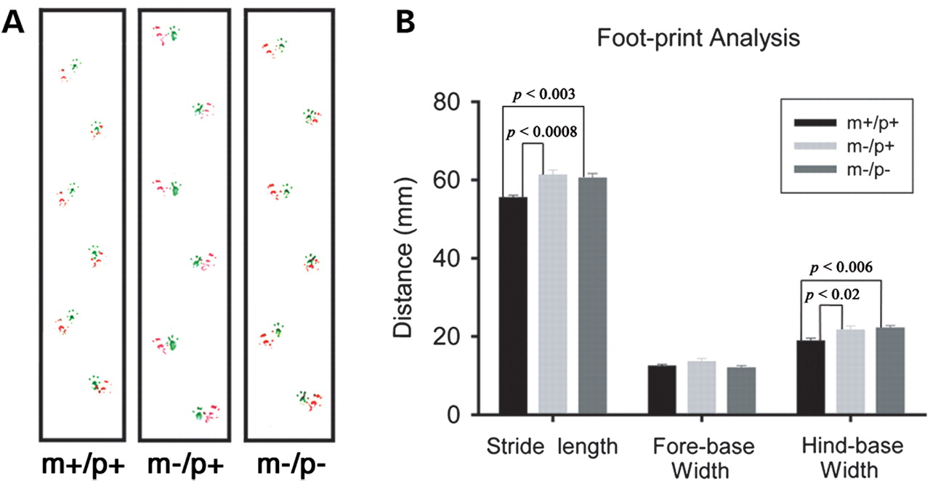
Figure 3. Footprint assay of gait abnormalities in wild-type and Ube3a deficient mice. (A) Examples of foot print ...
Notes:
Figure 3. Footprint assay of gait abnormalities in wild-type and Ube3a deficient mice. (A) Examples of foot print assays from each of the three genotypes. Forepaws were marked with green ink, hind paws with red ink. The stride length was measured using the left hind paw, while the stride width was measured using both forepaw and hind paw widths. (B) The stride length and the hind-base width of Ube3am−/p+ (light gray bars) and Ube3am−/p− (dark gray bars) mice were significantly longer compared to Ube3am+/p+ (black bars). Significant differences and P-values (one-way ANOVA test) are indicated by brackets. Error bars are SEM.
Unless provided in the caption above, the following copyright applies to the content of this slide: © The Author 2008. Published by Oxford University Press. All rights reserved. For Permissions, please email: journals.permissions@oxfordjournals.org

Slide 4
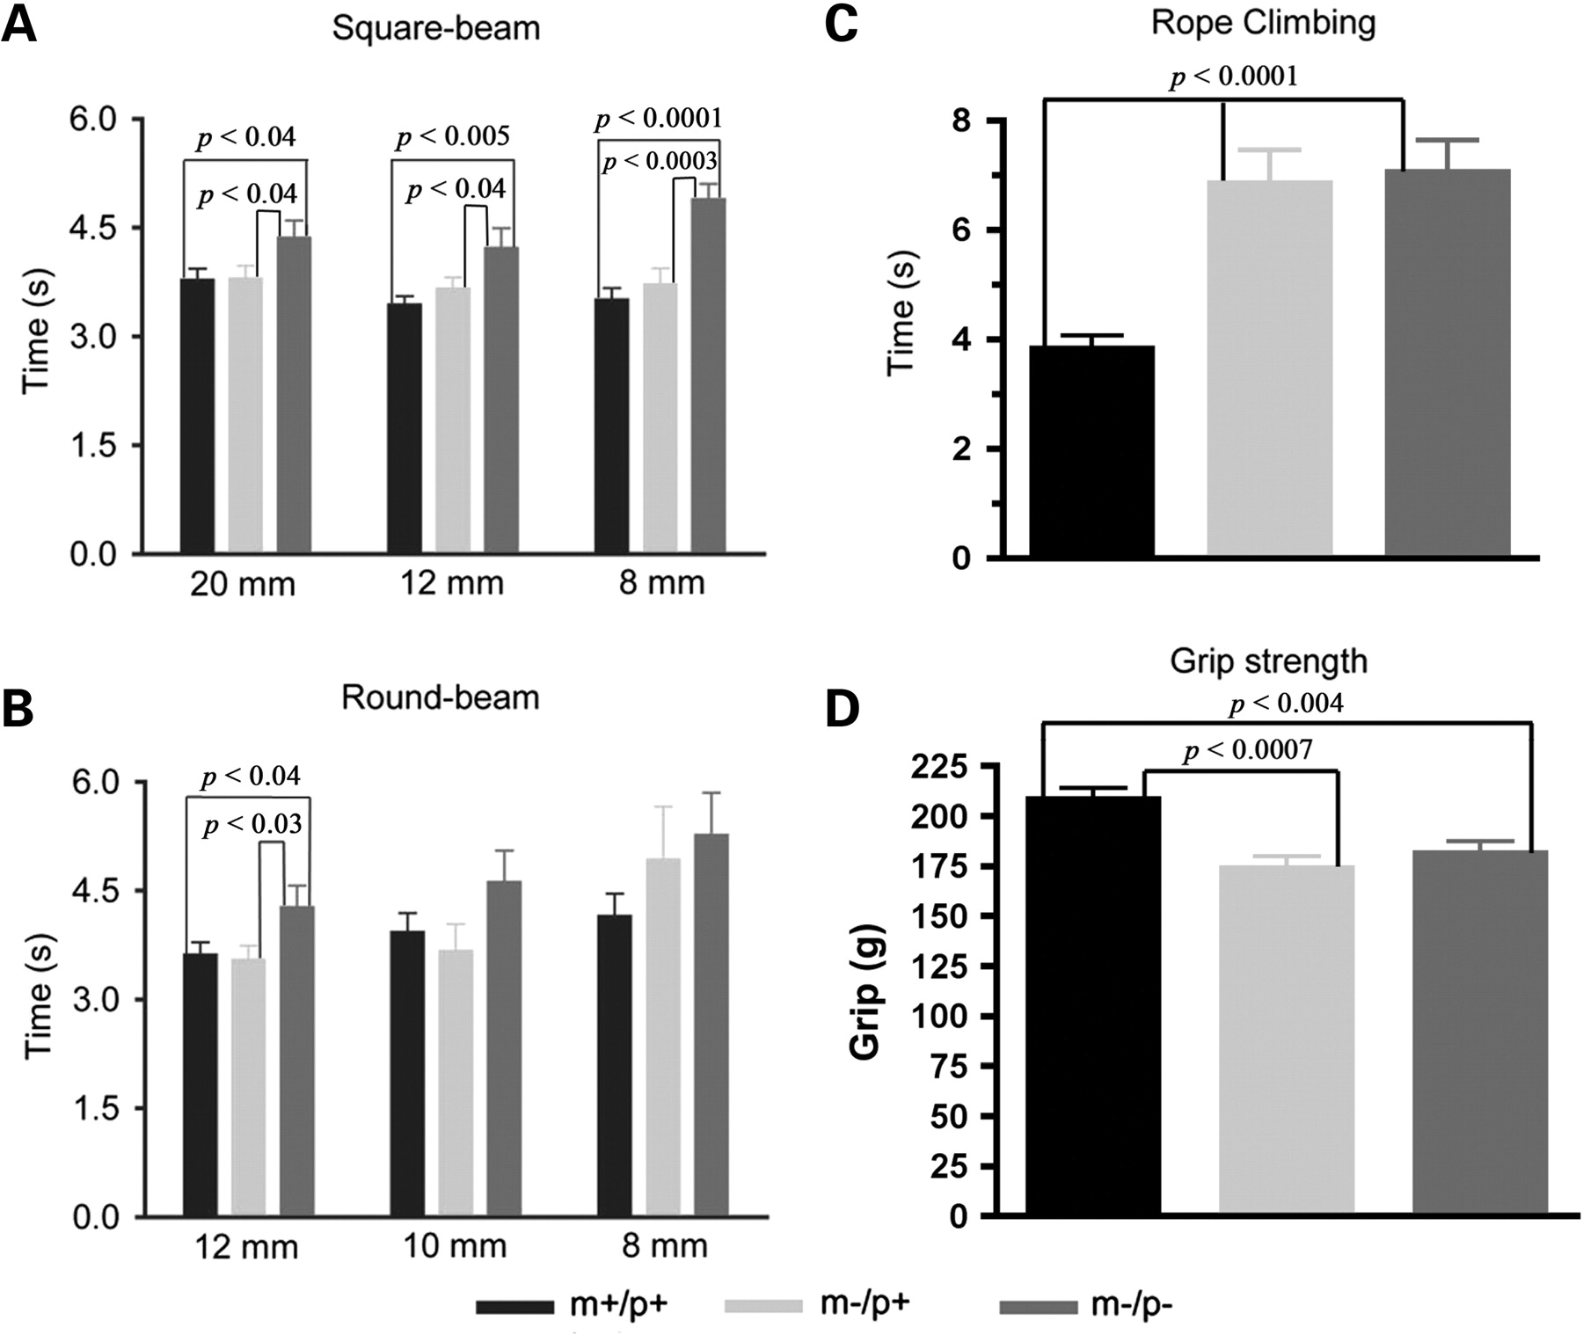
Figure 4. Quantitative analysis of grip strength, vertical rope climbing and raised beam task in wild-type and Ube3a ...
Notes:
Figure 4. Quantitative analysis of grip strength, vertical rope climbing and raised beam task in wild-type and Ube3a deficient mice. (A) Ube3am−/p− mice (dark gray bars) needed significantly more time to cross the 80 mm raised square beams of all three different widths (20, 12 and 8 mm) than did wild-type (black bars) or Ube3am−/p+ mice (light gray bars). (B) Ube3am−/p− mice (dark gray bars) needed significantly more time than wild-type or Ube3am−/p+ mice to cross the 80 mm raised round beam of 12 mm diameter. There were no significant differences between the three genotypes for round beam diameters 10 and 8 mm. (C) The vertical rope climbing assay revealed significant differences between both Ube3a deficient genotypes and wild-type animals. Ube3a deficient mice climbed significantly slower than wild-type animals. Ube3a deficient mice were also resistant to climbing and some could not be trained, resulting in abnormally large error bars for the measurements in maternal heterozygotes (NMat-Het = 16; light gray bar) and Ube3a null mice (NKO = 15; dark gray bars). (D) Grip strength analysis revealed significantly reduced grip strengths in Ube3am−/p+ mice and Ube3am−/p− mice compared to wild-type animals. There was no significant difference in grip strengths between Ube3am−/p+ and Ube3am−/p−. Each data point represents the average across all mice within each group (Nwt = 23; NMat-Het = 18; NKO = 13). Error bars are SEM. Significant differences and P-values (Mann–Whitney U statistical test) are indicated by brackets.
Unless provided in the caption above, the following copyright applies to the content of this slide: © The Author 2008. Published by Oxford University Press. All rights reserved. For Permissions, please email: journals.permissions@oxfordjournals.org

Slide 5
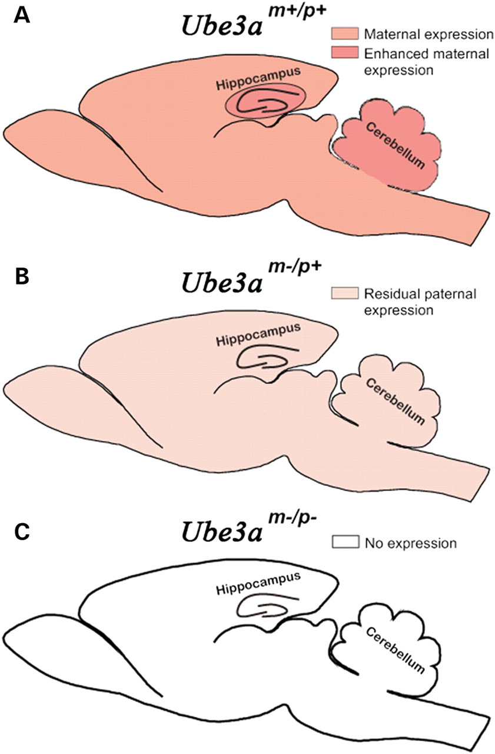
Figure 5. The magnitude of the quantitative differences in licking behavior correspond to the degree of loss of Ube3a. ...
Notes:
Figure 5. The magnitude of the quantitative differences in licking behavior correspond to the degree of loss of Ube3a. (A) In the wild-type mouse, the maternal Ube3a allele is expressed everywhere in the brain with enhanced expression in the hippocampus and cerebellum. (B) Loss of the maternal allele will result in complete loss of maternal Ube3a expression but low-level expression of the paternal allele remains throughout the brain. (C) In the knock out mice, Ube3a expression is completely eliminated from all brain areas, even those where Ube3a expression is normally low. The differences in Ube3a expression in wild-type mice, maternal hetorozygotes and null mice are directly correlated with the quantitative differences in the licks-per-visit phenotype between these three genotypes. The cerebellum is the brain structure most likely to be responsible for the phenotype in Ube3am−/p+ mice. Complete loss of Ube3a likely amplifies the phenotype because the complete loss of expression eliminates residual function in the cerebellum and in cerebellar projection areas in the rest of the brain.
Unless provided in the caption above, the following copyright applies to the content of this slide: © The Author 2008. Published by Oxford University Press. All rights reserved. For Permissions, please email: journals.permissions@oxfordjournals.org

