Slide 1
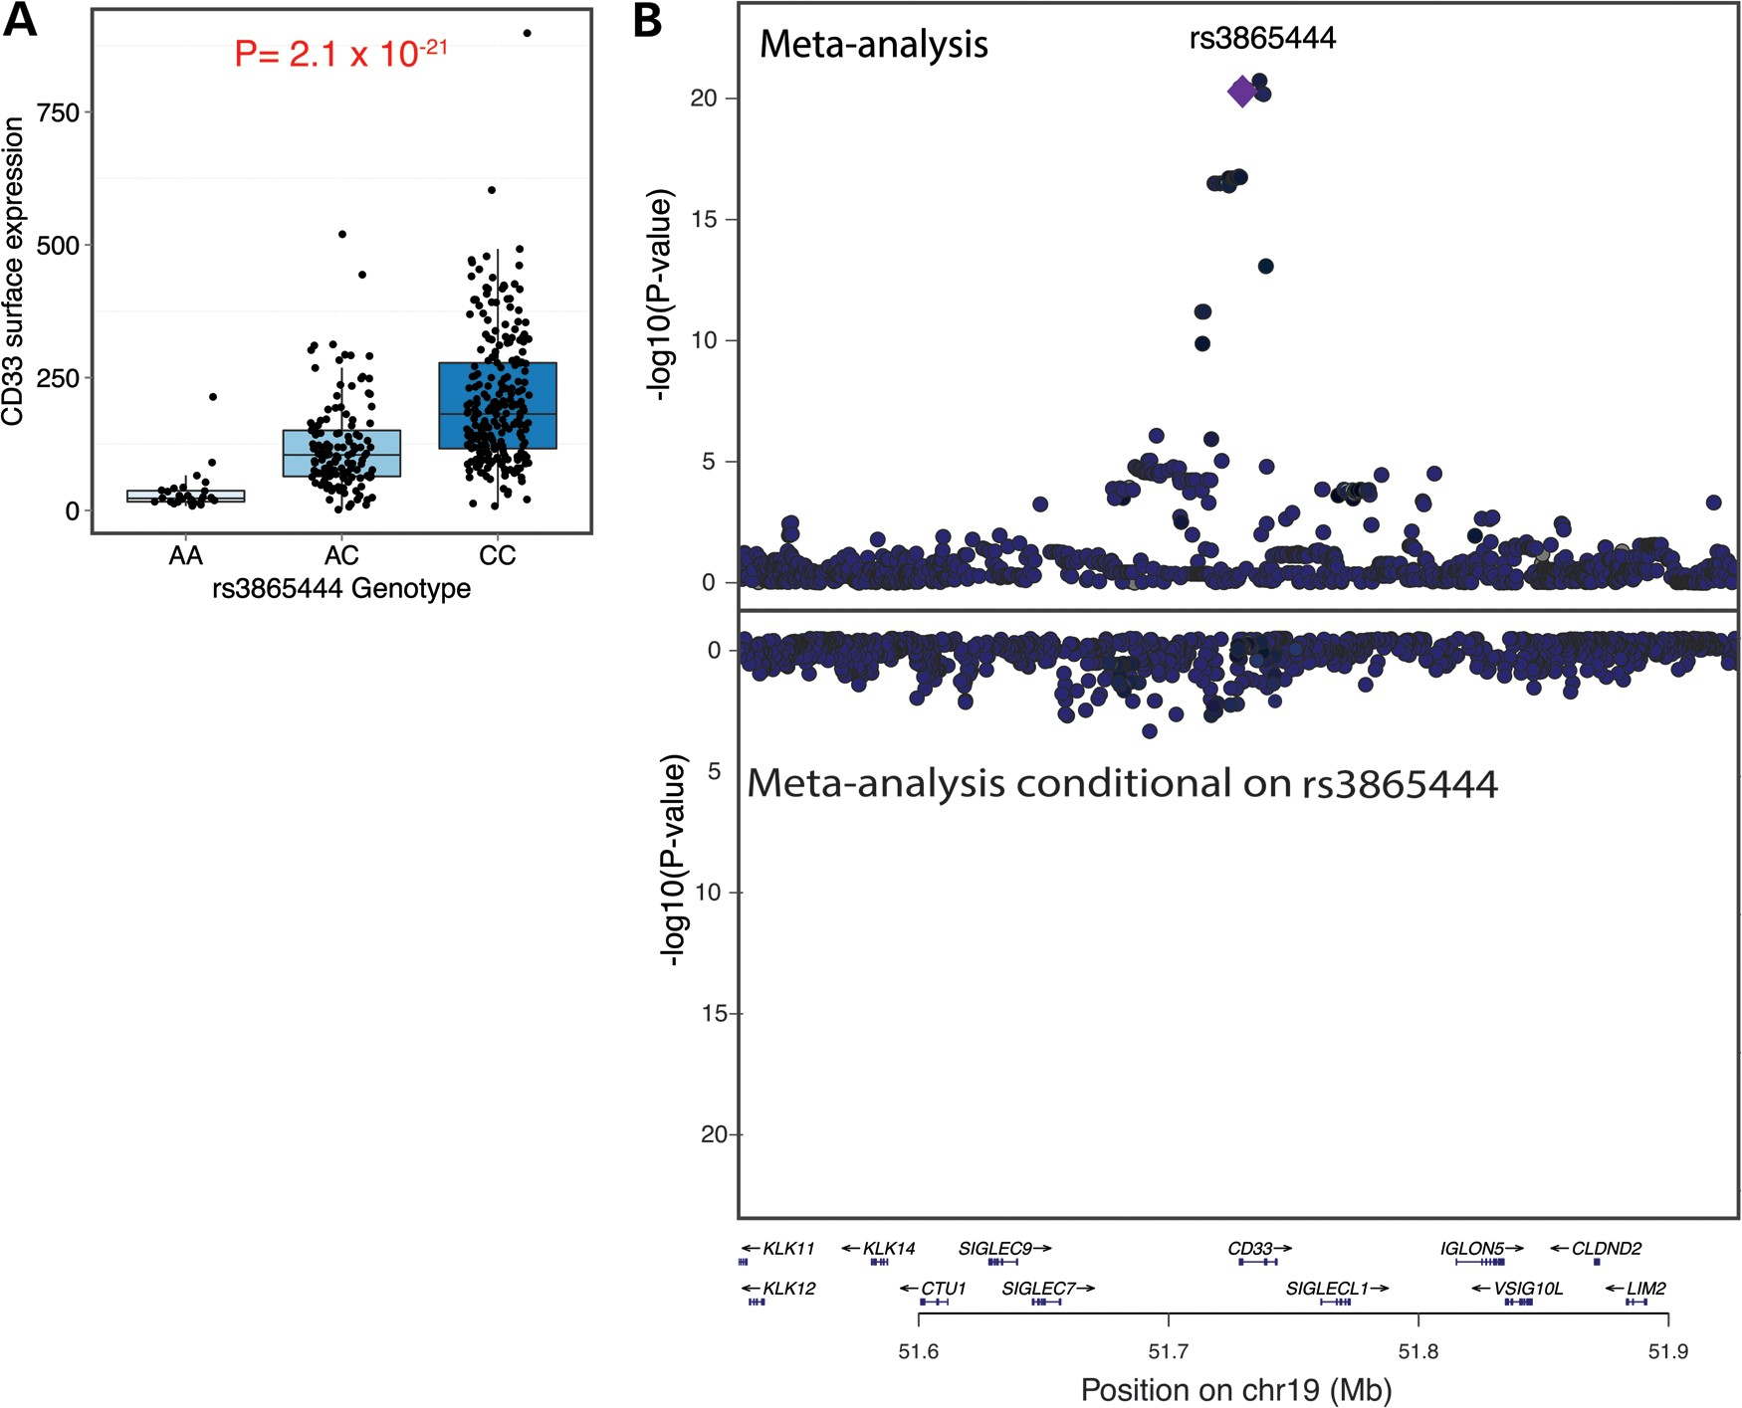
Figure 1. A single haplotype in the CD33 locus is associated with greater CD33 expression on the cell surface of ...
Notes:
Figure 1. A single haplotype in the CD33 locus is associated with greater CD33 expression on the cell surface of monocytes. (A) rs3865444C is significantly associated with greater CD33 surface expression in a meta-analysis of monocyte-derived data from ROSMAP/CHAP EA and AA subjects (n = 390, P = 2.1 × 10−21). (B) Upper panel: Within the CD33 locus, meta-analysis of the ROSMAP/CHAP EA and AA CD33 monocyte surface expression data distills the significant SNPs to a group of five variants in high LD, one of which is likely to be the causal variant. rs3865444 is one of those five variants. Lower panel: Using conditional analysis to adjust for the effect of rs3865444, we find no significant residual associations with CD33 surface expression in the CD33 locus. The y-axis scale is inverted relative to the upper panel. This image was produced using LocusZoom (27).
Unless provided in the caption above, the following copyright applies to the content of this slide: © The Author 2013. Published by Oxford University Press. All rights reserved. For Permissions, please email: journals.permissions@oup.com

Slide 2
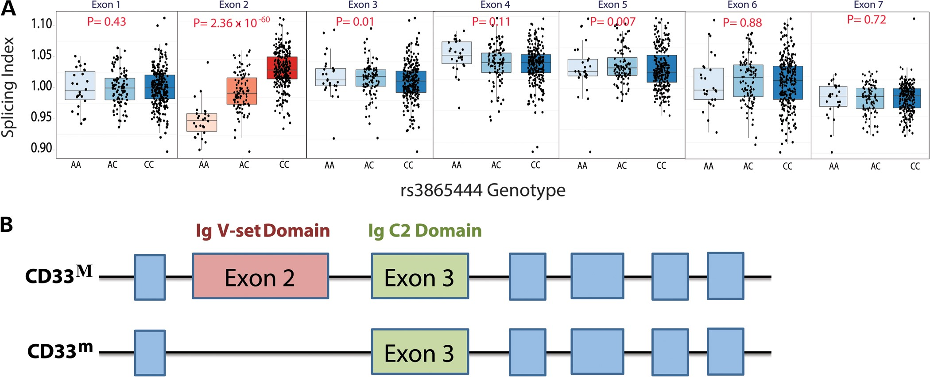
Figure 2. The CD33 locus is associated with greater mRNA expression of CD33 exon 2, which encodes an Ig V-set domain. ...
Notes:
Figure 2. The CD33 locus is associated with greater mRNA expression of CD33 exon 2, which encodes an Ig V-set domain. (A) Using a SI to deconvolve gene-level and exon-specific expression, rs3865444C is significantly associated with a greater mRNA expression of CD33 exon 2 (n = 398, P = 2.36 × 10−60) quantified using a microarray platform and RNA from ex vivo, cytometrically sorted monocytes from ImmVar EA, AA and EAA subjects. The CD33 locus is not significantly associated with expression of other CD33 exons in monocytes. (B) CD33 is a type 1 transmembrane glycoprotein expressed on the surface of myeloid cells. Full-length CD33M consists of a signal peptide, an extracellular Ig V-set sialic-acid binding domain, an extracellular Ig C2-set domain, a transmembrane region, and a cytosolic domain containing immunoreceptor tyrosine-based inhibitory motifs. The alternatively spliced CD33m isoform lacks the Ig V-set domain encoded by exon 2 (13). The figure is not drawn to scale.
Unless provided in the caption above, the following copyright applies to the content of this slide: © The Author 2013. Published by Oxford University Press. All rights reserved. For Permissions, please email: journals.permissions@oup.com

Slide 3
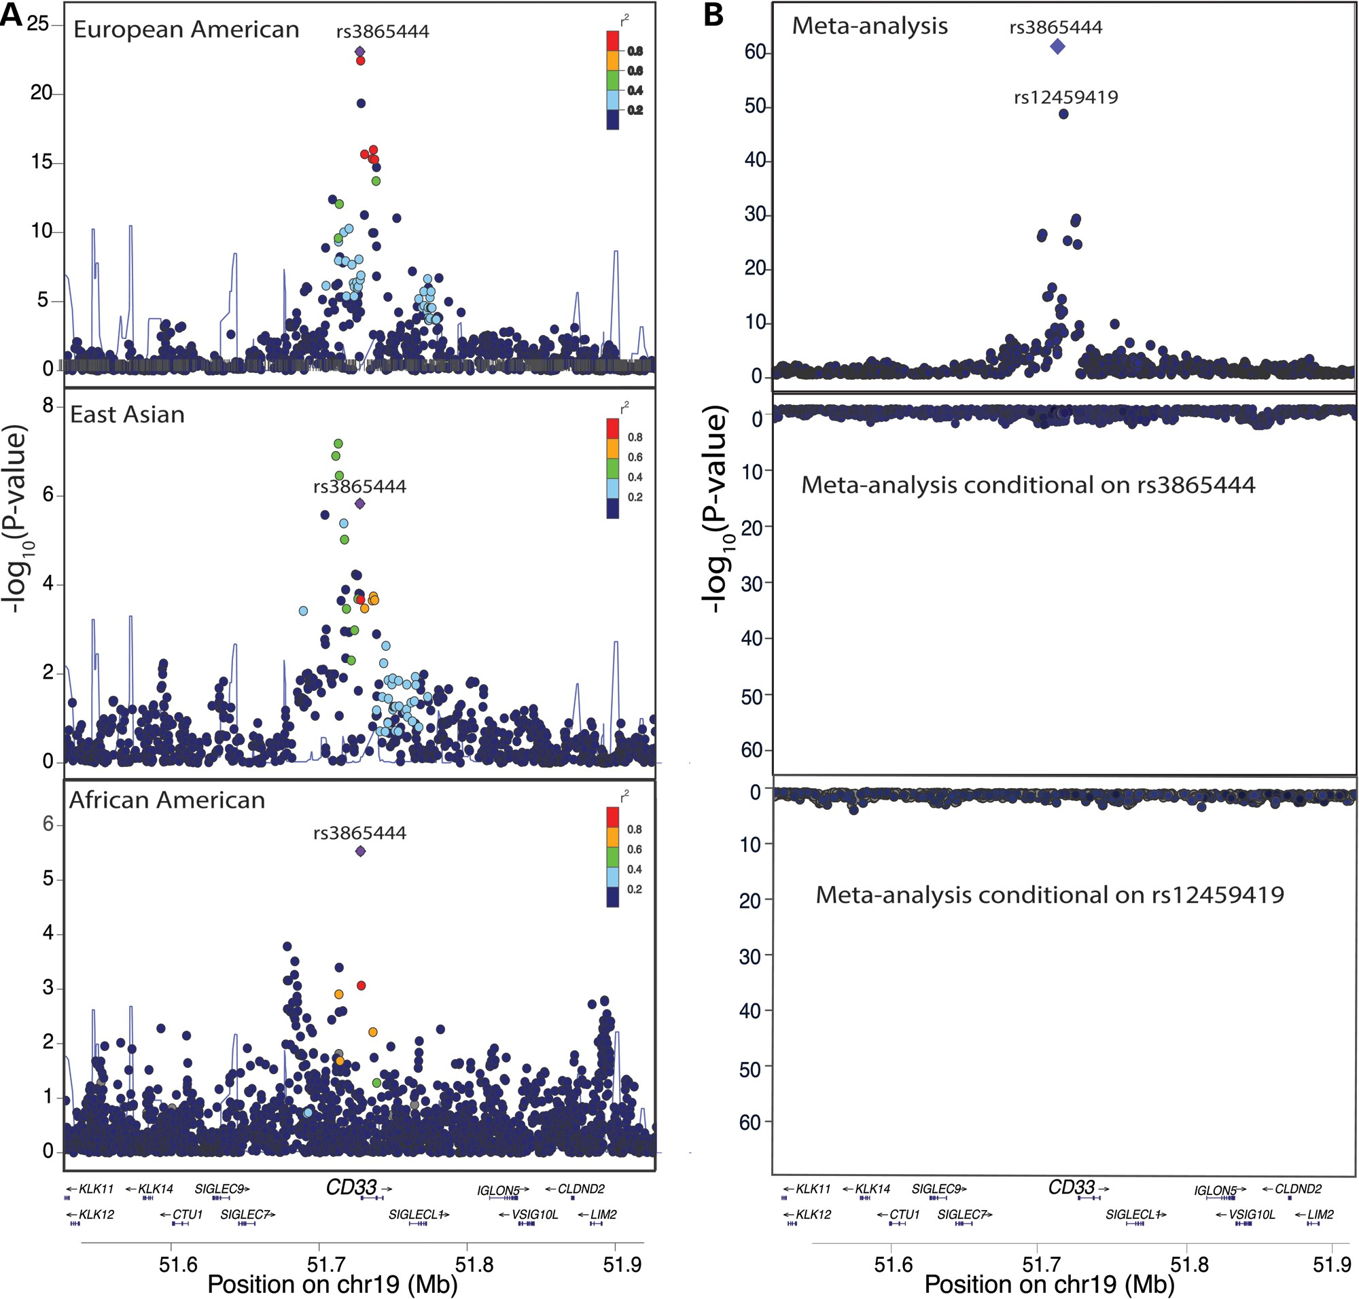
Figure 3. rs3865444^{C} is the best candidate causal variant for association with the mRNA SI of CD33 exon 2 in ...
Notes:
Figure 3. rs3865444C is the best candidate causal variant for association with the mRNA SI of CD33 exon 2 in monocytes. (A) In the ImmVar EA and AA populations, rs3865444 is the most significant SNP for association with the mRNA SI of CD33 exon 2 (pEA = 1.6 × 10−23; pAA = 2.9 × 10−6). In the ImmVar EAA population, multiple SNPs in high LD with rs3865444 are associated with the SI of exon 2. (B) In a meta-analysis (upper panel) of the EA, AA and EAA populations, rs3865444 is the most significant SNP for association with the SI of CD33 exon 2 (P = 2.36 × 10−60) (top panel), and, after conditioning on rs3865444 and rs12459419, there are no significant genetic associations with the SI of exon 2 (lower panel). These images were produced using LocusZoom (27).
Unless provided in the caption above, the following copyright applies to the content of this slide: © The Author 2013. Published by Oxford University Press. All rights reserved. For Permissions, please email: journals.permissions@oup.com

Slide 4
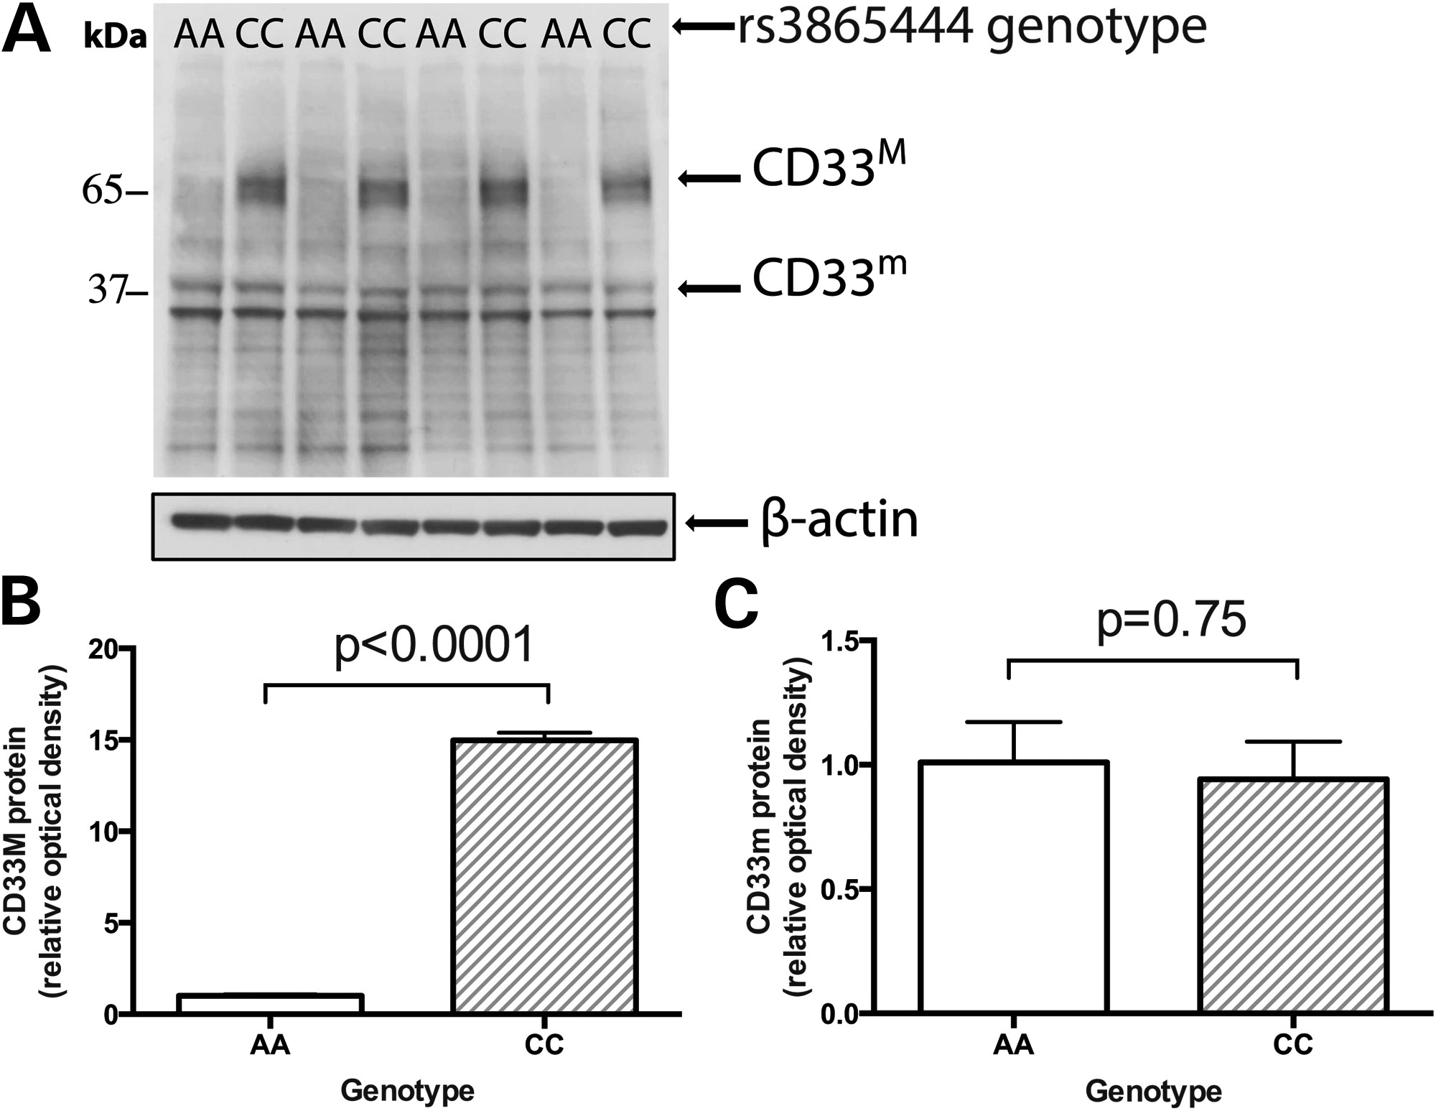
Figure 4. Western blot analysis confirms the association between rs3865444^{C} and increased abundance of the ...
Notes:
Figure 4. Western blot analysis confirms the association between rs3865444C and increased abundance of the full-length CD33M isoform in monocytes. (A) In purified, ex vivo monocytes isolated from healthy subjects in the PhenoGenetic cohort, western blot analysis indicates that full-length CD33M isoform is expressed at low levels in individuals with the protective rs3865444AA genotype compared with individuals with the risk rs3865444CC genotype. (B) As quantified by densitometric analysis, this association is statistically significant (P < 0.0001). (C) The truncated CD33m isoform has no significant association with rs3865444 genotype (P = 0.75).
Unless provided in the caption above, the following copyright applies to the content of this slide: © The Author 2013. Published by Oxford University Press. All rights reserved. For Permissions, please email: journals.permissions@oup.com

