Slide 1
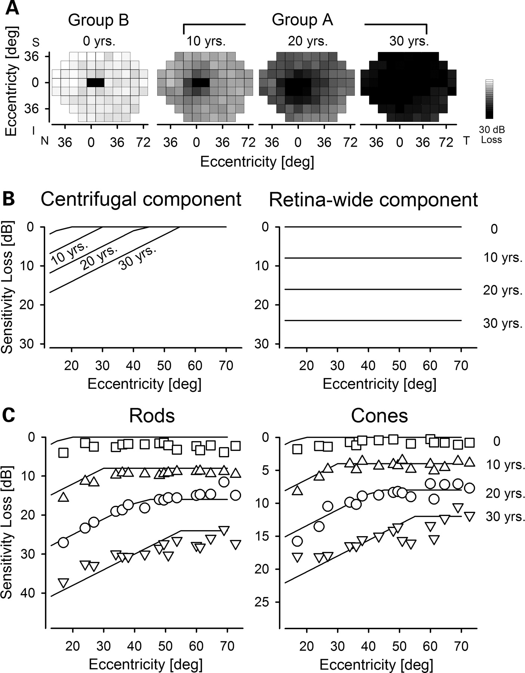
Figure 4. Spatio-temporal progression of retina-wide disease. (A) Maps of mean rod sensitivity loss in Group B ...
Notes:
Figure 4. Spatio-temporal progression of retina-wide disease. (A) Maps of mean rod sensitivity loss in Group B individuals with no retina-wide disease (0 years, n = 16) and Group A individuals divided into three sub-groups based on their estimated duration of retina-wide disease (10 years, n = 9; 20 years, n = 13; 30 years, n = 8). (B) Two components (centrifugal and retina-wide) of a model describe spatio-temporal progression of rod disease as a function of eccentricity from the fovea. (C) Mean values of the rod and cone sensitivity losses before initiation of retina-wide disease (0 years) and over three decades of disease duration (10, 20 and 30 years) are shown as a function of eccentricity from the fovea (symbols). Spatio-temporal model of disease progression (lines) consisting of the sum of a centrifugal component and a diffuse retina-wide component are fit (by eye) as ensemble to the data.
Unless provided in the caption above, the following copyright applies to the content of this slide: © The Author 2008. Published by Oxford University Press. All rights reserved. For Permissions, please email: journals.permissions@oxfordjournals.org

Slide 2
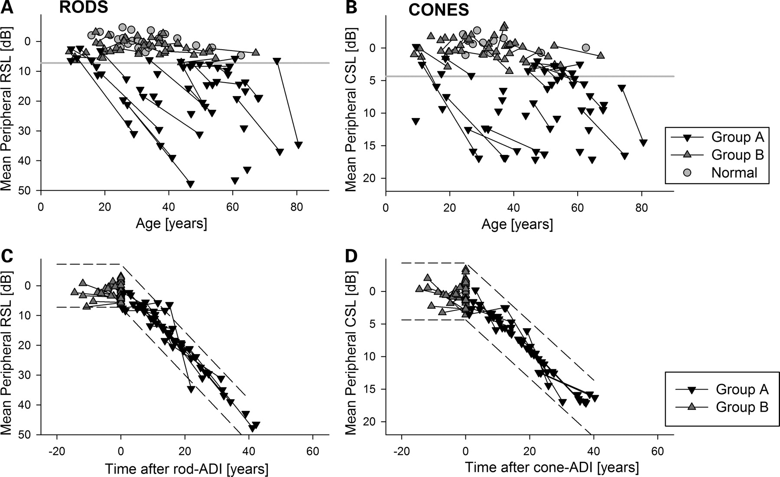
Figure 3. Derivation of a quantitative severity metric based on a mathematical model of retina-wide rod and cone ...
Notes:
Figure 3. Derivation of a quantitative severity metric based on a mathematical model of retina-wide rod and cone disease progression. (A and B) Plots of mean retina-wide rod and cone sensitivity loss (RSL, CSL) as a function of age illustrate the range of ABCA4 disease severity observed in the current cohort. Serial evaluations in the same individual are shown with a line connecting symbols. The lower limit (mean−3SD) of normal is shown (horizontal gray line). Group A individuals showed significant sensitivity loss at one or both of their evaluations. Group B individuals had normal sensitivities. (C and D) Plot of mean RSL and CSL data against time after age of disease initiation (ADI) supports a common underlying function of disease progression by reducing the scatter apparent in (A) and (B). The function of disease progression assumes that all individuals progress with an invariant exponential rate after a variable delay. Dashed lines represent the normal variability (+/−3SD) extended along the respective exponentials for rod and cone disease.
Unless provided in the caption above, the following copyright applies to the content of this slide: © The Author 2008. Published by Oxford University Press. All rights reserved. For Permissions, please email: journals.permissions@oxfordjournals.org

Slide 3
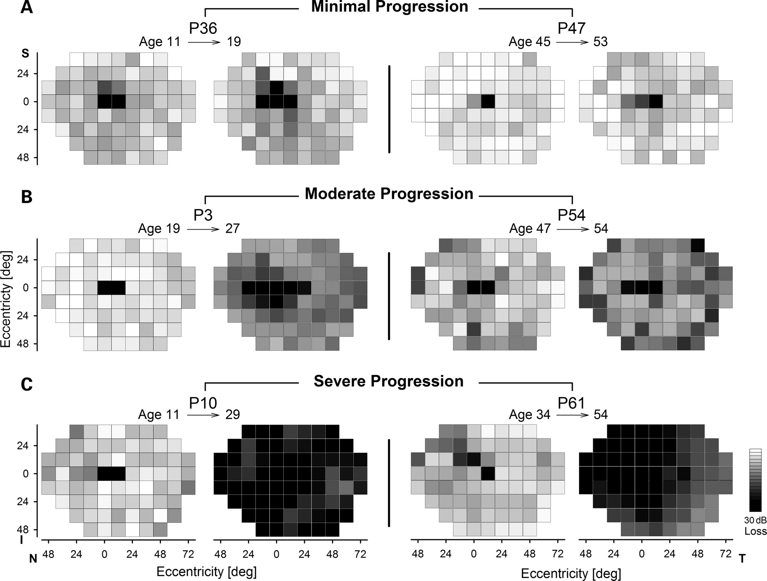
Figure 2. Serial data illustrating different levels of retina-wide disease progression. Evaluations in three younger ...
Notes:
Figure 2. Serial data illustrating different levels of retina-wide disease progression. Evaluations in three younger (left two panels) and three older (right two panels) individuals with ABCA4 mutations demonstrate examples of minimal (A), moderate (B) and severe (C) progression of retina-wide rod disease over intervals ranging from 7 to 20 years.
Unless provided in the caption above, the following copyright applies to the content of this slide: © The Author 2008. Published by Oxford University Press. All rights reserved. For Permissions, please email: journals.permissions@oxfordjournals.org

Slide 4
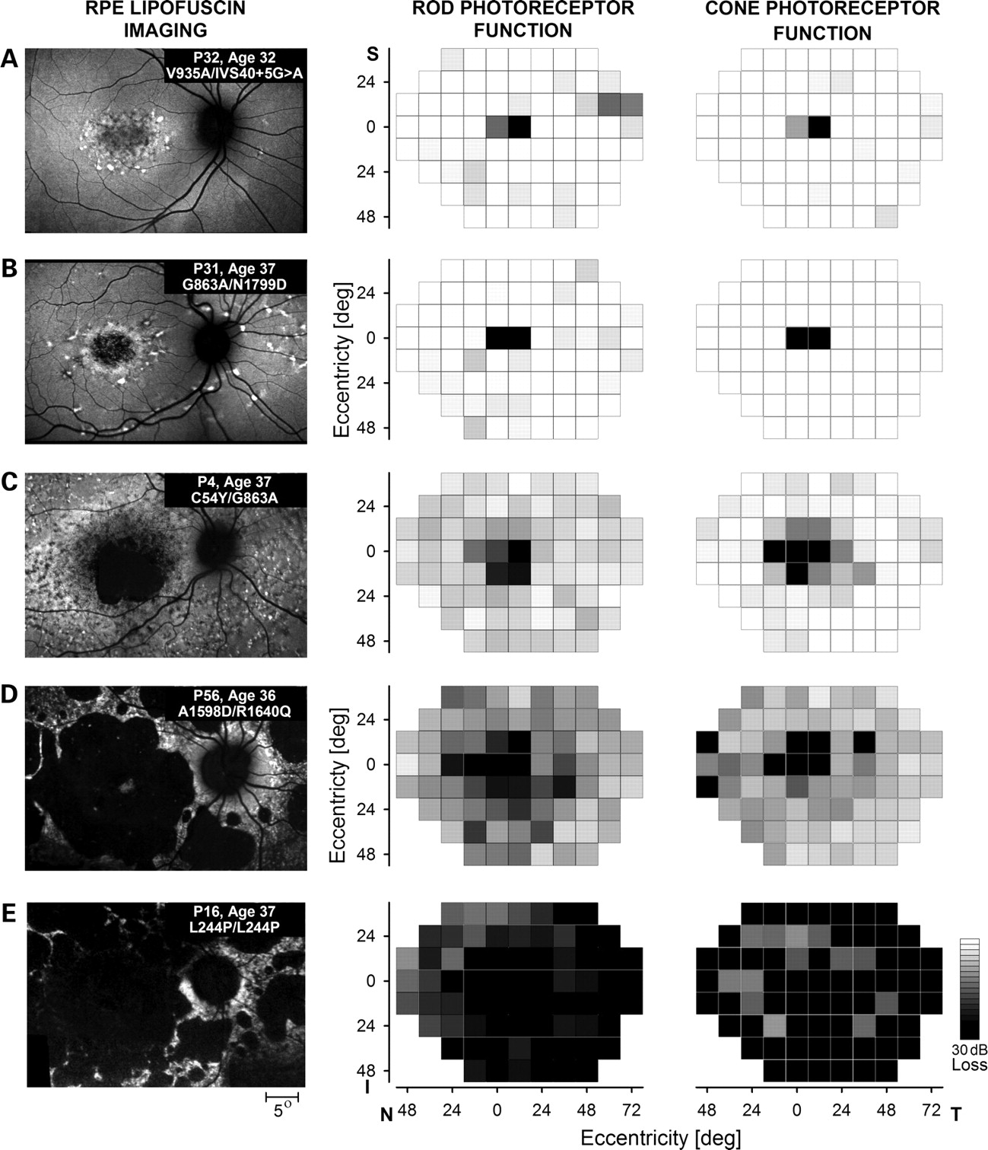
Figure 1. The wide spectrum of ABCA4 disease severity in the macula and across the retina, illustrated in unrelated ...
Notes:
Figure 1. The wide spectrum of ABCA4 disease severity in the macula and across the retina, illustrated in unrelated individuals in their fourth decade of life. Images (left column) show the macular distribution of RPE disease by taking advantage of lipofuscin autofluorescence excited with short-wavelength light. All images are individually contrast stretched for better visibility of features. Patient number, age and disease-causing ABCA4 mutations are shown (insets). Maps (middle and right columns) show retina-wide distribution of rod- and cone-mediated sensitivity losses obtained with psychophysical testing on a uniform grid. Magnitudes of the losses compared with mean normal values are shown on a gray scale; the physiological blind spot is represented with a black square at 12° temporal visual field locus. All images and maps in this and subsequent figures are shown as equivalent right eyes to facilitate comparisons. I, inferior field; N, nasal field; S, superior field; and, T, temporal field.
Unless provided in the caption above, the following copyright applies to the content of this slide: © The Author 2008. Published by Oxford University Press. All rights reserved. For Permissions, please email: journals.permissions@oxfordjournals.org

