Slide 1
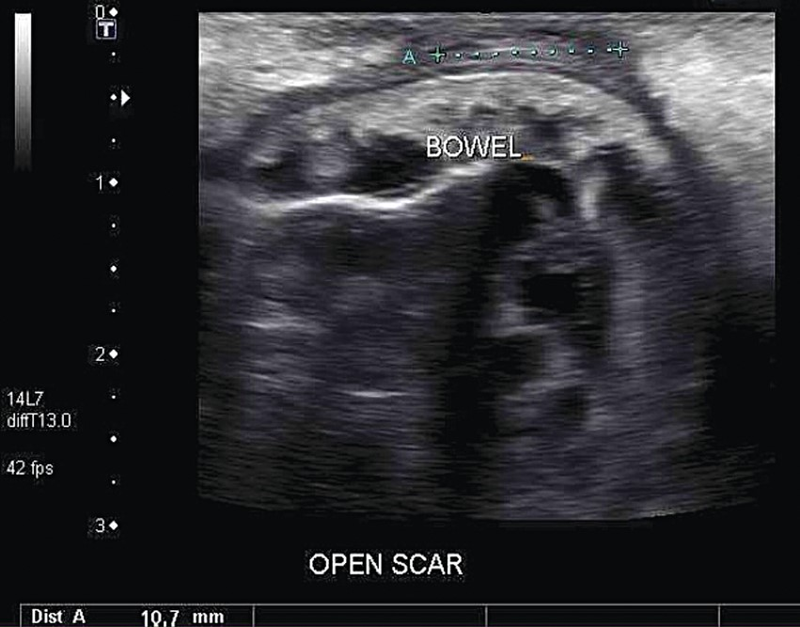
Figure 1: Ultrasound of the patient's abdominal wall, revealing a large defect with small bowel herniation adjacent to ...
Notes:
Figure 1: Ultrasound of the patient's abdominal wall, revealing a large defect with small bowel herniation adjacent to the skin.
Unless provided in the caption above, the following copyright applies to the content of this slide: Published by Oxford University Press and JSCR Publishing Ltd. All rights reserved. © The Author 2014.This is an Open Access article distributed under the terms of the Creative Commons Attribution Non-Commercial License (http://creativecommons.org/licenses/by-nc/3.0/), which permits non-commercial re-use, distribution, and reproduction in any medium, provided the original work is properly cited. For commercial re-use, please contact journals.permissions@oup.com

Slide 2
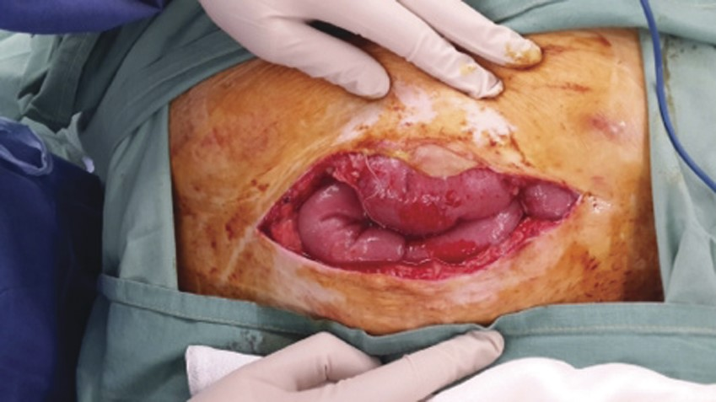
Figure 2: Dehiscence of the rectus sheath, resulting in small bowel herniation.
Notes:
Figure 2: Dehiscence of the rectus sheath, resulting in small bowel herniation.
Unless provided in the caption above, the following copyright applies to the content of this slide: Published by Oxford University Press and JSCR Publishing Ltd. All rights reserved. © The Author 2014.This is an Open Access article distributed under the terms of the Creative Commons Attribution Non-Commercial License (http://creativecommons.org/licenses/by-nc/3.0/), which permits non-commercial re-use, distribution, and reproduction in any medium, provided the original work is properly cited. For commercial re-use, please contact journals.permissions@oup.com

