Slide 1
Figure 1. The standard Palgrave cover used on many IR books in its Palgrave Studies in International Relations series. ...
Notes:
Figure 1. The standard Palgrave cover used on many IR books in its Palgrave Studies in International Relations series. Cover image reprinted with permission from Palgrave.
Unless provided in the caption above, the following copyright applies to the content of this slide: © The Author (2016). Published by Oxford University Press on behalf of the International Studies Association. All rights reserved. For permissions, please e-mail: journals.permissions@oup.com

Slide 2
Figure 2. Reprinted with permission from Robert Litwak. Image by Kathy Butterfield.
Notes:
Figure 2. Reprinted with permission from Robert Litwak. Image by Kathy Butterfield.
Unless provided in the caption above, the following copyright applies to the content of this slide: © The Author (2016). Published by Oxford University Press on behalf of the International Studies Association. All rights reserved. For permissions, please e-mail: journals.permissions@oup.com

Slide 3
Figure 3. Reprinted with permission from Zed Books.
Notes:
Figure 3. Reprinted with permission from Zed Books.
Unless provided in the caption above, the following copyright applies to the content of this slide: © The Author (2016). Published by Oxford University Press on behalf of the International Studies Association. All rights reserved. For permissions, please e-mail: journals.permissions@oup.com

Slide 4
Figure 5. Reprinted with permission from Oxford University Press. Image designed by David Stevenson.
Notes:
Figure 5. Reprinted with permission from Oxford University Press. Image designed by David Stevenson.
Unless provided in the caption above, the following copyright applies to the content of this slide: © The Author (2016). Published by Oxford University Press on behalf of the International Studies Association. All rights reserved. For permissions, please e-mail: journals.permissions@oup.com

Slide 5
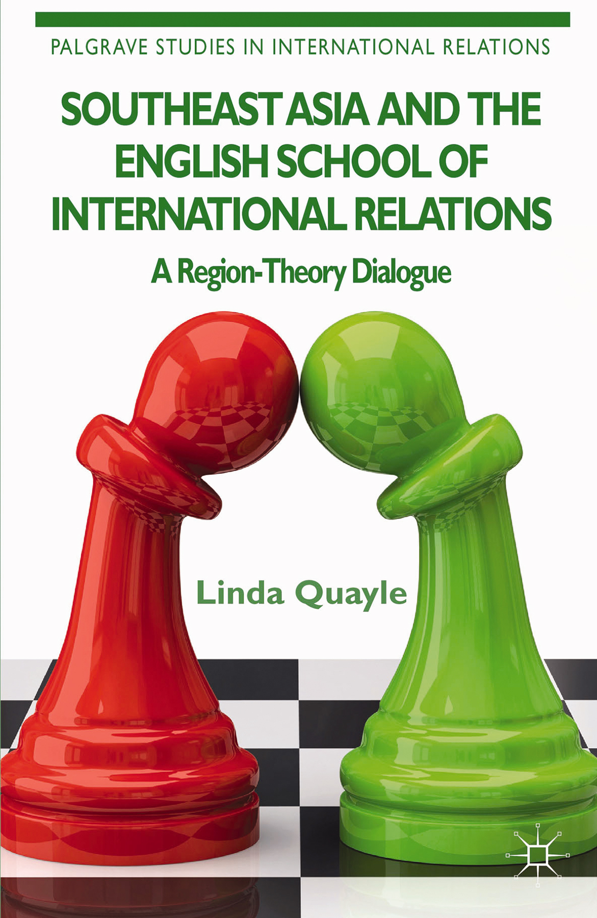
Figure 6. Reprinted with permission from Palgrave.
Notes:
Figure 6. Reprinted with permission from Palgrave.
Unless provided in the caption above, the following copyright applies to the content of this slide: © The Author (2016). Published by Oxford University Press on behalf of the International Studies Association. All rights reserved. For permissions, please e-mail: journals.permissions@oup.com

Slide 6
Figure 7. Reprinted with permission from Palgrave.
Notes:
Figure 7. Reprinted with permission from Palgrave.
Unless provided in the caption above, the following copyright applies to the content of this slide: © The Author (2016). Published by Oxford University Press on behalf of the International Studies Association. All rights reserved. For permissions, please e-mail: journals.permissions@oup.com

Slide 7
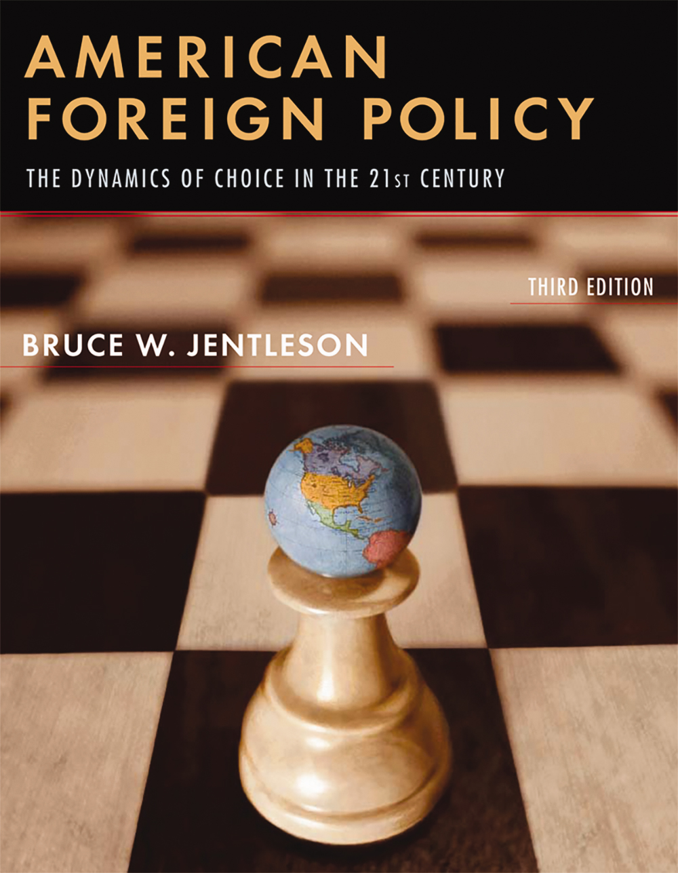
Figure 8. Reprinted with permission from W. W. Norton.
Notes:
Figure 8. Reprinted with permission from W. W. Norton.
Unless provided in the caption above, the following copyright applies to the content of this slide: © The Author (2016). Published by Oxford University Press on behalf of the International Studies Association. All rights reserved. For permissions, please e-mail: journals.permissions@oup.com

Slide 8
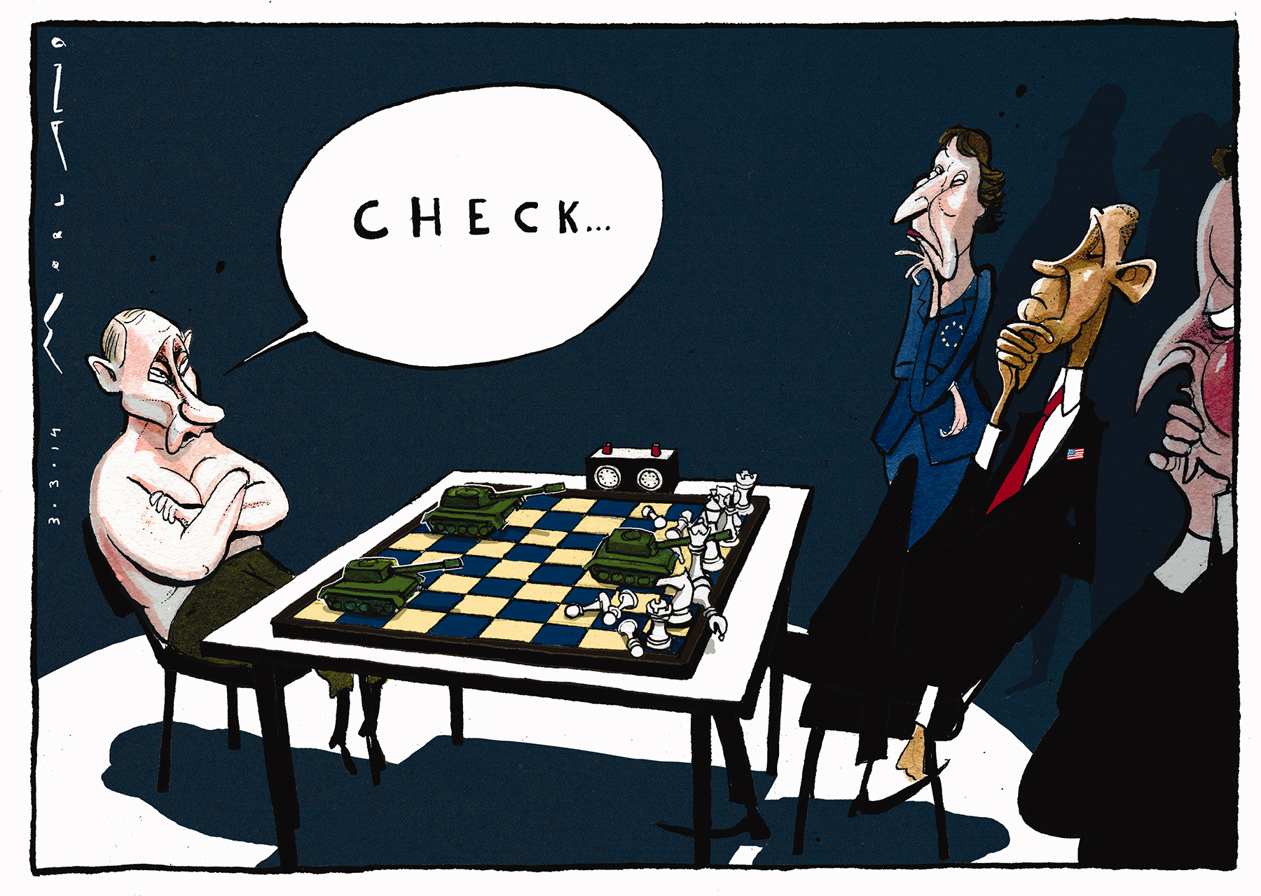
Figure 4. Cartoon by Morten Morland. Published in The Times, March 3, 2014. Reprinted with permission from Morten ...
Notes:
Figure 4. Cartoon by Morten Morland. Published in The Times, March 3, 2014. Reprinted with permission from Morten Morland.
Unless provided in the caption above, the following copyright applies to the content of this slide: © The Author (2016). Published by Oxford University Press on behalf of the International Studies Association. All rights reserved. For permissions, please e-mail: journals.permissions@oup.com

Slide 9
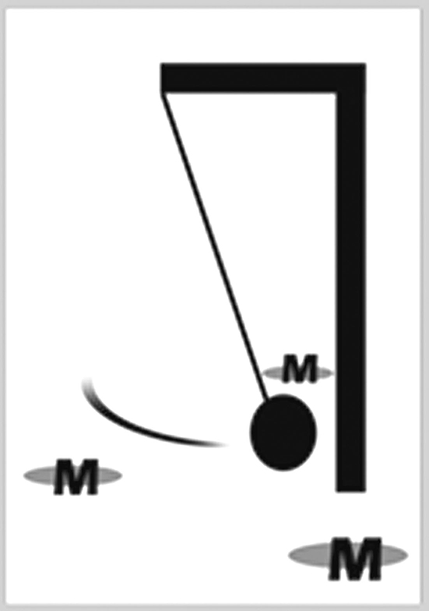
Figure 9. A metal ball swinging between three magnets (image by the author).
Notes:
Figure 9. A metal ball swinging between three magnets (image by the author).
Unless provided in the caption above, the following copyright applies to the content of this slide: © The Author (2016). Published by Oxford University Press on behalf of the International Studies Association. All rights reserved. For permissions, please e-mail: journals.permissions@oup.com

