Slide 1
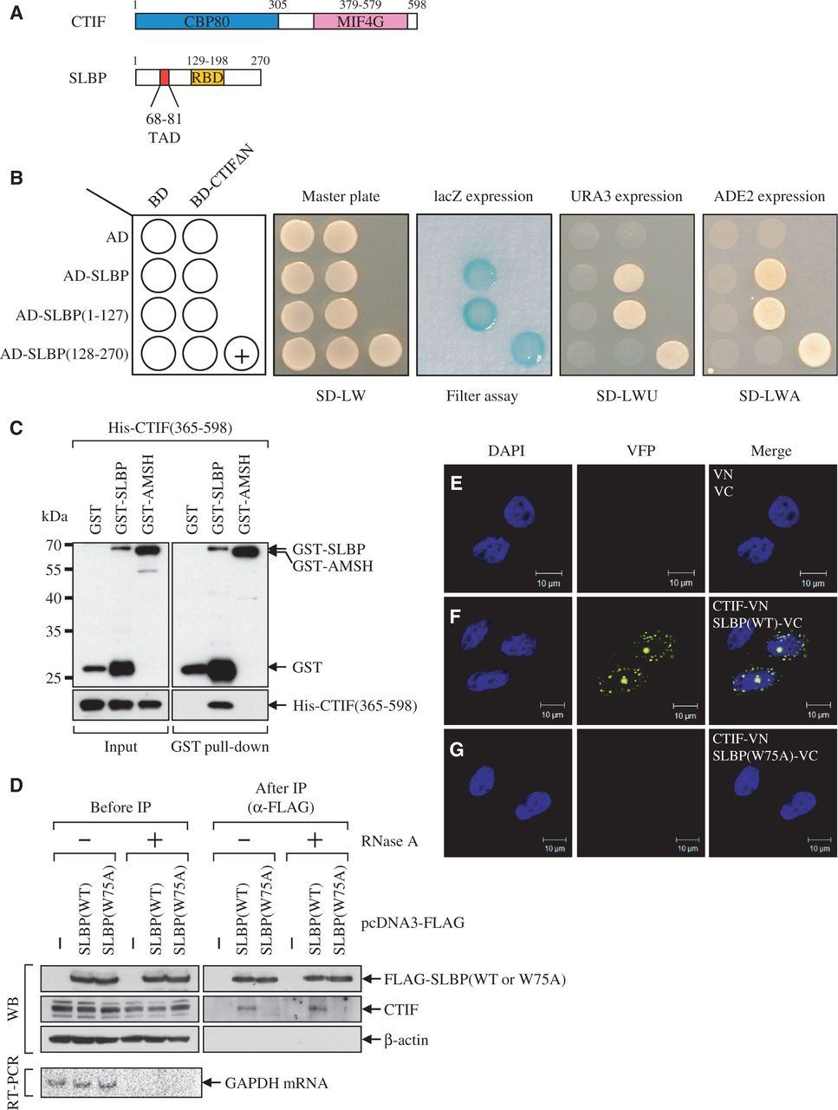
Figure 1. SLBP interacts with CTIF. (A) Schematic diagram of CTIF and SLBP. CBP80 and MIF4G in CTIF indicate ...
Notes:
Figure 1. SLBP interacts with CTIF. (A) Schematic diagram of CTIF and SLBP. CBP80 and MIF4G in CTIF indicate CBP80-interacting domain and a middle domain of eIF4GI, respectively. TAD and RBD in SLBP indicate a TAD- and a RNA-binding domain, respectively. (B) Identification of SLBP as CTIF-interacting protein by yeast two-hybrid screening. Yeast strains were co-transformed with a bait plasmid expressing either BD-CTIFΔN or BD and a prey plasmid expressing AD-SLBP, AD-SLBP(1–127), AD-SLBP(128–270) or AD. Transformed yeast cells were spread on selective medium lacking leucine and tryptophan (SD-LW) to select for co-transformants. Specific interactions between two proteins were tested by monitoring (i) the appearance of visible blue color (filter assay); (ii) the growth on selective medium lacking leucine, tryptophan and uracil (SD-LWU); and (iii) the growth on selective medium lacking leucine, tryptophan and adenine (SD-LWA). BD-polypyrimidine tract-binding protein (PTB) and AD-PTB served as the positive control for the protein–protein interaction (+). (C) In vitro GST pull-down assays. Escherichia coli lysates expressing GST, GST-SLBP or GST-AMSH (negative control) were mixed with purified recombinant His-CTIF(365-598). After GST pull-down, the purified proteins were analyzed by western blotting (WB) using α-GST antibody (top) or α-6xHis antibody (bottom). The locations of molecular weight (MW) markers are indicated on the left. (D) IPs of SLBP and SLBP(W75A). The extracts of HeLa cells transiently expressing either FLAG-SLBP or FLAG-SLBP(W75A) were either untreated or treated with RNase A and then subjected to IPs using α-FLAG-conjugated agarose beads. WB was carried out to detect the indicated proteins (top). To confirm that cellular RNAs were completely removed by RNase A treatment, cellular glyceraldehyde 3-phosphate dehydrogenase (GAPDH) mRNA was analyzed using RT-PCR (bottom). The relative amounts of cell extracts used before IP compared with after IP are provided in Supplementary Table S1. (E–G) In vivo bimolecular fluorescence complementation (BiFC) analysis for CTIF–SLBP interaction. HeLa cells were transiently transfected with plasmid expressing either N-terminal fragment (1–173 amino acids) of yellow Venus-enhanced fluorescent proteins (VN) or CTIF-VN and plasmid expressing C-terminal fragment (155–238 amino acids) of yellow Venus-enhanced fluorescent proteins (VC), SLBP-VC, or SLBP(W75A)-VC. After 8 h, the cells were fixed and observed by confocal microscopy. Nuclei were stained with 4′,6-diamidino-2-phenylindole (DAPI). All results are representative of at least two independently performed experiments.
Unless provided in the caption above, the following copyright applies to the content of this slide: © The Author(s) 2012. Published by Oxford University Press.This is an Open Access article distributed under the terms of the Creative Commons Attribution License (http://creativecommons.org/licenses/by-nc/3.0/), which permits non-commercial reuse, distribution, and reproduction in any medium, provided the original work is properly cited. For commercial re-use, please contact journals.permissions@oup.com.

Slide 2
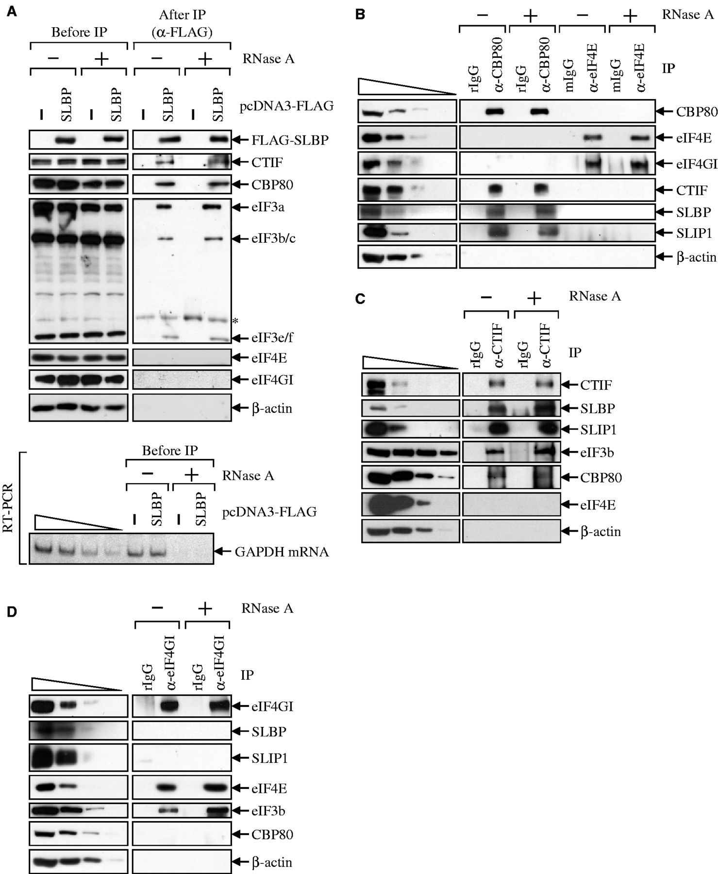
Figure 2. SLBP associates with CT initiation complex. (A) IP of FLAG-SLBP. HEK293T cells were transiently transfected ...
Notes:
Figure 2. SLBP associates with CT initiation complex. (A) IP of FLAG-SLBP. HEK293T cells were transiently transfected with plasmid expressing either FLAG or FLAG-SLBP. Total-cell extracts were obtained 2 days after transfection and either untreated or treated with RNase A before IP. Each extract was subjected to IP using α-FLAG-conjugated agarose beads. WB was carried out to detect the indicated proteins (top). To confirm that cellular RNAs were completely removed by RNase A treatment, cellular GAPDH mRNA was analyzed using RT-PCR (bottom). To show that RT-PCR used in this study was sufficiently semi-quantitative, 2-fold serial dilutions of total-cell RNAs were presented in the four left-most lanes. (B) IPs of endogenous CBP80 and eIF4E. The extracts of HeLa cells were either untreated or treated with RNase A and then subjected to IPs using α-CBP80 antibody, rabbit IgG (rIgG) as a control for α-CBP80 antibody, α-eIF4E antibody or mouse IgG (mIgG) as a control for α-eIF4E antibody. To show that WB used in this study was sufficiently semi-quantitative, 3-fold serial dilutions of total-cell extracts are represented in the four left-most lanes. (C) IP of endogenous CTIF. Total-cell extracts were subjected to IP using α-CTIF antibody or, as a control, α-rabbit IgG (rIgG) before or after treatment with RNase A. (D) IP of endogenous eIF4GI. All results are representative of at least two independently performed experiments. The relative amounts of cell extracts used before IP compared with after IP are provided in Supplementary Table S1.
Unless provided in the caption above, the following copyright applies to the content of this slide: © The Author(s) 2012. Published by Oxford University Press.This is an Open Access article distributed under the terms of the Creative Commons Attribution License (http://creativecommons.org/licenses/by-nc/3.0/), which permits non-commercial reuse, distribution, and reproduction in any medium, provided the original work is properly cited. For commercial re-use, please contact journals.permissions@oup.com.

Slide 3
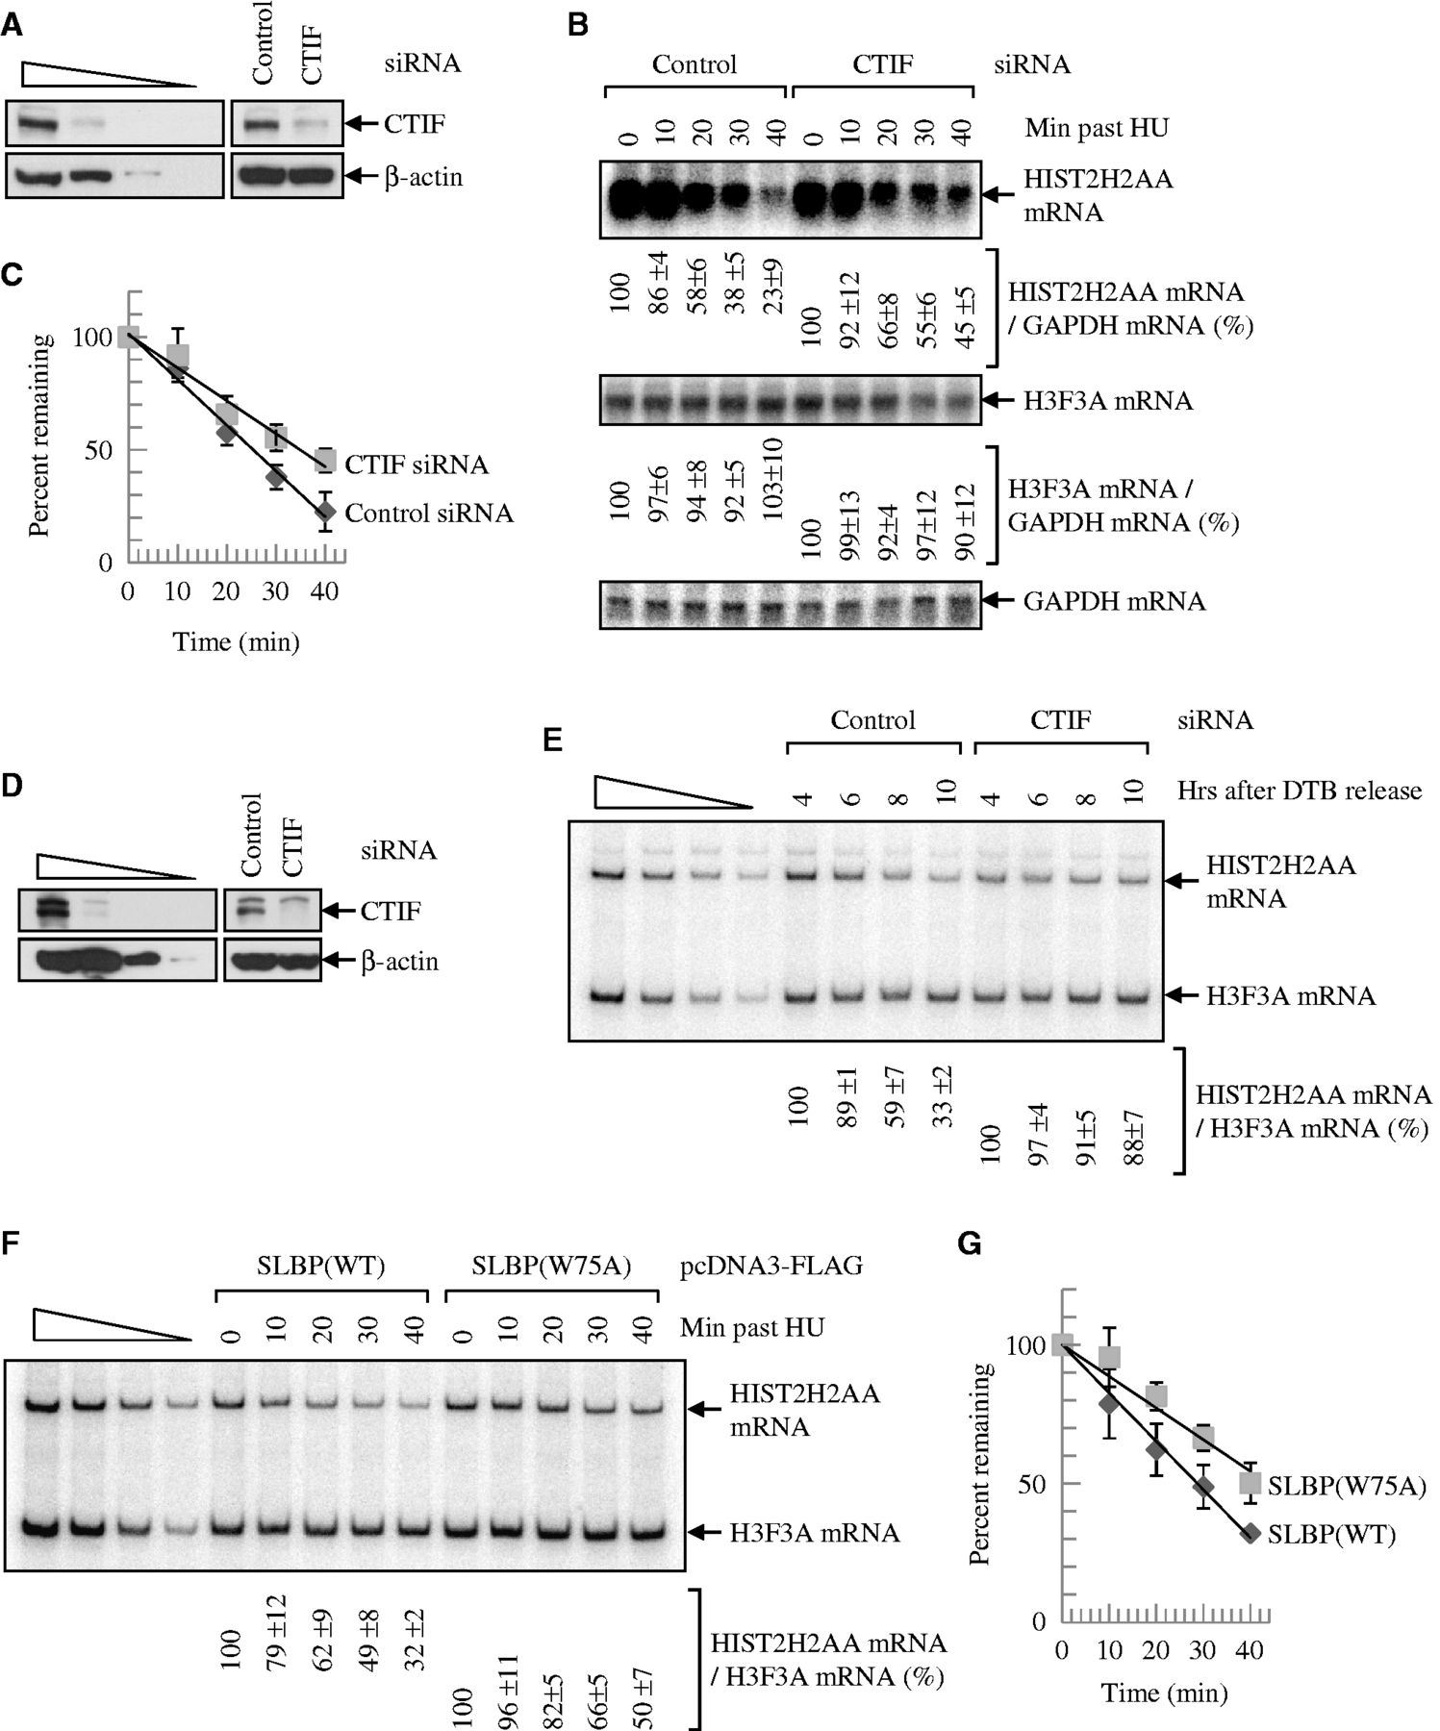
Figure 3. Downregulation of CTIF or overexpression of SLBP(W75A) abolishes the rapid degradation of ...
Notes:
Figure 3. Downregulation of CTIF or overexpression of SLBP(W75A) abolishes the rapid degradation of replication-dependent histone mRNA on the inhibition of DNA replication or at the end of S phase. (A–C) HeLa cells were transiently transfected with CTIF siRNA or non-specific Control siRNA. Three days later, cells were treated with HU. Total-cell proteins and RNAs were purified at the indicated time points. (A) WB demonstrating efficient downregulation of CTIF. (B) Northern blotting of HIST2H2AA mRNAs and H3F3A mRNAs. The levels of HIST2H2AA mRNAs were normalized to the level of GAPDH mRNAs. Normalized levels of HIST2H2AA mRNAs obtained at 0 min after HU treatment in the presence of each siRNA were set to 100%. (C) Half-life of HIST2H2AA mRNAs. The normalized levels of HIST2H2AA mRNAs obtained from Figure 3B were plotted as a function of time after HU treatment. (D and E) HEK293T cells were transiently transfected with CTIF siRNA or non-specific control siRNA. One day after transfection, cells were synchronized by DTB. Total-cell RNAs and proteins were prepared at the indicated time points after the release from DTB until these cells exited S phase completely. (D) WB demonstrating efficient downregulation of CTIF. (E) RT-PCR of HIST2H2AA mRNAs. The levels of HIST2H2AA mRNAs were normalized to the level of H3F3A mRNAs. Normalized levels of HIST2H2AA mRNAs obtained at 4 h after DTB release in the presence of each siRNA were set to 100%. The means and standard deviations of results obtained from three independent transfections and RT-PCRs are presented below the panel. (F and G) HeLa cells were transiently transfected with plasmid expressing either SLBP(WT) or SLBP(W75A). Two days later, cells were treated with HU and total-cell proteins and RNAs were purified at the indicated time points. (F) RT-PCRs of HIST2H2AA mRNAs and H3F3A mRNAs. The levels of HIST2H2AA mRNAs were normalized to the level of H3F3A mRNAs. Normalized levels of HIST2H2AA mRNAs obtained at 0 min after HU treatment were set to 100%. (G) Half-life of HIST2H2AA mRNAs. The normalized levels of HIST2H2AA mRNAs obtained from Figure 3F were plotted as a function of time after HU treatment.
Unless provided in the caption above, the following copyright applies to the content of this slide: © The Author(s) 2012. Published by Oxford University Press.This is an Open Access article distributed under the terms of the Creative Commons Attribution License (http://creativecommons.org/licenses/by-nc/3.0/), which permits non-commercial reuse, distribution, and reproduction in any medium, provided the original work is properly cited. For commercial re-use, please contact journals.permissions@oup.com.

Slide 4
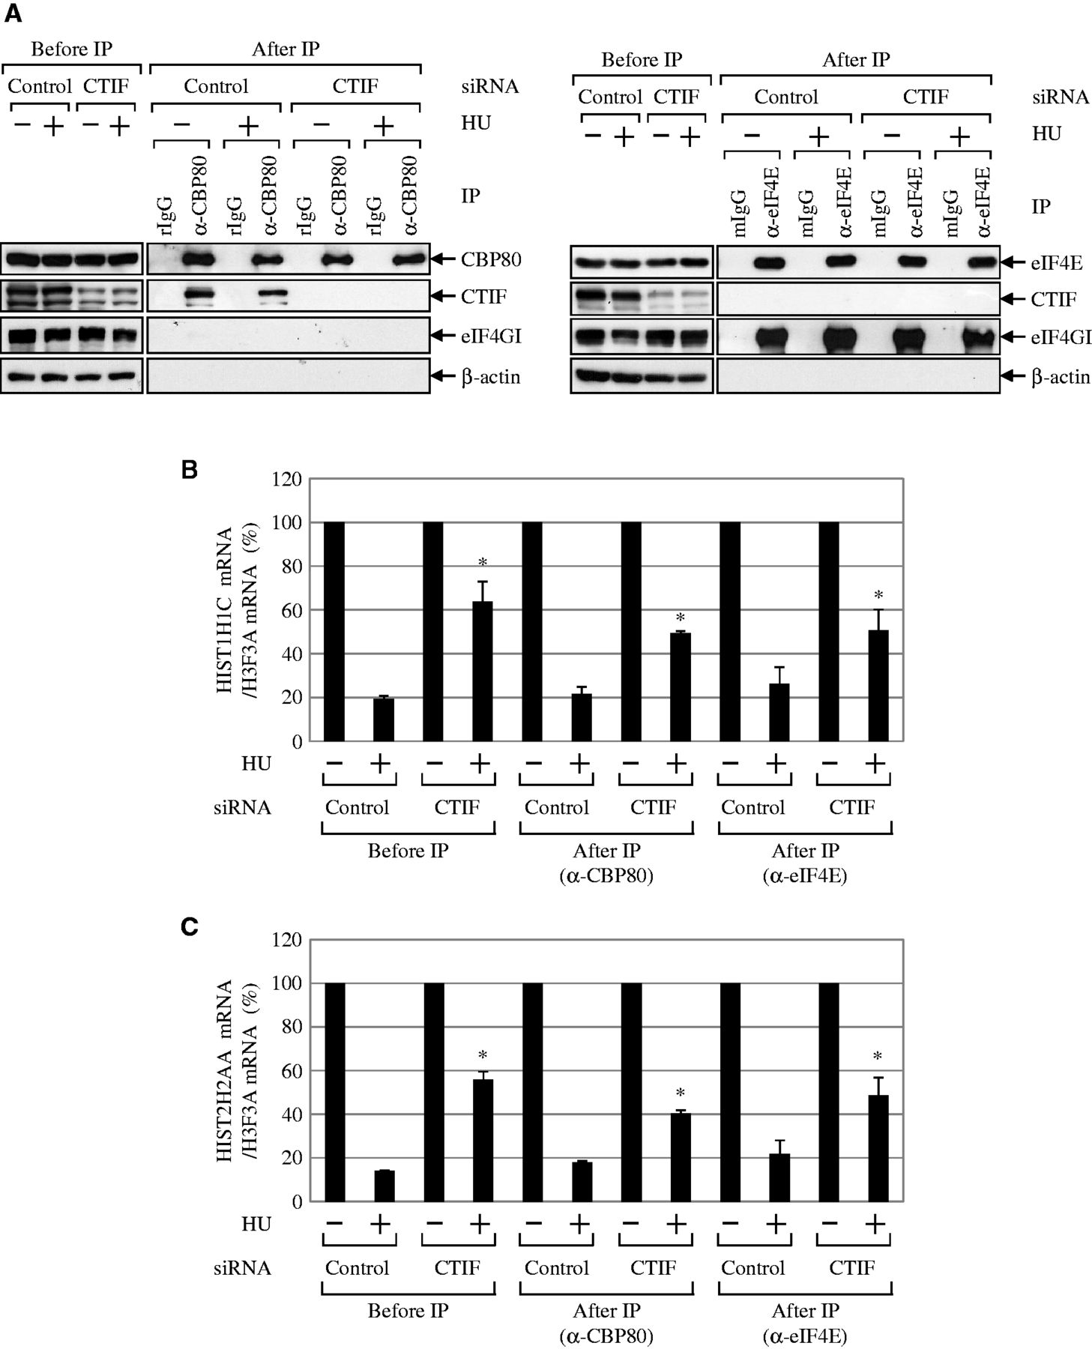
Figure 4. Histone mRNA degradation occurs on CBP80/20-bound mRNAs. HEK293T cells were transiently transfected with CTIF ...
Notes:
Figure 4. Histone mRNA degradation occurs on CBP80/20-bound mRNAs. HEK293T cells were transiently transfected with CTIF siRNA or non-specific control siRNA. Three days later, cells were treated with HU for 1 h before cell harvest. Cell extracts were subjected to IP using α-CBP80 antibody or α-eIF4E antibody. Co-immunopurified proteins and RNAs were analyzed by WB and qRT-PCRs. (A) WB results to demonstrate the specific IPs of CBP80 (left) and eIF4E (right). The relative amounts of cell extracts used before IP compared with after IP are provided in Supplementary Table S1. (B) qRT-PCR of HIST1H1C mRNAs. The levels of HIST1H1C mRNAs were normalized to the level of H3F3A mRNAs. The normalized levels of HIST1H1C mRNAs that were obtained from cells untreated with HU before or after IP were then set to 100%. *P < 0.05 as determined by Student’s t-tests. (C) As in Figure 4B, except that the levels of endogenous HIST2H2AA mRNAs were analyzed by qRT-PCRs. The columns and bars in each panel represent the mean and standard deviation of at least two independently performed transfections, IPs and qRT-PCRs. *P < 0.05.
Unless provided in the caption above, the following copyright applies to the content of this slide: © The Author(s) 2012. Published by Oxford University Press.This is an Open Access article distributed under the terms of the Creative Commons Attribution License (http://creativecommons.org/licenses/by-nc/3.0/), which permits non-commercial reuse, distribution, and reproduction in any medium, provided the original work is properly cited. For commercial re-use, please contact journals.permissions@oup.com.

Slide 5
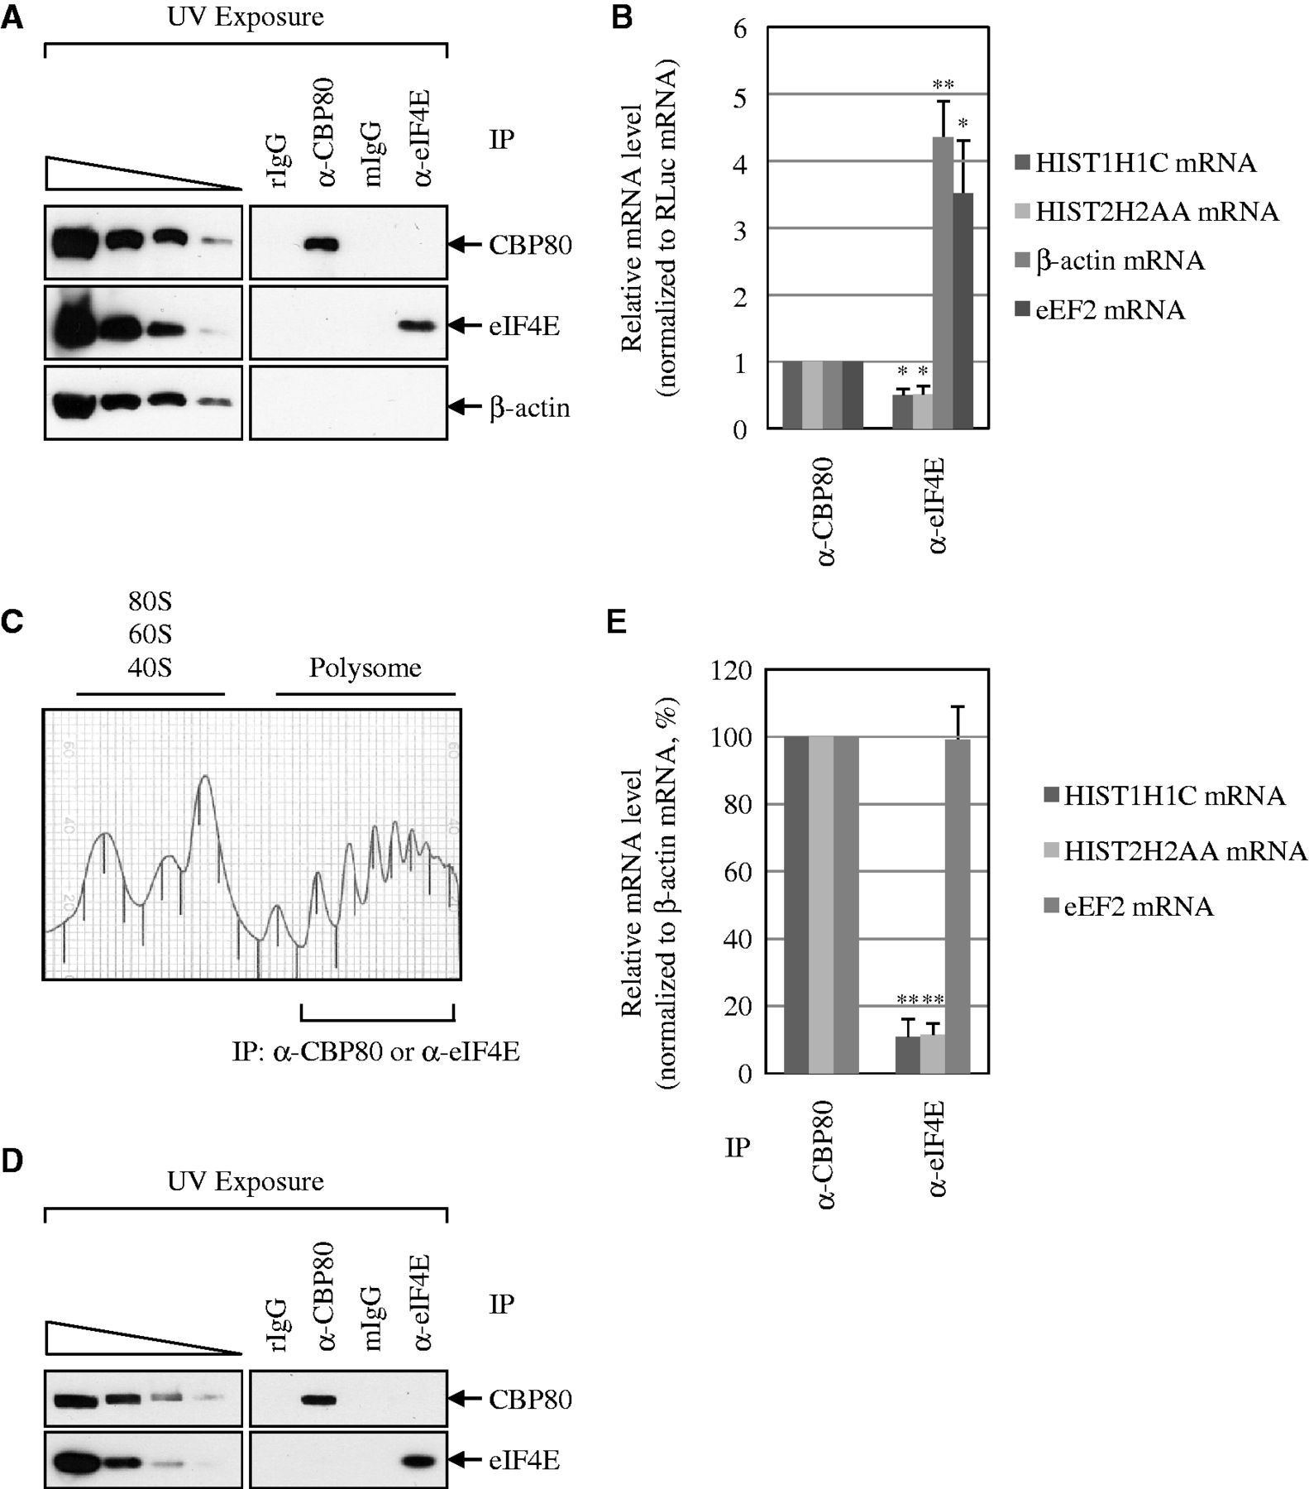
Figure 5. A larger amount of replication-dependent histone mRNAs bind to CBP80/20 than eIF4E at the steady state, ...
Notes:
Figure 5. A larger amount of replication-dependent histone mRNAs bind to CBP80/20 than eIF4E at the steady state, compared with poly(A)-containing mRNAs. (A and B) IPs were performed using either α-CBP80 antibody or α-eIF4E antibody and the extracts of UV-irradiated HEK293T cells. To control for variations of RNA extraction and qRT-PCR, in vitro-transcribed Renilla luciferase (RLuc) mRNAs were added to samples after IPs. (A) WB results to demonstrate the specific IPs of CBP80 and eIF4E. (B) qRT-PCR of co-immunoprecipitated mRNAs. The level of each tested mRNA was normalized to the level of RLuc mRNA. The normalized level of each mRNA was further normalized to the IP efficiency. The normalized level of each mRNA obtained in CBP80 IP was then set to 1. The columns and bars in each panel represent the mean and standard deviation of at least two independently performed transfections, IPs and qRT-PCRs. *P < 0.05, **P < 0.01. (C–E) IPs of polysome fractions. The cytosolic extracts were obtained and then fractionated on 10–50% sucrose gradients to resolve the polysomes. Polysome-fractionated protein samples were pooled, subjected to the exposure to UV, and IPs using either α-CBP80 antibody or α-eIF4E antibody. Rabbit (r) and mouse (m) IgGs were used for negative controls for α-CBP80 antibody and α-eIF4E antibody, respectively. (C) The polysome profile of cytosolic extracts. (D) WB results to demonstrate the specific IPs of CBP80 and eIF4E from polysome fractionated samples. (E) qRT-PCRs of co-immunoprecipitated mRNAs. The levels of co-immunoprecipitated histone mRNAs and eEF2 mRNAs were normalized to the level of β-actin mRNA. The normalized levels in CBP80 IP were set to 100%. The relative amounts of cell extracts used before IP compared with after IP are provided in Supplementary Table S1. **P < 0.01.
Unless provided in the caption above, the following copyright applies to the content of this slide: © The Author(s) 2012. Published by Oxford University Press.This is an Open Access article distributed under the terms of the Creative Commons Attribution License (http://creativecommons.org/licenses/by-nc/3.0/), which permits non-commercial reuse, distribution, and reproduction in any medium, provided the original work is properly cited. For commercial re-use, please contact journals.permissions@oup.com.

