Slide 1
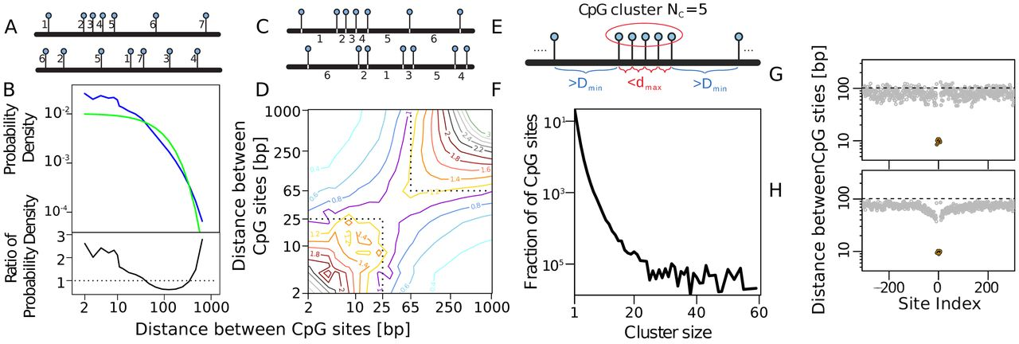
Figure 1. Distances between CpG sites in the human genome. (A) Schematic of randomization of CpG positions used to ...
Notes:
Figure 1. Distances between CpG sites in the human genome. (A) Schematic of randomization of CpG positions used to produce an equal number of CpG sites but remove all spatial correlations between the CpG positions. The position of each of the 28 million CpGs in the genome was randomly assigned a new position (avoiding overlapping of CpG sites) within a ‘blank genome’ of 28 billion positions. (B) The observed CpG–CpG distance frequencies for the data (blue), and after CpG randomization (green). The standard errors of the mean for 12 separate genome randomizations lie within the thickness of the green line. The lower panel shows the ratio between the real and randomized distance frequencies. (C) Schematic of randomization of distances between CpG sites, keeping each individual distance unchanged but removing the correlation between distances, i.e. the distances are preserved. Effectively, an array of the 28 million genomic CpG–CpG distances was shuffled to produce a random sequence of these distances. (D) Frequencies of distances (d1) and subsequent distances (d2) are divided by the corresponding frequencies after distance randomization, showing enhancement of short-short and long-long distance combinations. (E) Schematic of CpG cluster criteria. (F) Distribution of cluster sizes NC in the genome for dmax = 25 bp and Dmin = 65 bp. (G) The genome contains 21 000 clusters of size NC = 15 with dmax = 25 bp and Dmin = 65 bp. In the plot, the point at site index = 1 is the distance between the central CpG (site index = 0) and the first CpG to the right (site index = 1) averaged across all clusters. The point at site index = 2 is the average of the distances between the first and second CpGs on the right, and so on. Average successive CpG–CpG distances going leftward from the central CpG are given by negative site indices. Black points show average distances between CpG sites within the cluster, with the average distances outside the cluster shown in gray. (H) As (G) but for Dmin = 45 bp. Note the correlation between CpG distances surrounding the island. Note the logarithmic vertical axes in (F, G and H) and the double logarithmic axes in (B, top) and (D).
Unless provided in the caption above, the following copyright applies to the content of this slide: © The Author(s) 2016. Published by Oxford University Press on behalf of Nucleic Acids Research.This is an Open Access article distributed under the terms of the Creative Commons Attribution License (http://creativecommons.org/licenses/by-nc/4.0/), which permits non-commercial re-use, distribution, and reproduction in any medium, provided the original work is properly cited. For commercial re-use, please contact journals.permissions@oup.com

Slide 2
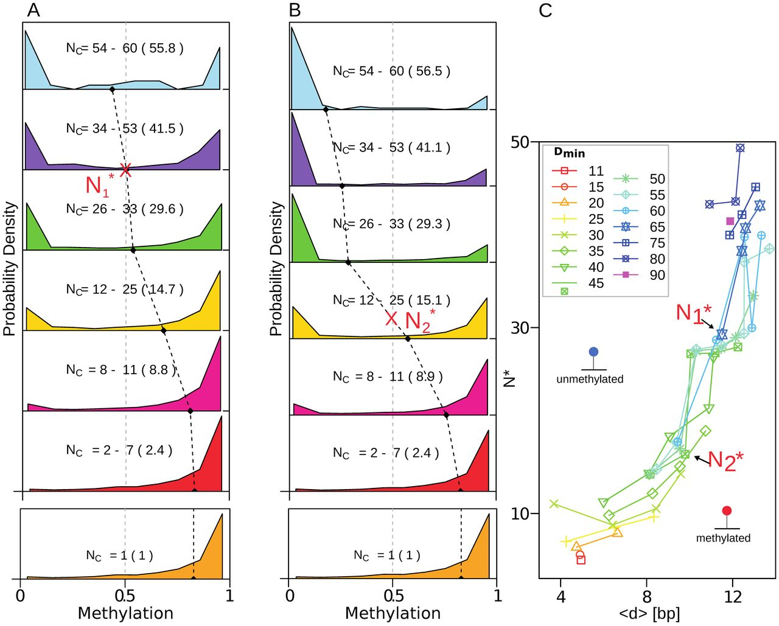
Figure 2. Empirical CpG distance and methylation distributions. (A) Distributions of average methylation of clusters ...
Notes:
Figure 2. Empirical CpG distance and methylation distributions. (A) Distributions of average methylation of clusters sized 1 ≤ NC ≤ 60 with dmax = 25 bp and Dmin = 65 bp. Panels show different NC ranges (with the mean NC in parentheses). The black dashed line shows the average methylation of each distribution. (B) As (A) but Dmin = 45 bp. (C) For each pool of clusters defined with specific values of Dmin and dmax, there is a critical cluster size, N*, at which the methylation distribution is maximally bimodal (e.g. $N_{1}^*$ and $N_{2}^*$, mark the maximal bimodality obtained in (A and B)). For each cluster pool, N* is plotted against the average inter-CpG distance 〈d〉 in that pool. Each line corresponds to a particular value of Dmin (as indicated in the inset), with each point on the line derived from a cluster with a distinct dmax value.
Unless provided in the caption above, the following copyright applies to the content of this slide: © The Author(s) 2016. Published by Oxford University Press on behalf of Nucleic Acids Research.This is an Open Access article distributed under the terms of the Creative Commons Attribution License (http://creativecommons.org/licenses/by-nc/4.0/), which permits non-commercial re-use, distribution, and reproduction in any medium, provided the original work is properly cited. For commercial re-use, please contact journals.permissions@oup.com

Slide 3
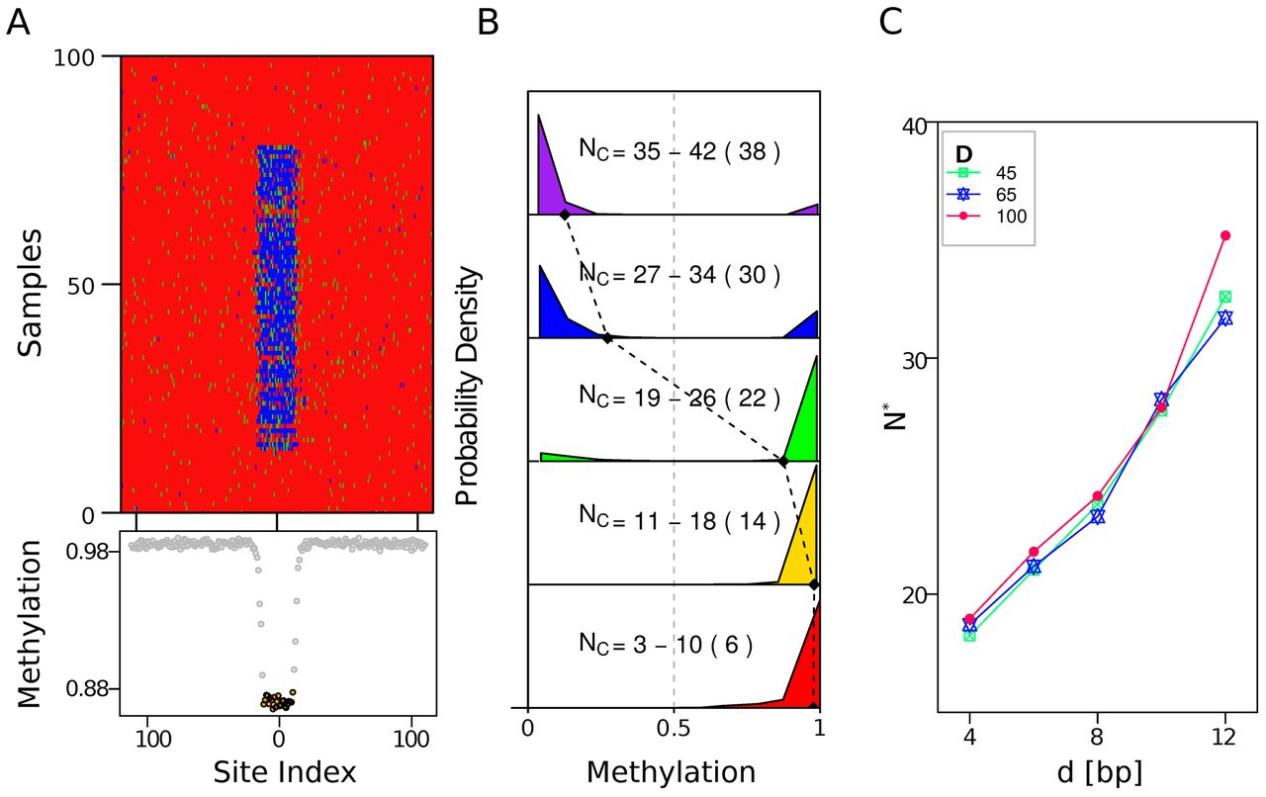
Figure 4. Model results. (A) Space-time plot for a bistable system of cluster size N_{C} = 23 (dense region in ...
Notes:
Figure 4. Model results. (A) Space-time plot for a bistable system of cluster size NC = 23 (dense region in center of plot), d = 10 bp, D = 65 bp. m, h and u sites shown in red, green and blue. CpG sites within a cluster are spaced at a distance d, separated by D from the Nout = 200 CpG sites spaced D* = 100 bp apart (the genomic average), with periodic boundary conditions (a ring of NC + Nout CpG sites). Nine different reactions (Figure 3A) with rates {β = 0.005, μ = 0.01, σ1 = 0.2, σ2 = 0.8, σ3 = 0.8, κ1 = 0.8, κ2 = 0.8} were used in a standard Gillespie algorithm (see text). Collaborative reactions were subject to a distance test (see Figure 3 and text). The state of all sites were recorded just before replication, with a subset of 100 out of 3000 simulated generations shown. (B) Methylation distributions for simulations for varying CpG-cluster sizes using D = 65 bp and d = 10 bp. Compare with Figure 2A. (C) Modeled dependence of N* on d. Compare with Figure 2C.
Unless provided in the caption above, the following copyright applies to the content of this slide: © The Author(s) 2016. Published by Oxford University Press on behalf of Nucleic Acids Research.This is an Open Access article distributed under the terms of the Creative Commons Attribution License (http://creativecommons.org/licenses/by-nc/4.0/), which permits non-commercial re-use, distribution, and reproduction in any medium, provided the original work is properly cited. For commercial re-use, please contact journals.permissions@oup.com

Slide 4
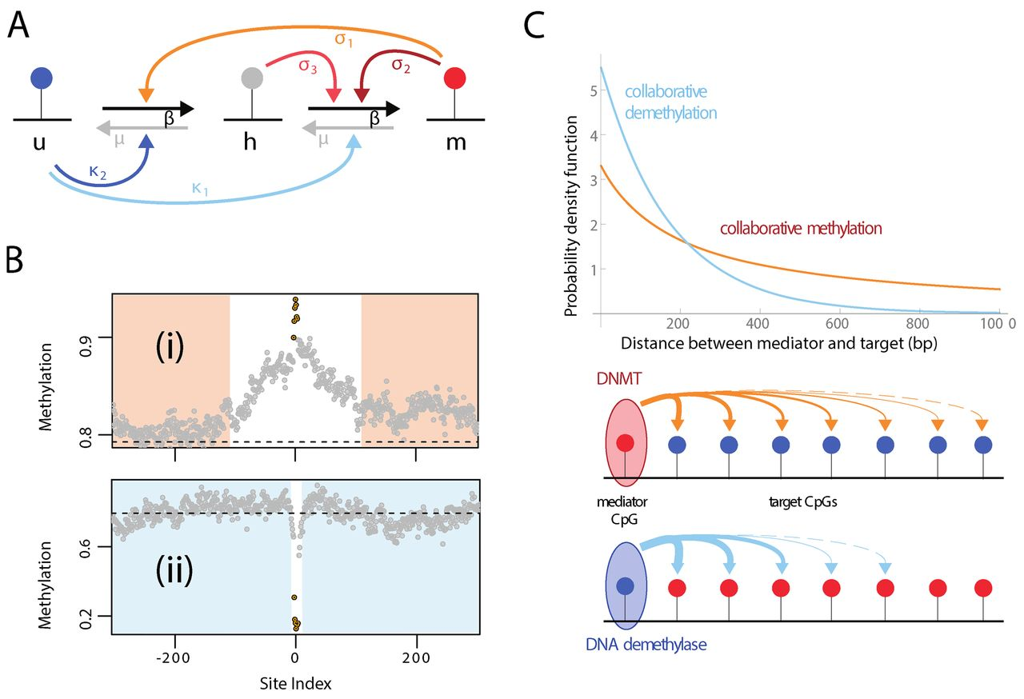
Figure 3. Model design. (A) Collaborative model (7). Straight arrows (gray and black) are non-collaborative reactions, ...
Notes:
Figure 3. Model design. (A) Collaborative model (7). Straight arrows (gray and black) are non-collaborative reactions, curved arrows are collaborative reactions (start at mediator CpG, end at the reaction stimulated). See text. (B) Average CpG methylation for genomic regions containing CpG-clusters consisting of seven CpG sites with the average inter-CpG distance 〈d〉 < 12.5 (black points) with a low density of surrounding CpG sites (gray points). Specifically, clusters were selected where 30 CpGs on each side of the cluster are spaced on average at least 80 bp apart. Clusters are sorted into those that are hyper-methylated (upper panel) or are hypo-methylated (lower panel). As in Figure 1G, site index is the ordinate position of the CpG relative to the central CpG of the cluster. (C) Introducing distance-dependent collaboration—short-range demethylation and long-range methylation. Plots show the reaction probability density function as a function of the distance between mediator and target in the new model. Methylation reactions have a power-law distance dependence ∼a/(d + α) with d the distance and α = 196 bp; an offset. Demethylation reactions have an exponential distance dependence ∼b · exp (d/d0), with d0 = 174 bp the range of the interaction. The parameters a = 650 bp and b = 5.525 are scaling factors.
Unless provided in the caption above, the following copyright applies to the content of this slide: © The Author(s) 2016. Published by Oxford University Press on behalf of Nucleic Acids Research.This is an Open Access article distributed under the terms of the Creative Commons Attribution License (http://creativecommons.org/licenses/by-nc/4.0/), which permits non-commercial re-use, distribution, and reproduction in any medium, provided the original work is properly cited. For commercial re-use, please contact journals.permissions@oup.com

