Slide 1
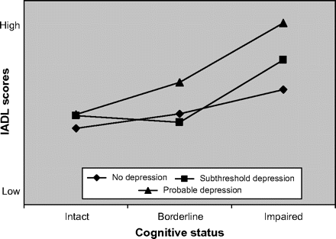
Figure 1. Interaction effect of depression and cognitive status on instrumental activities of daily living (IADL) ...
Notes:
Figure 1. Interaction effect of depression and cognitive status on instrumental activities of daily living (IADL) scores.
Unless provided in the caption above, the following copyright applies to the content of this slide: © The Author 2009. Published by Oxford University Press on behalf of The Gerontological Society of America. All rights reserved. For permissions, please e-mail: journals.permissions@oxfordjournals.org.

