Slide 1
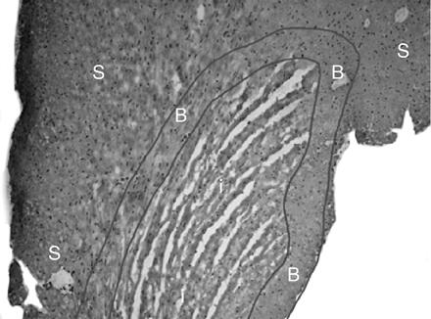
Fig. 1 Laser dissected areas. Hematoxilin stained cross-sections of a heart 1 day after reperfusion (original ...
Notes:
Fig. 1 Laser dissected areas. Hematoxilin stained cross-sections of a heart 1 day after reperfusion (original magnification 100×). The heart is dissected in infarcted area (i), borderzone (B) and spared myocardium (S) by laser-dissection-microscopy. The borderzone is defined as the rim of approximately 0.5 mm of myocardium bordering the infarct area.
Unless provided in the caption above, the following copyright applies to the content of this slide: Copyright © 2006, European Society of Cardiology

Slide 2
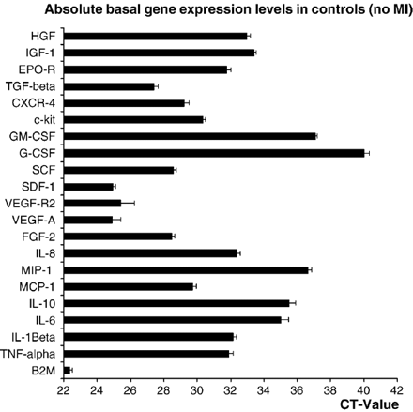
Fig. 3 Absolute gene expression levels in controls. The absolute levels of basal gene expression in control hearts, ...
Notes:
Fig. 3 Absolute gene expression levels in controls. The absolute levels of basal gene expression in control hearts, expressed as CT value, differed considerably for the various genes. A low CT value represents a high gene expression. SDF-1, Flk-1 and VEGF-A were constitutively highly expressed. G-CSF was not expressed in control hearts and therefore the CT value was set on 40. Fold difference of gene expression was equated relatively to these absolute gene expression levels in control mouse hearts. B2M served as an internal valuation standard.
Unless provided in the caption above, the following copyright applies to the content of this slide: Copyright © 2006, European Society of Cardiology

Slide 3
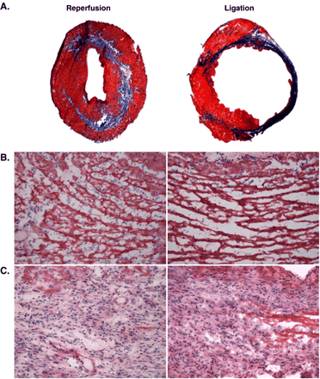
Fig. 2 The morphology of the heart after myocardial infarction. A) Masson trichrome stained cross section of the ...
Notes:
Fig. 2 The morphology of the heart after myocardial infarction. A) Masson trichrome stained cross section of the heart at 28 days post-MI induced by permanent ligation (right) or ligation of 30 min followed by reperfusion (left). There is more pronounced LV wall thinning and lumen dilatation after ligation, while in both models massive collagen deposition (blue) was observed (original magnification 12.5×). B/C) Details of hematoxilin/eosin stained sections of the infarcted area at 1 day (B) and 7 days (C) post-MI of the reperfusion (left) and ligation model (right) (original magnification 200×). At 1 day post-MI in both models remnants of cardiomyocyte are visible. In reperfused MI there is a great infiltration with neutrophils (specific staining not shown), which is less in ligated MI. At 7 days post-MI cardiomyocyte remnants are cleared after reperfusion, where after ligation few remnants are still present. In both models there is a great influx of inflammatory cells, which is predominantly comprised of macrophages.
Unless provided in the caption above, the following copyright applies to the content of this slide: Copyright © 2006, European Society of Cardiology

Slide 4
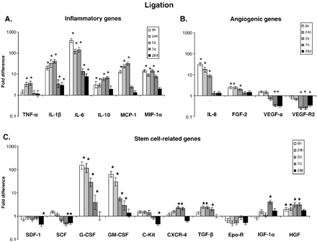
Fig. 5 Gene expression after ligation MI. Fold difference in gene expression in whole heart cross-sections after ...
Notes:
Fig. 5 Gene expression after ligation MI. Fold difference in gene expression in whole heart cross-sections after ligation of inflammatory genes (A), angiogenic genes (B) and stem-cell related genes (C) at 6 and 24 h and 2, 7 and 28 days. * indicates a statistically significant difference compared to control hearts. Gene expression patterns after ligation is relatively similar to reperfused MI (Fig. 4). Also after ligation, highest fold difference was in the inflammatory group and for G-CSF and GM-CSF.
Unless provided in the caption above, the following copyright applies to the content of this slide: Copyright © 2006, European Society of Cardiology

Slide 5
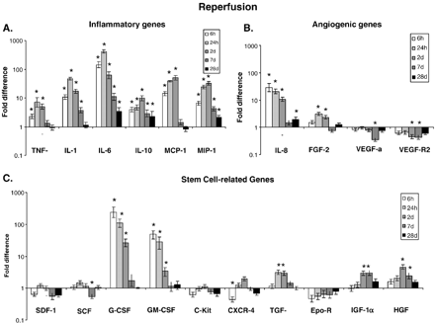
Fig. 4 Gene expression after reperfusion MI. Fold difference in gene expression in whole heart cross-sections after ...
Notes:
Fig. 4 Gene expression after reperfusion MI. Fold difference in gene expression in whole heart cross-sections after reperfused MI of inflammatory genes (A), angiogenic genes (B) and stem-cell related genes (C) at 6 and 24 h and 2, 7 and 28 days. * indicates a statistically significant difference compared to control hearts. Fold differences were highest in the inflammatory gene group and for G-CSF and GM-CSF in the stem cell-related gene group. In the angiogenic and stem cell-related group, there were no or only small differences compared to control hearts, except for IL-8, G-CSF and GM-CSF, which are genes that also relate to the inflammatory response.
Unless provided in the caption above, the following copyright applies to the content of this slide: Copyright © 2006, European Society of Cardiology

Slide 6
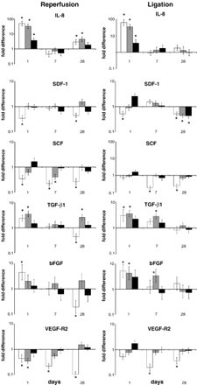
Fig. 6 Gene expression pattern analysis in micro-dissected regions of myocardium. Equal amounts of tissue from ...
Notes:
Fig. 6 Gene expression pattern analysis in micro-dissected regions of myocardium. Equal amounts of tissue from infarcted area (white bars), border zone (grey bars) and spared myocardium (black bars) were collected using laser dissection microscopy and gene expression was measured at 1, 7 and 28 days post-MI. Graphs on the right side represent the reperfusion model, and graphs on the left side the permanent ligation model. * indicates a significant difference compared to control non-infarcted hearts.
Unless provided in the caption above, the following copyright applies to the content of this slide: Copyright © 2006, European Society of Cardiology

Slide 7
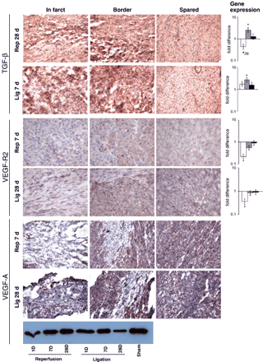
Fig. 7 Protein expression analysis. Representative micrographs of immunohistological stainings of TGF-β (A), VEGF-R2 ...
Notes:
Fig. 7 Protein expression analysis. Representative micrographs of immunohistological stainings of TGF-β (A), VEGF-R2 (B) and VEGF-A (C). Original magnification 200×. Red staining indicates protein expression. Here we show protein expression parallels spatial and temporal patterns of gene expression, presented at the right side. The protein TGF-β is mostly expressed in the border zone (A). VEGF-R2 expression is reduced primarily in the infarcted area. The decrease in VEGF-A expression originates from the infarcted area. Western blot analysis of VEGF-A (C) indicated VEGF-a protein expression is decreased post-MI.
Unless provided in the caption above, the following copyright applies to the content of this slide: Copyright © 2006, European Society of Cardiology

