Slide 1
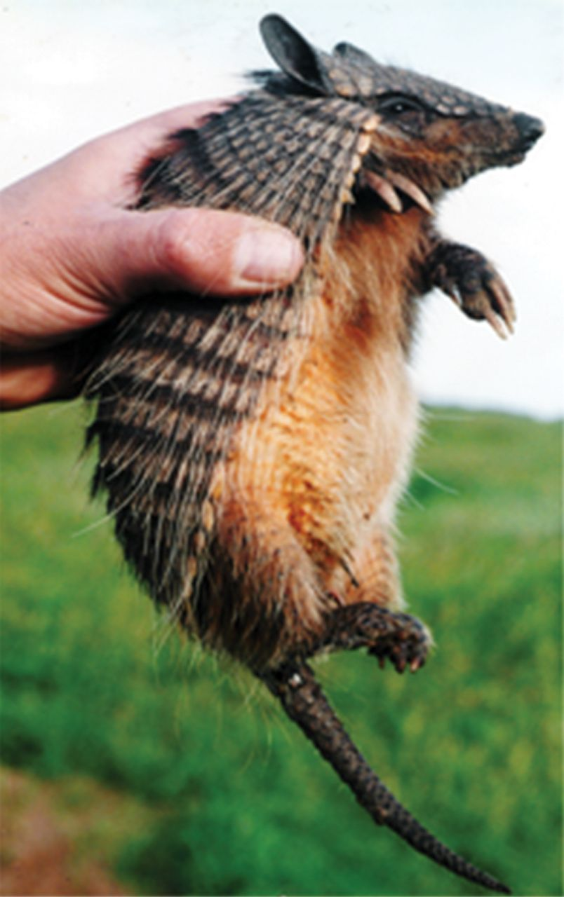
Fig. 1. An adult of Chaetophractus vellerosus from Pipinas, Buenos Aires Province, Argentina. Photo by Esteban ...
Notes:
Fig. 1. An adult of Chaetophractus vellerosus from Pipinas, Buenos Aires Province, Argentina. Photo by Esteban Soibelzon used with permission.
Unless provided in the caption above, the following copyright applies to the content of this slide: © 2016 by American Society of Mammalogists.

Slide 2
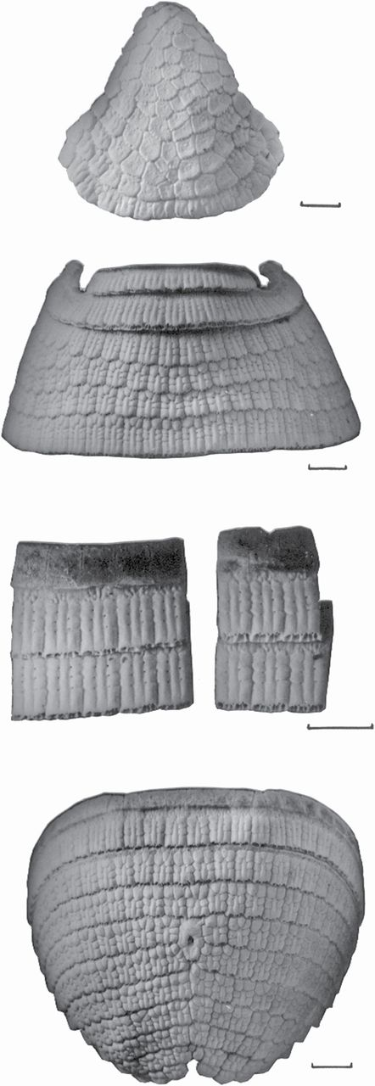
Fig. 2. Dermic carapace of Chaetophractus vellerosus. From top to bottom: cephalic shield, nucal strips, and scapular ...
Notes:
Fig. 2. Dermic carapace of Chaetophractus vellerosus. From top to bottom: cephalic shield, nucal strips, and scapular shield, movable bands (just detail of some osteoderms of them), and pelvic shield. Graphic scale = 1cm. Greatest length of the cephalic shield is 58.1mm.
Unless provided in the caption above, the following copyright applies to the content of this slide: © 2016 by American Society of Mammalogists.

Slide 3
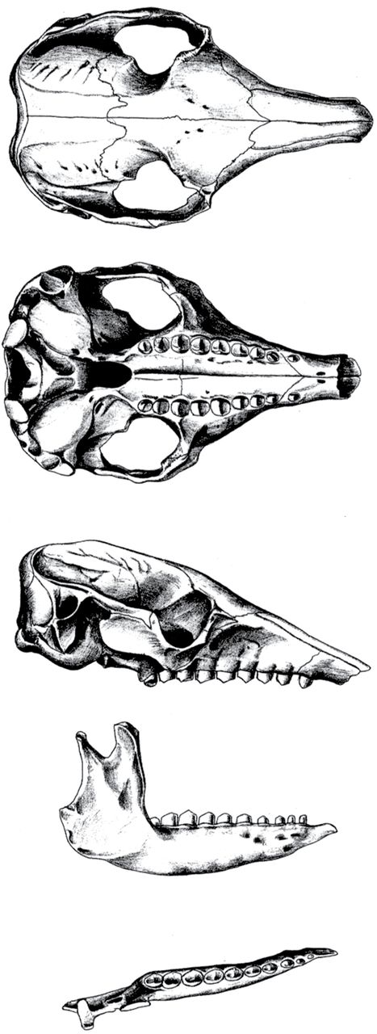
Fig. 3. Dorsal, ventral, and lateral views of the skull, and lateral and dorsal view of the mandible of ...
Notes:
Fig. 3. Dorsal, ventral, and lateral views of the skull, and lateral and dorsal view of the mandible of Chaetophractus vellerosus. Greatest length of skull is 65.6mm.
Unless provided in the caption above, the following copyright applies to the content of this slide: © 2016 by American Society of Mammalogists.

Slide 4
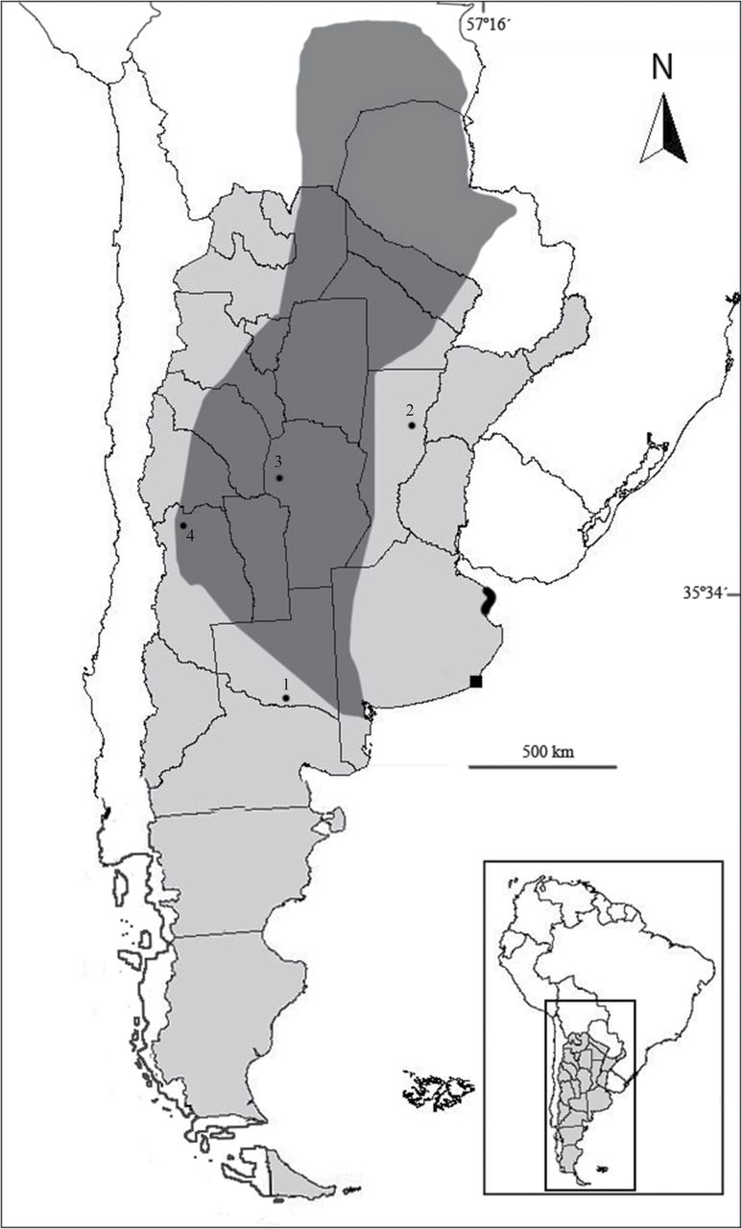
Fig. 4. Geographic distribution of Chaetophractus vellerosus. Extended light gray shading indicates main distribution ...
Notes:
Fig. 4. Geographic distribution of Chaetophractus vellerosus. Extended light gray shading indicates main distribution area; small black shading indicates relictual area in Buenos Aires Province (including Pipinas locality), Argentina. Black dots indicate archaeological sites: 1) “Tapera Moreira,” La Pampa Province; 2) “La Lechuza,” Santa Fe Province; 3) 4 Late Holocene sites in Córdoba Province; 4) “Agua de la Cueva,” Mendoza Province. Black square indicates fossil record at Punta Hermengo, Miramar, Buenos Aires.
Unless provided in the caption above, the following copyright applies to the content of this slide: © 2016 by American Society of Mammalogists.

