Slide 1
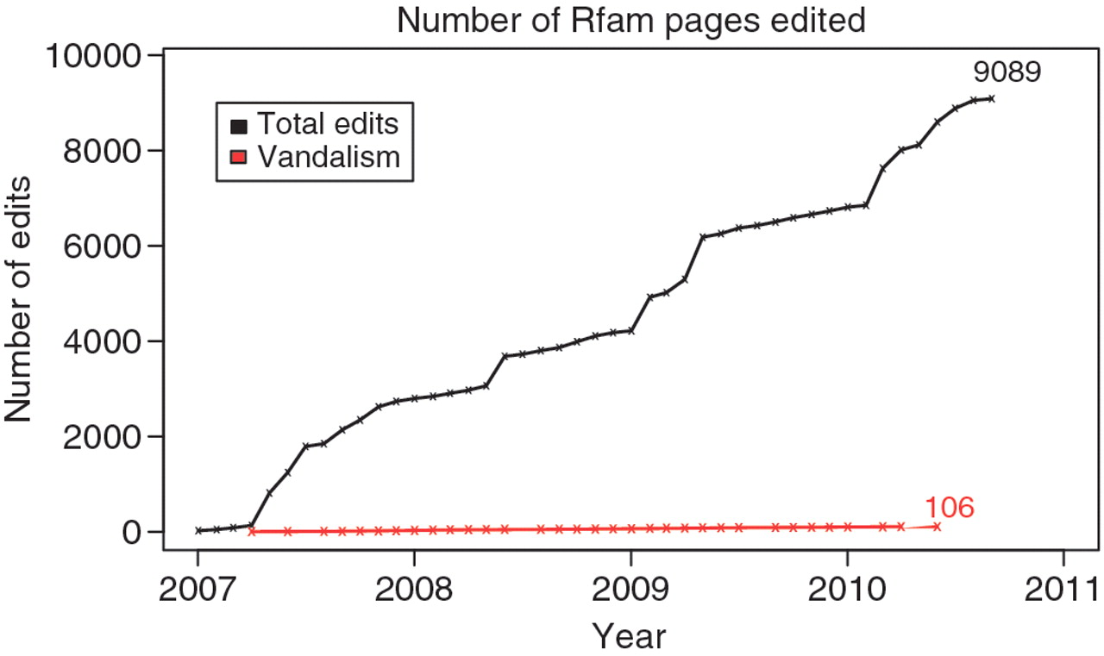
Figure 1. Edits for Wikipedia articles on RNA families. The cumulative number of edits since 1st January 2007 for the ...
Notes:
Figure 1. Edits for Wikipedia articles on RNA families. The cumulative number of edits since 1st January 2007 for the 733 Wikipedia articles that are associated with Rfam entries is shown in black. The total number of edits that were reverted or labeled as vandalism is shown in red. To mid-2010, there were just 106 of these. However, some reverted edits may have been well-intentioned but were deemed inappropriate for Wikipedia.
Unless provided in the caption above, the following copyright applies to the content of this slide: © The Author(s) 2010. Published by Oxford University Press.This is an Open Access article distributed under the terms of the Creative Commons Attribution Non-Commercial License (http://creativecommons.org/licenses/by-nc/2.5), which permits unrestricted non-commercial use, distribution, and reproduction in any medium, provided the original work is properly cited.

Slide 2
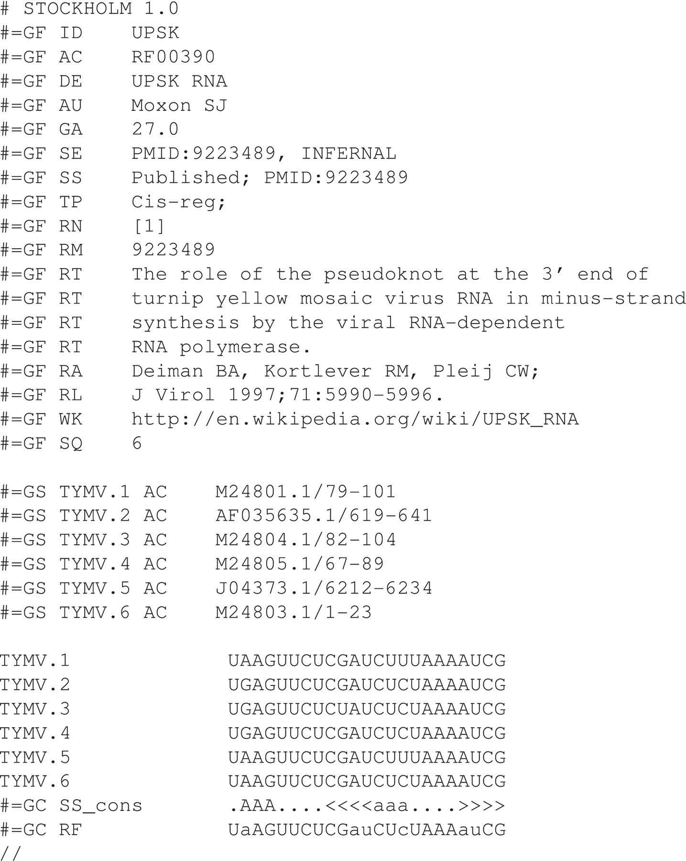
Figure 2. An example Stockholm alignment for the UPSK pseudoknot from turnip yellow mosaic virus. The Stockholm ...
Notes:
Figure 2. An example Stockholm alignment for the UPSK pseudoknot from turnip yellow mosaic virus. The Stockholm alignment format is flexible enough to allow generic mark-up of file information with ‘ #=GF ' lines, sequence information with ‘ #=GS ' lines and column information with ‘ #=GC ' lines. Each is followed by at least a two-letter code giving an indication for what follows e.g. ‘ID' implies ‘identifier', ‘ AC ' implies ‘accession', ‘ AU ' implies ‘author', etc. All the commonly used tags are documented in the Wikipedia article for Stockholm alignment ( 25 ).
Unless provided in the caption above, the following copyright applies to the content of this slide: © The Author(s) 2010. Published by Oxford University Press.This is an Open Access article distributed under the terms of the Creative Commons Attribution Non-Commercial License (http://creativecommons.org/licenses/by-nc/2.5), which permits unrestricted non-commercial use, distribution, and reproduction in any medium, provided the original work is properly cited.

