Slide 1
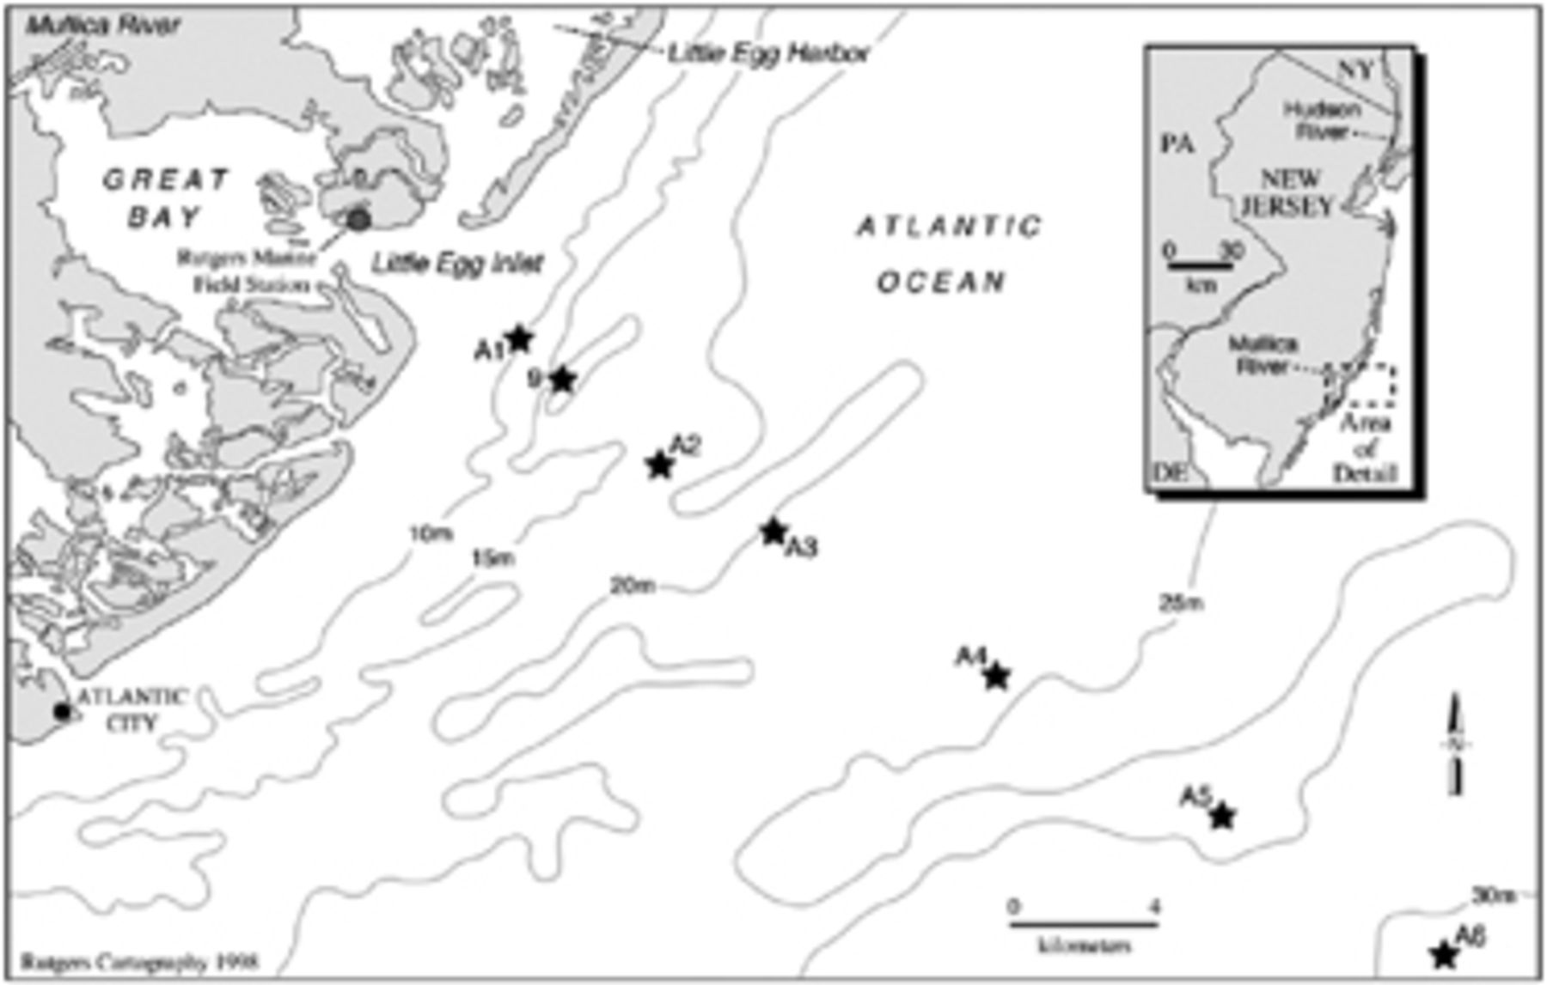
1 Bathymetry map of the 34-km transect line from the study site off the Southern Coast of New Jersey.
Notes:
1 Bathymetry map of the 34-km transect line from the study site off the Southern Coast of New Jersey.
Unless provided in the caption above, the following copyright applies to the content of this slide: © 2008 Federation of European Microbiological Societies. Published by Blackwell Publishing Ltd. All rights reserved

Slide 2
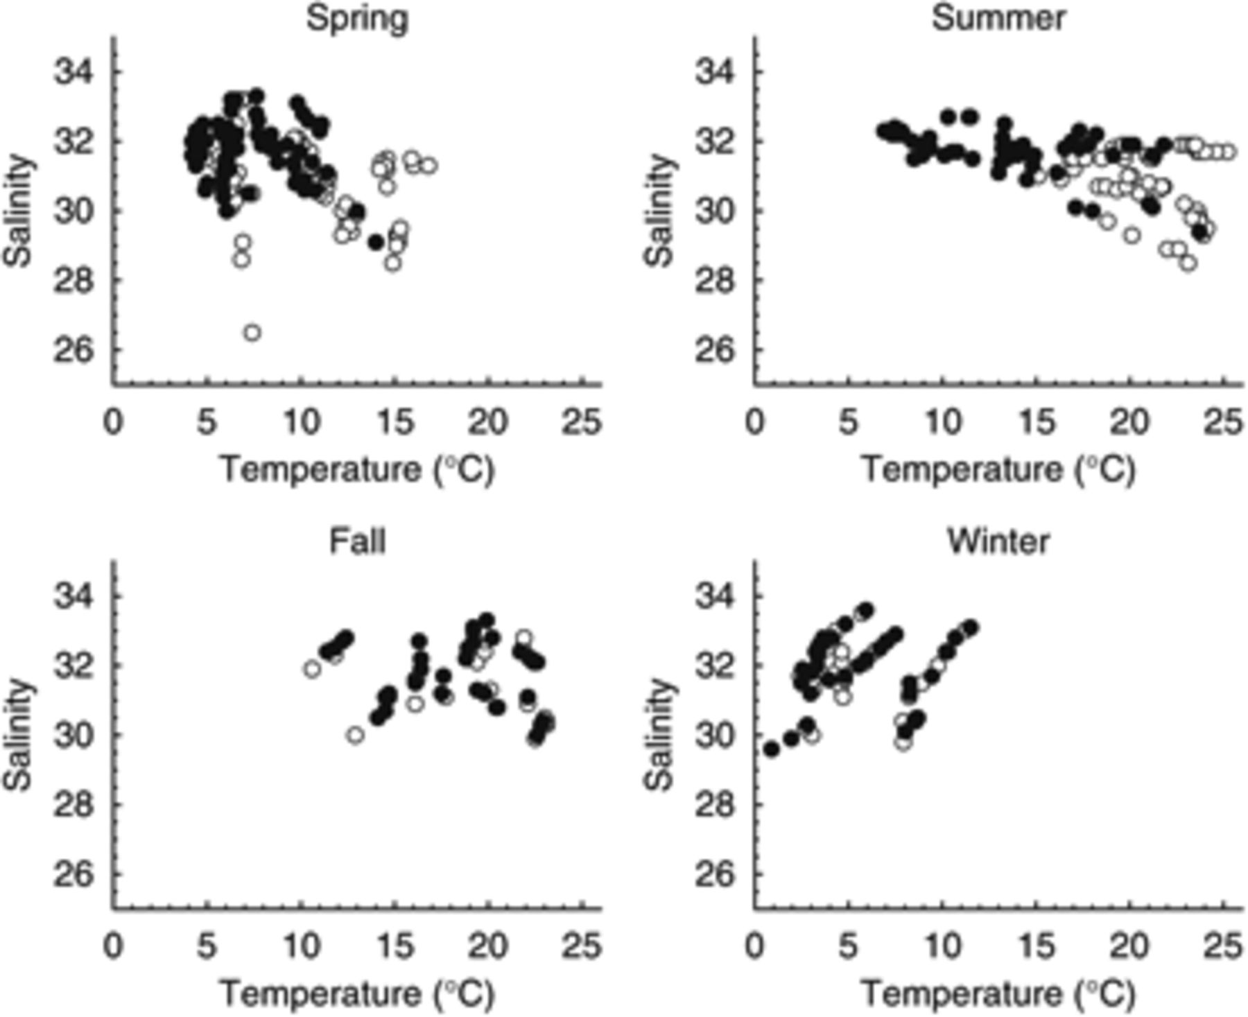
2 Temperature vs. salinity plots of different seasons from a 2-year data set in the Mid-Atlantic Bight ...
Notes:
2 Temperature vs. salinity plots of different seasons from a 2-year data set in the Mid-Atlantic Bight (1995–1996). Surface samples are presented (○), bottom samples (●).
Unless provided in the caption above, the following copyright applies to the content of this slide: © 2008 Federation of European Microbiological Societies. Published by Blackwell Publishing Ltd. All rights reserved

Slide 3
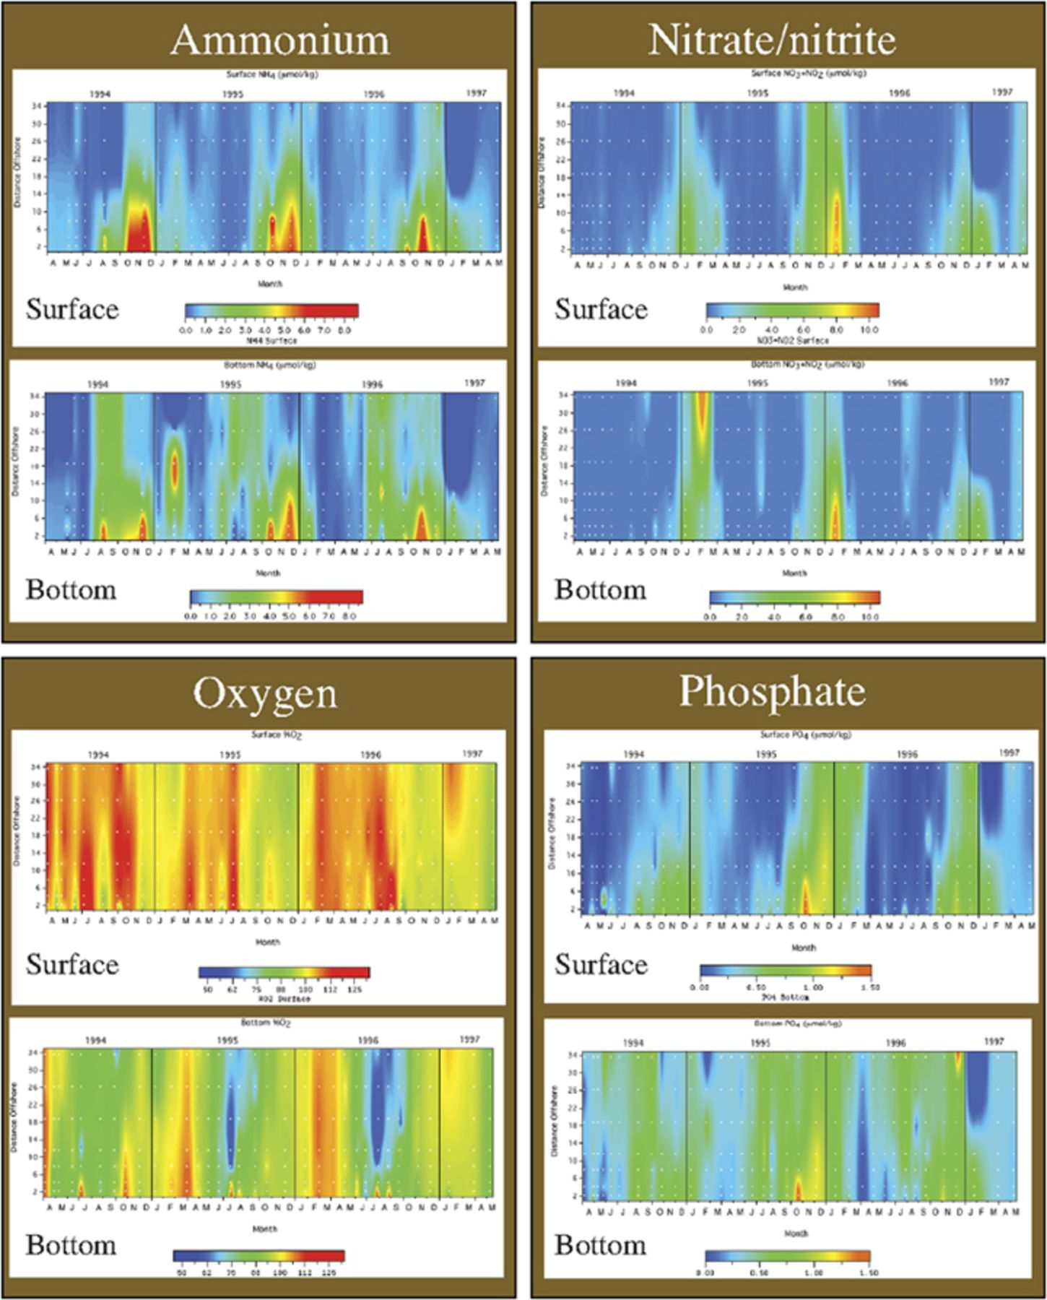
3 Nutrient fields plotted against distance offshore in the Mid-Atlantic Bight study area over a 3-year time ...
Notes:
3 Nutrient fields plotted against distance offshore in the Mid-Atlantic Bight study area over a 3-year time frame. Surface and bottom samples are indicated.
Unless provided in the caption above, the following copyright applies to the content of this slide: © 2008 Federation of European Microbiological Societies. Published by Blackwell Publishing Ltd. All rights reserved

Slide 4
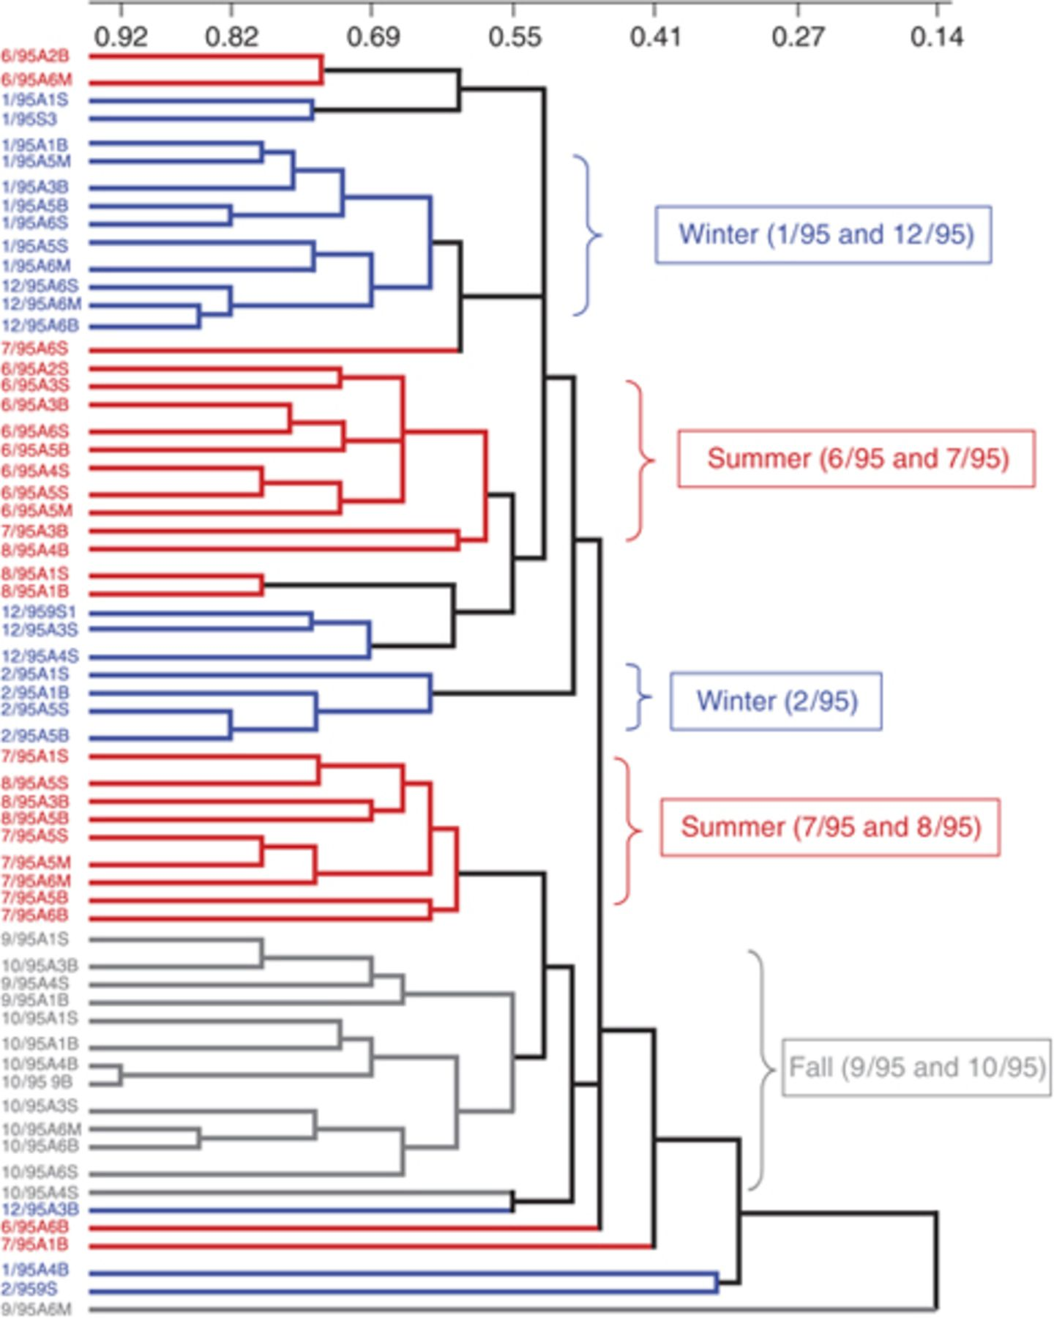
4 compah analysis of bacterial TRFLP fingerprints from 1995 (n=61). Samples are color coded in 3-month ...
Notes:
4 compah analysis of bacterial TRFLP fingerprints from 1995 (n=61). Samples are color coded in 3-month increments. The percent similarity is indicated by the scale bar at the top.
Unless provided in the caption above, the following copyright applies to the content of this slide: © 2008 Federation of European Microbiological Societies. Published by Blackwell Publishing Ltd. All rights reserved

Slide 5
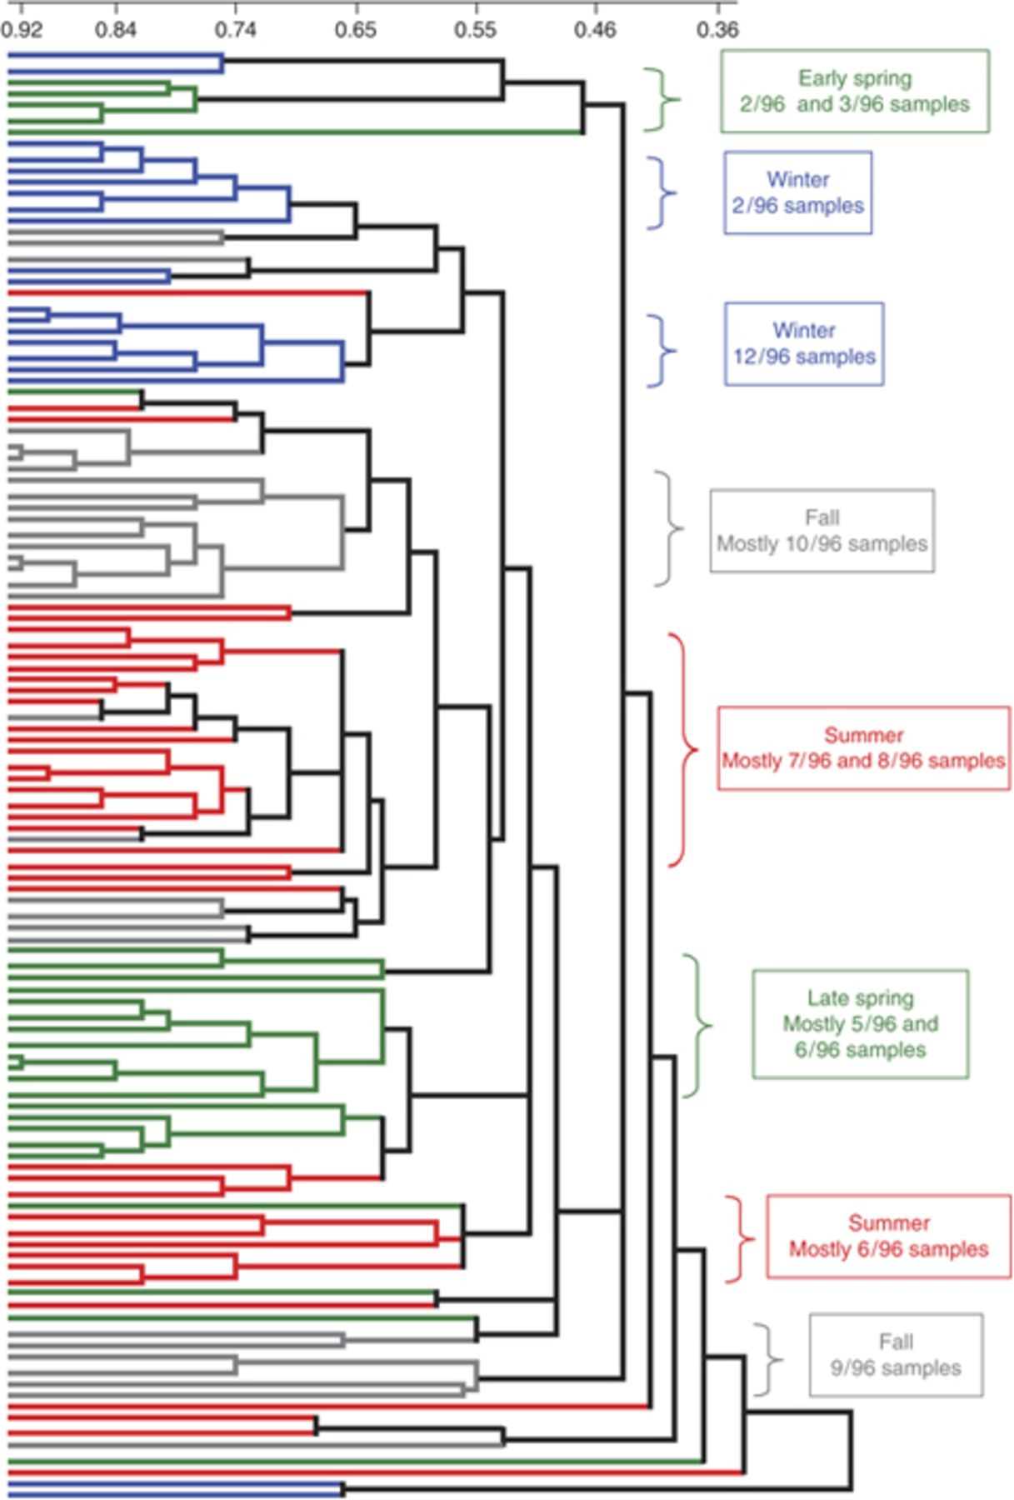
5 compah analysis of bacterial TRFLP fingerprints from 1996 (n=116). Samples are color coded in 3-month ...
Notes:
5 compah analysis of bacterial TRFLP fingerprints from 1996 (n=116). Samples are color coded in 3-month increments and the sample labels are provided in Table 1.
Unless provided in the caption above, the following copyright applies to the content of this slide: © 2008 Federation of European Microbiological Societies. Published by Blackwell Publishing Ltd. All rights reserved

Slide 6
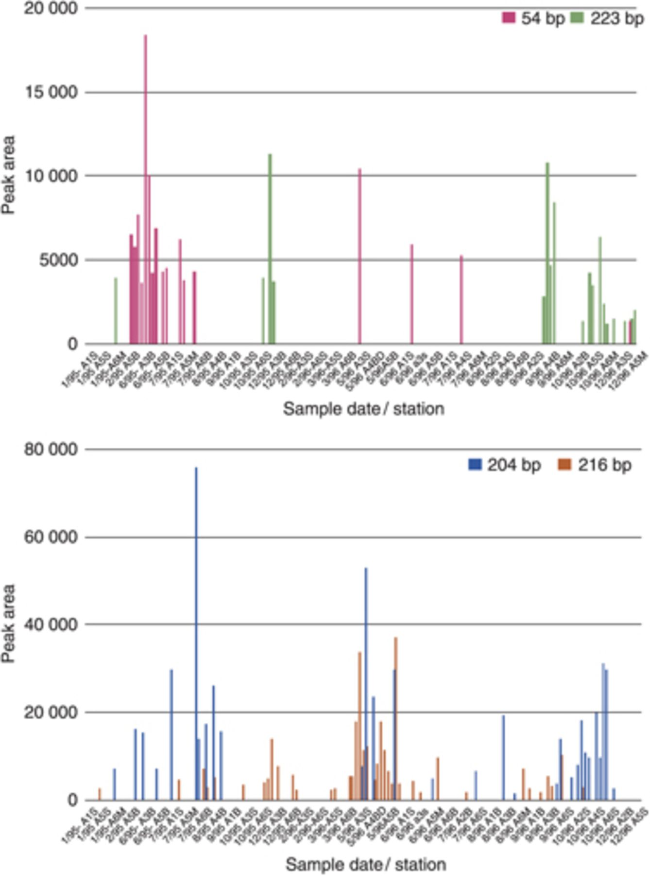
6 Peak area vs. time of sampling for select TRFs. A 2-year sampling period is presented.
Notes:
6 Peak area vs. time of sampling for select TRFs. A 2-year sampling period is presented.
Unless provided in the caption above, the following copyright applies to the content of this slide: © 2008 Federation of European Microbiological Societies. Published by Blackwell Publishing Ltd. All rights reserved

Slide 7
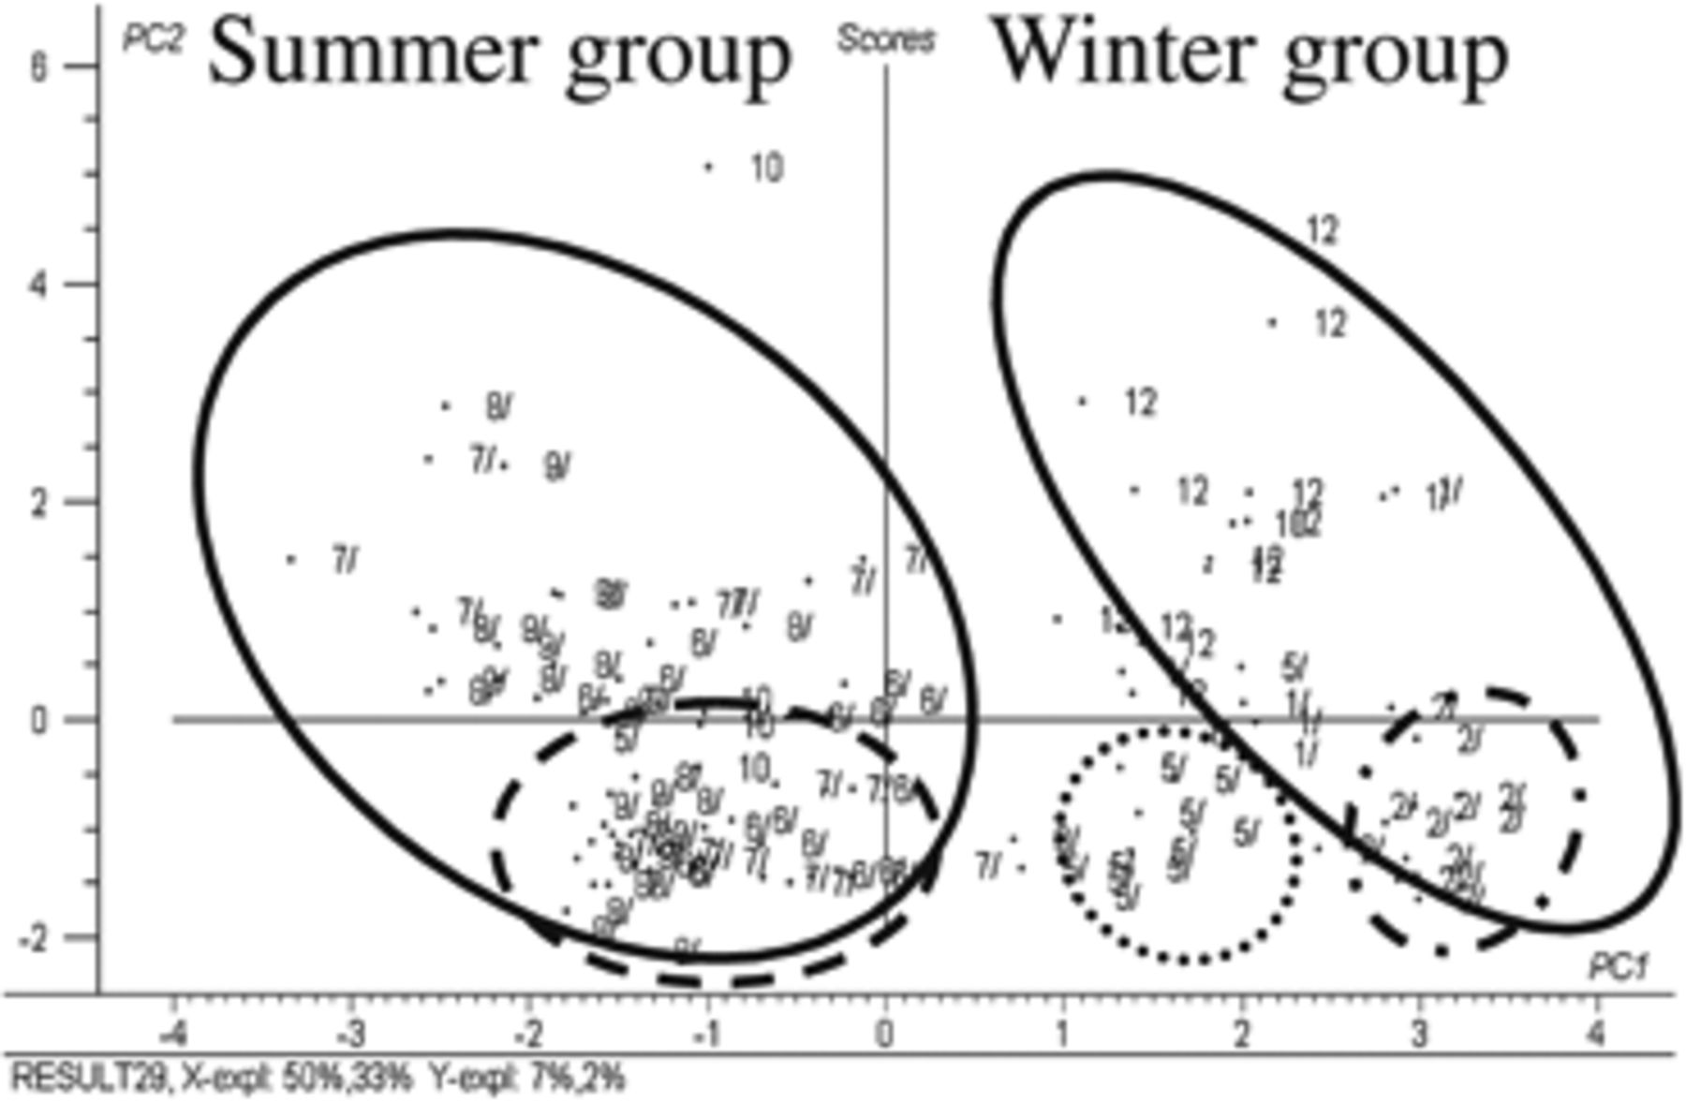
7 Partial least squares regression scores plot of the major TRFs in the dataset (n=60). The months of the ...
Notes:
7 Partial least squares regression scores plot of the major TRFs in the dataset (n=60). The months of the various TRFLP profiles are shown and the seasonal clustering is indicated by dashed and closed circles.
Unless provided in the caption above, the following copyright applies to the content of this slide: © 2008 Federation of European Microbiological Societies. Published by Blackwell Publishing Ltd. All rights reserved

Slide 8
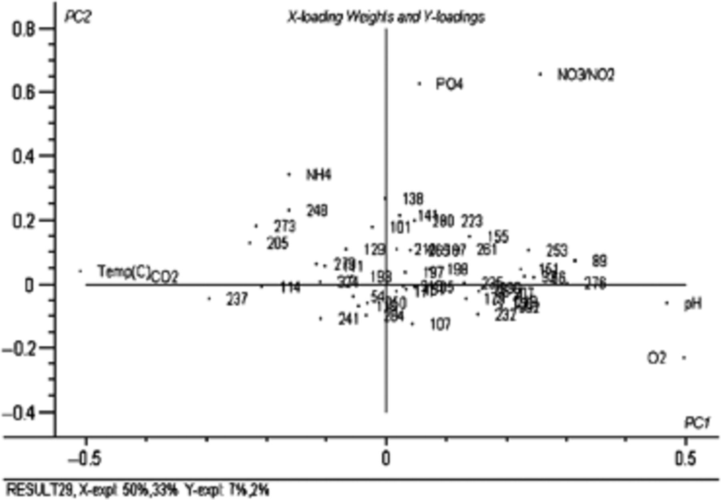
8 X- and Y-loadings weight plot using the physical/chemical data and the major TRFs from the profiles in the ...
Notes:
8 X- and Y-loadings weight plot using the physical/chemical data and the major TRFs from the profiles in the dataset (n=157). The individual TRFs are indicated.
Unless provided in the caption above, the following copyright applies to the content of this slide: © 2008 Federation of European Microbiological Societies. Published by Blackwell Publishing Ltd. All rights reserved

