Slide 1
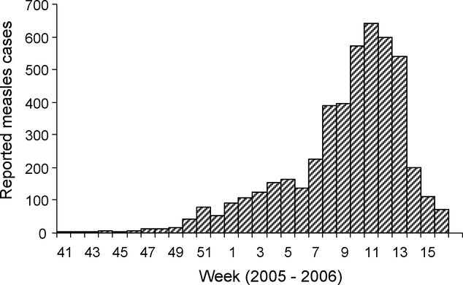
Figure 2 Reported measles cases Week 41 2005–Week 16 2006, Mbuji Mayi, Democratic Republic of Congo. The mass ...
Notes:
Figure 2 Reported measles cases Week 41 2005–Week 16 2006, Mbuji Mayi, Democratic Republic of Congo. The mass vaccination campaign was carried out in Weeks 11 and 12.
Unless provided in the caption above, the following copyright applies to the content of this slide: © Royal Society of Tropical Medicine and Hygiene 2010

Slide 2
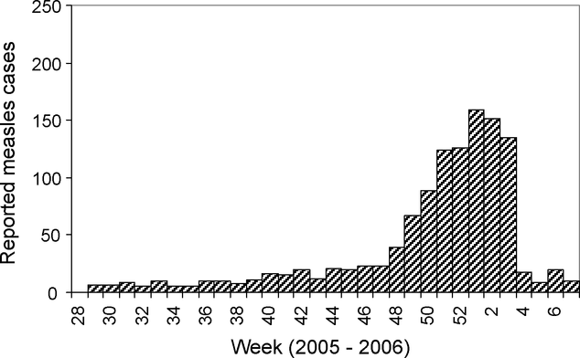
Figure 1 Reported measles cases Week 28 2005 – Week 7 2006, Matadi, Democratic Republic of Congo. The mass vaccination ...
Notes:
Figure 1 Reported measles cases Week 28 2005 – Week 7 2006, Matadi, Democratic Republic of Congo. The mass vaccination campaign was carried out in Week 1, 2006.
Unless provided in the caption above, the following copyright applies to the content of this slide: © Royal Society of Tropical Medicine and Hygiene 2010

