Slide 1
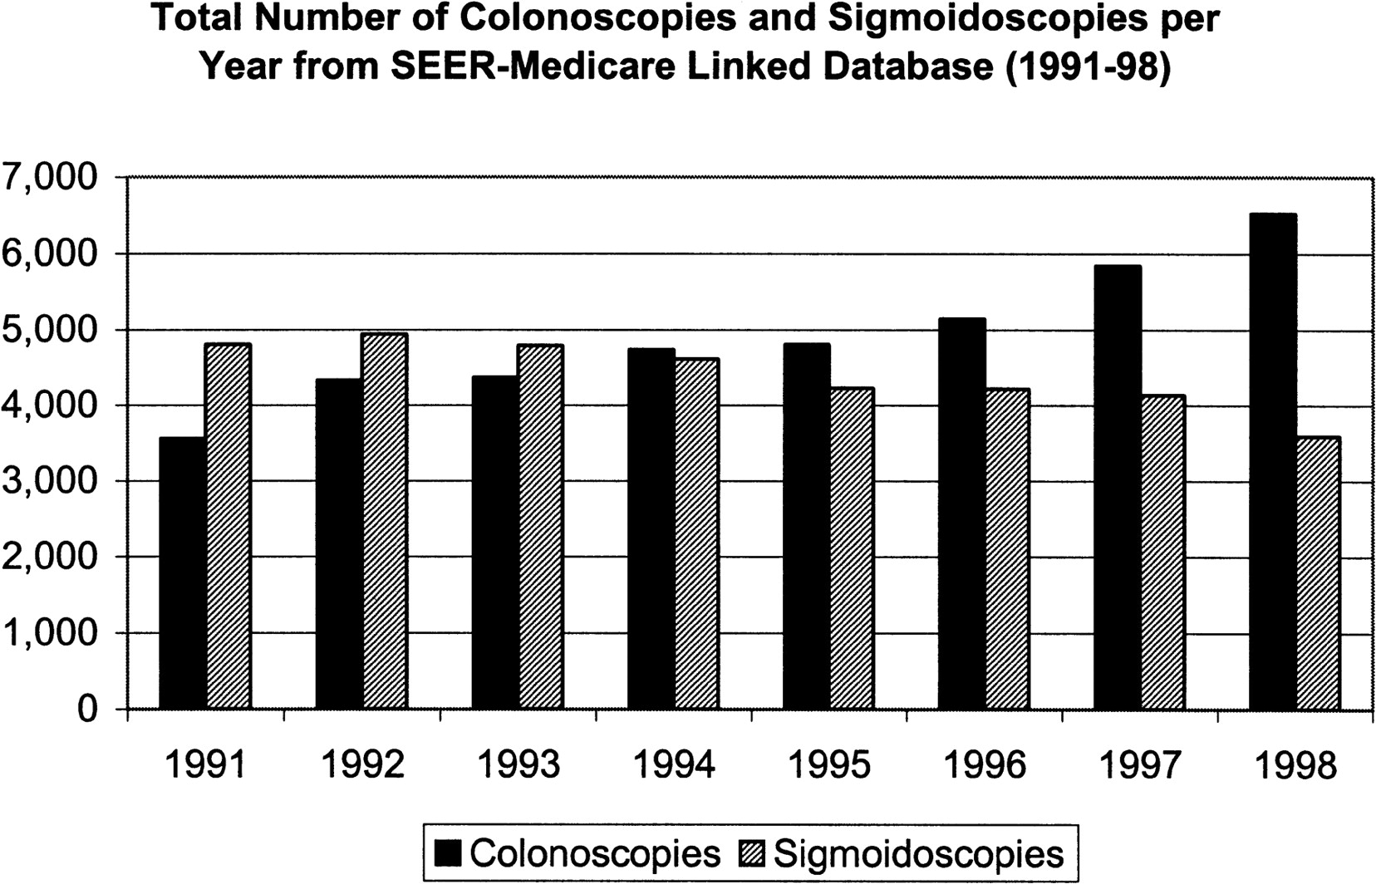
Fig. 1. Total number of colonoscopy and sigmoidoscopy procedures per year from the SEER–Medicare linked database ...
Notes:
Fig. 1. Total number of colonoscopy and sigmoidoscopy procedures per year from the SEER–Medicare linked database (1991–1998).
Unless provided in the caption above, the following copyright applies to the content of this slide: © Oxford University Press

Slide 2
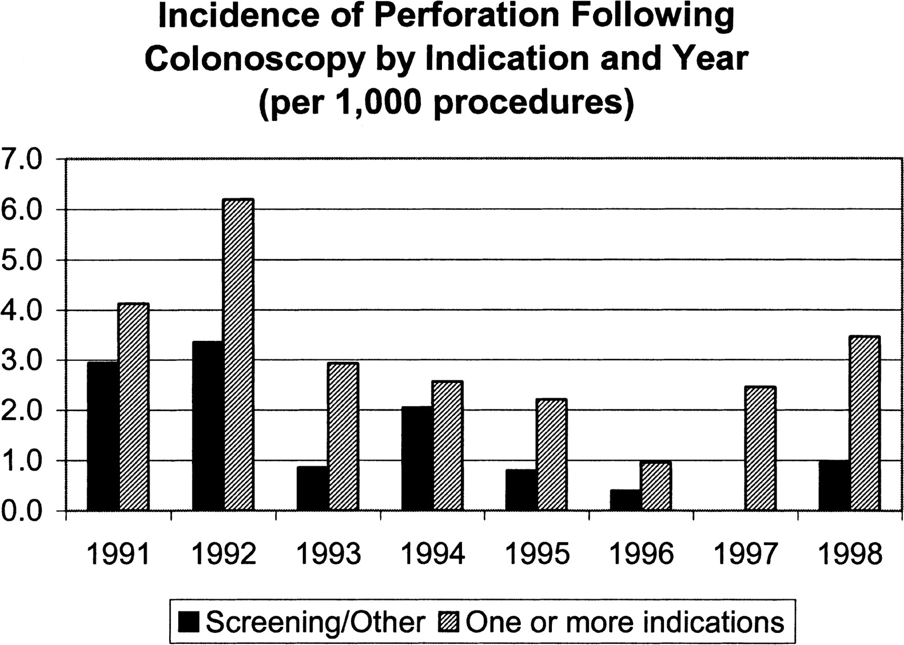
Fig. 2. Incidence (per 1000 procedures) of perforation after colonoscopy by indication and year.
Notes:
Fig. 2. Incidence (per 1000 procedures) of perforation after colonoscopy by indication and year.
Unless provided in the caption above, the following copyright applies to the content of this slide: © Oxford University Press

