Slide 1
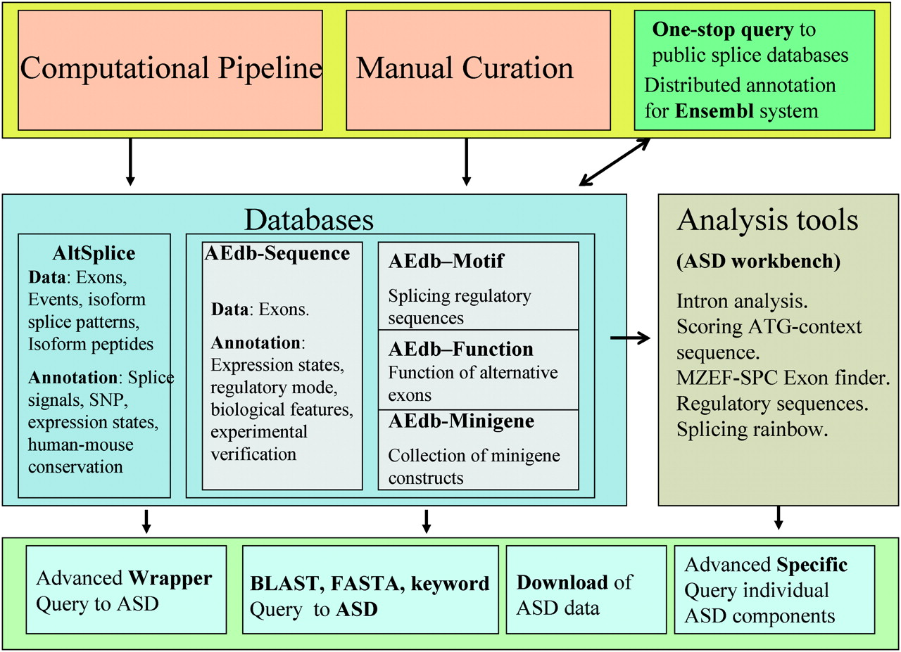
Figure 1 Structure of ASD. We used computational pipelines and manual curation (top, pink) to create the modular ...
Notes:
Figure 1 Structure of ASD. We used computational pipelines and manual curation (top, pink) to create the modular databases of ASD (middle, blue). The individual databases are integrated, cross-linked and are available through a variety of interface tools (bottom, sky blue). Currently the databases are the computer generated Altsplice and the manually-curated AEdb-Sequence, AEdb-Motif, AEdb-Function and AEdb-Minigene databases. The ASD data are integrated with Ensembl genome annotation system and is visible from Ensembl genome browser; Publicly-available databases on alternative splicing are accessible from ASD interfaces (top right, dark green) The databases are connected to analysis tools that are collected in the ASD workbench (middle right, grey).
Unless provided in the caption above, the following copyright applies to the content of this slide: © The Author 2006. Published by Oxford University Press. All rights reserved The online version of this article has been published under an open access model. Users are entitled to use, reproduce, disseminate, or display the open access version of this article for non-commercial purposes provided that: the original authorship is properly and fully attributed; the Journal and Oxford University Press are attributed as the original place of publication with the correct citation details given; if an article is subsequently reproduced or disseminated not in its entirety but only in part or as a derivative work this must be clearly indicated. For commercial re-use, please contact journals.permissions@oxfordjournals.org

Slide 2
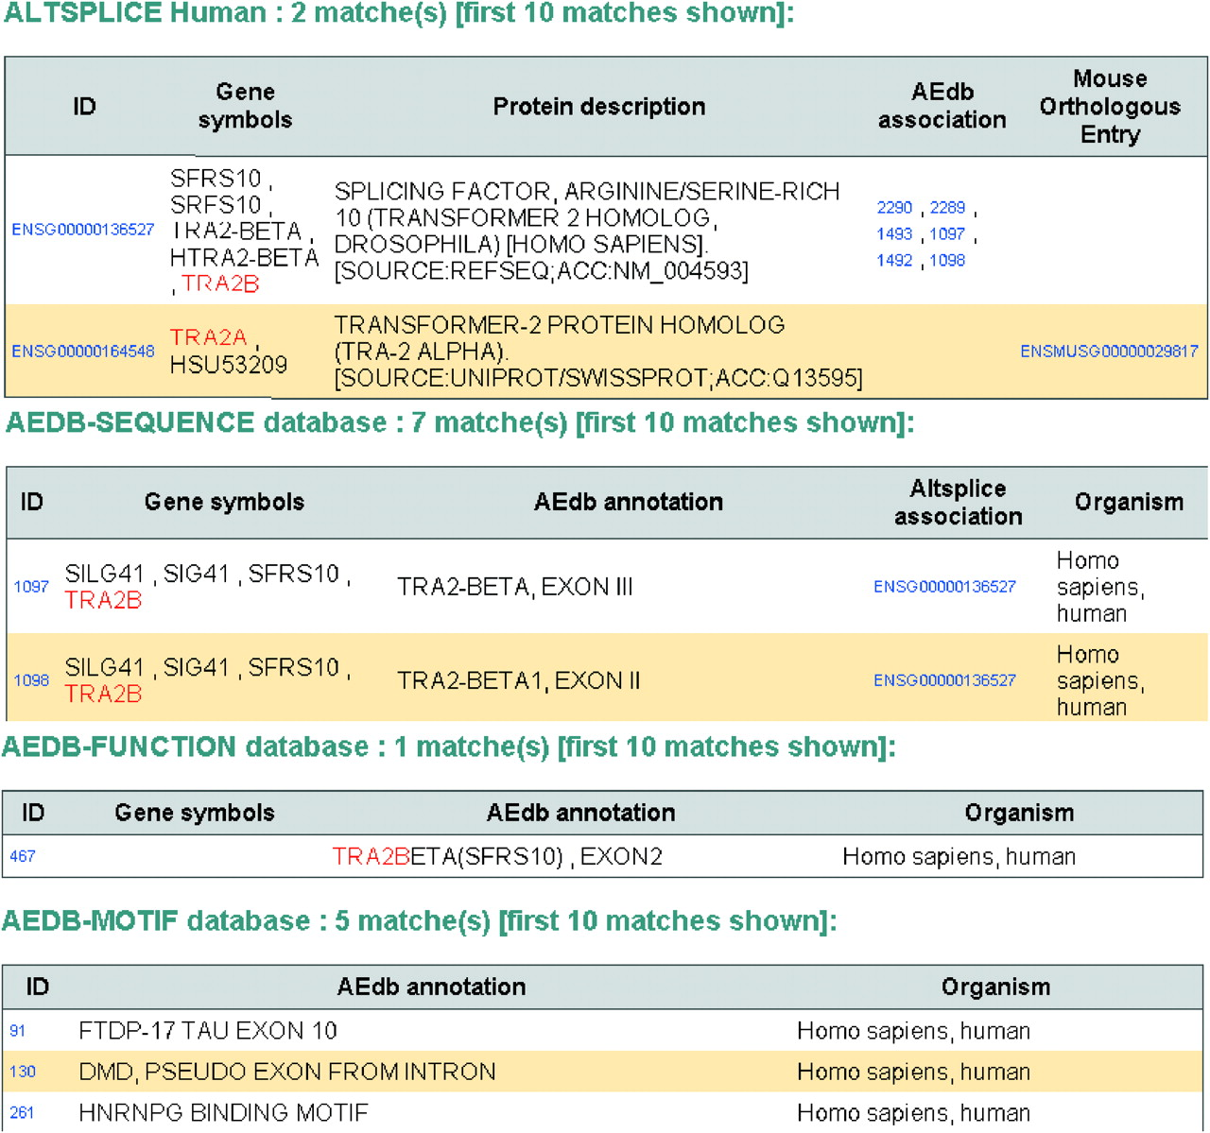
Figure 2 Result page of query to all of ASD data. The ASD was queried using the wrapper interface with the term ...
Notes:
Figure 2 Result page of query to all of ASD data. The ASD was queried using the wrapper interface with the term ‘tra2a* | tra2b*’ and this resulted in the retrieval of data entries from AltSplice-Human (two entries), AEdb-Sequence (seven entries), AEdb-Function (one entry) and AEdb-Motif (five entries). This figure illustrates the integration among the different data sets of ASD—(i) the AltSplice-Human entries are seen associated with entries from AEdb-Sequence, and from AltSplice-Mouse; (ii) the AEdb-Sequence entries are seen associated with entries from AltSplice-Human. These associations are hyperlinked.
Unless provided in the caption above, the following copyright applies to the content of this slide: © The Author 2006. Published by Oxford University Press. All rights reserved The online version of this article has been published under an open access model. Users are entitled to use, reproduce, disseminate, or display the open access version of this article for non-commercial purposes provided that: the original authorship is properly and fully attributed; the Journal and Oxford University Press are attributed as the original place of publication with the correct citation details given; if an article is subsequently reproduced or disseminated not in its entirety but only in part or as a derivative work this must be clearly indicated. For commercial re-use, please contact journals.permissions@oxfordjournals.org

Slide 3
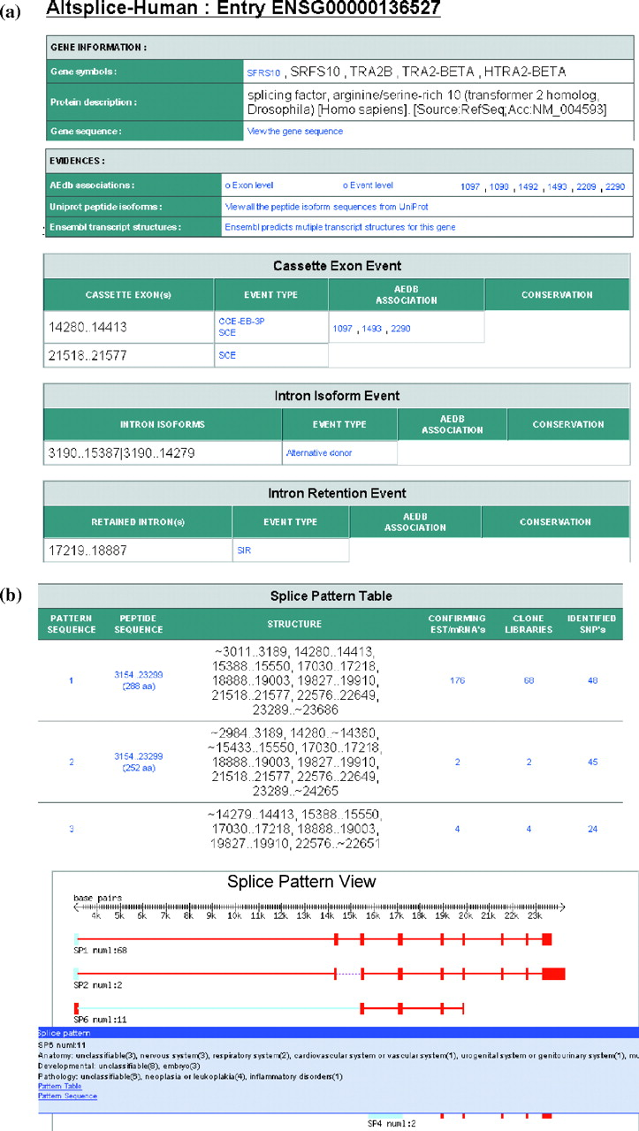
Figure 3 Display of data on alternative splicing of human tra2-beta gene as seen in AltSplice and AEdb-Function data ...
Notes:
Figure 3 Display of data on alternative splicing of human tra2-beta gene as seen in AltSplice and AEdb-Function data sets. (a) This figure presents a display of data sections on Gene Information, Evidences and Splicing events as seen in AltSplice. Gene information section provides hyperlinks to a page listing the gene entry from HUGO Gene Nomenclature database and to a page which lists the sequence of the gene. The evidences section provides hyperlinks to the associated entries from AEdb-Sequence, to pages that list variant peptide sequences for the gene from UniProt or to pages that list the Ensembl transcript sequences for the gene. The events section lists all the splicing events that AltSplice has identified for the gene. Column 1 lists the gene coordinates of alternatively spliced exons/introns. Column 2 indicates whether the event involves modifications in the flanking exons as well; entries are hyperlinked to pages listing detailed information on the event. Column 3 indicates the identifier of the associated entry from AEdb-Sequence (if any) and the entry is hyperlinked. Column 4 indicates the identifier of the orthologous gene (if any) and the coordinates of the exon orthologous to the one presented in column 1; the entry is hyperlinked to the orthologous gene entry. (b) This figure presents the textual and graphical display of observed splicing patterns for tra2-beta gene as seen in AltSplice data. Splice Pattern Table: Entry in column 1 is hyperlinked to a page listing the sequence of the splicing pattern. Entry in column 2 gives the coding start and end positions on the gene and the length of the translated peptide sequence and is hyperlinked to a page listing the peptide sequence. Entry in column 3 lists the structure of the splicing pattern as a string of exons (exon boundaries are presented in gene coordinates). Entry in column 4 is hyperlinked to pages listing detailed information on the confirming transcript sequences. Entry in column 5 is hyperlinked to pages listing expression states. Entry in column 6 is hyperlinked to pages listing allele specificity of the splicing pattern. Splice Pattern View: Exons are indicated by boxes and introns by lines. Exons/introns that are variants are indicated in blue color. Browsing the cursor over various elements of the pattern displays pop-up's giving detailed information on the elements. The displayed pop-up in this example shows information on the expression state of Splicing Pattern 6. (c) This figure presents data on the functional changes due to alternative splicing in tra2-beta as seen in AEdb-Function data set. The data are organised into three sections namely, gene information, bibliography information and functional information. This figure illustrates the wealth of knowledge captured from literature.
Unless provided in the caption above, the following copyright applies to the content of this slide: © The Author 2006. Published by Oxford University Press. All rights reserved The online version of this article has been published under an open access model. Users are entitled to use, reproduce, disseminate, or display the open access version of this article for non-commercial purposes provided that: the original authorship is properly and fully attributed; the Journal and Oxford University Press are attributed as the original place of publication with the correct citation details given; if an article is subsequently reproduced or disseminated not in its entirety but only in part or as a derivative work this must be clearly indicated. For commercial re-use, please contact journals.permissions@oxfordjournals.org

Slide 4
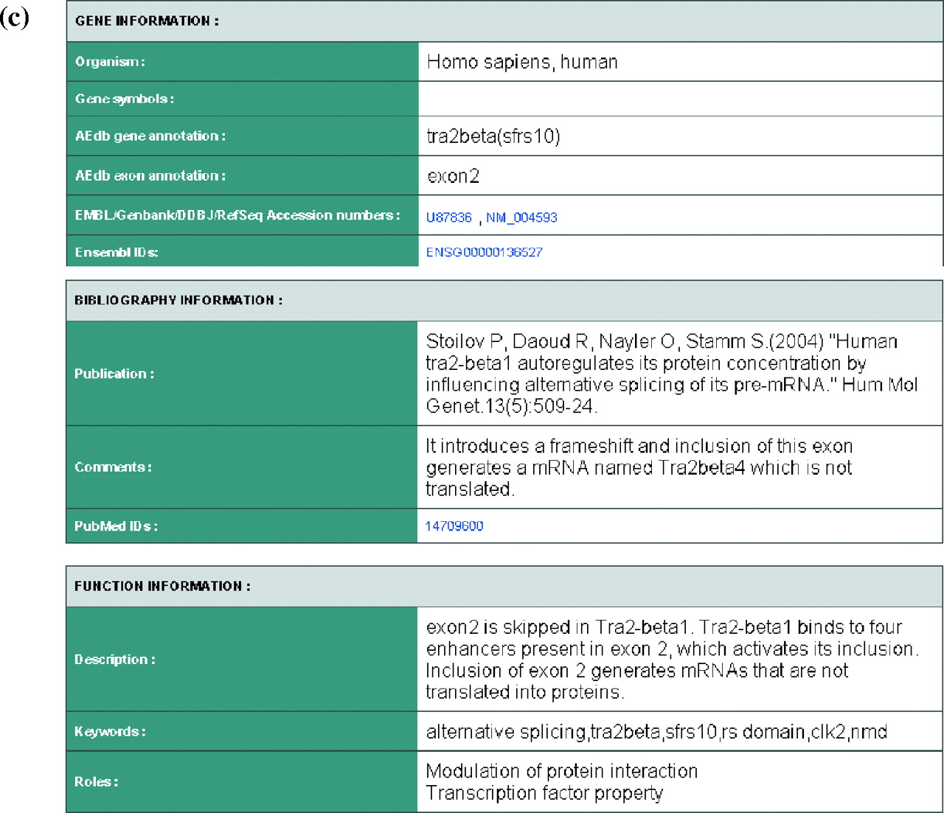
Figure 3 Display of data on alternative splicing of human tra2-beta gene as seen in AltSplice and AEdb-Function data ...
Notes:
Figure 3 Display of data on alternative splicing of human tra2-beta gene as seen in AltSplice and AEdb-Function data sets. (a) This figure presents a display of data sections on Gene Information, Evidences and Splicing events as seen in AltSplice. Gene information section provides hyperlinks to a page listing the gene entry from HUGO Gene Nomenclature database and to a page which lists the sequence of the gene. The evidences section provides hyperlinks to the associated entries from AEdb-Sequence, to pages that list variant peptide sequences for the gene from UniProt or to pages that list the Ensembl transcript sequences for the gene. The events section lists all the splicing events that AltSplice has identified for the gene. Column 1 lists the gene coordinates of alternatively spliced exons/introns. Column 2 indicates whether the event involves modifications in the flanking exons as well; entries are hyperlinked to pages listing detailed information on the event. Column 3 indicates the identifier of the associated entry from AEdb-Sequence (if any) and the entry is hyperlinked. Column 4 indicates the identifier of the orthologous gene (if any) and the coordinates of the exon orthologous to the one presented in column 1; the entry is hyperlinked to the orthologous gene entry. (b) This figure presents the textual and graphical display of observed splicing patterns for tra2-beta gene as seen in AltSplice data. Splice Pattern Table: Entry in column 1 is hyperlinked to a page listing the sequence of the splicing pattern. Entry in column 2 gives the coding start and end positions on the gene and the length of the translated peptide sequence and is hyperlinked to a page listing the peptide sequence. Entry in column 3 lists the structure of the splicing pattern as a string of exons (exon boundaries are presented in gene coordinates). Entry in column 4 is hyperlinked to pages listing detailed information on the confirming transcript sequences. Entry in column 5 is hyperlinked to pages listing expression states. Entry in column 6 is hyperlinked to pages listing allele specificity of the splicing pattern. Splice Pattern View: Exons are indicated by boxes and introns by lines. Exons/introns that are variants are indicated in blue color. Browsing the cursor over various elements of the pattern displays pop-up's giving detailed information on the elements. The displayed pop-up in this example shows information on the expression state of Splicing Pattern 6. (c) This figure presents data on the functional changes due to alternative splicing in tra2-beta as seen in AEdb-Function data set. The data are organised into three sections namely, gene information, bibliography information and functional information. This figure illustrates the wealth of knowledge captured from literature.
Unless provided in the caption above, the following copyright applies to the content of this slide: © The Author 2006. Published by Oxford University Press. All rights reserved The online version of this article has been published under an open access model. Users are entitled to use, reproduce, disseminate, or display the open access version of this article for non-commercial purposes provided that: the original authorship is properly and fully attributed; the Journal and Oxford University Press are attributed as the original place of publication with the correct citation details given; if an article is subsequently reproduced or disseminated not in its entirety but only in part or as a derivative work this must be clearly indicated. For commercial re-use, please contact journals.permissions@oxfordjournals.org

Slide 5
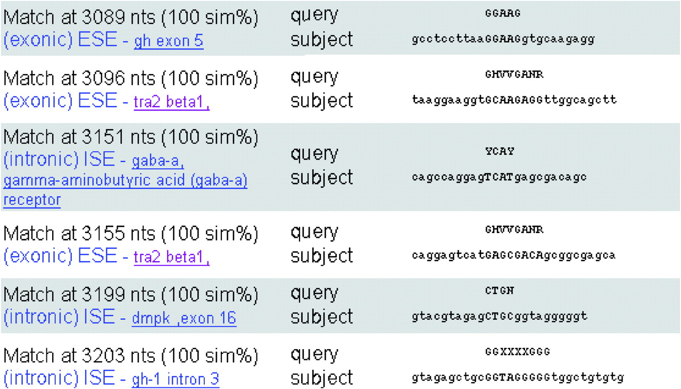
Figure 4 Example output from workbench tool that detects splicing regulatory sequences. The figure displays a portion ...
Notes:
Figure 4 Example output from workbench tool that detects splicing regulatory sequences. The figure displays a portion of the page that reports splicing regulatory sequences in tra2-beta gene. The names of identified motifs are hyperlinked to appropriate entries in AEdb-Motif database. Matches against tra2-beta regulatory sequences are also seen. It is known that tra2-beta1 auto regulates its protein concentration by influencing alternative splicing of its pre-mRNA (31).
Unless provided in the caption above, the following copyright applies to the content of this slide: © The Author 2006. Published by Oxford University Press. All rights reserved The online version of this article has been published under an open access model. Users are entitled to use, reproduce, disseminate, or display the open access version of this article for non-commercial purposes provided that: the original authorship is properly and fully attributed; the Journal and Oxford University Press are attributed as the original place of publication with the correct citation details given; if an article is subsequently reproduced or disseminated not in its entirety but only in part or as a derivative work this must be clearly indicated. For commercial re-use, please contact journals.permissions@oxfordjournals.org

