Slide 1
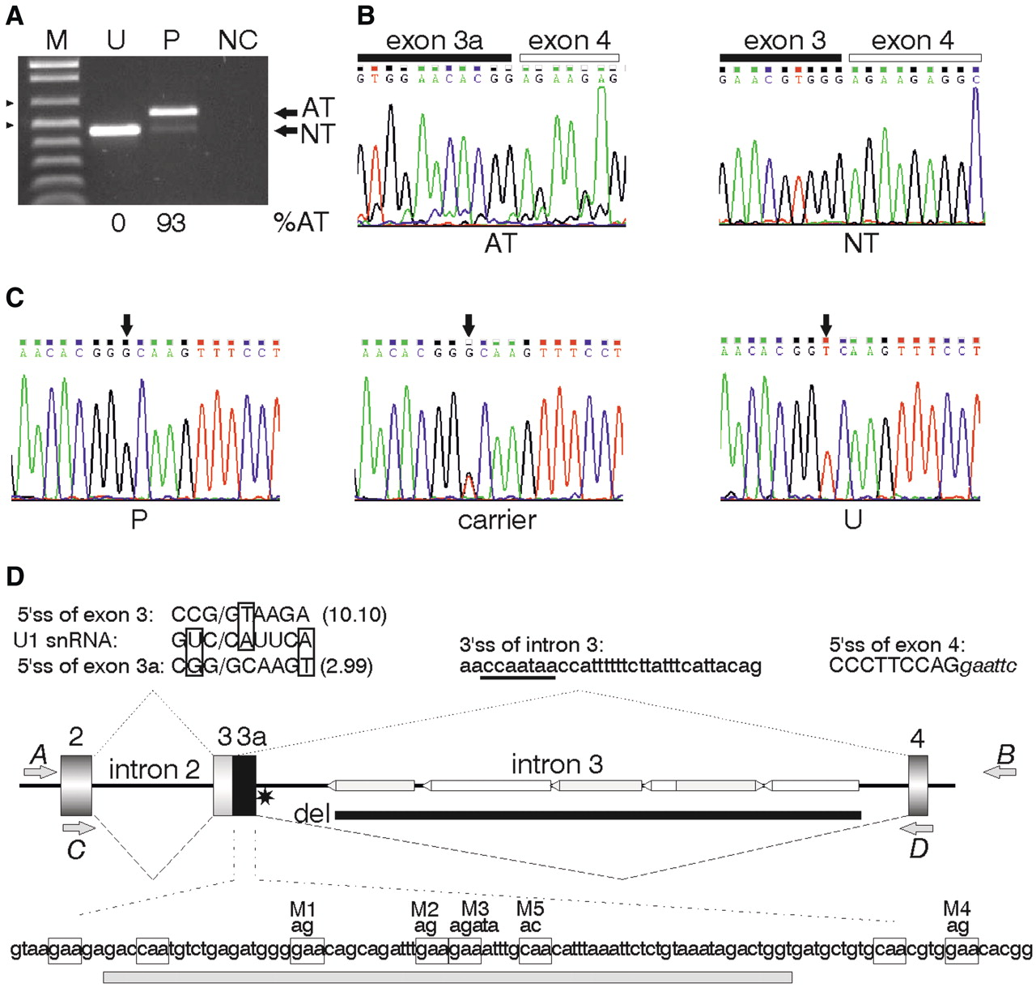
Figure 1. Identification of aberrant GC 5′ss in the BTK gene. ( A ) Reverse transcription–PCR agarose gel with ...
Notes:
Figure 1. Identification of aberrant GC 5′ss in the BTK gene. ( A ) Reverse transcription–PCR agarose gel with transcripts from the XLA patient 210/DACC (P) and an unaffected control (U). M, size marker (500- and 650-nt fragments are denoted by arrowheads); NC, negative PCR control. Amplification of normal (NT) and aberrant (AT) transcripts was carried out with primers C and D in exons 2 and 4. The sizes of NT and AT fragments are 457 and 564 nt, respectively. ( B ) Sequence chromatograms of AT/NT transcripts. ( C ) DNA sequencing with primers E (5′-ctg gtt gct taa tcc ctc tt) and F (5′-gag atg ttc tga ata tga agg) identified a single-nucleotide substitution in intron 3 in the XLA patient 210/DACC (P) and his heterozygous carrier mother, but not in unaffected controls. ( D ) The BTK minigene construct and schematics of RNA products of the wild-type and mutated alleles. Exons are shown as boxes, introns as lines. Authentic and aberrant transcripts are shown as dotted and dashed lines, respectively. The disease-causing T > G mutation is denoted by a star. The alignment of canonical and GC 5′ss with U1 snRNA is shown at the top; the improved base-pairing with U1 snRNA is boxed; the maximum entropy (ME) scores are in parentheses. Predicted BPS of exon 4 is underlined. Tranposable elements in intron 3 are denoted by horizontal bars, with Alu s in gray and LINEs in white; their orientation is indicated by arrowheads. Intron 3 deletion made in the minigene constructs is denoted by a thick line. GAA/CAA trinucleotides in the sequence between aberrant and authentic 5′ss are boxed at the bottom; mutations M1-M5 are shown above; a 76-nt riboprobe for UV crosslinking is shown below as a gray bar. Cloning (A, B) and amplification (C, D) primers are denoted by gray arrows.
Unless provided in the caption above, the following copyright applies to the content of this slide: © The Author(s) 2011. Published by Oxford University Press.This is an Open Access article distributed under the terms of the Creative Commons Attribution Non-Commercial License (http://creativecommons.org/licenses/by-nc/3.0), which permits unrestricted non-commercial use, distribution, and reproduction in any medium, provided the original work is properly cited.

Slide 2
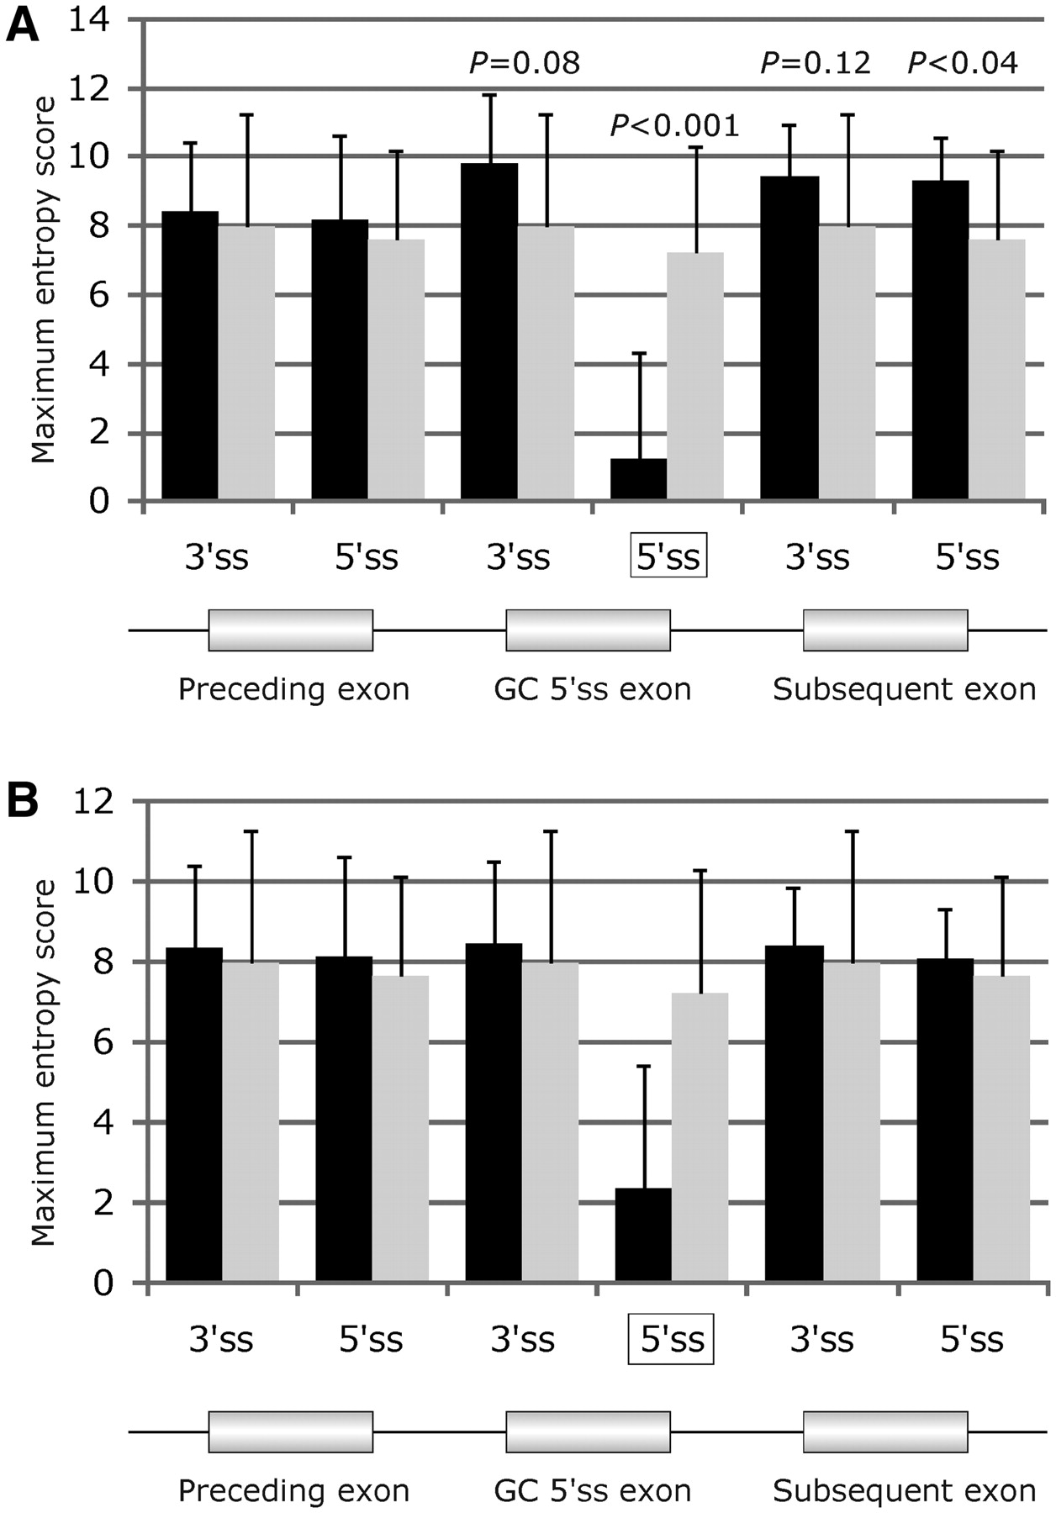
Figure 2. Comparison of the predicted strength of disease-causing GC 5′ss and their authentic counterparts. GC and GT ...
Notes:
Figure 2. Comparison of the predicted strength of disease-causing GC 5′ss and their authentic counterparts. GC and GT 5′ss are denoted by black and gray columns, respectively. ( A ) Disease-causing aberrant GC 5′ss. ( B ) Authentic human GC 5′ss. The predicted strength was computed as the maximum entropy (ME) score ( 16 , 39 , 86 ). Error bars represent standard deviations (SD). Corresponding splice sites are schematically shown in the lower panels where the GC 5′ss is boxed.
Unless provided in the caption above, the following copyright applies to the content of this slide: © The Author(s) 2011. Published by Oxford University Press.This is an Open Access article distributed under the terms of the Creative Commons Attribution Non-Commercial License (http://creativecommons.org/licenses/by-nc/3.0), which permits unrestricted non-commercial use, distribution, and reproduction in any medium, provided the original work is properly cited.

Slide 3
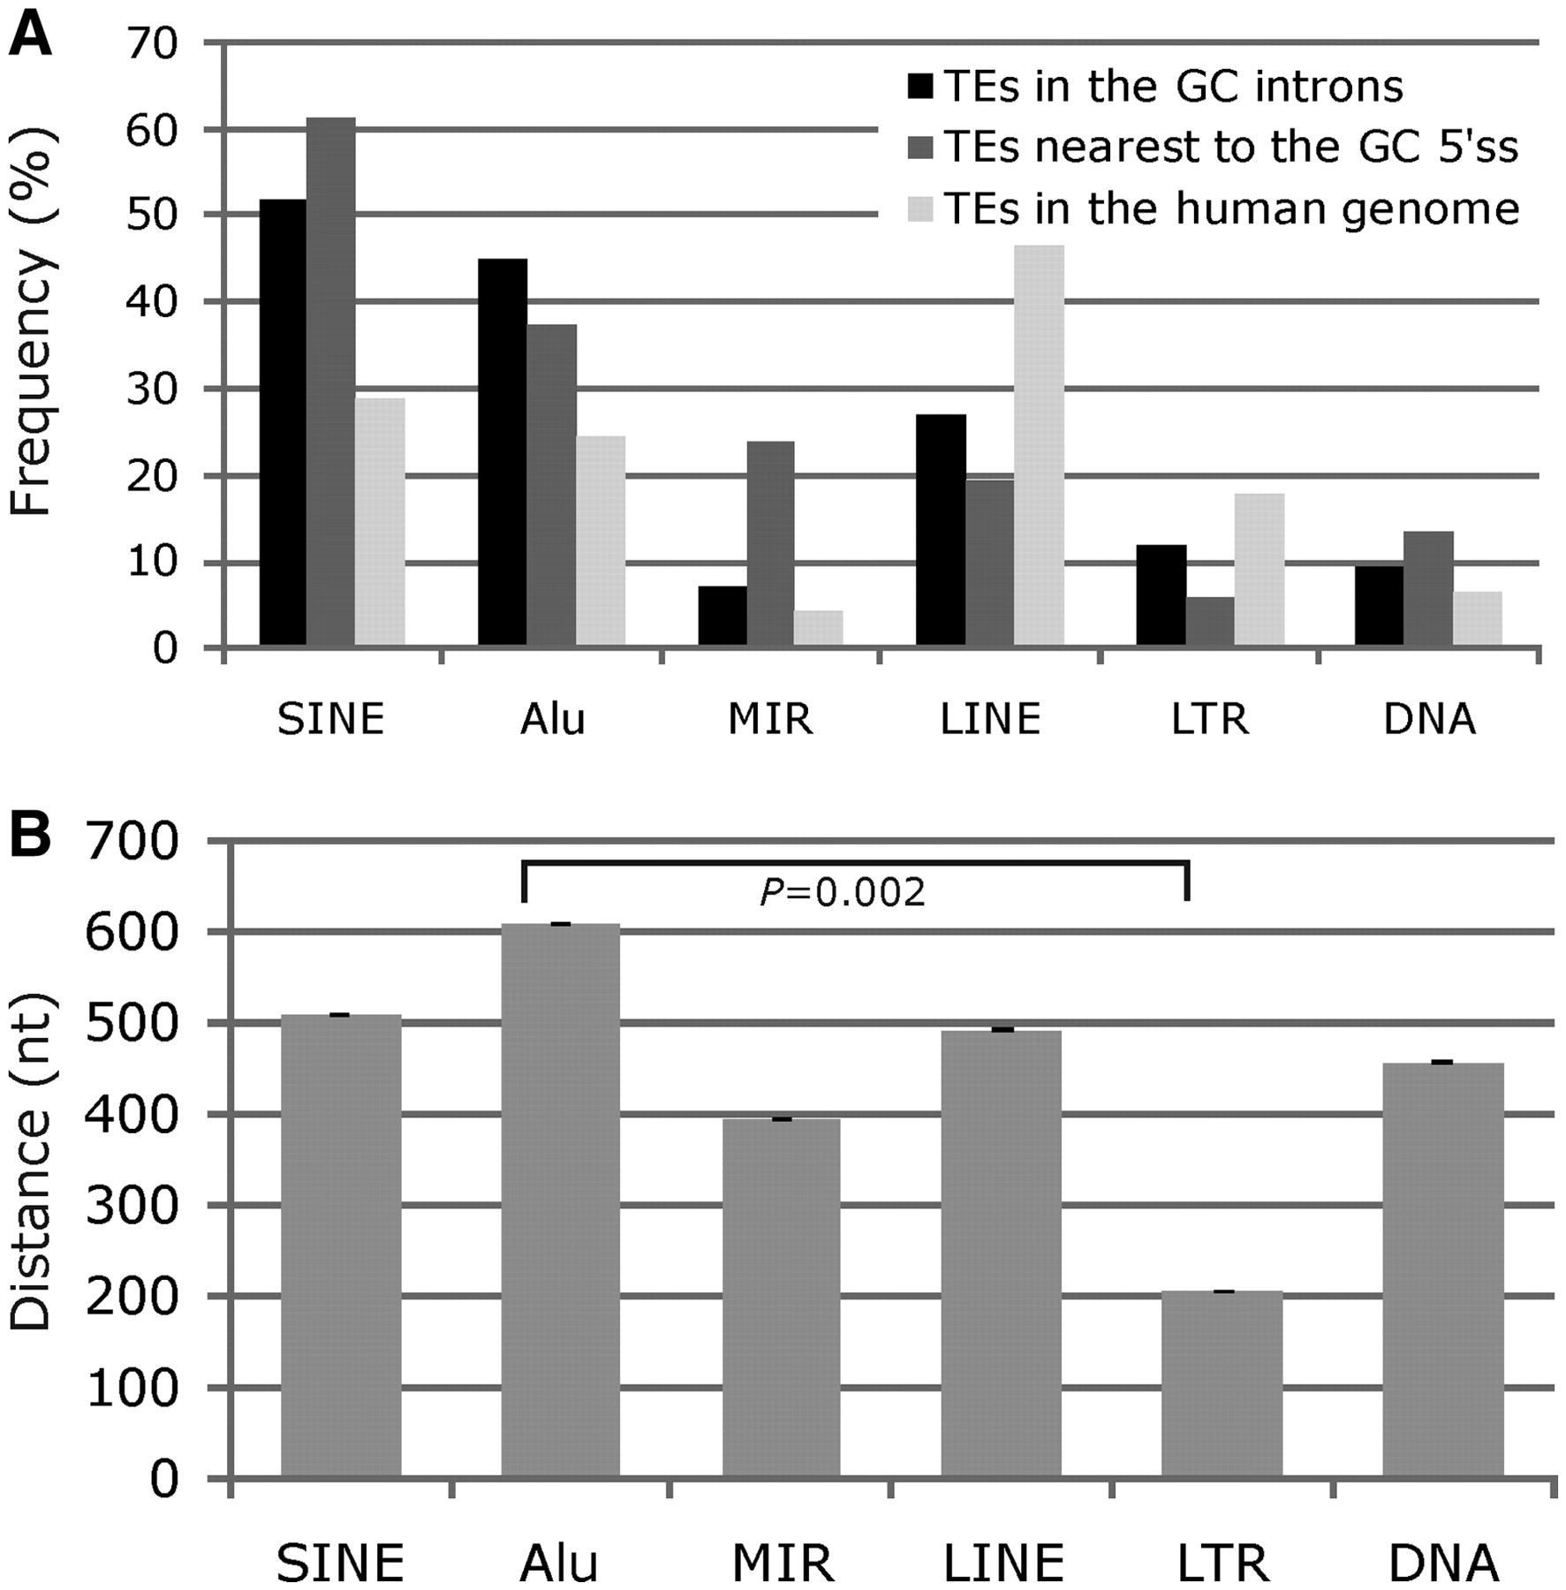
Figure 9. Transposable elements and selection of GC 5′ss. ( A ) Frequencies of TE families in 500 GC introns, among ...
Notes:
Figure 9. Transposable elements and selection of GC 5′ss. ( A ) Frequencies of TE families in 500 GC introns, among the first TEs downstream of the GC 5′ss and the overall frequency in the human genome ( 93 ) for comparison. ( B ) The average distance between the GC 5′ss and the 5′-end of the first downstream TE. TE families are shown at the bottom.
Unless provided in the caption above, the following copyright applies to the content of this slide: © The Author(s) 2011. Published by Oxford University Press.This is an Open Access article distributed under the terms of the Creative Commons Attribution Non-Commercial License (http://creativecommons.org/licenses/by-nc/3.0), which permits unrestricted non-commercial use, distribution, and reproduction in any medium, provided the original work is properly cited.

Slide 4
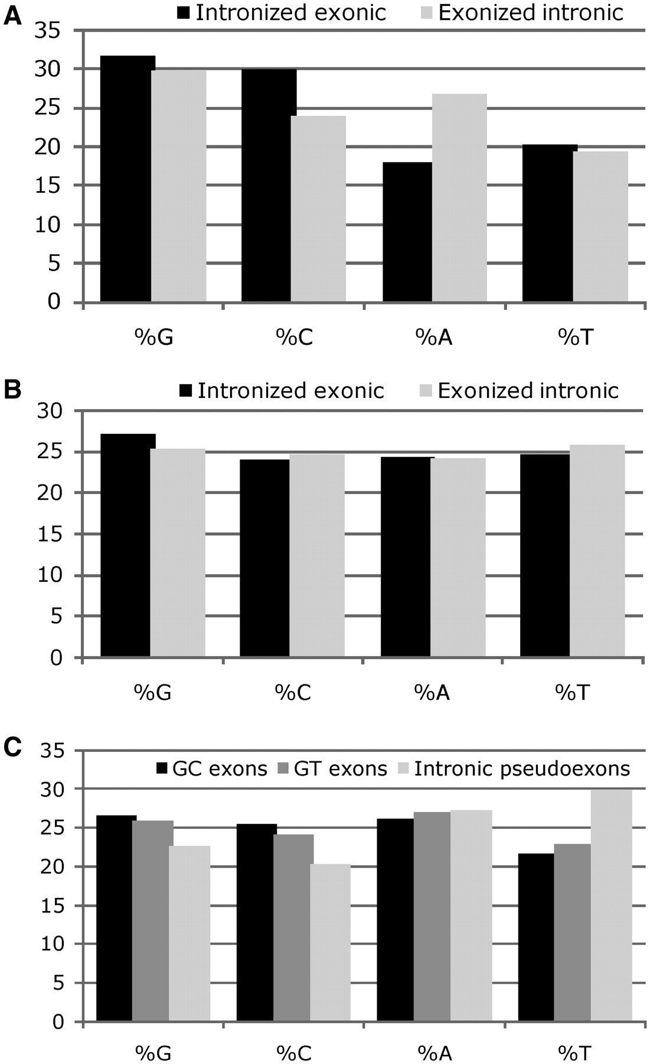
Figure 3. Nucleotide composition of intronized exonic and exonized intronic segments. ( A ) Disease-associated GC 5′ss ...
Notes:
Figure 3. Nucleotide composition of intronized exonic and exonized intronic segments. ( A ) Disease-associated GC 5′ss (a total of 881 nt). ( B ) Disease-associated GT 5′ss (36 378 nt). ( C ) Authentic GC ( n = 500) and GT ( n = 44 232) human exons are shown together with a sample of 2309 intronic pseudoexons in the 5′ untranslated region ( 44 ) for comparison.
Unless provided in the caption above, the following copyright applies to the content of this slide: © The Author(s) 2011. Published by Oxford University Press.This is an Open Access article distributed under the terms of the Creative Commons Attribution Non-Commercial License (http://creativecommons.org/licenses/by-nc/3.0), which permits unrestricted non-commercial use, distribution, and reproduction in any medium, provided the original work is properly cited.

Slide 5
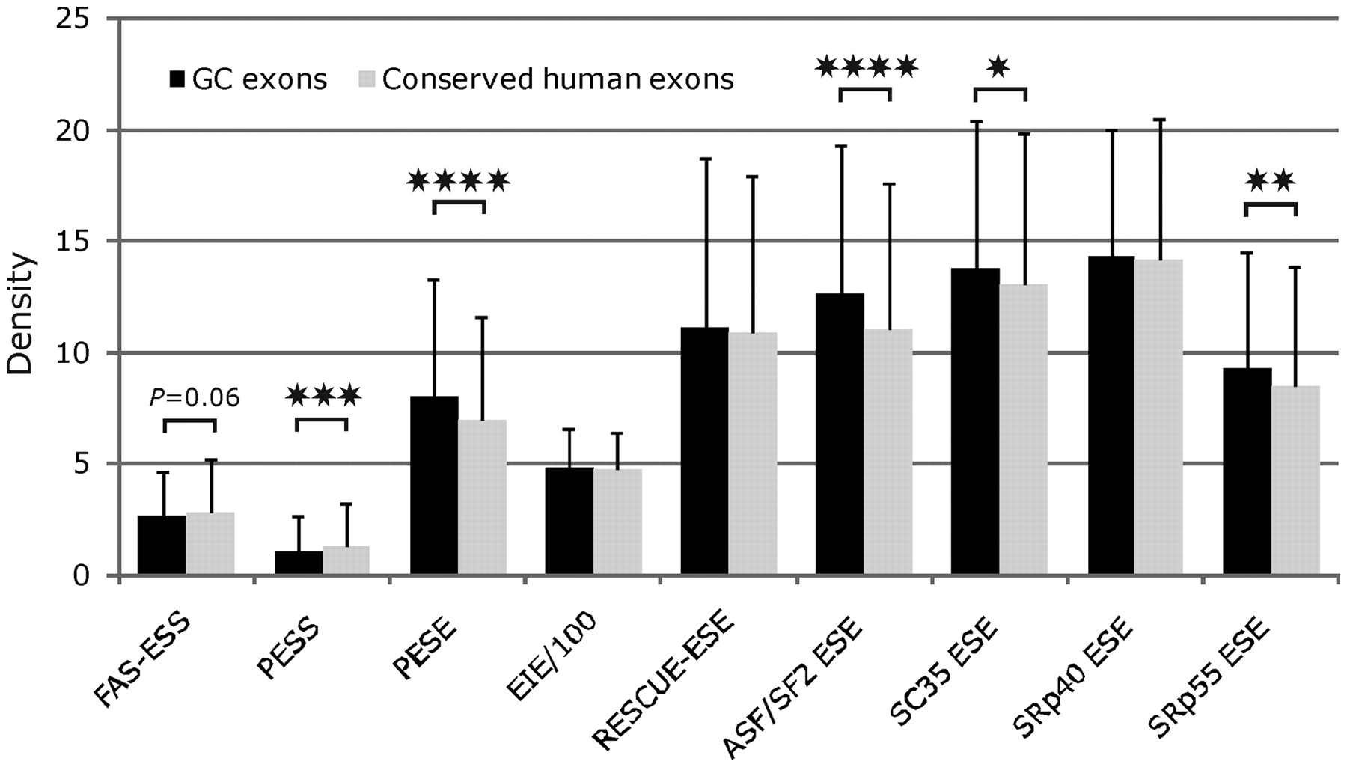
Figure 4. Density of auxiliary splicing elements in human GC and GT exons. Comparison of the mean densities of ...
Notes:
Figure 4. Density of auxiliary splicing elements in human GC and GT exons. Comparison of the mean densities of FAS-ESSs ( 46 ), PESSs/PESEs ( 44 ), EIEs ( 45 ), RESCUE-ESEs ( 87 , 88 ) and putative SF2/ASF, SC35, SRp40 and SRp55 ESEs ( 89 , 90 ) in 500 GC and 44 232 GT exons. **** P < 0.0001; *** P < 0.001; ** P < 0.01; * P < 0.05 (unpaired t -tests). Element densities were calculated for each input sequence as described previously ( 25 ); EIE densities are shown as 1/100 of their actual values. Error bars indicate SD.
Unless provided in the caption above, the following copyright applies to the content of this slide: © The Author(s) 2011. Published by Oxford University Press.This is an Open Access article distributed under the terms of the Creative Commons Attribution Non-Commercial License (http://creativecommons.org/licenses/by-nc/3.0), which permits unrestricted non-commercial use, distribution, and reproduction in any medium, provided the original work is properly cited.

Slide 6
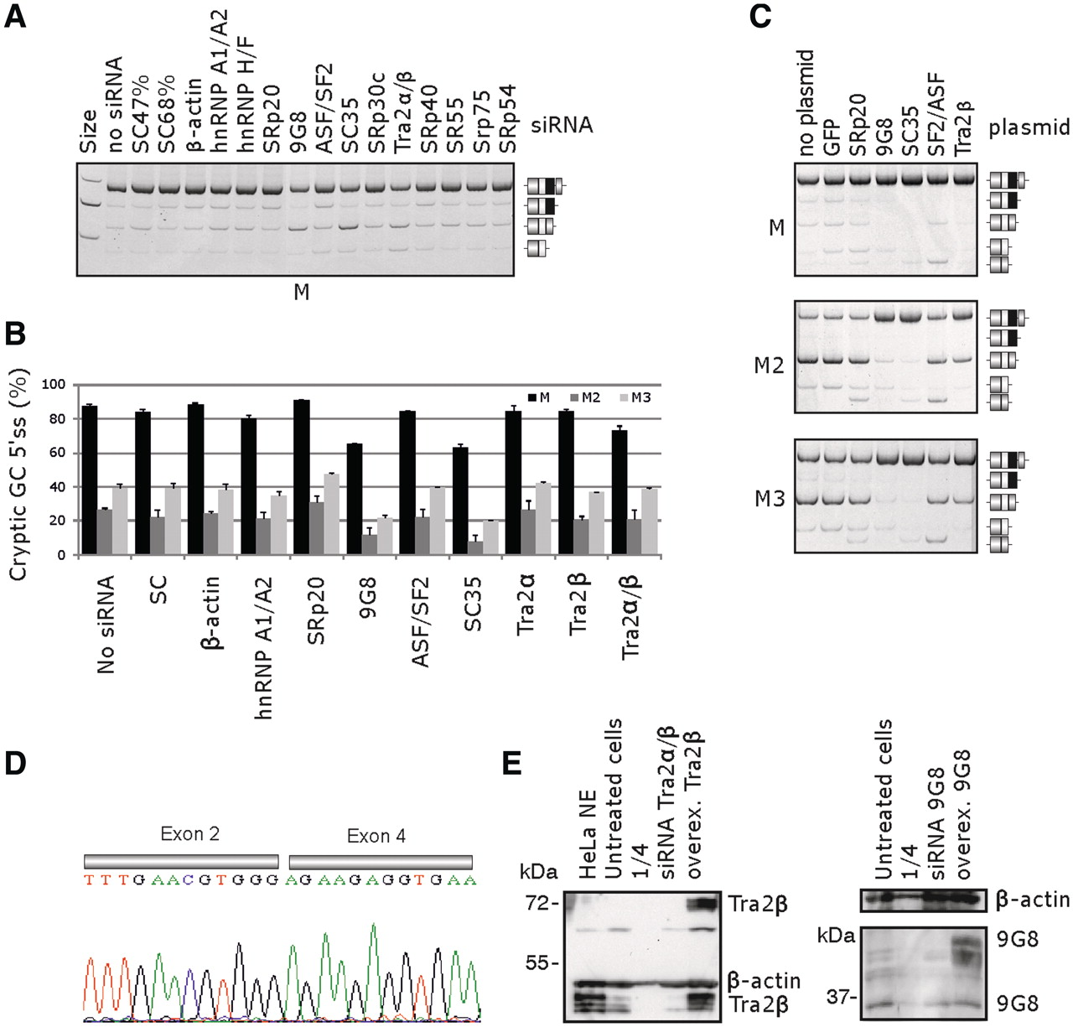
Figure 6. Splicing factors associated with promotion or repression of the GC 5′ss in BTK intron 3. ( A ) RNA ...
Notes:
Figure 6. Splicing factors associated with promotion or repression of the GC 5′ss in BTK intron 3. ( A ) RNA interference-mediated depletion of proteins shown at the top in 293 T cells. SC47%, SC68%, scrambled control siRNAs with the indicated GC contents. RNA products are to the right, the reporter is at the bottom. Individual depletion of Tra2α and Tra2β proteins (the official gene symbol TRAB ) is shown in panel B. ( B ) Summary of the triplicated transfection experiment with M, M2 and M3 constructs. Error bars represent SD. ( C ) Overexpression of SF2/ASF, SRp20, 9G8, SC35 and Tra2β in 293 T cells. BTK reporter constructs are to the left, RNA products to the right. GFP, plasmid expressing green fluorescent protein. Tra2β here refers to the longest isoform designated Tra2β1 ( 82 ). ( D ) Sequence chromatogram showing BTK exon 3 skipping in 293 T cells overexpressing SF2/ASF and SRp20. ( E ) Western blot analysis of Tra2β and 9G8 proteins. Antibodies against Tra2β and β-actin were purchased from Abcam (ab31353 and ab37063, respectively), antibodies against 9G8 ( SFRS7 ) were obtained from Sigma (SAB1101226). NE, nuclear extracts; 1/4, loading of the lysate was reduced by 75% as compared to untreated 293 T cells. Overexpressed Tra2β and 9G8 were fused with GFP and T7 tags, respectively. Size markers are shown to the left. Antibodies against SC35 (ab28428) failed to yield specific bands, but the increased and decreased expression was observed using quantitative RT–PCR with RNA samples from transfected cells (data not shown).
Unless provided in the caption above, the following copyright applies to the content of this slide: © The Author(s) 2011. Published by Oxford University Press.This is an Open Access article distributed under the terms of the Creative Commons Attribution Non-Commercial License (http://creativecommons.org/licenses/by-nc/3.0), which permits unrestricted non-commercial use, distribution, and reproduction in any medium, provided the original work is properly cited.

Slide 7
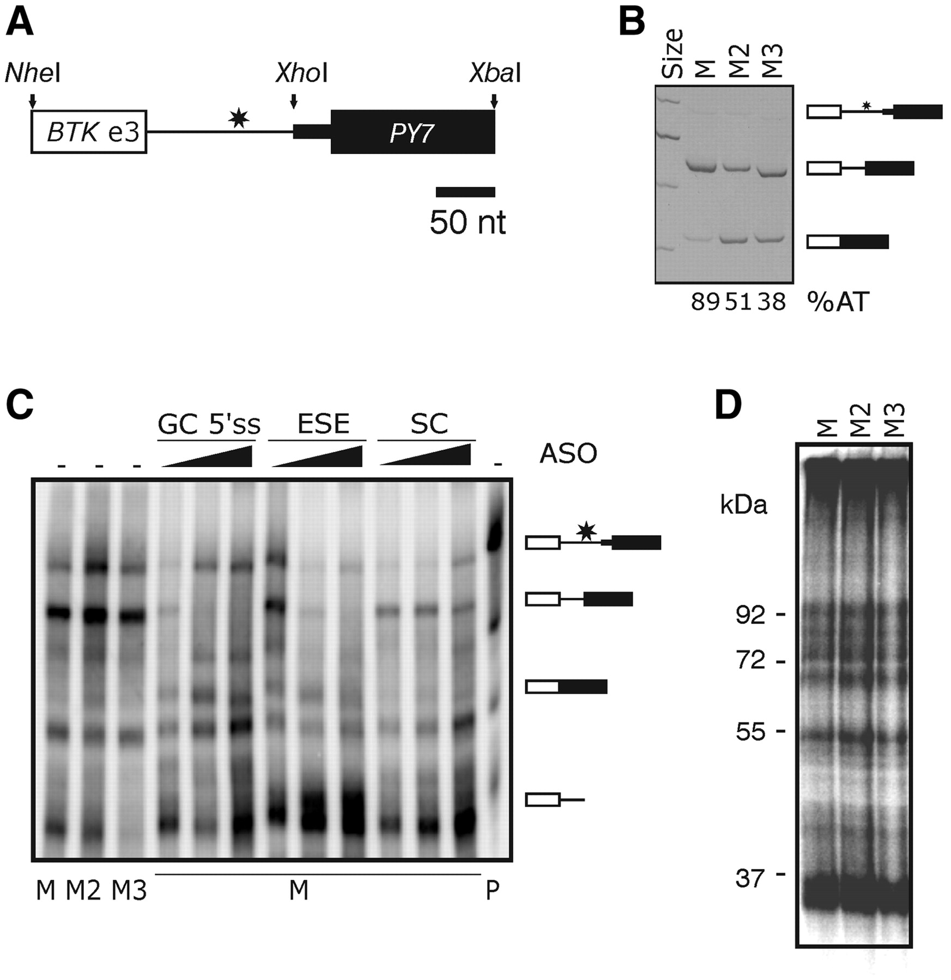
Figure 7. UV-RNA crosslinking of hybrid BTK -PY7 constructs. ( A ) Schematic representation of the hybrid BTK- PY7 ...
Notes:
Figure 7. UV-RNA crosslinking of hybrid BTK -PY7 constructs. ( A ) Schematic representation of the hybrid BTK- PY7 reporter. The length of introns (lines) and exons (boxes) is to a scale shown at the bottom. Restriction enzymes are shown at the top. The position of GC 5′ss-activating mutation is denoted by a star. ( B ) Splicing pattern of the hybrid BTK- PY7 reporters in HeLa cells. ( C ) Splicing of BTK- PY7 reporters in HeLa nuclear extracts. Mutations are shown at the bottom; P, mock treated riboprobe; splicing products are to the right. Final concentration of ASOs was 2, 20 and 200 nM. ( D ) UV-RNA crosslinking of BTK- PY7 reporter constructs (at the top). The size of crosslinked proteins is to the left.
Unless provided in the caption above, the following copyright applies to the content of this slide: © The Author(s) 2011. Published by Oxford University Press.This is an Open Access article distributed under the terms of the Creative Commons Attribution Non-Commercial License (http://creativecommons.org/licenses/by-nc/3.0), which permits unrestricted non-commercial use, distribution, and reproduction in any medium, provided the original work is properly cited.

Slide 8
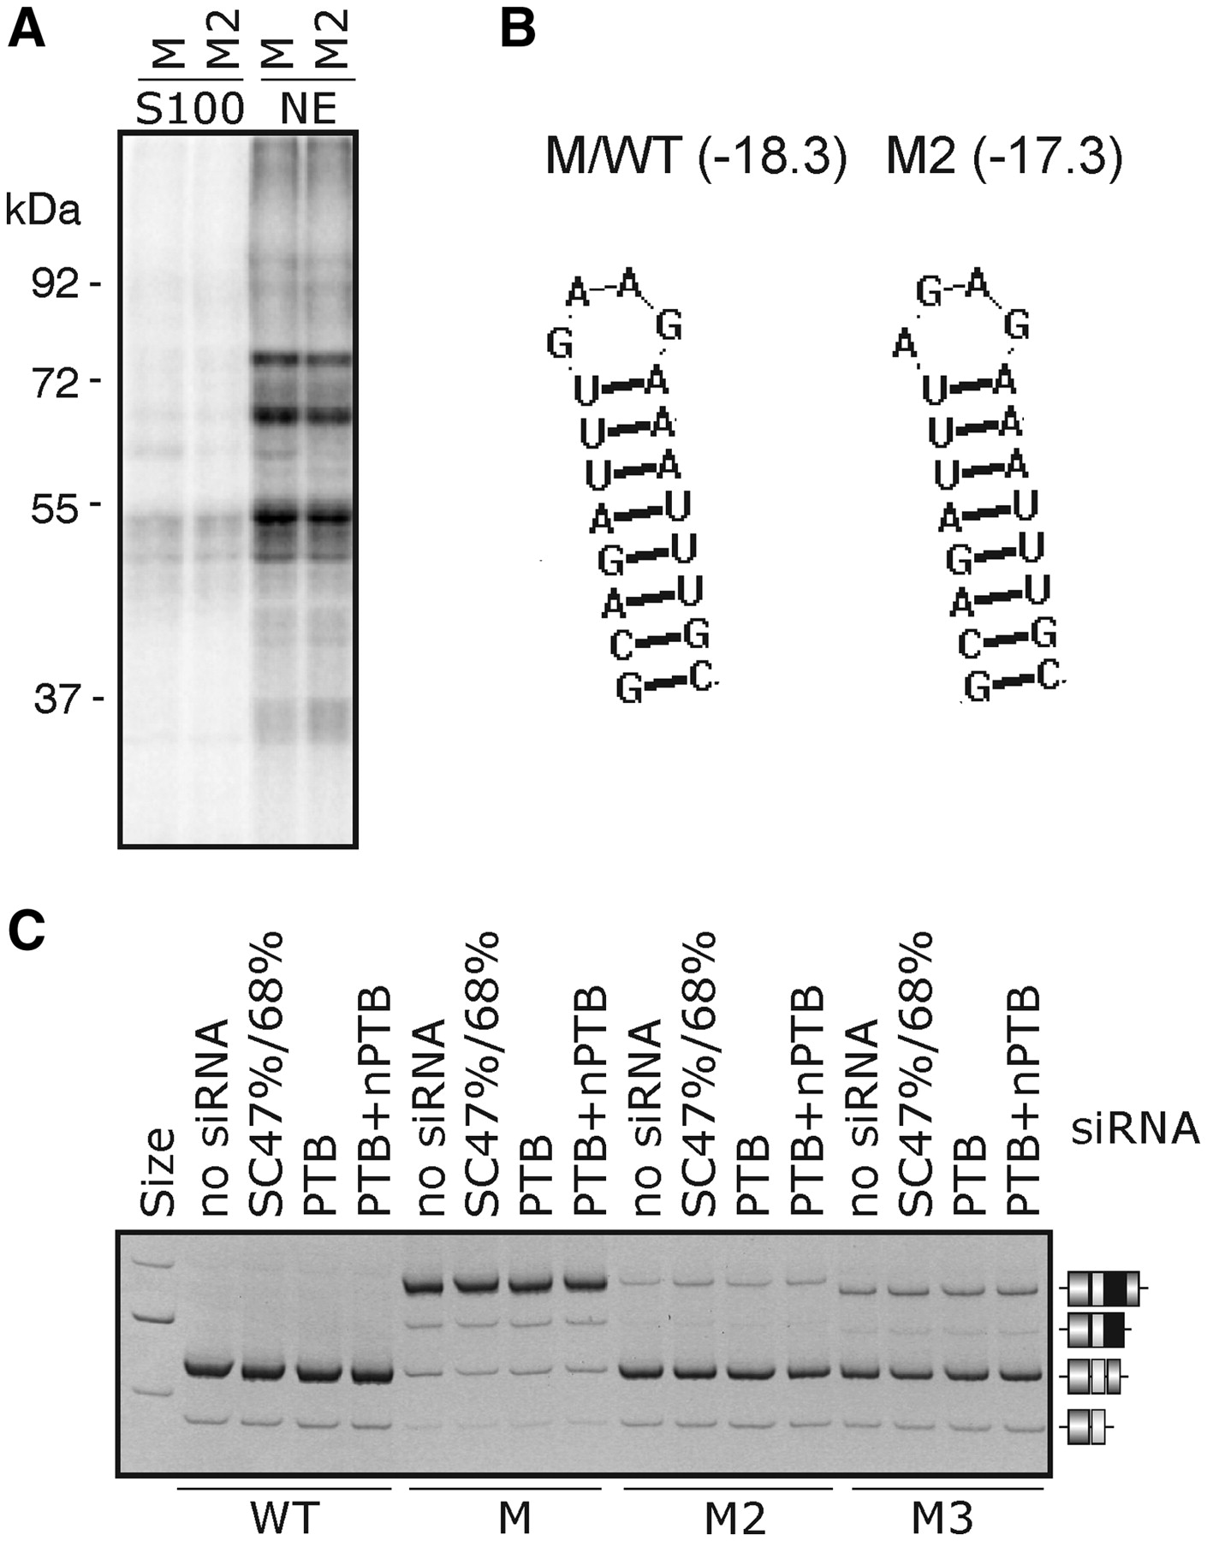
Figure 8. UV-RNA crosslinking of exonized pre-mRNA of BTK intron 3. ( A ) UV crosslinking of M and M2 RNAs in ...
Notes:
Figure 8. UV-RNA crosslinking of exonized pre-mRNA of BTK intron 3. ( A ) UV crosslinking of M and M2 RNAs in cytoplasmic S100 and nuclear extracts. ( B ) Predicted hairpins of M and M2 riboprobes. ( C ) Splicing of BTK constructs in 293 T cells depleted of PTB/nPTB. RNA products are shown schematically to the right, reporter constructs at the bottom and siRNAs at the top. SC47%/SC68%, control siRNAs with the indicated GC content. Final concentration of siRNAs targeting PTB ( 91 ) was 70 nM. Final concentration of each siRNA targeting nPTB ( 92 ) was 15 nM.
Unless provided in the caption above, the following copyright applies to the content of this slide: © The Author(s) 2011. Published by Oxford University Press.This is an Open Access article distributed under the terms of the Creative Commons Attribution Non-Commercial License (http://creativecommons.org/licenses/by-nc/3.0), which permits unrestricted non-commercial use, distribution, and reproduction in any medium, provided the original work is properly cited.

Slide 9
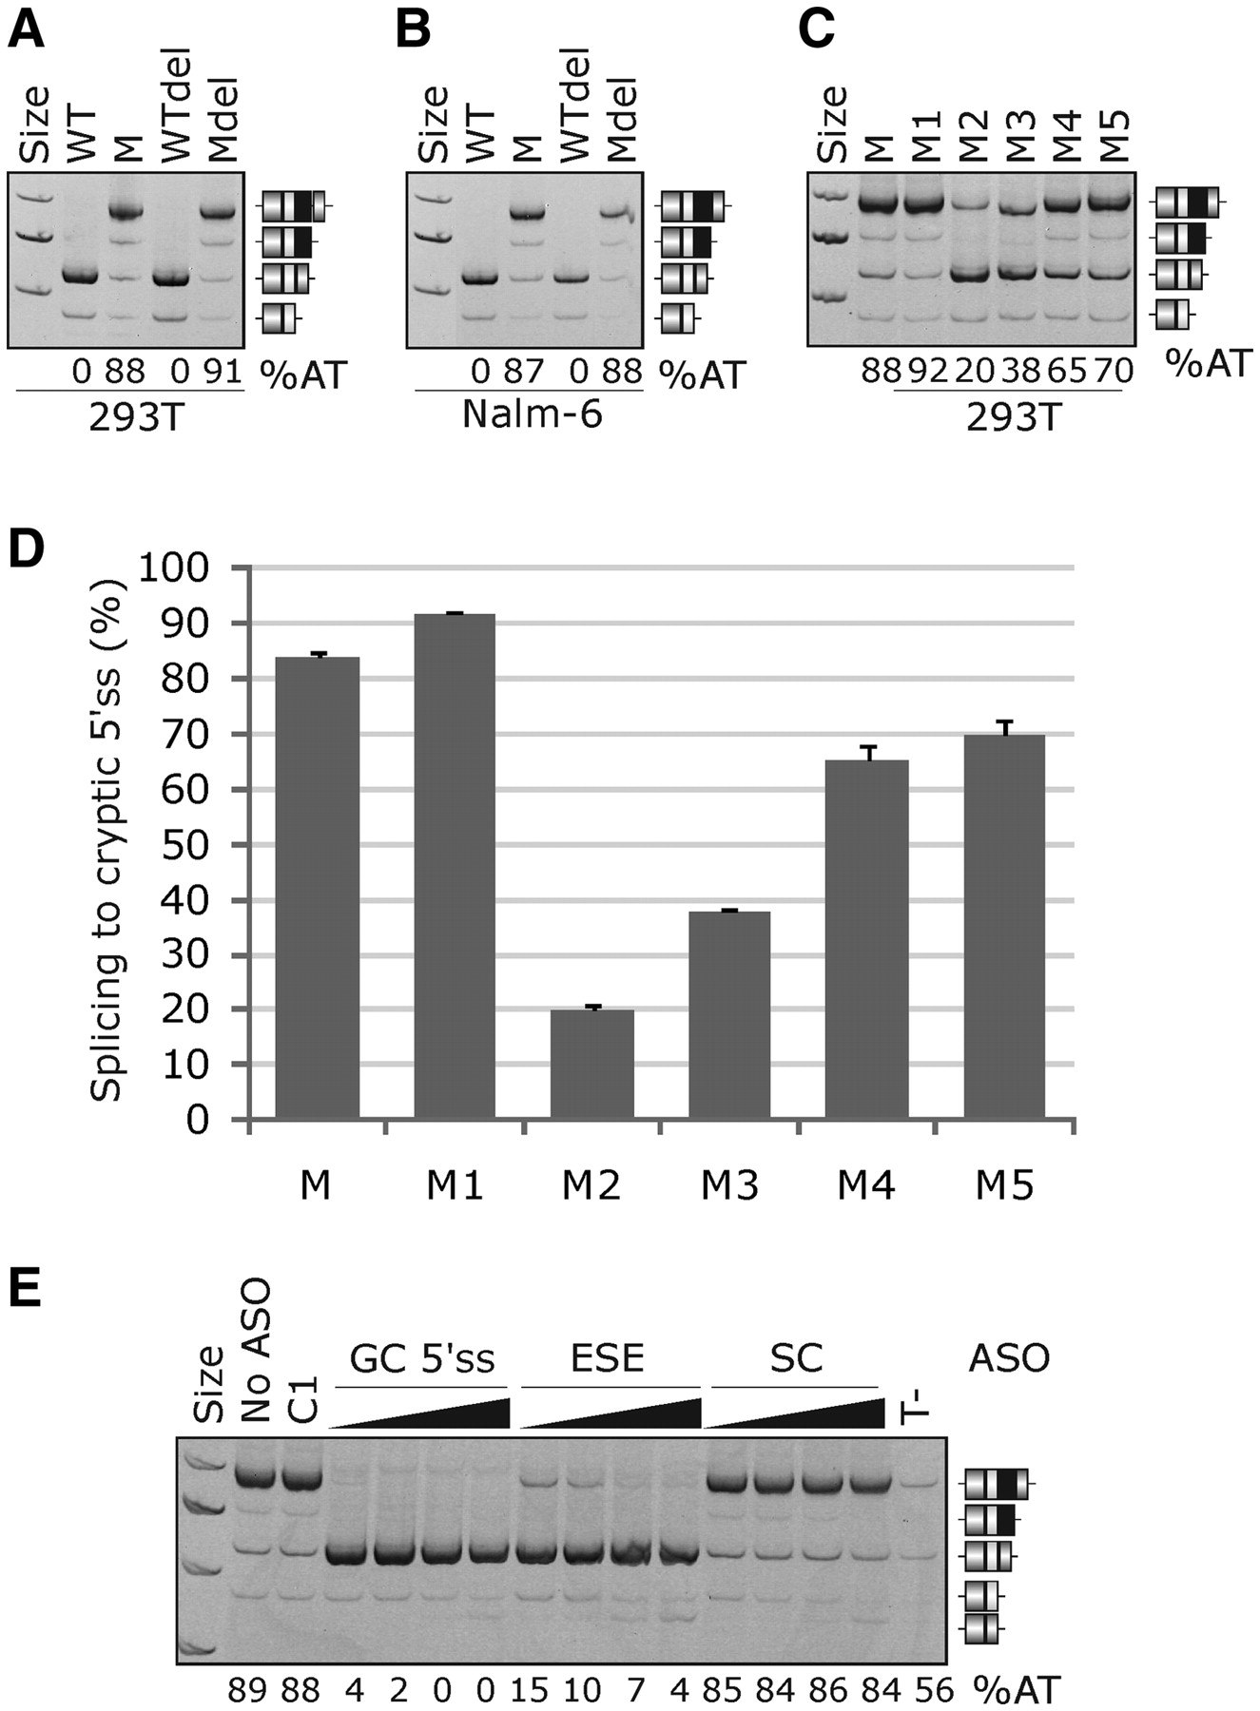
Figure 5. Efficient activation of the GC 5′ss in BTK intron 3 requires a GAA intronic enhancer. The splicing pattern ...
Notes:
Figure 5. Efficient activation of the GC 5′ss in BTK intron 3 requires a GAA intronic enhancer. The splicing pattern of BTK minigene reporters in 293 T ( A, C ) and Nalm-6 ( B ) cell lines. Designation of the reporter constructs is at the top, RNA products are to the right and percentage of splicing to the GC 5′ss (%AT) is at the bottom. WT, wild type reporter construct; M, construct with the T > G transversion; M1–M5 mutations and deletion of interspersed repeats (Del) are shown in Figure 1 D. ( D ) Summary of the triplicated transfection experiment. Error bars represent SD. ( E ) Effective repression of aberrant splicing by antisense oligonucleotides (ASOs) targeting the GC 5′ss itself or the upstream M2/M3 enhancer (ESE). The final concentration of each ASO was 20, 50, 100 and 200 nM. SC, an equimolar mix of scrambled controls of the two ASOs; C1, a generic negative control at 200 nM, T-, equimolar amounts of GC 5′ss and ESE ASOs (at 100 nM each) added to cells without any transfection reagent. No-transfection, no-template and no-RT controls are not shown. RNA products are to the right and the percentage of splicing to the GC 5′ss (%AT) is at the bottom. The lowest effective ASO concentrations were determined in a separate experiment shown in Supplementary Figure S1 .
Unless provided in the caption above, the following copyright applies to the content of this slide: © The Author(s) 2011. Published by Oxford University Press.This is an Open Access article distributed under the terms of the Creative Commons Attribution Non-Commercial License (http://creativecommons.org/licenses/by-nc/3.0), which permits unrestricted non-commercial use, distribution, and reproduction in any medium, provided the original work is properly cited.

