Slide 1
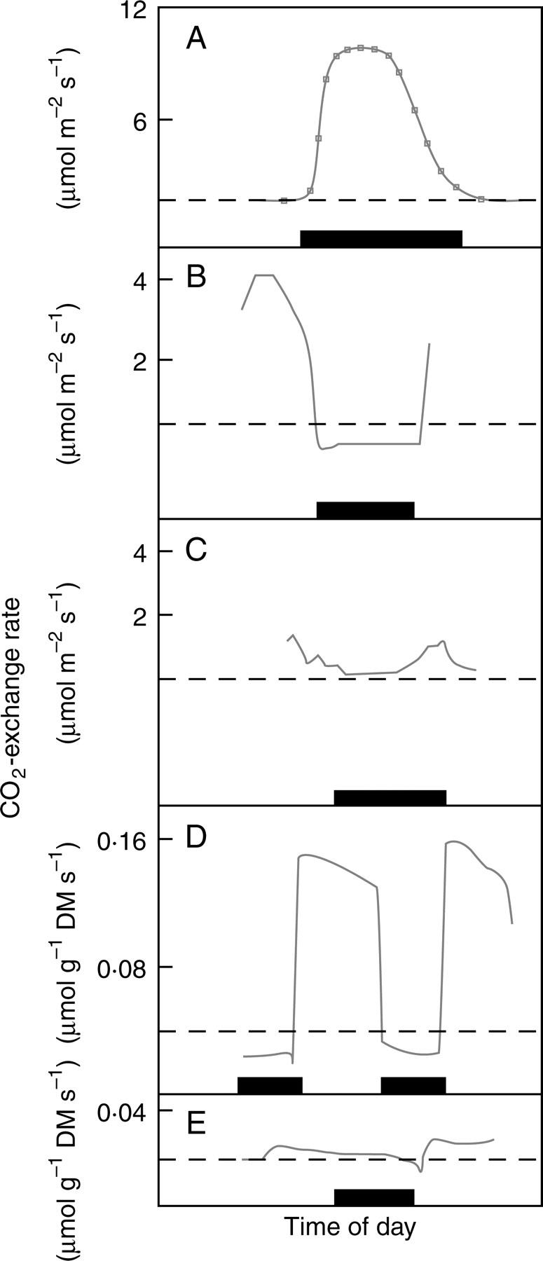
Fig. 1. Daily gas-exchange of plants with different modes of CAM: (A) Obligate CAM in watered plants of Opuntia ...
Notes:
Fig. 1. Daily gas-exchange of plants with different modes of CAM: (A) Obligate CAM in watered plants of Opuntia ficus-indica (Nobel and Hartsock, 1983); (B) C3 CO2-uptake in well-watered plants of the inducible-CAM species, Talinum triangulare (Herrera et al., 1991); (C) small dark CO2 fixation in plants of T. triangulare drought-stressed for 10 d (Herrera et al., 1991); (D) CAM-cycling in watered plants of Talinum calycinum (Martin et al., 1988); (E) CAM-idling in plants of Talinum calycinum drought-stressed for 3 d (Martin et al., 1988). The broken line indicates no net CO2-exchange; the dark bar on the abscissa indicates the duration of the dark period. The corresponding values of nocturnal acid accumulation were: (A) 85 µmol H+ cm−2 (droughted plants had a value of 16 µmol H+ cm−2); (B) 8 µmol H+ g−1 FM (0·2 µmol H+ cm−2); (C) 100 µmol H+ g−1 FM (2·0 µmol H+ cm−2); (D, E) 56 µmol H+ g−1 FM. Redrawn with permission from the authors.
Unless provided in the caption above, the following copyright applies to the content of this slide: © The Author 2008. Published by Oxford University Press on behalf of the Annals of Botany Company. All rights reserved. For Permissions, please email: journals.permissions@oxfordjournals.org

Slide 2
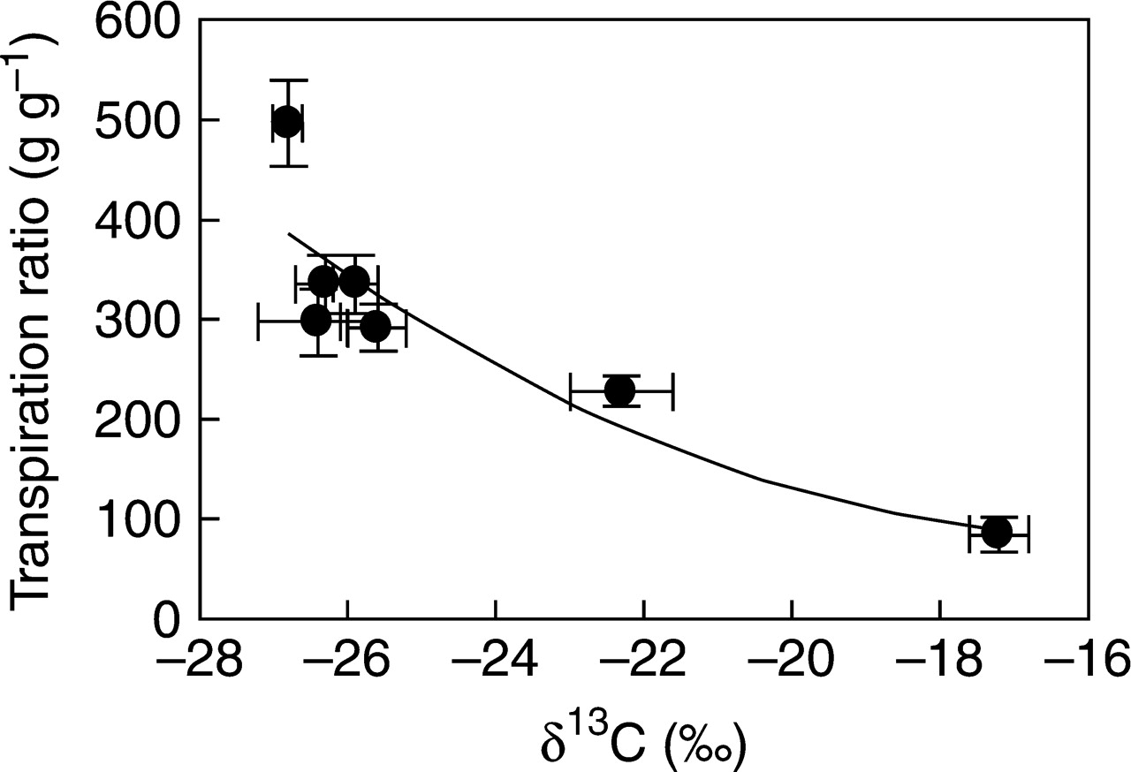
Fig. 2. Relationship between transpiration ratio (mass H₂O transpired : biomass) and carbon isotopic ...
Notes:
Fig. 2. Relationship between transpiration ratio (mass H2O transpired : biomass) and carbon isotopic composition in several species of Clusia. Values are mean ± 1 s.e. The determination coefficient is r2 = 0·79. Data in Winter et al. (2005).
Unless provided in the caption above, the following copyright applies to the content of this slide: © The Author 2008. Published by Oxford University Press on behalf of the Annals of Botany Company. All rights reserved. For Permissions, please email: journals.permissions@oxfordjournals.org

Slide 3
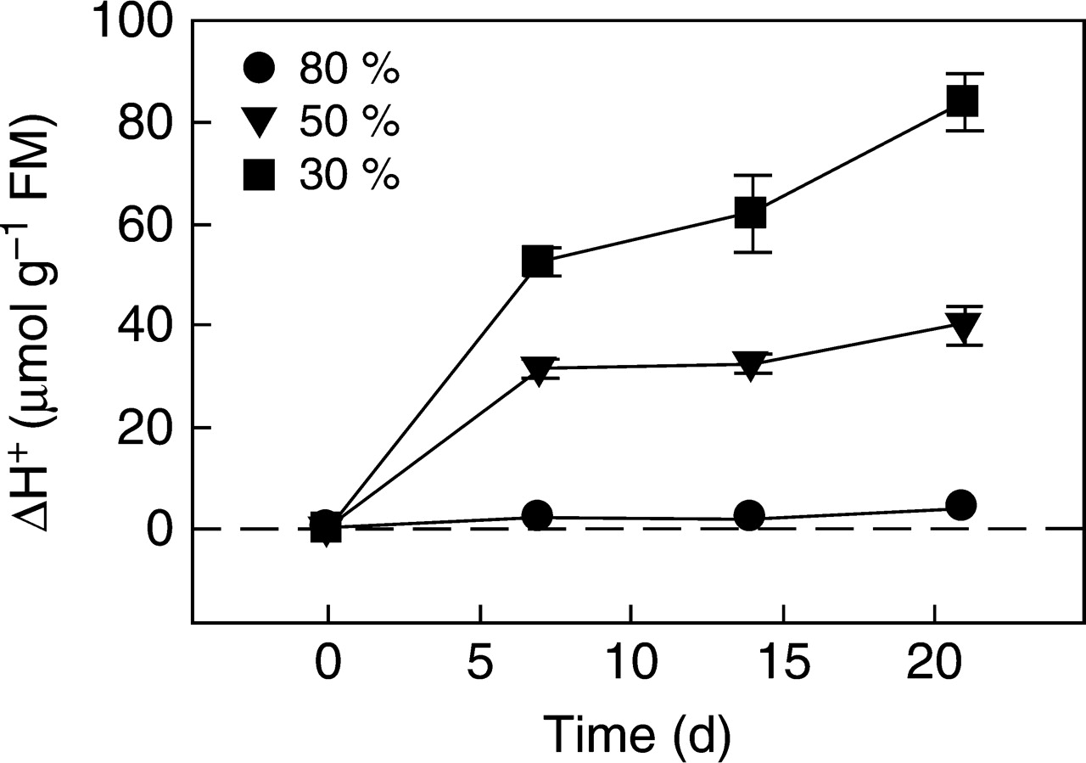
Fig. 3. Time-course of changes in nocturnal acid accumulation on a fresh mass basis in plants of the facultative CAM ...
Notes:
Fig. 3. Time-course of changes in nocturnal acid accumulation on a fresh mass basis in plants of the facultative CAM plant, Talinum triangulare, watered to 80 % (circles), 50 % (triangles) and 30 % (squares) field capacity. Values are mean ± 1 s.e. Modified from Irazábal (2005).
Unless provided in the caption above, the following copyright applies to the content of this slide: © The Author 2008. Published by Oxford University Press on behalf of the Annals of Botany Company. All rights reserved. For Permissions, please email: journals.permissions@oxfordjournals.org

