Slide 1
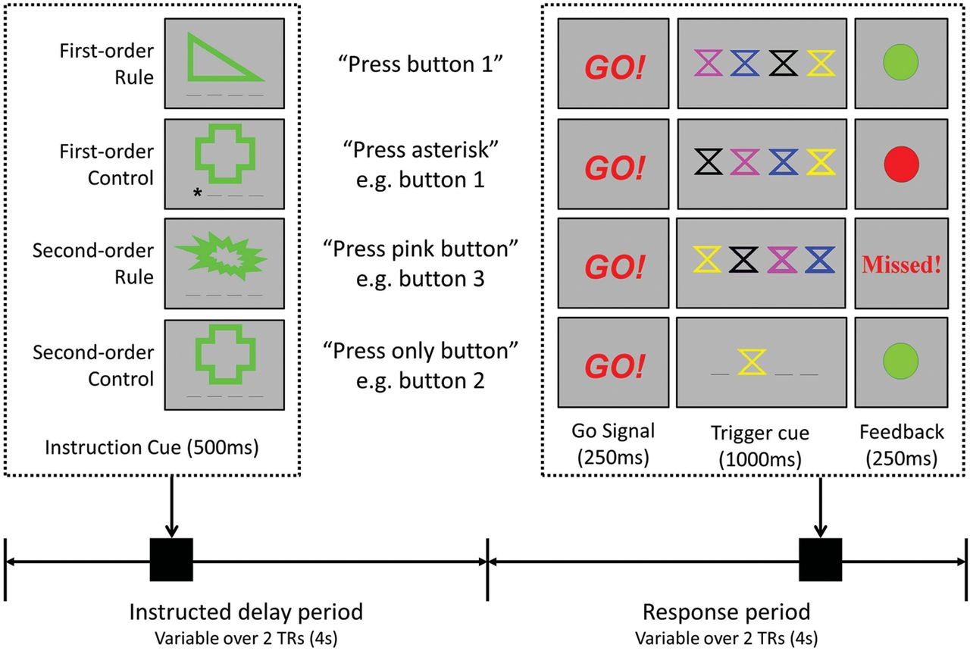
Figure 1. Trial structure: each trial was divided into two 4 s periods: the instructed delay period (0–4 s onset ...
Notes:
Figure 1. Trial structure: each trial was divided into two 4 s periods: the instructed delay period (0–4 s onset latency) contained the instruction cue (green shape with 4 underscores underneath, one of these underscores was replaced with an asterisk for first-order control instruction cues) and the response period (4–8 s onset latency) contained the Go! signal, immediately followed by the trigger cue where the subject made a response (pressing 1 of the 4 buttons) and feedback (green dot for correct response, red dot for incorrect, and missed for no response within the 1000 ms time window). Between each instruction cue and the trigger-related cues is the appropriate response in quotation marks. This information was not presented to subjects.
Unless provided in the caption above, the following copyright applies to the content of this slide: © The Author 2012. Published by Oxford University Press. All rights reserved. For Permissions, please e-mail: journals.permissions@oup.com

Slide 2
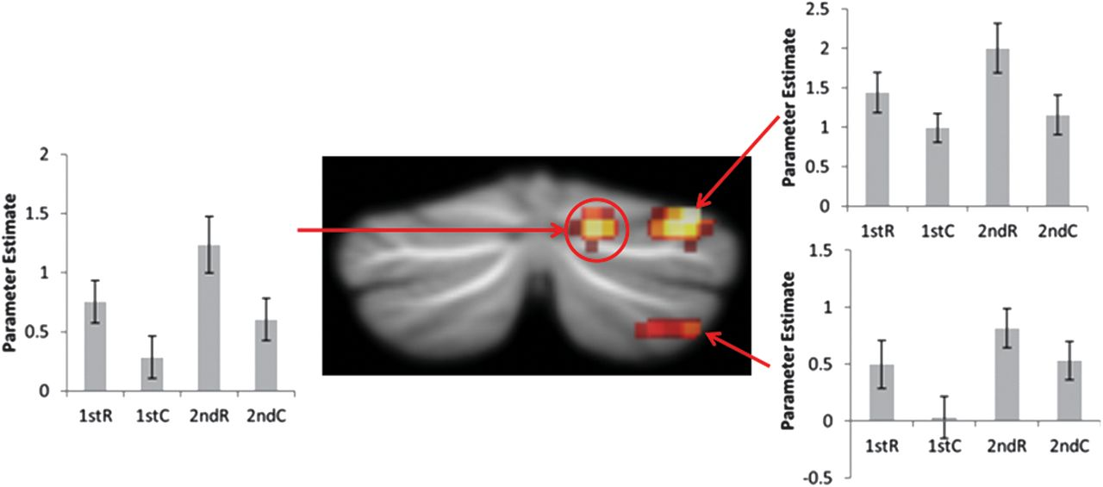
Figure 2. Cerebellar activations for main effect of rule: activation for rule instruction cues greater than control ...
Notes:
Figure 2. Cerebellar activations for main effect of rule: activation for rule instruction cues greater than control instruction cues within the right hemisphere Crus I and Crus II overlayed on SUIT template. Left and right of the activations are plots of parameter estimates for medial Crus I, lateral Crus I, and lateral Crus II (arrows indicate which plots correspond to which activation). Activation in medial Crus I (circled) additionally survived a more stringent conjunction analysis of main effect of rules.
Unless provided in the caption above, the following copyright applies to the content of this slide: © The Author 2012. Published by Oxford University Press. All rights reserved. For Permissions, please e-mail: journals.permissions@oup.com

Slide 3
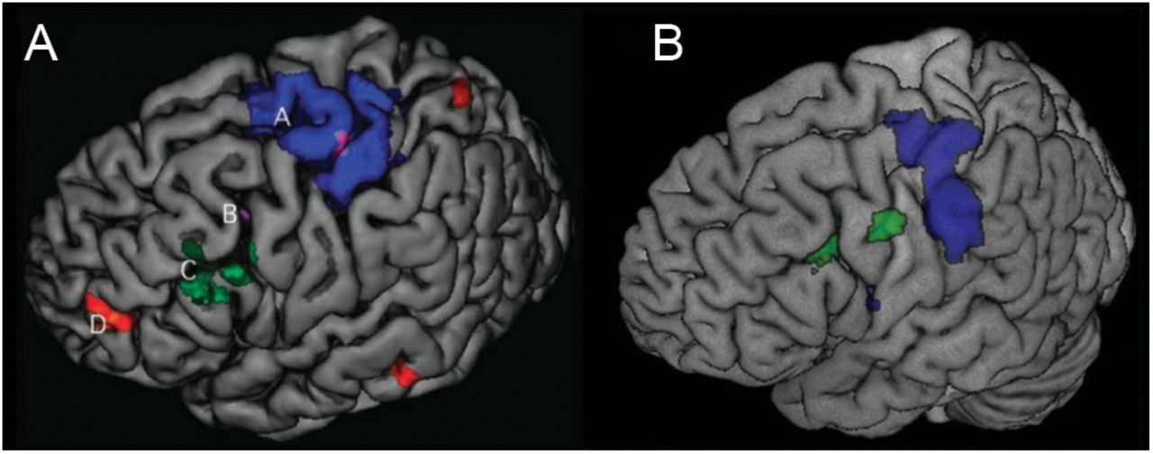
Figure 3. (A) Image from Badre and D'Esposito (2007) showing frontal lobe hierarchy. Superimposed on this figure: A ...
Notes:
Figure 3. (A) Image from Badre and D'Esposito (2007) showing frontal lobe hierarchy. Superimposed on this figure: A (blue) refers to first-order rules, B (purple) refers to second-order rules, C (green) refers to third-order rules, and D (red) refers to fourth-order rules. (B) Results from this study showing first-order rules > second-order rules (blue) and second-order rules > first-order rules (green).
Unless provided in the caption above, the following copyright applies to the content of this slide: © The Author 2012. Published by Oxford University Press. All rights reserved. For Permissions, please e-mail: journals.permissions@oup.com

