Slide 1
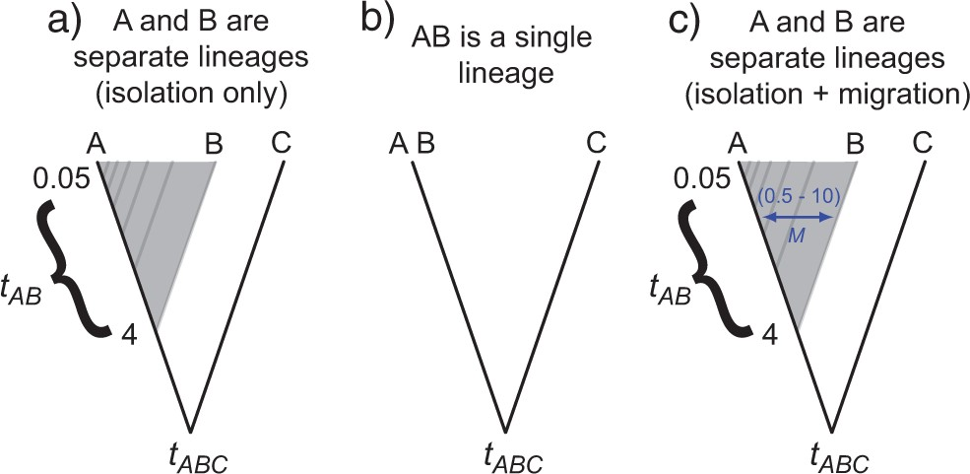
Figure 1. Three histories underlying simulated datasets that were analyzed using PHRAPL: a) taxa A and B diverged at ...
Notes:
Figure 1. Three histories underlying simulated datasets that were analyzed using PHRAPL: a) taxa A and B diverged at time $t_{AB}$ in the past; b) taxa A and B are a single panmictic lineage; and c) taxa A and B diverged at time $t_{AB}$ in the past, but continued to share migrants at rate M. In histories (a) and (c), species coalescent times $t_{AB}$ were varied between 0.05 and 4 (shown in the shaded region), where times $t$ are in units of 4$N$. In history (c), $M$ was varied between 0.5 and 10, where $M= 4Nm$. Note that the branch lengths preceding $t_{ABC}$ in these trees were adjusted according to the $t_{AB} $simulated (see text); however, this scaling is not shown here.
Unless provided in the caption above, the following copyright applies to the content of this slide: © The Author(s) 2017. Published by Oxford University Press, on behalf of the Society of Systematic Biologists. All rights reserved. For Permissions, please email: journals.permissions@oup.com

Slide 2
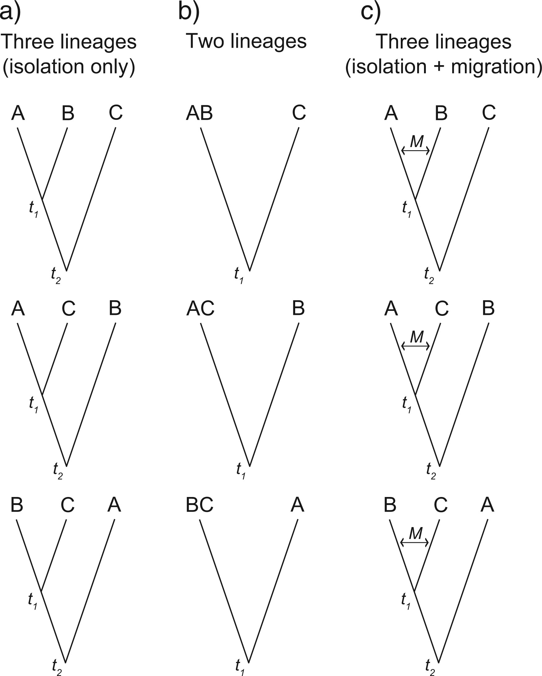
Figure 2. The set of models fitted to simulated datasets using PHRAPL. $M = 4Nm$ and $t_{\mathrm{1}}$ and ...
Notes:
Figure 2. The set of models fitted to simulated datasets using PHRAPL. $M = 4Nm$ and $t_{\mathrm{1}}$ and $t_{\mathrm{2}}$ are population coalescent times in units of $4N$.
Unless provided in the caption above, the following copyright applies to the content of this slide: © The Author(s) 2017. Published by Oxford University Press, on behalf of the Society of Systematic Biologists. All rights reserved. For Permissions, please email: journals.permissions@oup.com

Slide 3
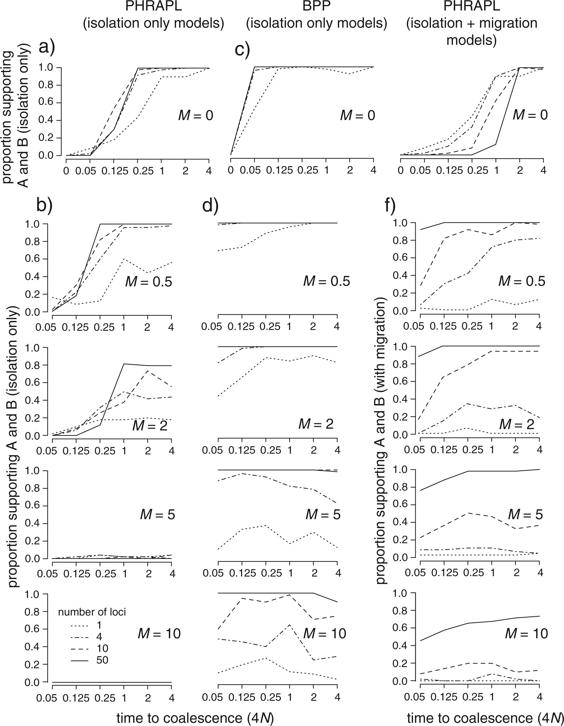
Figure 3. Model selection results for simulated datasets using PHRAPL (a, b, e, and f) and BPP (c, d) where $\theta = ...
Notes:
Figure 3. Model selection results for simulated datasets using PHRAPL (a, b, e, and f) and BPP (c, d) where $\theta = 0.005$. Panels (a, b) show the proportion of replicate PHRAPL analyses supporting divergence between species A and B when datasets were analyzed against isolation-only models (models in Fig. 2a, b). Proportions are shown across datasets produced under increasing coalescence time $t$ ($x$-axis), increasing migration rate $M$ (top to bottom), and increasing numbers of loci (line solidity). Panels (c, d) show these same proportions when the datasets are analyzed using BPP. Panels (e, f) show results when datasets were analyzed under an expanded model set that includes migration (models in Fig. 2a–c). In contrast to the other plots, plots in panel (f) give the proportion of replicate analysis in which the true isolation plus migration model was supported.
Unless provided in the caption above, the following copyright applies to the content of this slide: © The Author(s) 2017. Published by Oxford University Press, on behalf of the Society of Systematic Biologists. All rights reserved. For Permissions, please email: journals.permissions@oup.com

Slide 4
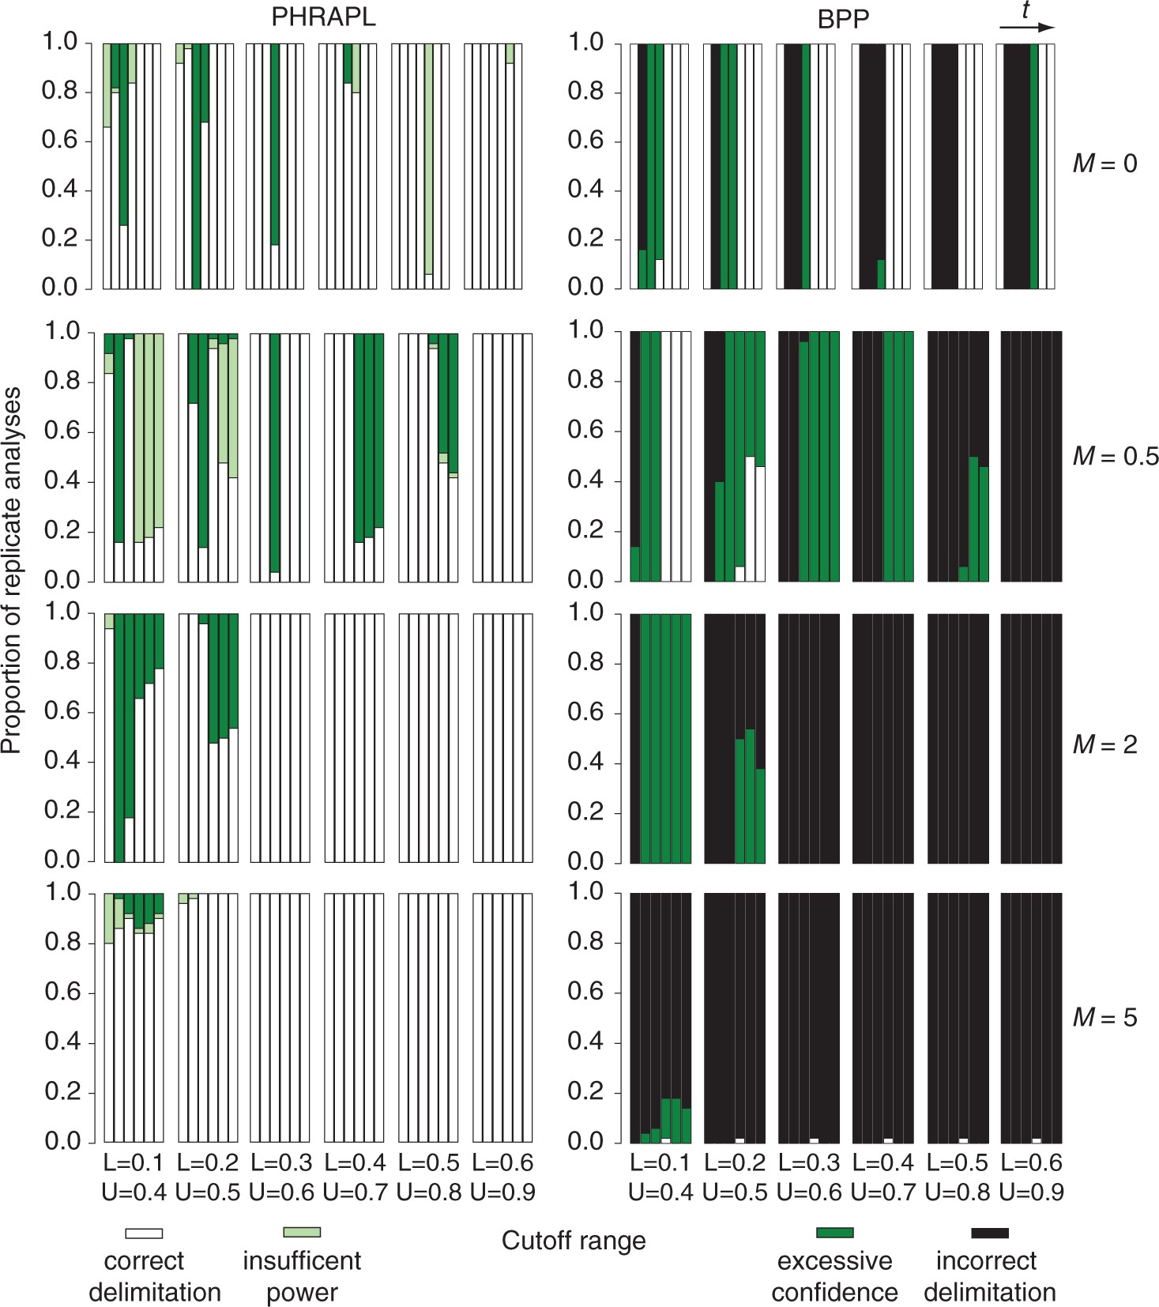
Figure 4. Accuracy of species delimitation when using the gdi in conjunction with PHRAPL and BPP. Each bar shows the ...
Notes:
Figure 4. Accuracy of species delimitation when using the gdi in conjunction with PHRAPL and BPP. Each bar shows the frequency with which species delimitation based on the gdi from the true parameter values agrees with species delimitation based on, (left), the gdi from the estimated parameter values from PHRAPL or, (right), results from BPP. Only performance using 50 loci is shown. Along the $x$-axis, each group of bars gives results for different gdi cutoffs. These cutoffs consist of a lower bound (L), below which populations A and B are defined as a single species, and an upper bound (U), above which populations A and B are defined as separate species. Index values between bounds signal when the number of species is ambiguous. Bars within bar groups represent treatments of increasing coalescence time and each row represents a different migration rate. The frequency with which each treatment resulted in the correct, or partially correct, delimitation is shown using different bar shading: white $=$ the inferred delimitation outcome matched the true outcome; light green/gray $=$ ambiguity was inferred when the true delimitation is known (insufficient power); dark green/gray $=$ delimitation was inferred (whether one or two species) when the truth was ambiguous (excessive confidence); and black $=$ one species was inferred when there were two, or vice versa.
Unless provided in the caption above, the following copyright applies to the content of this slide: © The Author(s) 2017. Published by Oxford University Press, on behalf of the Society of Systematic Biologists. All rights reserved. For Permissions, please email: journals.permissions@oup.com

Slide 5
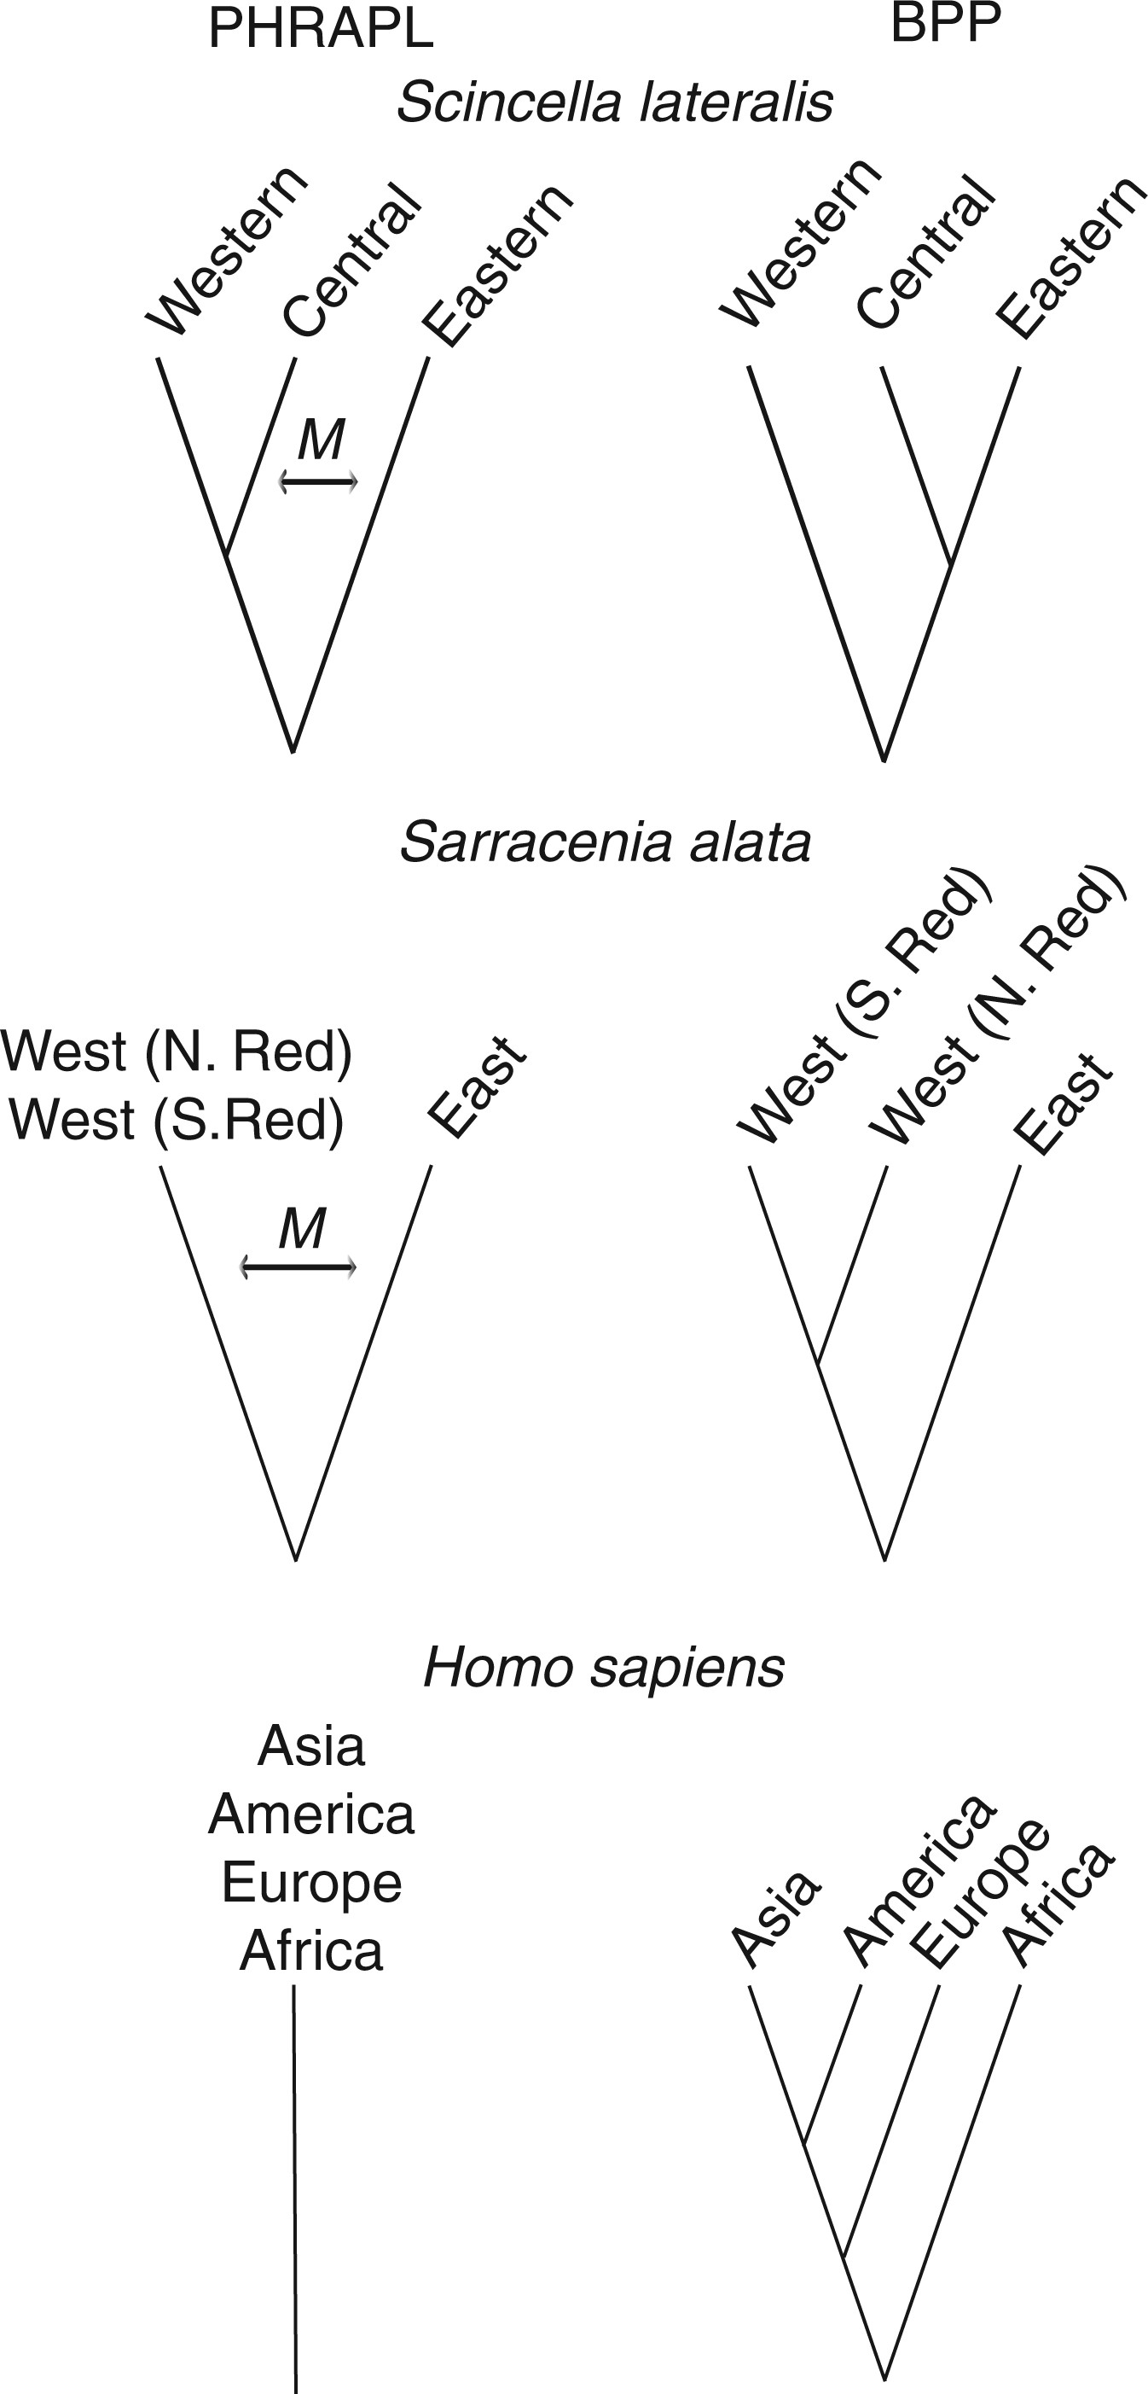
Figure 5. Inferred best models for three empirical datasets based on analysis using PHRAPL (left) and BPP (right). For ...
Notes:
Figure 5. Inferred best models for three empirical datasets based on analysis using PHRAPL (left) and BPP (right). For S. lateralis and S. alata, the PHRAPL models shown are composites constructed from the top models inferred for each.
Unless provided in the caption above, the following copyright applies to the content of this slide: © The Author(s) 2017. Published by Oxford University Press, on behalf of the Society of Systematic Biologists. All rights reserved. For Permissions, please email: journals.permissions@oup.com

Slide 6
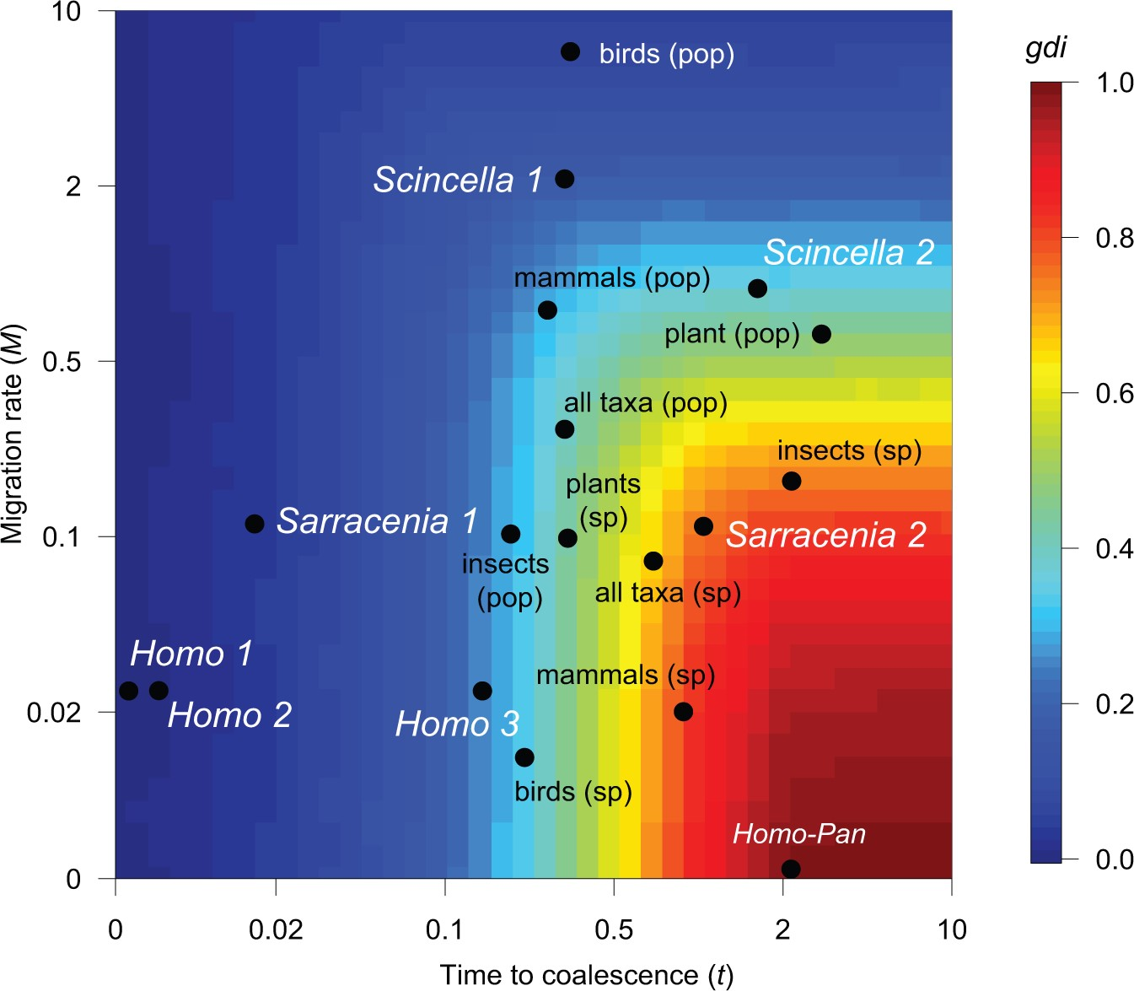
Figure 6. Contour plot showing the relationship between parameter values (coalescence time and migration rate) and the ...
Notes:
Figure 6. Contour plot showing the relationship between parameter values (coalescence time and migration rate) and the gdi. For the three empirical datasets analyzed in this study, model averaged parameter estimates from PHRAPL based on the first (1), second (2), and third (3) splits in the best supported tree are shown in enlarged font. Because ancestral migration was not included in the analyzed models, when calculating the gdi for the root node, ancestral migration was assumed to equal contemporary migration. For comparison, estimated values for several other taxa were also plotted. First, a point for the split between Homo and Pan is shown; coalescence time ($t)$ for this split is based on 8.5 million years of separation (Benton and Donoghue 2007), an $N_{e}$ of 47,500 (Schrago 2014), and a 20-year generation time (($8.5 \times 10^{6})/(4 \times 47,500$)) and migration rate is assumed to be zero. Four taxonomic groups were also plotted using data culled in a meta-analysis (Pinho and Hey 2010). Data were divided based on species rank: “sp,” where populations represent recognized species, and “pop,” where populations are not recognized as species. Font color differences are only meant to enhance readability of the text. Each point shows the median gdi calculated for datasets in each group based on estimated coalescence time (converted to units of 4$N)$ and migration rate (converted to 4Nm). Sample sizes for bird, mammal, insect, and plant populations were 14, 18, 8, and 12, respectively; samples sizes for species of these same groups were 8, 9, 13, and 8, respectively.
Unless provided in the caption above, the following copyright applies to the content of this slide: © The Author(s) 2017. Published by Oxford University Press, on behalf of the Society of Systematic Biologists. All rights reserved. For Permissions, please email: journals.permissions@oup.com

Slide 7
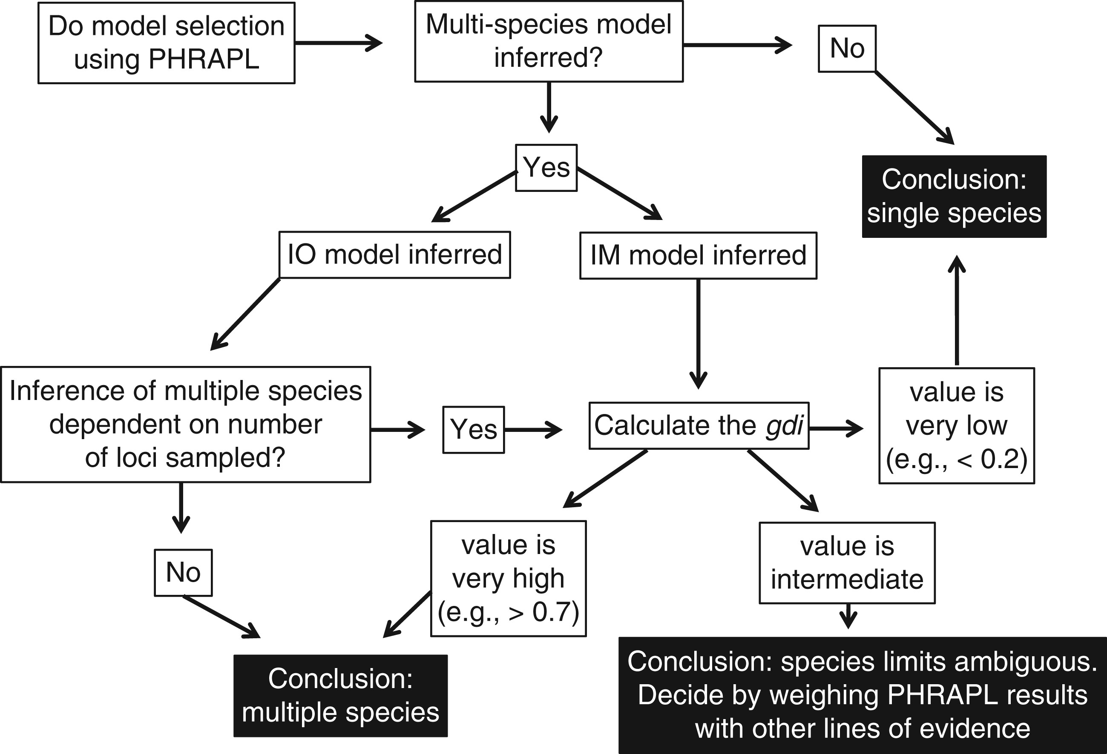
Figure 7. An example decision tree for using PHRAPL to delimit species with genetic data.
Notes:
Figure 7. An example decision tree for using PHRAPL to delimit species with genetic data.
Unless provided in the caption above, the following copyright applies to the content of this slide: © The Author(s) 2017. Published by Oxford University Press, on behalf of the Society of Systematic Biologists. All rights reserved. For Permissions, please email: journals.permissions@oup.com

