Slide 1
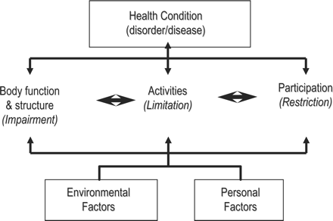
Figure 1. Conceptual model of International Classification of Functioning, Disability, and Health.
Notes:
Figure 1. Conceptual model of International Classification of Functioning, Disability, and Health.
Unless provided in the caption above, the following copyright applies to the content of this slide: Copyright © 2007 by the Ambulatory Pediatric Association, published by Elsevier Inc.

Slide 2
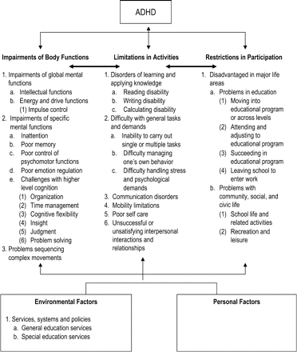
Figure 2. Functional problems associated with attention-deficit/hyperactivity disorder using the International ...
Notes:
Figure 2. Functional problems associated with attention-deficit/hyperactivity disorder using the International Classification of Functioning, Disability, and Health conceptual model.
Unless provided in the caption above, the following copyright applies to the content of this slide: Copyright © 2007 by the Ambulatory Pediatric Association, published by Elsevier Inc.

