Slide 1
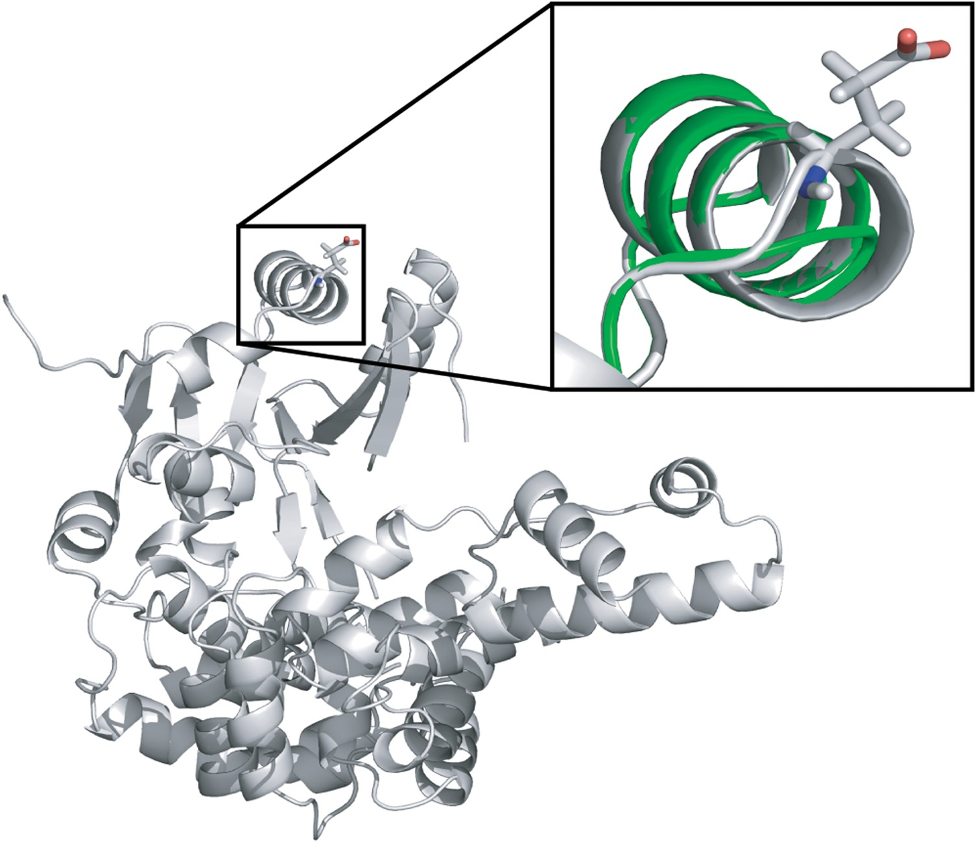
Figure 1. Experimental structure of TRNT1 (gray) with overlay (green) showing a computational estimate of Glu43 ...
Notes:
Figure 1. Experimental structure of TRNT1 (gray) with overlay (green) showing a computational estimate of Glu43 deletion. Inset: area around Glu43 deletion with side chain of Glu43 shown in the experimental structure. The minor change in the modeled structure is consistent with a small functional impact of the allele.
Unless provided in the caption above, the following copyright applies to the content of this slide: © The Author 2015. Published by Oxford University Press. All rights reserved. For Permissions, please email: journals.permissions@oup.com

Slide 2
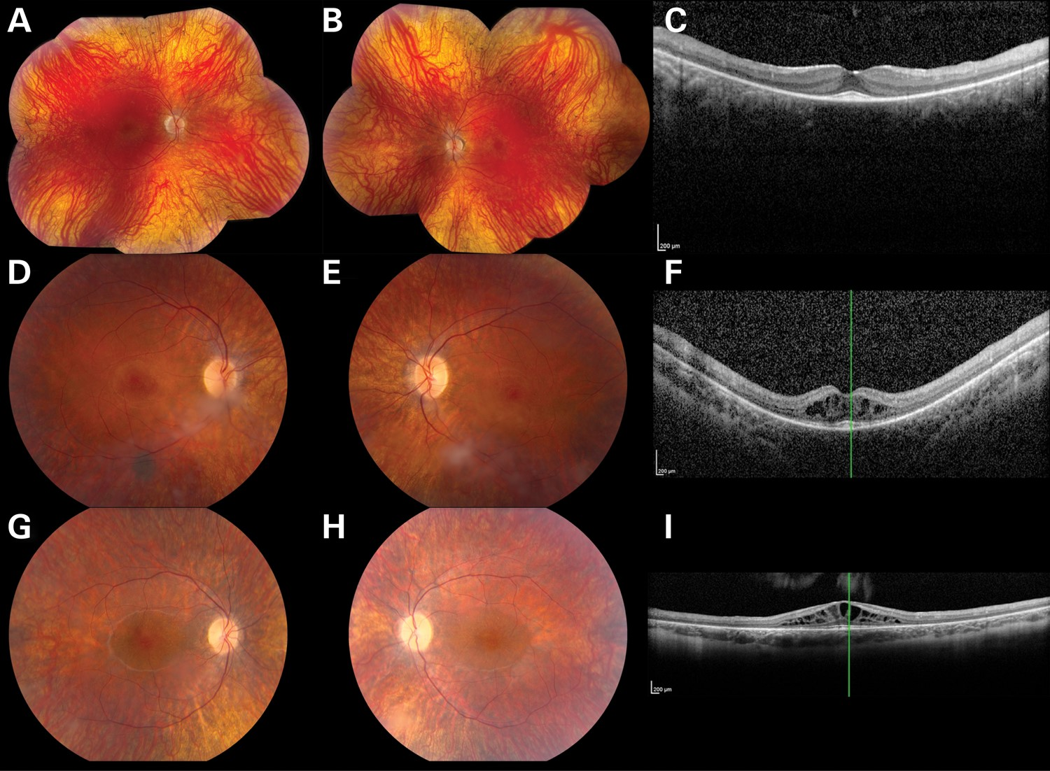
Figure 2. Color fundus photographs (A, B, D, E, G, H) and OCT (C, F, I) from individuals P1 (A–C), P2 (D–F) and P3 ...
Notes:
Figure 2. Color fundus photographs (A, B, D, E, G, H) and OCT (C, F, I) from individuals P1 (A–C), P2 (D–F) and P3 (G–I) affected with TRNT1-associated autosomal-recessive RP. The color photographs reveal vascular narrowing in all three individuals, subtle bone spicule-like pigmentation in P1 and cystoid macular edema in P2 and P3. OCT reveals thinning of the photoreceptor layers in all three individuals and marked cystoid macular edema in P2 and P3.
Unless provided in the caption above, the following copyright applies to the content of this slide: © The Author 2015. Published by Oxford University Press. All rights reserved. For Permissions, please email: journals.permissions@oup.com

Slide 3
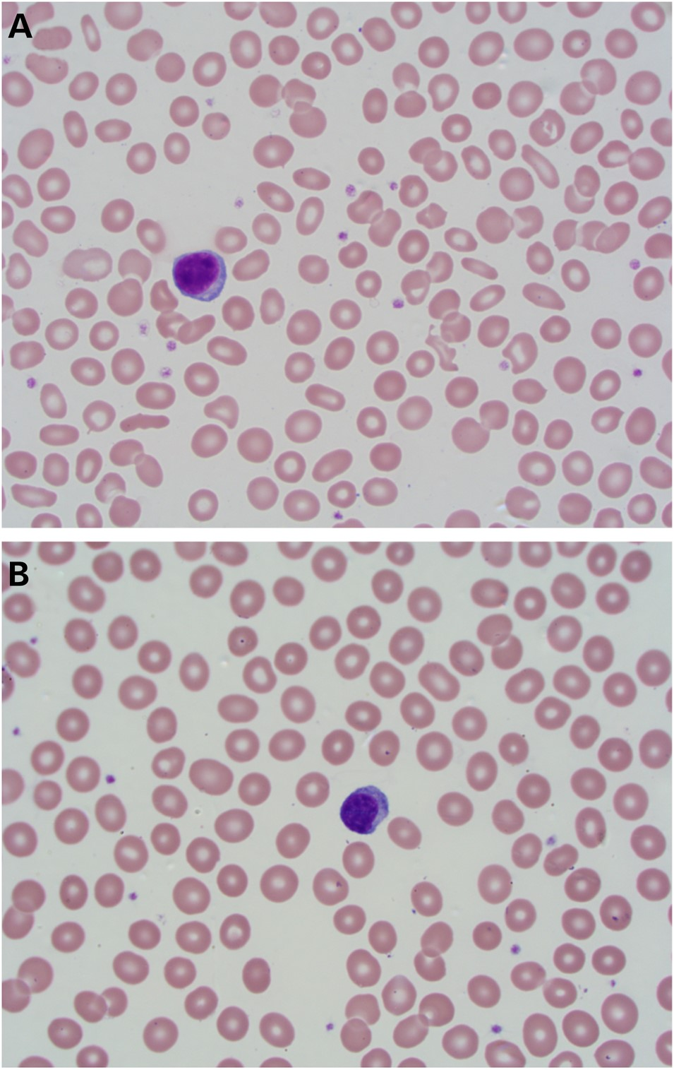
Figure 3. Photomicrograph of a Wright's stained peripheral blood smear from Patient 1 (A) demonstrating microcytosis, ...
Notes:
Figure 3. Photomicrograph of a Wright's stained peripheral blood smear from Patient 1 (A) demonstrating microcytosis, hypochromia, anisocytosis and numerous eliptocytes. A normal blood smear (B) is provided for comparison (100×).
Unless provided in the caption above, the following copyright applies to the content of this slide: © The Author 2015. Published by Oxford University Press. All rights reserved. For Permissions, please email: journals.permissions@oup.com

Slide 4
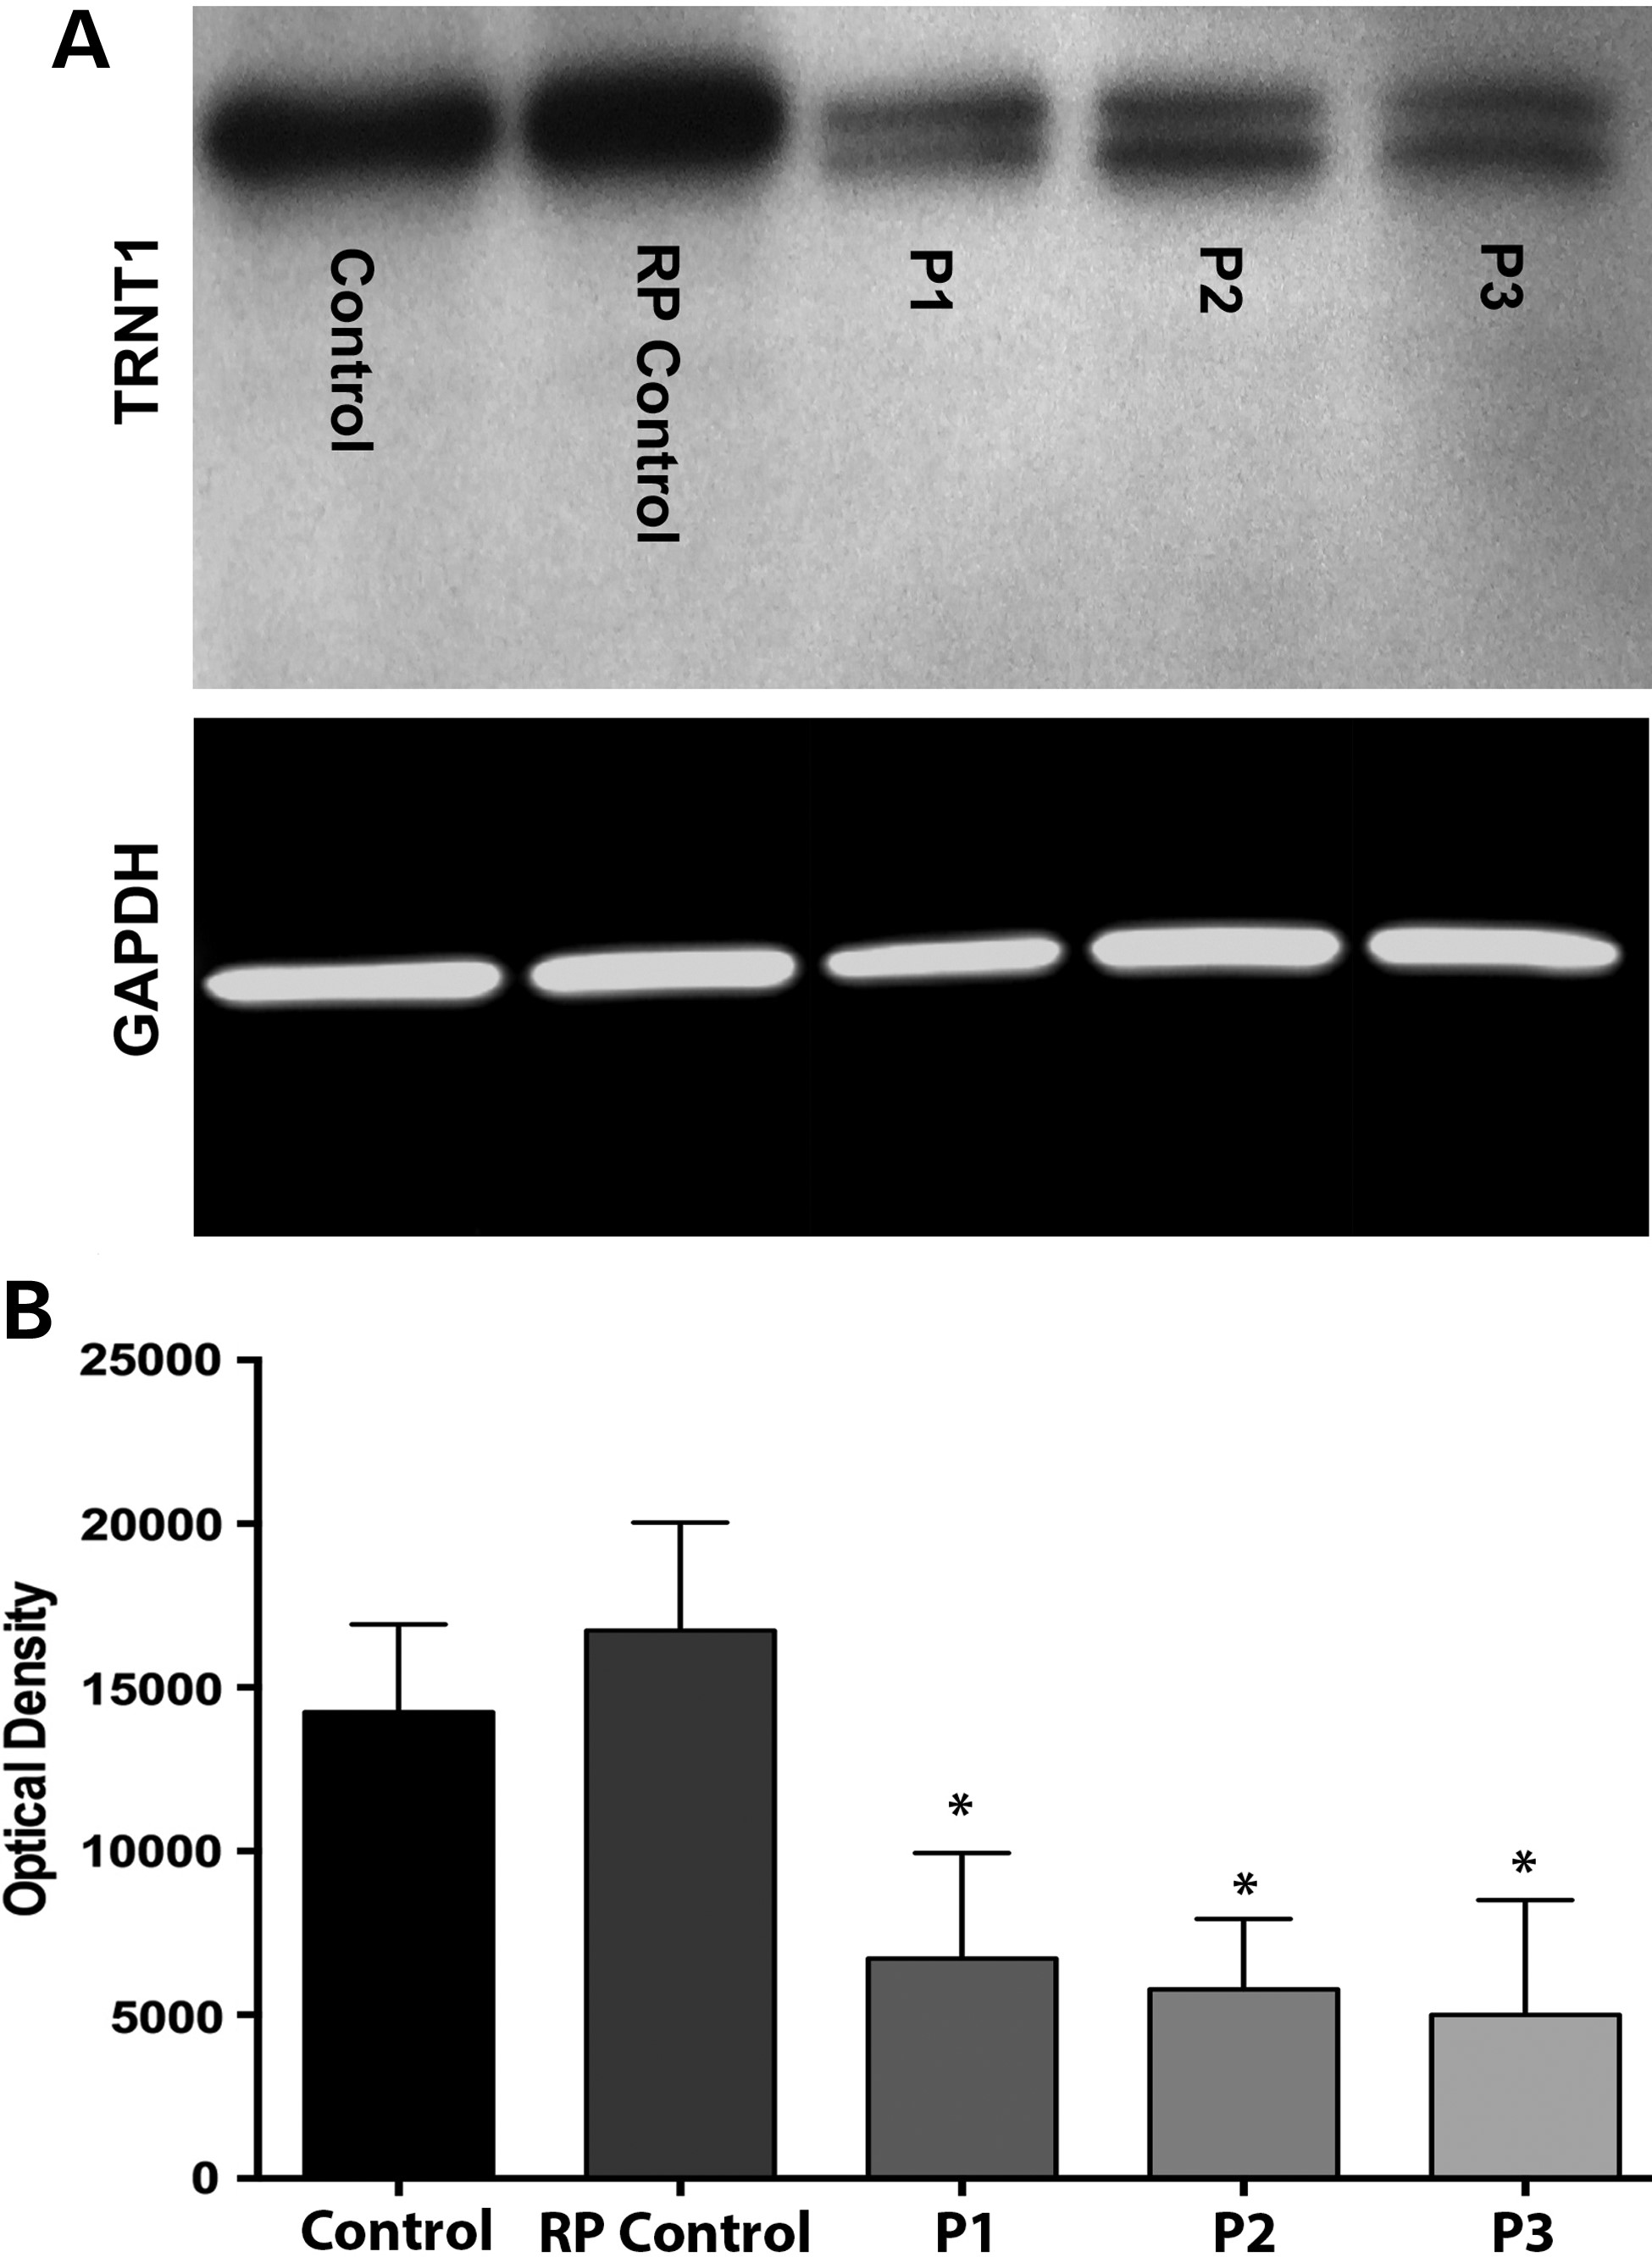
Figure 4. Expression of WT and mutant TRNT1 proteins in control and patient fibroblasts. (A) Western blot analysis ...
Notes:
Figure 4. Expression of WT and mutant TRNT1 proteins in control and patient fibroblasts. (A) Western blot analysis depicting TRNT1 expression in dermal fibroblasts obtained from a normal control, an RP control (i.e. patient with non-TRNT1-associated RP) and three compound heterozygous patients (gel was loaded with 20 µg of total protein). GAPDH served as loading control. (B) Quantification by densitometry of lysates between groups for TRNT1 (n = 4) normalized to GAPDH. Data presented as mean ± SEM. Statistical significance between control and patient fibroblasts determined by one-way ANOVA–Tukey, post hoc test, (*) P-value < 0.05, n = 4. An overall diminution of TRNT1 protein and a second 47 kDa band present only in cells from patients with TRNT1 mutations was detected (see the Supplementary Material, Fig. S2D).
Unless provided in the caption above, the following copyright applies to the content of this slide: © The Author 2015. Published by Oxford University Press. All rights reserved. For Permissions, please email: journals.permissions@oup.com

Slide 5
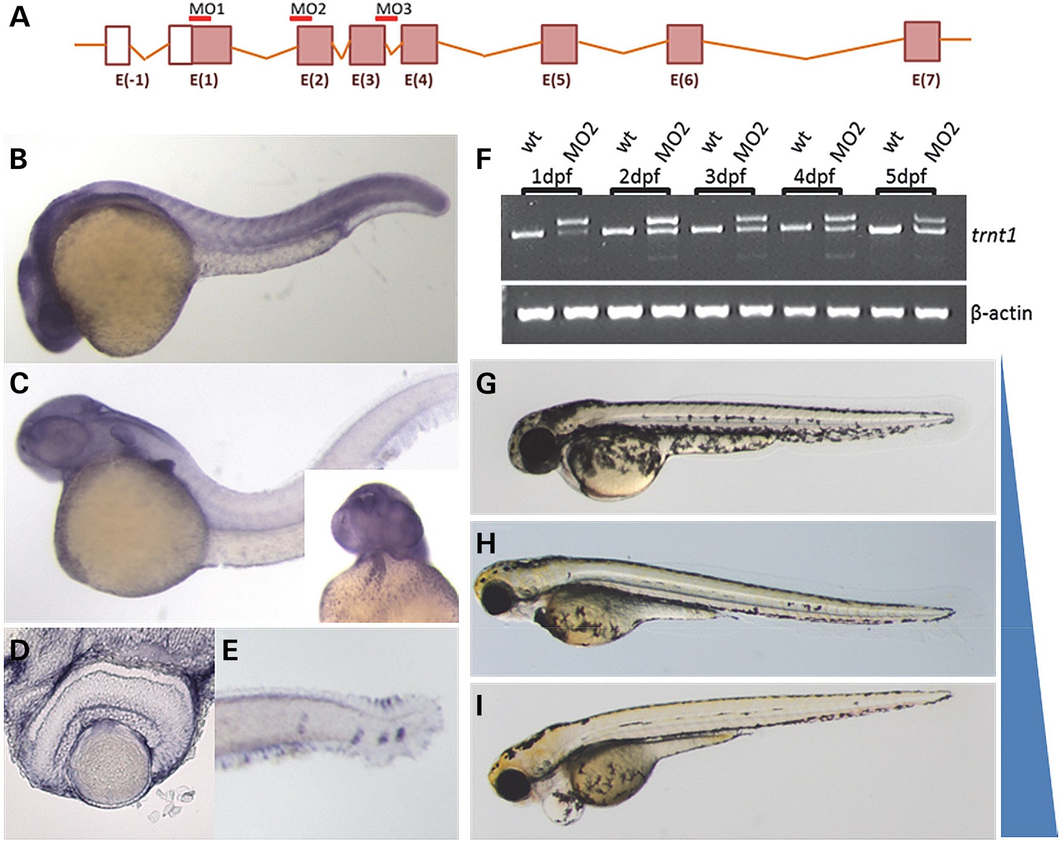
Figure 5. trnt1 expression and knockdown in zebrafish embryos. (A) Zebrafish trnt1 gene structure noting the location ...
Notes:
Figure 5. trnt1 expression and knockdown in zebrafish embryos. (A) Zebrafish trnt1 gene structure noting the location of MOs used for knockdown. (B) Zebrafish trnt1 transcript is broadly expressed throughout the embryo up to 1 dpf. (C) By 2 dpf, trnt1 becomes enriched in the brain, pectoral fin, blood and heart (inset). (D) Section through the central retina of 3 dpf larva showing trnt1 expression. (E) trnt1 expression in blood forming regions and the neuromast. (F) RT-PCR of RNA isolated from control and morphant embryos showing altered splicing in MO-injected embryos through 5 dpf. Uninjected WT embryos are used as control. Phenotypic range of morphological defects observed in trnt1 morphants at 5 dpf. (G) WT-like, (H) reduced eye size and blood flow and (I) eye and cardiovascular defects. Blue bar represents the penetrance of morphological defects with MO dose: 6.5 ng generating 80% defective, 4.5 ng generating 60% defective and 1.5 ng inducing defects in 15% of injected embryos.
Unless provided in the caption above, the following copyright applies to the content of this slide: © The Author 2015. Published by Oxford University Press. All rights reserved. For Permissions, please email: journals.permissions@oup.com

Slide 6
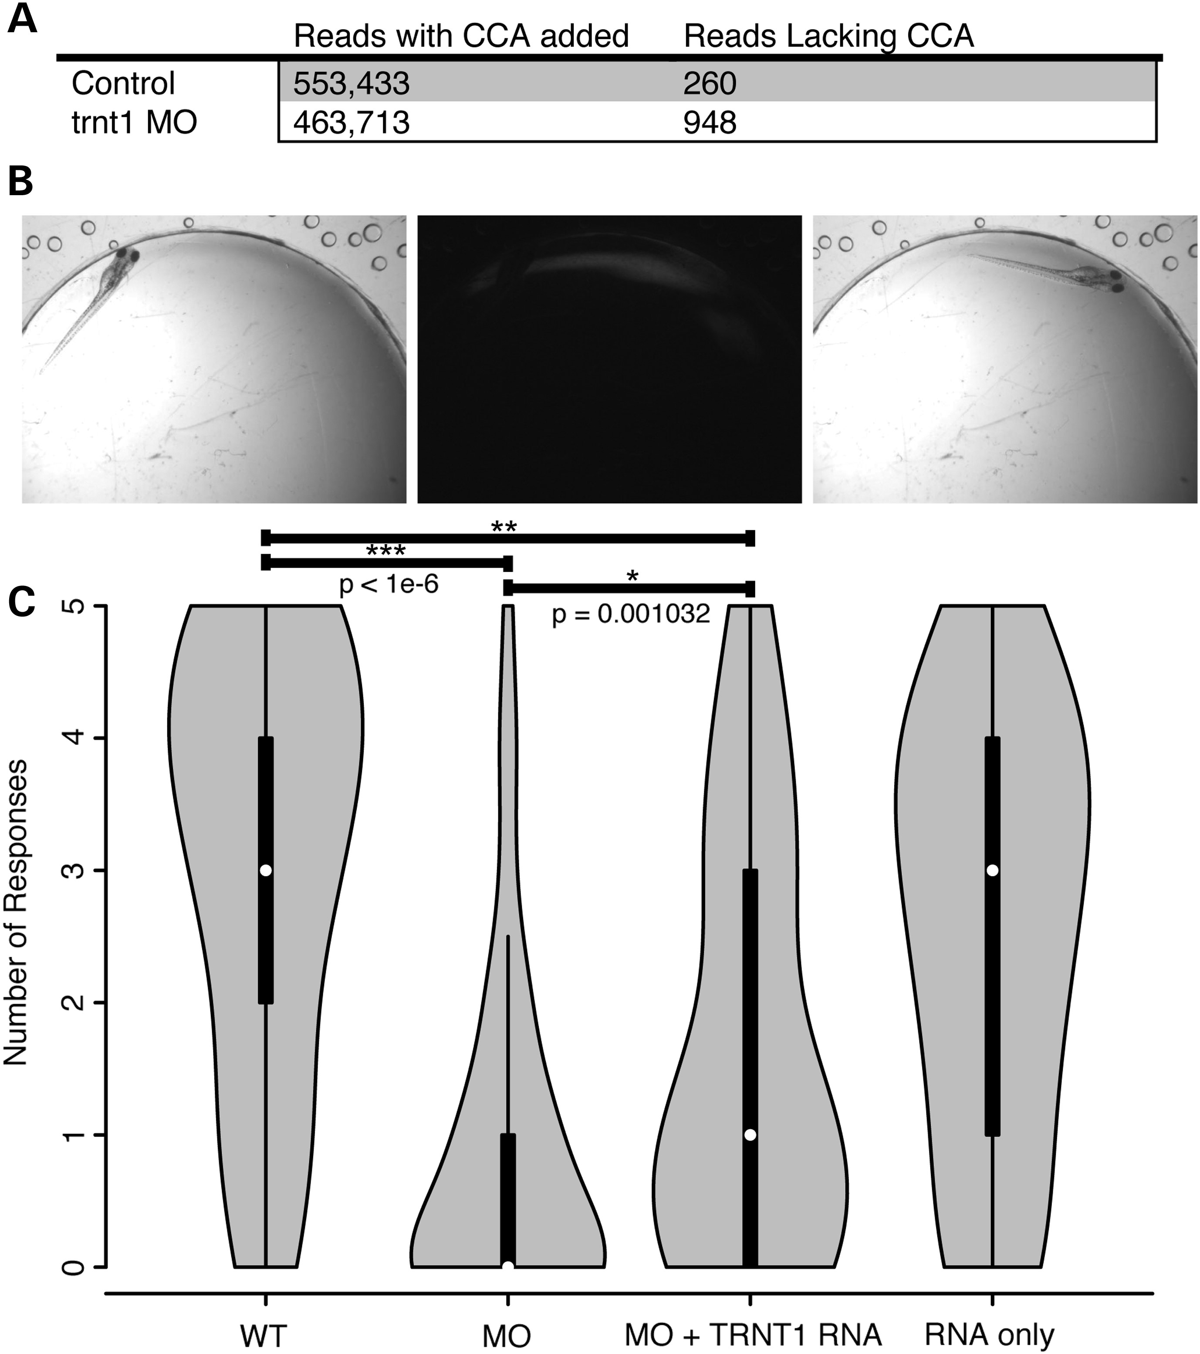
Figure 6. trnt1 knockdown affects tRNA maturation and visual behaviors. (A) RNA-Seq analysis of control and morphant ...
Notes:
Figure 6. trnt1 knockdown affects tRNA maturation and visual behaviors. (A) RNA-Seq analysis of control and morphant embryos evaluating nucleotide triplet CCA addition of all annotated tRNAs. (B) Vision Startle Reflex Response. (C) Violin plot showing the distribution of the number of responses for control, knockdown and hTRNT1 RNA-injected larvae. ***P-value < 1e-6 MO versus WT; *P-value = 0.001032 MO versus MO+RNA; **P-value = 1.492e-6 MO+RNA versus WT by the Mann–Whitney test.
Unless provided in the caption above, the following copyright applies to the content of this slide: © The Author 2015. Published by Oxford University Press. All rights reserved. For Permissions, please email: journals.permissions@oup.com

