Slide 1
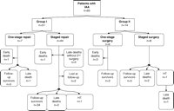
Fig. 1 Distribution and disposition of patients with interrupted aortic arch who underwent various surgical repairs ...
Notes:
Fig. 1 Distribution and disposition of patients with interrupted aortic arch who underwent various surgical repairs (HT: heart transplantation).
Unless provided in the caption above, the following copyright applies to the content of this slide: © 2006 Elsevier B.V. All rights reserved.

Slide 2
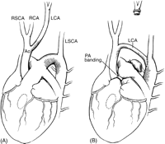
Fig. 2 Carotid artery swing-down repair of interrupted aortic arch; before (A) and after (B) correction.
Notes:
Fig. 2 Carotid artery swing-down repair of interrupted aortic arch; before (A) and after (B) correction.
Unless provided in the caption above, the following copyright applies to the content of this slide: © 2006 Elsevier B.V. All rights reserved.

Slide 3
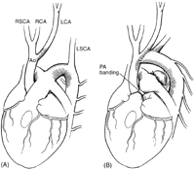
Fig. 3 Direct end-to-end anastomosis of interrupted aortic arch repair; before (A) and after (B) correction.
Notes:
Fig. 3 Direct end-to-end anastomosis of interrupted aortic arch repair; before (A) and after (B) correction.
Unless provided in the caption above, the following copyright applies to the content of this slide: © 2006 Elsevier B.V. All rights reserved.

Slide 4
Fig. 4 Actuarial survival curves for patients with interrupted aortic arch repair: (A) overall; (B) in patients with ...
Notes:
Fig. 4 Actuarial survival curves for patients with interrupted aortic arch repair: (A) overall; (B) in patients with staged and one-stage repair; and (C) in patients of group I and group II.
Unless provided in the caption above, the following copyright applies to the content of this slide: © 2006 Elsevier B.V. All rights reserved.

Slide 5
Fig. 5 Actuarial freedom from any type of reoperation curves for patients with interrupted aortic arch repair: (A) ...
Notes:
Fig. 5 Actuarial freedom from any type of reoperation curves for patients with interrupted aortic arch repair: (A) overall; (B) in patients with staged and one-stage repair; and (C) in patients in group I and group II.
Unless provided in the caption above, the following copyright applies to the content of this slide: © 2006 Elsevier B.V. All rights reserved.

Slide 6
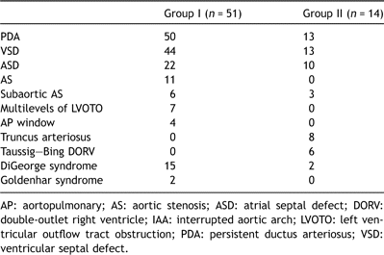
Table 1. Intracardiac- and extracardiac-associated lesions in patients with IAA
Notes:
Table 1. Intracardiac- and extracardiac-associated lesions in patients with IAA
Unless provided in the caption above, the following copyright applies to the content of this slide: © 2006 Elsevier B.V. All rights reserved.

Slide 7
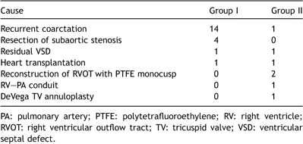
Table 2. Reoperation
Notes:
Table 2. Reoperation
Unless provided in the caption above, the following copyright applies to the content of this slide: © 2006 Elsevier B.V. All rights reserved.

Slide 8
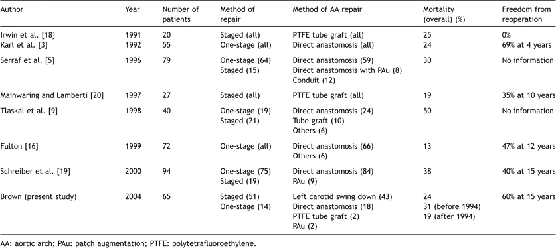
Table 3. Results of surgical treatment in children with interrupted aortic arch
Notes:
Table 3. Results of surgical treatment in children with interrupted aortic arch
Unless provided in the caption above, the following copyright applies to the content of this slide: © 2006 Elsevier B.V. All rights reserved.

